Slide 1
STUPID POINTLESS ANNOYING MAIL
Jereme Lamps, Jingxian Zhang, Liang Tao, Sharanya Bathey

Slide 2
Motivation
Hundreds of spam mails! Who likes them??
But, some useful information might be hidden
Underneath
We want to find out how and why a persons
spam patterns change over time

Slide 3
Audience
Anyone who wants to understand or analyze
their spam patterns to see their interest direction

Slide 4
Questions we intend to Answer
If the spam has relevance to your interest
and spending patterns over time?
If your browsing/registration/shopping has
caused your mail to increase?
If someone you registered your email with
sold your information?

Slide 5
SIGN IN
Email
Password
I’m aware my emails will be accessed and visualized.
Sign in

Slide 6
SIGN IN
junezjx@gmail.com
*************
I’m aware my emails will be accessed and visualized.
Sign in

Slide 7
CATEGORIES
400
190
150
320
120
75
200
8
140
105
YEAR
2012
2013
2014
Go to the monthly view.
Categories | Financial | General | Clothes | Food | Social

Slide 8
CATEGORIES
130
60
30
5
240
5
30
60
35
30
8
2
MONTH
Apr
May
Jun
Go to the category view.
Jan
Feb
Mar
YEAR : 2014
Categories | Financial | General | Clothes | Food | Social

Slide 9
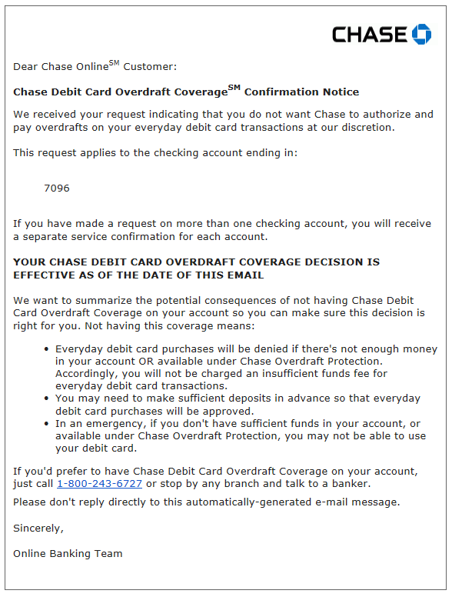
CATEGORY: Financial
Subject: Chase Debit Card Overdraft Coverage - Service Change Confirmation​
Date: Thu, Mar 14, 2014 at 10:36 AM
From: Chase <no-reply@alertsp.chase.com>
To: junezjx@gmail.com
Date: 03/08
Subject: Your Debit Card Transaction
See details
Date: 03/14
Subject: Chase Debit Card Overdraft Coverage - Service Change Confirmation
See details
Date: 03/17
Subject: Wei Zhong accepted your $68.00 payment
See details
MONTH
Apr
May
Jun
Jan
Feb
Mar
YEAR : 2014
Financial: | Chase | TCF | Capital One | Discover

Slide 10
CATEGORY: Financial
Go to the main view.
MONTH
Apr
May
Jun
Jan
Feb
Mar
YEAR : 2014
Financial: | Chase | TCF | Capital One | Discover

Slide 11
CATEGORIES
400
190
150
320
120
75
200
8
140
105
YEAR
2012
2013
2014
Categories | Financial | General | Clothes | Food | Social

Slide 12
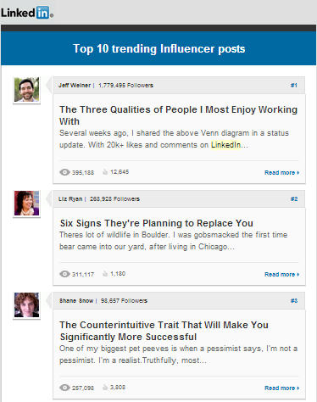
CATEGORY: Social
Subject: Jingxian, 10 Influencer posts you need to read
Date: Thu, Mar 20, 2014 at 07:59 AM
From: LinkedIn <linkedin@e.linkedin.com>
To: junezjx@gmail.com
Date: 03/03
Subject: Jingxian, people are looking at your LinkedIn profile
See details
Date: 03/20
Subject: Jingxian, 10 Influencer posts you need to read
See details
Date: 03/28
Subject: Rheet has endorsed you!
See details
MONTH
Apr
May
Jun
Jan
Feb
Mar
YEAR : 2014
Social: | Facebook | Twitter | LinkedIn | Instagram

Slide 13
Tools and Analysis
Categorization is our biggest challenge.
How do we tackle this dynamically?
Large enough dataset
d3.js
Analysis of: From, Subject and Time parts
of the email

Slide 14
Questions for Users
Example: you place an order on Amazon for a Mobile
Charger. Over the coming week you receive a ton of
emails from them about different products
Our question is what would be the best way to
show order information?
Emails like order confirmation
Spam

Slide 15
Thank you!
Q & A

