Slide 1
Facebook Group Communication
Jereme Lamps, Jingxian Zhang,
Liang Tao, Sharanya Bathey

Slide 2
Motivation
Receive tons of notifications from Facebook groups and have to scroll through 100 posts before you get to an important one
We want to filter and prioritize based on group participation and show you the most relevant notifications!

Slide 3
Audience
Anyone who is part of lots of Facebook groups and has multiple interest areas

Slide 4
Questions we intend to Answer
Find the most important post based on group participation
Look at group members activity levels
Browse posts more efficiently

Slide 5

Email / Username
Password
Sign in

Slide 6

sports
education
business
entertainment
food

Slide 7
CS 467 FA14
CS
EDUCATION
CE
UIUC
UIUC MCS

Slide 8






























Education
Timeline view
Members
Keywords
CS 467 FA14
Search by Keyword or Member
reviews, assignments
assignment, similar
fun, link
link
office hour
thanks, presented, project
link
Activity level

Slide 9
Education
Rank by Like
Members
Keywords
CS 467 FA14
Rank by Comment
reviews, assignments
assignment, similar
fun, link
link
office hour
thanks, presented, project
link

Slide 10
Education
Members
Keywords
CS 467 FA14
fun, link
thanks, presented, project
reviews, assignments
link
link
assignment, similar
office hour

Slide 11
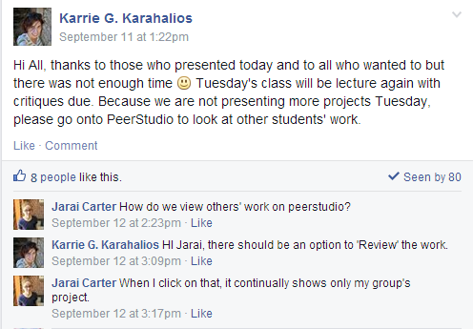
Education
Members
Keywords
CS 467 FA14
fun, link
thanks, presented, project
reviews, assignments

Slide 12
Education
Members
Keywords
CS 467 FA14
reviews, assignments
assignment, similar
Karrie G. Karahalios
Post: 15
Comment: 41
Like: 4
fun, link
link
office hour
thanks, presented, project
link

Slide 13
Education
Members
Keywords
CS 467 FA14
link
office hour
link
survey, feedback, vote
color, map, link
link
thanks, presented, project
PeerStudio, support

Slide 14
Tools and Analysis
d3.js for the UI
Python or Java for Data Cleaning
Facebook SDK and API for data collection
Keyword determining algorithm

Slide 15
Materials Incorporated
The colors we choose are equally distributed in the hue palette
Choosing Colors for Data Visualization by Stone
Rhetoric methods used: filtering, individualization, classification
Visualization Rhetoric: Framing Effects in Narrative Visualization by Hullman

Slide 16
Thank you!
Q & A

