Slide 1
CS 467: Social Visualization
Final Project Ideas
Linya Huang
Madhushree Sreenivasa
Sharanya Bathey
Tejala Thippeswamy

Slide 2

Health Trends - Nike+
Idea : Nowadays obesity is a common problem in the US. We plan to take fitness data from Nike+ users about their activity type like cycling ,running, number of calories burnt and visualize the information to see interesting patterns in country’s health status. We also want to visualize the individual's goal achievement.
Visualization :
Map of the US showing densities of users using Nike+ for fitness and health status of each state.
Show personal visualization of his/her activity like calories burnt, much time spent in cycling,running and other activities.
We looked for the data sources and found that Nike+ dataset does not give us data for all users using Nike+. We are open for suggestions/inputs for getting the dataset.

Slide 3

Github Technology Trend Exploration
Idea: Github has become one of the most widely used public technology forums. We intend to analyze github repositories to see useful information.
Visualization:
Show visualization of the most popular repositories
How the use of programming languages has changed over time? Which programming languages are being used for what purposes?
Allow a person to find the most popular repository in his/her area of development
Look at general trends of contribution to a repository
This is the basic idea, a lot more information about each repository and contribution is available. We need to analyse more about what else we can visualize.

Slide 4

Music Trends
Idea: Visualizing hows ones music choice are trending over the country.
Visualization:
The idea is to provide the user with a tool to visualize how his music interests are trending over the country
Analyse the similarity between the user’s music tastes and his close friends and show how these genres are trending over the country.
Suggested Forums:
Facebook

Slide 5
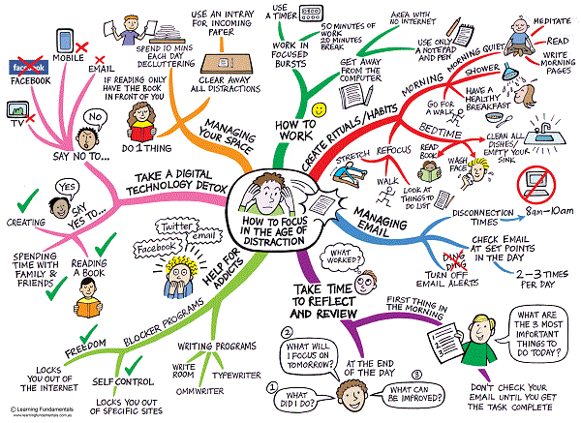
Map Me
Idea: Draw a mind map of who I am from the very many social networks I use
Visualization:
1. Visualize my personal and professional social interests
Draw a mind map of my interests from Facebook, Twitter and LinkedIn (possibly more social networks)
Example: Some things that one can see in their own mind map: music that I like on Facebook, people that I follow on Twitter and my professional interests through LinkedIn.

