Slide 1

@bsharif // @fungster257 // @davide_ceretti // @arachnegl @fredkingham // @sarah_j_hayman // @mindmelting

Slide 2
PROBLEM
Juniors completing consent forms
Juniors unfamiliar with procedures
No central guidance for forms
Difficulty remembering all key details (incl. risks)
Patients deserve reliable information to make INFORMED DECISIONS

Slide 3
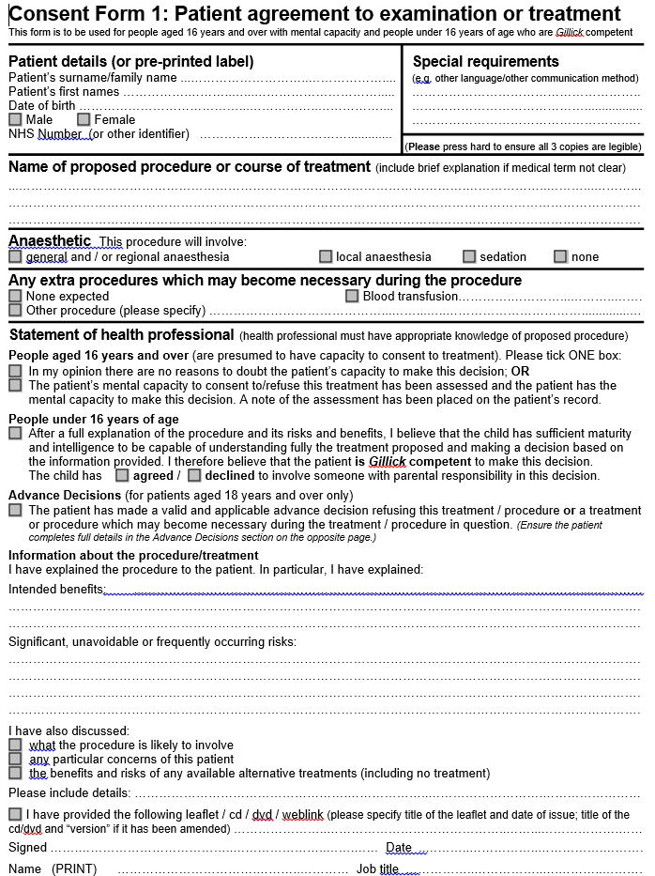
NEED TO KNOW
Name of Procedure
Explanation
Extra Procedures
Intended Benefits
Serious Risks
Frequent Risks
}
}

Slide 4
What we did
List of procedures – medical & surgical (ICD-9)
Stored into database
Front end with search
Add consent forms for procedures
Logo

Slide 5
How this helps
PATIENTS
Reliable Information
Informed Decision
TRAINEES
Memory refresher
No more guessing
CONSULTANT
Ensure correct information
Contribute to patient safety

