Slide 1

MAVS SYSTEMS SRD - Presentation July 26, 2011
Captain Nate Beran
Lt. Karl Feinauer
Lt. Ivan Fan
Lt. Brian Shef
Lt. Hoang Tang
Notes:
Ivan

Slide 2
Introduction
MAVS SYSTEM
The purpose of this project is to build an integrated security system that allows the user to maintain complete control over the security of their property without requiring a third party monitoring service.

Slide 3
Overview
Chapter 1 Product Services and Summary | Provides an overview of the project and this document
Chapter 2 Environments | Provides a description of each environment in which this product will be developed, used or maintained
Chapter 3 External Interface and Data Flows | Provides the definitions of all external data items and data flows. Does not contain internal data items or data flows
Chapter 4 Customer Requirements | Requirements originated by customers
Chapter 5 Localization Requirements | Requirements to adapt the product for a specific language and/or cultural usage
Chapter 6 Marketing and Sales Requirements | Requirements originated and/or in support of Marketing and Sales
Chapter 7 Administrative Requirements | Requirements imposed by the organization’s administrative procedures
Chapter 8 Development Requirements | Requirements originated by the development team
Chapter 9 Quality Assurance Requirements | Requirements originated by and/or in support of Quality Assurance
Chapter 10 Safety Requirements | Requirements imposed by law, regulation or common sense whose primary purpose is the assurance of product safety
Chapter 11 Standards Compliance | A compendium of standards (ANSI, ISO, CCITT, etc.) and regulations to which the product must conform. Conformance shall be stated as a requirement
Chapter 12 Maintenance Requirements | Requirements aimed at increasing maintainability

Slide 4
Overview
Chapter 12 Maintenance Requirements | Requirements aimed at increasing maintainability
Chapter 13 Support Requirements | Requirements necessary for the required level of support
Chapter 14 Performance Requirements | Requirements constraining reliability, speed, etc.; includes most constraints
Chapter 15 System Constraint Requirements | Constraints derived from limitations
Chapter 16 Exception Conditions and Handling | External exceptions and behavior
Chapter 17 Early Subsets and Implementation Priorities | Skeleton incremental development plan
Chapter 18 Foreseeable Modifications and Enhancements | Prognostications of the product
Chapter 19 Acceptance Criteria | Details of product acceptance criteria
Chapter 20 Design Guidelines | Ideas and general information about the design of the product
Chapter 21 Assumptions | Assumptions made for the product
Chapter 22 Sources of Information | Sources (oral and written) of information that applies to this product
Chapter 23 Use Cases | Use cases for all externals
Chapter 24 Glossary of Terms | An aggregation of each chapter’s terms

Slide 5
Introduction
Roles:
Roles/Responsibility | Resource
Project Manager / Team Leader | Charles Beran
Research | Charles Beran Karl Feinauer Hoang Tang Brian Shef Ivan Fan
Project Planner | Charles Beran
Risk Manager | Hoang Tang
Hardware Development Manager | Karl Feinauer
Software Development Manager | Brian Shef
Documentation | Brian Shef
Treasurer | Ivan Fan
Change Manager | Brian Shef
Procurement Manager | Karl Feinauer
Testing Manager | Ivan Fan

Slide 6
Product Service and Summary
Scope
The MAVS System will allow the user to receive alerts.
The MAVS System will receive input from sensors and determine activity on the property which will trigger an alert.
The user shall be able to control the camera and system settings from the mobile device, or from the central computer located on-site.
The user will manually arm, trigger, de-trigger, and disarm the system from both the mobile device and the central computer.
The user shall also be able to dial their local emergency services with the touch of a single button from the mobile device.
The user shall be notified in the event of a communication error, or other error that prevents the system from operating normally.

Slide 7
Product Service and Summary
Definitions and Acronyms
CSE – Computer Science and Engineering
IC - Integrated Circuit
IEEE – Institute of Electrical and Electronics Engineers
MAVS System – Maverick Audio Visual Security System (Name of the product)
MAVS Team – Maverick Audio Visual Security Team (Name of the Team)
SC - Sensor Controller
SOG – Standard Operating Guidelines
SOP – Standard Operating Procedure

Slide 8
Product Service and Summary
Definitions and Acronyms
SRD – System Requirements Document
User – Refers to the property owner, manager, or security personnel
UPS - Uninterruptible Power Supply
UTA – University of Texas at Arlington
Subject -- Refers to an entity capable of triggering an alert
Mobile Device -- Refers to any mobile device or tablet running Android 2.0 or greater
POE -- Point of Entry. Refers to a structural feature on a property through which persons or animals enter and exit the property, such as doors or windows.
Alarm – Any user specified notification that may or may not play a sound

Slide 9
Product Service and Summary
Overall Description
The MAVS System is a security system that gives the user total control and full capabilities concerning monitoring.
The MAVS System is triggered primarily by sensors configured to the user’s specifications.
The user can access streaming video and audio from an on-site camera with their mobile device.
The user can also access these features from a central computer located on-site.
The user can control the camera, configure the system settings, or instantly alert police to an emergency situation through a graphical interface from the mobile device.
The MAVS System can be installed in homes, businesses, or any personal property with a secure point of entry.

Slide 10
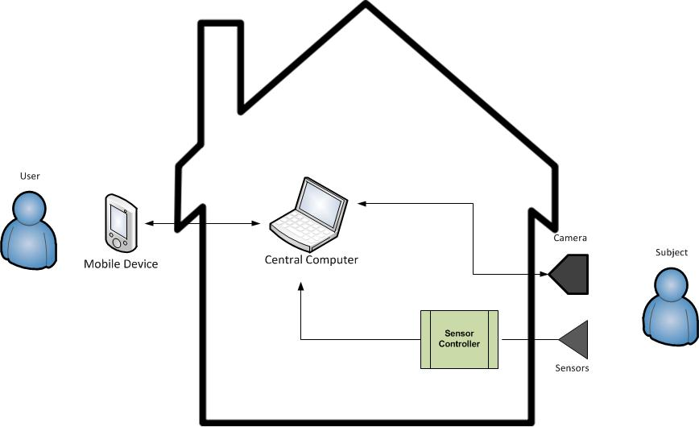
Product Service and Summary
Overall Description

Slide 11
Assumptions
Overall Description
The MAVS System will be installed on a property with a working Internet connection.
The MAVS System camera will be placed in a location with a clear field of view.
The MAVS System sensors will be placed in locations close enough for connection to the IC.
The MAVS System will be monitored by a user.
The MAVS System central computer will be in an indoor, climate controlled environment.
The MAVS System central computer will run the MAVS Systems software 24 hours a day.
The MAVS System central computer will be on a computer capable of running the .NET version 3.0 framework

Slide 12
Customer Requirements
Divided into three different sections
High priority: Must be implemented for project to be accepted
Medium priority: Nice to have. Should fulfill as many as possible
Low priority: Least important. Implement if time permits

Slide 13
Customer Requirements High Priority
The system shall contain a camera to monitor areas of interest
The camera shall be capable of panning
The camera shall be controllable via user’s mobile device
The camera’s video feed shall be accessible from the user’s mobile device
The system shall contain sensors to detect motion on the property
The system shall notify the user when a sensor is triggered
User must be connected to the Internet
The system shall allow users to dial 911 with the touch of one button
User must be connected to cellular network
The user shall be able to define zones that the camera can automatically pan to based on the triggering of sensors
Specified zones must be reachable by the camera

Slide 14
Customer Requirements High Priority
The system shall save a log of triggered events on the central computer
The user shall be able to set up profiles that specify the severity of a triggered event
The user shall be able to set up notification profiles on their mobile device that establish how to react to notifications concerning certain triggered events
The MAVS System shall require user authentication for accessing camera functions, such as audio/video
Store passwords securely, no plain text
The camera shall track the subject that has triggered the sensors, as long as the subject is within the camera’s view
The ability for the camera to continuously track the subject is constrained by the amount of sensors available. The exact mechanism for tracking will be determined in the System Architecture phase.

Slide 15
Customer Requirements Medium Priority
The system shall be able to incorporate additional sensors, regardless of type
Sensors must be compatible with IC
The system shall support two-way audio
Constraint assumes camera support
The system shall handle user unavailability
Only possible if other users allowed access to system
The system’s mobile application shall alert the user when connectivity to the central computer is lost
The user shall be able to view archived video footage on the central computer

Slide 16
Customer Requirements Low Priority
The system shall notify the user when it has lost its main power source
The system must be hooked up to backup power

Slide 17
Acceptance Criteria
For the project to be accepted, the previous high priority requirements must be fulfilled and all safety requirements must be met

Slide 18
Safety Requirements
The system shall have applicable warning labels on the hardware
The system shall be designed to protect people from injury
The system shall not have exposed wiring
The system shall be designed to minimize exposed sharp edges
The system shall be designed to remain safe through normal wear
The user shall not abuse or modify the system

Slide 19
System Constraint Requirements
The camera shall not operate in the rain
Derived from limited resources and budget
The system shall operate on AC power
Recommended to have backup UPS power if main power source is down
Access to the camera feeds and options shall only be accessible when the user has a connection to the Internet
There will be no other means to communicate between the central computer and mobile device

Slide 20
System Constraint Requirements
The MAVS System shall save video to the central computer only as long as there is enough disk space to hold it.

Slide 21
Performance Requirements
Minimize Trigger Response Time
Maximize the video frame rate
Minimize Command Response Time
Operable under normal Texas weather both day and night
Maximize Application Response Time
Minimize System Resource

Slide 22
Development Requirements
Mainly Internal
Source Control
Github
Development Model
Hybrid Staged Delivery

Slide 23
Development Requirements
Coding Guideline and Standard
Microsoft’s Design Guideline for class Library Developers
Architecture and Design
Modular

Slide 24
Standards Compliance
Senior Design Project Standard
UTA CSE Rule and Regulation
Shall be Consistence with our System Requirement

Slide 25
Standards Compliance
Unique (set)
Each requirement should be stated only once.
Normalized
Requirements should not overlap (i.e., they shall not refer to other requirements or the capabilities of other requirements).
Linked set
Explicit relationships should be defined among individual requirements to show how the requirements are related to form a complete system.
Complete
A SRD should include all the requirements identified by the customer, as well as those needed for the definition of the system.
Consistent
SRD content should be consistent and non-contradictory in the level of detail, style of requirement statements, and in the presentation of material.

Slide 26
Standards Compliance…
Bounded
The boundaries, scope, and context for the set of requirements should be identified.
Modifiable
The SRD should be modifiable. Clarity and non-overlapping requirements contribute to this.
Configurable
Versions should be maintained across time and across instances of the SRD.
Granular
This should be the level of abstraction for the system being defined.

Slide 27
Maintenance Requirements - Bug fixing, feature adding
Good until Dec 2011
User manual
Architecture documentation
Software maintenance
Remotely
Field support
Modular Design

Slide 28
Support Requirements
Good until Dec 2011
Hardware
Field Support
Software
Remotely/Field Support
User Manual
Camera and Sensor

Slide 29
Localization Requirements
Language
Units
Time
MM/DD/YYYY
HOUR:MINUTE
Electric
Communication

Slide 30
Marketing and Sales Requirements
Hardware
GUI

Slide 31
Quality Assurance Requirements
Document Review
System Testing
Component Testing
Integration Testing
Power Outages

Slide 32
Environments
Development
Operations
Maintenance

Slide 33
Design Guidelines
Hybrid Staged Delivery Model
Follows Architecture
Modular
Microsoft’s Design Guidelines for Class Library Developers

Slide 34
Administrative Requirements
Team Meetings
Sponsor
Project Plan
Team Charter
Time Sheet
Risk Management
Status Reports

Slide 35
External Interface and Data Flows
Hardware Interfaces
Software Interfaces
High Level Data Flow Diagram
Logical Data Sources and Sinks
Notes:
Brian Shef

Slide 36
Hardware Interfaces
Between Sensors and Central Computer
Was a sensor tripped? Which one?
Between Central Computer and Mobile Device
Internet / mobile networks are outside the scope of the MAVS System
Sensors shall be able to detect presence of an entity
User will determine system’s response
User can control camera via the Mobile Device
Notes:
Brian Shef

Slide 37
Software Interfaces
Central Computer works as the hub or back-end
Through the Central Computer or Mobile Device GUI, the User can:
Arm/Disarm the system
View status
View live camera feed
Set alert profiles
Manage settings
Control Camera (Pan, Tilt, Zoom)
Notes:
Brian Shef

Slide 38
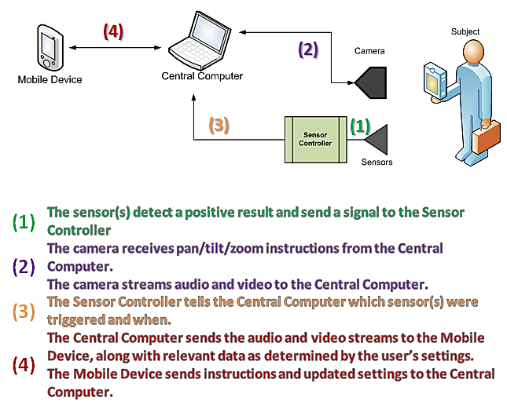
High Level Data Flow Diagram
Notes:
Brian Shef

Slide 39
Logical Data Sources and Sinks
Sensors and Camera are main sources of data
Sensors’ status is data
Camera’s images are data
Central Computer is a data source (back-end)
Main Data Sinks
Central Computer GUI
Mobile Device GUI
Mobile Device can access data stored on Central Computer
Notes:
Brian Shef

Slide 40
Use Cases
The user arms the system
The user controls the camera
The user accesses video/audio from within the GUI
The user dials 9 1 1 from within the mobile GUI
The user disarms the system
The user speaks to the subject
The user creates an alarm profile
Notes:
Brian Shef

Slide 41
Exception Conditions and Handling
Video/Audio feed fails
Power resets, network connections reset, verify settings
System fails to notify the user of triggered events
User can view log of triggered events later. Manual reset may be required and settings verified
System falsely allows unauthorized user access to camera
System denies unauthorized user access to camera
User does not respond to critical triggered event notification
System begins notifying other authorized users, one at a time, until one responds
Notes:
Brian Shef

Slide 42
Foreseeable Modifications and Enhancements
Facial recognition for automatic access approval/denial
Tracking through computer vision as opposed to sensors
DropBox integration for saved images and event logs
Central Computer becomes low profile, self-contained computer
Web Interface and/or web backup
System will distinguish between people and other entities
Biometrics and voice recognition
User can control more than just the security system
Lights, A/C settings, household electronics and appliances, etc
Notes:
Brian Shef

Slide 43
Sources of Information
Dr. Manfred Huber – Professor who gives guidelines for development and implementation of the project
Microsoft’s Design Guideline for class Library Developers
http://msdn.microsoft.com/en-us/library/czefa0ke%28v=vs.71%29.aspx
Senior Design Document Library
http://ranger.uta.edu/~odell/Senior_Design_Document_Library/Senior_Design_Document_Library.html
United States Consumer Product Safety Act
http://www.cpsc.gov/businfo/cpsa.pdf
United States Consumer Product Safety Commission – Substantial Product Hazard Reports
http://www.cpsc.gov/LIBRARY/FOIA/FOIA06/brief/part1115.pdf
Notes:
Brian Shef

Slide 44
It’s Karl’s Birthday!
Happy Birthday to you
Happy birthday to you
Happy birthday dear Karl
Happy birthday to you!
Notes:
Brian Shef

Slide 45
Questions?
Notes:
Brian

