Slide 1
SkullDozer
Aaron Gann
Charles Beran
Malcom James
Bikash Acharya

Slide 2
Overview
Diagram
Hardware Input Layer
Status Tracking Layer
Environment Layer
Render Layer
Audio Layer
Database Layer
Terminal Layer
AI Layer

Slide 3
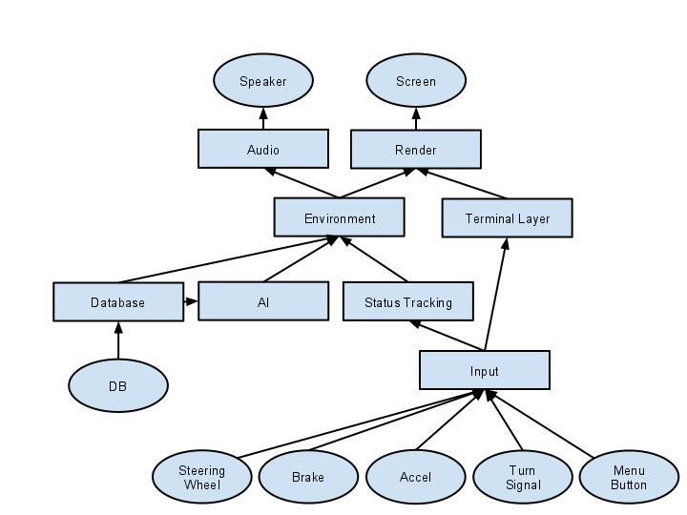
Diagram

Slide 4
Hardware Input Layer Description
Components
Brake
Accelerator
Turn Signal
Steering Wheel
Menu Button
External Interfaces
Brake
Accelerator
Steering Wheel
Turn Signal
Menu Button
Internal Interfaces
Output to Terminal Layer
Output to Status Tracking Layer

Slide 5
Status Tracking Layer
Components
Recording Subsystem
Status Subsystem
Speed
Position
Orientation
External Interfaces
None
Internal Interfaces
Input from Input Layer
Output to Environmental Layer
Output to Database Layer
Output to Audio Layer

Slide 6
Environment Layer
Components
Physics Bodies
Collision Component
External Interfaces
None
Internal Interfaces
Input from Status Tracking Layer
Input from AI Layer
Output to Audio Layer
Output to Render Layer

Slide 7
Render Layer
Components
Main View
Rear View
Dashboard
Menu
External Interfaces
Monitor
Internal Interfaces
Input from Environment Layer
Input from Terminal Layer
Input from Status Tracking Layer
Input from Database Layer

Slide 8
Audio Layer
Components
Ambient Noise
Collisions
Music
External Interfaces
Output to Speakers
Internal Interfaces
Input from Status Tracking Layer
Input from Database Layer
Input from Environment Layer

Slide 9
Database Layer
Components
Course Retrieval
Record Replay
Retrieve Replay
Model Retrieval
External Interfaces
Input from Database
Output to Database
Internal Interfaces
Output to AI Layer
Output to Environment Layer
Input from Status Tracking Layer

Slide 10
Terminal Layer
Components
GUI
Select Course
Start Course
End Course
Reset Course
Start Replay
Save Replay
External Interfaces
None
Internal Interfaces
Input to Input Layer
Output to Render r Layer

Slide 11
AI Layer
Components
Behavior Handler
Position Handler
External Interfaces
None
Internal Interfaces
Input from Database Layer
Output to Environment Layer

