Slide 1

Maverick Audio Visual Security Systems (MAVS Systems)
Captain Nate Beran
Lt. Karl Feinauer
Lt. Ivan Fan
Lt. Brian Shef
Lt. Hoang Tang
Notes:
Ivan

Slide 2
Initial Team Status Report Presentation
Team Name
Organization and Start-Up Process
Responsibilities
Plans for communication, meetings, and work
Tools
Teambuilding
Critical Strengths
Critical Weaknesses
Important Near-Term Challenges/Obstacles
Near-Term Work Outlook
Notes:
Ivan

Slide 3
Team Name
Maverick Audio Visual Security Systems
Maverick
noun /ˈmav(ə)rik/ A person who refuses to conform to a particular party or group
UT Arlington
Audio Visual Security Systems
Cameras
Microphones
Video feeds
Smart Phone Integration
Nifty acronym: MAVS Systems!
Notes:
Ivan

Slide 4
Responsibilities By Member (Nate Beran)
Nate Beran
Planning, Scheduling, Tracking, Reporting
Requirement Elicitation/Mapping
System Architecture
Detail Design
Component Integration
Programming (Software)
Decision Making
Notes:
Nate

Slide 5
Responsibilities By Member (Karl Feinauer)
Karl Feinauer
Network Design and Analysis
Hardware Design
Hardware Integration
Performance and Tuning
Security Analysis
Budget Analysis
Programming (Hardware and Software)
Notes:
Nate

Slide 6
Responsibilities By Member (Ivan Fan)
Ivan Fan
System Architecture
Scheduling
Hardware Design
Detail Design
Hardware Integration
Test Design and Execution
Programming (Hardware and Software)
Notes:
Nate

Slide 7
Responsibilities By Member (Brian Shef)
Brian Shef
System Architecture
Document Management
UI Design and Implementation
Source/Change Control
Website Design/Maintenance
Programming (Software)
Notes:
Nate

Slide 8
Responsibilities By Member (Hoang Tang)
Hoang Tang
System Architecture
Risk Analysis and Mitigation
Performance and Tuning
Technical Advisor
Test Design and Execution
Programming (Software)
Notes:
Nate

Slide 9
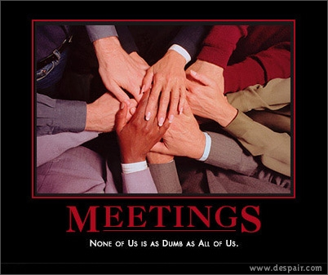
Plans for Communication
Google
Calendar
Gmail
Docs
Skype
Meetings
Notes:
Hoang

Slide 10
Tools
Github
Source Control
Bug Tracking
Wikis
Code Review
Microsoft Project
Scheduling
Tracking
Notes:
Hoang

Slide 11
Team building
Frequent Lunches
Brainstorming Sessions
Frequent Skype Meetings
Notes:
Karl

Slide 12
Critical Strengths
Communication Skills
MS Office Suite
Programming (C, C++, C#, Java)
Design (Architectural and Detail)
Coding to meet Specifications
Notes:
Karl

Slide 13
Critical Weaknesses
Multiprocessing
Prolog
Lisp
XDB
Active-X
PVCS
Notes:
Karl

Slide 14
Important Near-Term Challenges
Forming solid plan
Proper risk management
Brian’s Wedding
Don’t clap, you’ll make him blush
Fast Deadlines
No margarita machine in Senior Design Lab cubicles
Notes:
Brian

Slide 15
Near-Term Work Outlook
Getting Organized
Tool set up and configuration
Requirements Elicitation
Feasibility Analysis
Budget Analysis
Risk Analysis
Getting Started on Requirements Documentation
Notes:
Brian

Slide 16
Questions? Comments?
If not, wild cheering will suffice
Thank you
Notes:
Brian

