Slide 1
Discussion of “Stress Testing a Structural Model of Subscriptions: Robust Inference on Intensive Margin Consumer Demand” (by Aaron Bodoh-Creed, Brent Hickman, John A. List, Ian Muir, and Gregory Sun)
Discussant: Benjamin Shiller
IIOC - 2022

Slide 2
Important Topic
IO: Strong emphasis on discrete choice models, especially logit variety
Common even when logically inappropriate (e.g., vertical differentiation)
Sensible structure improve would estimates
This paper: ambitious effort to solve needed problems in demand estimation:
When intensive margin of interest (not just discrete choice)
Data contains sales only from one of many firms

Slide 3
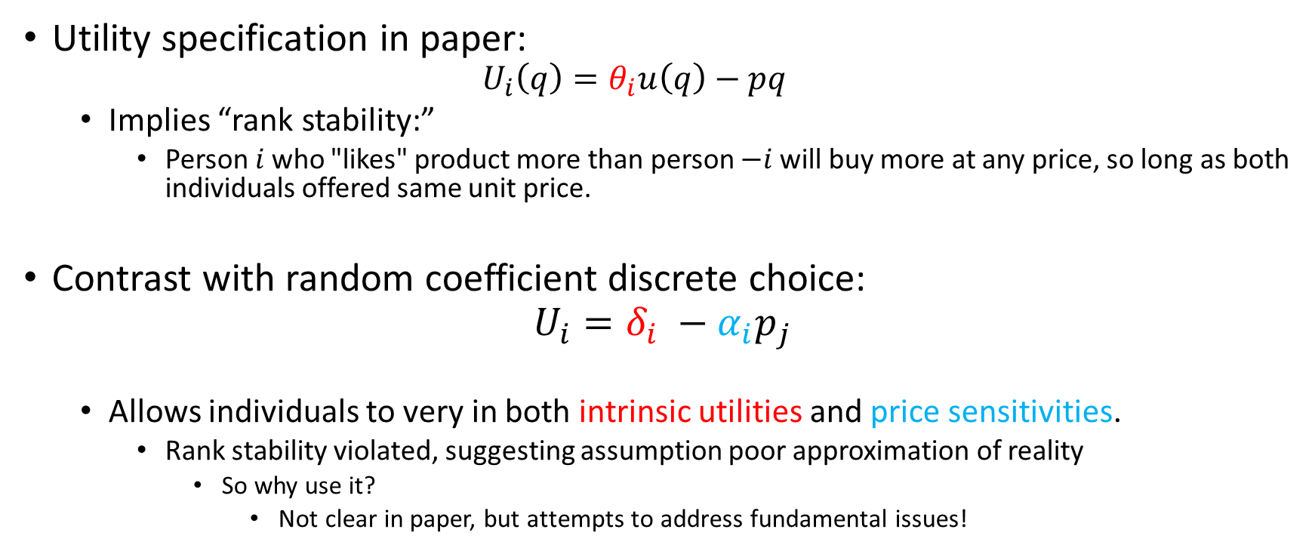
Fundamental Issues
Utility specification in paper:
$$U_{i}\left(q\right)=θ_{i}u\left(q\right)−pq$$
Implies “rank stability:”
Person $i$who "likes" product more than person $−i$will buy more at any price, so long as both individuals offered same unit price.
Contrast with random coefficient discrete choice:
$$U_{i}=δ_{i} −α_{i}p_{j}$$
Allows individuals to very in both intrinsic utilities and price sensitivities.
Rank stability violated, suggesting assumption poor approximation of reality
So why use it?
Not clear in paper, but attempts to address fundamental issues!

Slide 4
Discussant’s take on problem at hand
If
Observe quantity given individual buys at two experimental prices
And assume stable preferences:
Can back out their intrinsic and price sensitivity
Solved!
But, if only observe distribution across consumers of purchase amounts under two price sets…

Slide 5
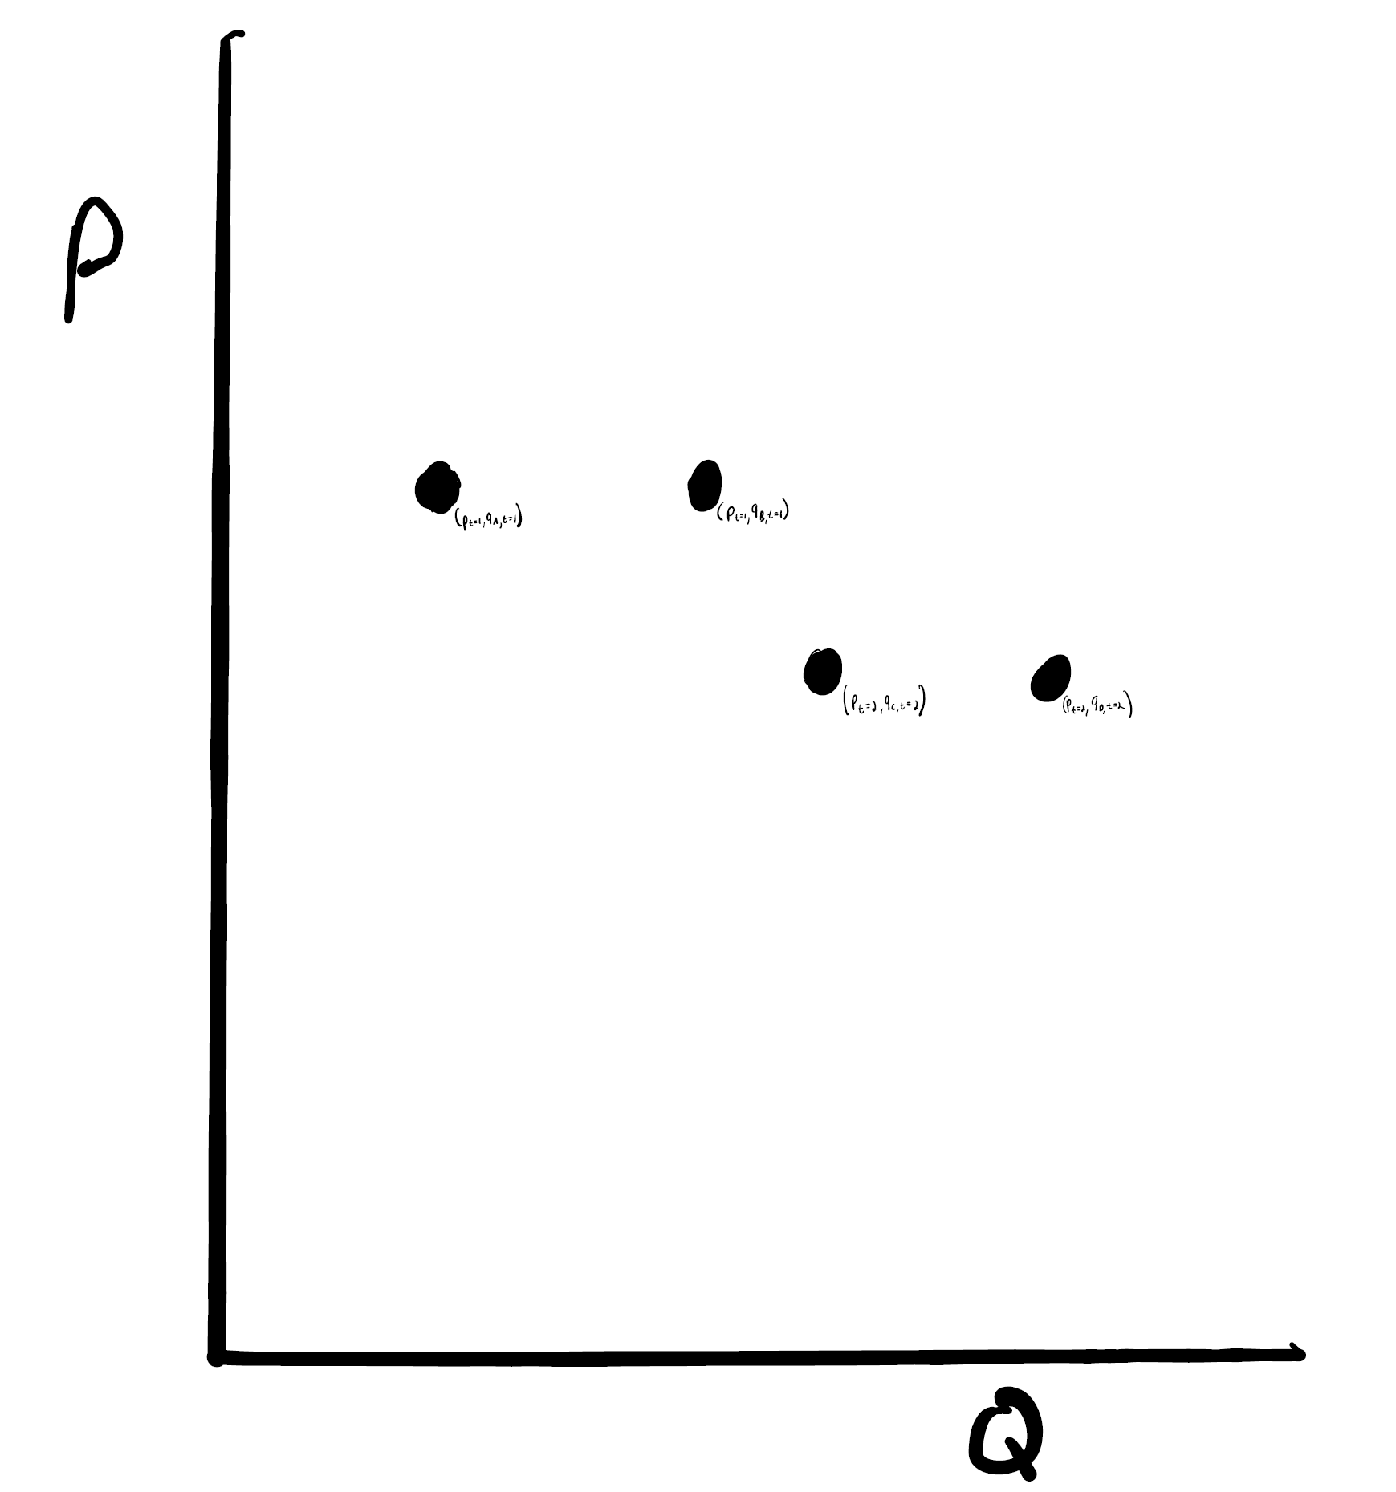
Not identified!

Slide 6
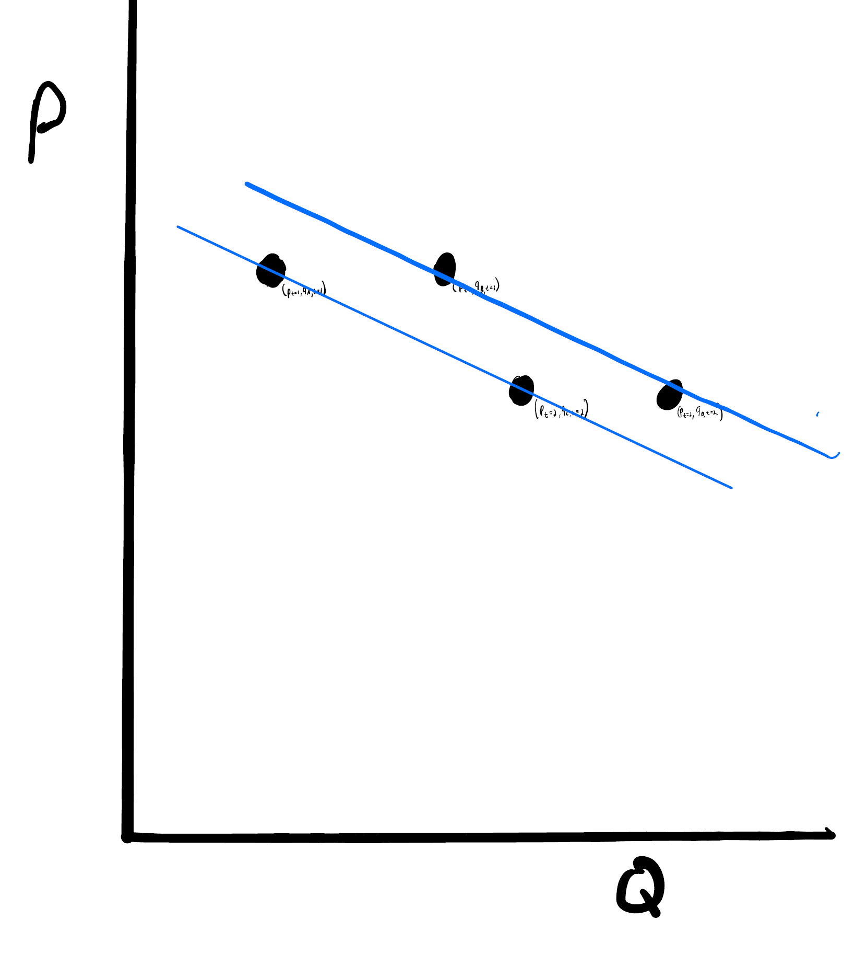

Slide 7
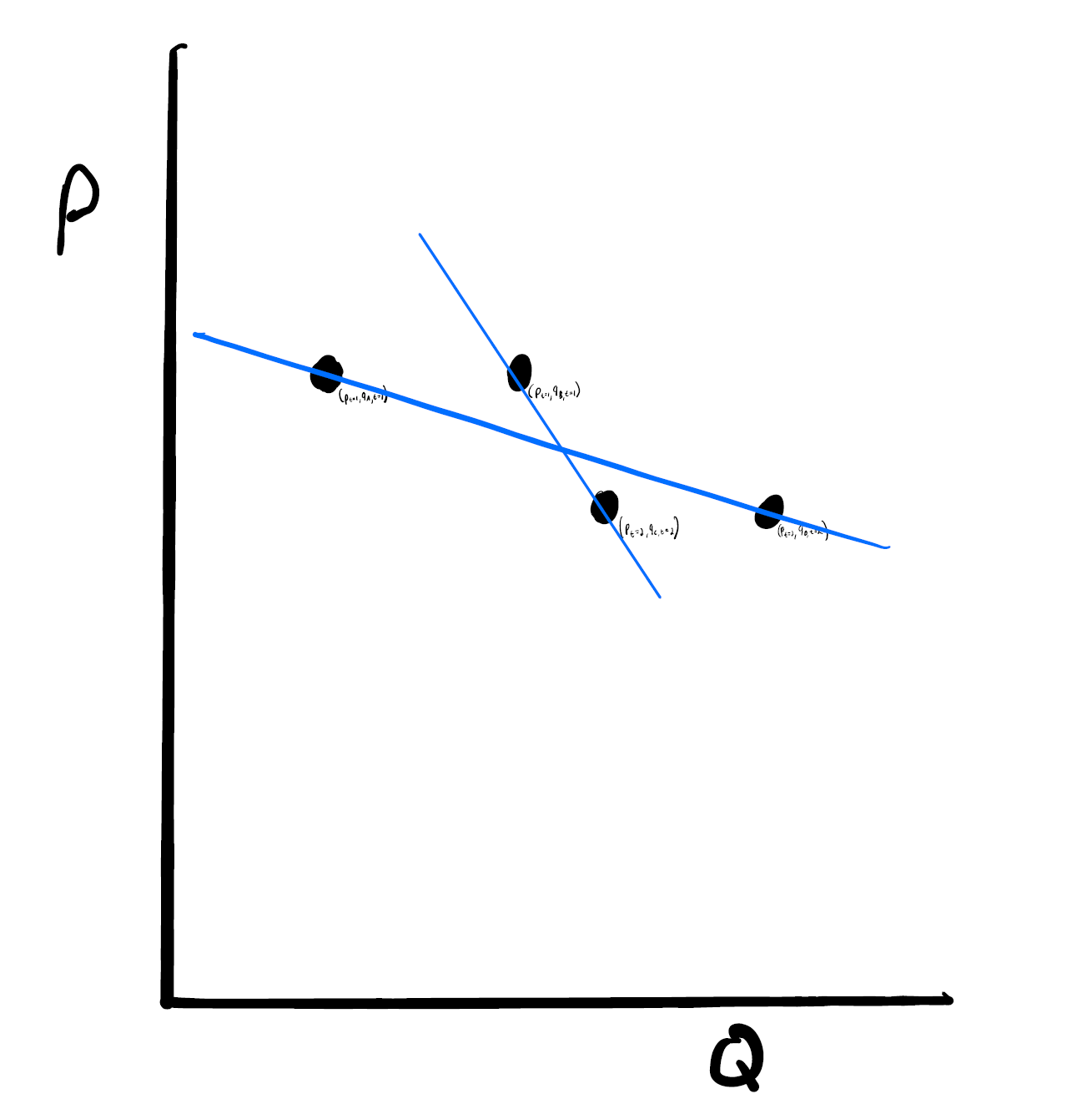
Cannot distinguish from former scenario
Rank separability assumption excludes latter case, implying identified

Slide 8
Summarizing
Need trick to non-parametrically back out demand:
Authors provides one
My question:
Can one directly compare advantages and weaknesses of:
Their method which imposes and then relaxes “rank stability” to get non-parametric demand estimates
A parametric empirical model allowing for heterogeneity in intrinsic utilities and price sensitivities?

