Slide 1

Predicting Fuel Efficiency (MPG) using Regression Models on Auto MPG Dataset
Course – CS5100 Foundations of AI
Instructor – Prof Mohammad
Authors
Bhalchandra Shinde | Shantanu Wankhare | Josh

Slide 2
Motivation
Why analyze MPG?
Fuel efficiency is a key metric in automotive engineering and energy conservation.
Consumers, manufacturers, and policymakers rely on MPG predictions.
Understanding relationships between engine specs and MPG helps improve design and sustainability.
Problem Statement:
MPG is influenced by multiple nonlinear factors (horsepower, weight, displacement, age).
Goal: Build accurate predictive models and compare performance across regression algorithms.

Slide 3
Dataset Overview
Dataset: Auto MPG (UCI Repository)
398 automobile samples
Target variable: MPG
Key features: horsepower, weight, cylinders, displacement, acceleration, model year, origin
Challenges:
Missing values
Mixed data types
Non-linear relationships

Slide 4
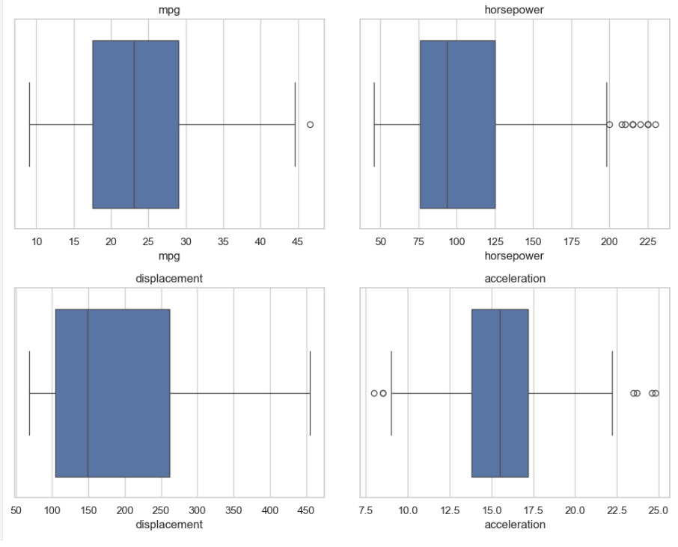
Data Cleaning Steps
1. Missing Value Handling
“?” replaced with NaN
Median imputation for horsepower
2. Outlier Detection
Boxplots inspected for extreme values
Removed unrealistic MPG and horsepower outliers
3. Type Correction
Converted origin, cylinders, and model_year → category
Note: Showing the before/after plots fulfills the requirement.

Slide 5
Feature Engineering
New Features Created:
hp-to-weight ratio → captures engine load
car_age → (82 – model_year)
one-hot encoded origin
scaled numeric features
Why these features?
Improve model ability to capture trends
Reduce noise
Make patterns more interpretable
 | mpg | cylinders | displacement | horsepower | weight | acceleration | model_year | name | hp_to_weight | car_age | origin_japan | origin_usa
0 | 18.0 | 8 | 1.090604 | 0.673118 | 0.630870 | -1.295498 | 70 | chevrolet chevelle malibu | 0.369595 | 1.627426 | False | True
1 | 15.0 | 8 | 1.503514 | 1.589958 | 0.854333 | -1.477038 | 70 | buick skylark 320 | 1.638144 | 1.627426 | False | True
2 | 18.0 | 8 | 1.196232 | 1.197027 | 0.550470 | -1.658577 | 70 | plymouth satellite | 1.466791 | 1.627426 | False | True
3 | 16.0 | 8 | 1.061796 | 1.197027 | 0.546923 | -1.295498 | 70 | amc rebel sst | 1.473177 | 1.627426 | False | True
4 | 17.0 | 8 | 1.042591 | 0.935072 | 0.565841 | -1.840117 | 70 | ford torino | 0.953937 | 1.627426 | False | True

Slide 6
Exploratory Data Analysis
What we discovered:
Strong negative correlation between horsepower and MPG
Weight and displacement also strongly influence MPG
mpg has non-linear relationships with multiple features
Include correlation heatmap or bar chart of feature importance.

Slide 7
Proposed Models
Univariate Models:
Linear Regression
Polynomial Regression (deg=2)
Piecewise Linear Regression (PWLF – learns breakpoints automatically)
Multivariate Models:
Linear Regression (all features)
Polynomial Regression (deg=2)
Random Forest Regressor
Piece Wise Linear Regression (Custom Multivariate)
High-Level Pros/Cons:
Linear: simple, interpretable
Polynomial: captures smooth curvature
PWLF: learns breakpoints automatically
Random Forest: best for nonlinearity, robust, low error

Slide 8
Model Performance Metrics
Metrics evaluated: (Add image for why and how these paramters are imp for evaluation)
R² and Adjusted R²
RMSE
MAE
Add brief definitions:
RMSE penalizes larger errors
MAE shows average absolute error
R² shows variance explained

Slide 9
Multivariate Modeling Approach
Why Multivariate?
MPG is influenced by multiple vehicle characteristics, not a single feature.
Correlations showed strong relationships with weight, displacement, horsepower, and model_year.
Using multiple predictors improves model accuracy and reduces bias.
Data Preparation
Selected 6 core numeric features + engineered hp_to_weight and car_age.
One-hot encoded categorical origin_* features.
Train-test split: 80/20.
Standardized numeric features where needed (for Polynomial & PWLR models).
Models Implemented
Multiple Linear Regression
  Assumes a single linear relationship using all features.
Multivariate Polynomial Regression (Degree 2)
  Allows curved/non-linear relationships across features.
Random Forest Regression
  Captures complex nonlinear interactions and feature importance.
Custom Multivariate Piecewise Linear Regression (PWLR)
  Uses a decision tree to partition feature space.
  Fits a linear model inside each region to model non-linear patterns.

Slide 10
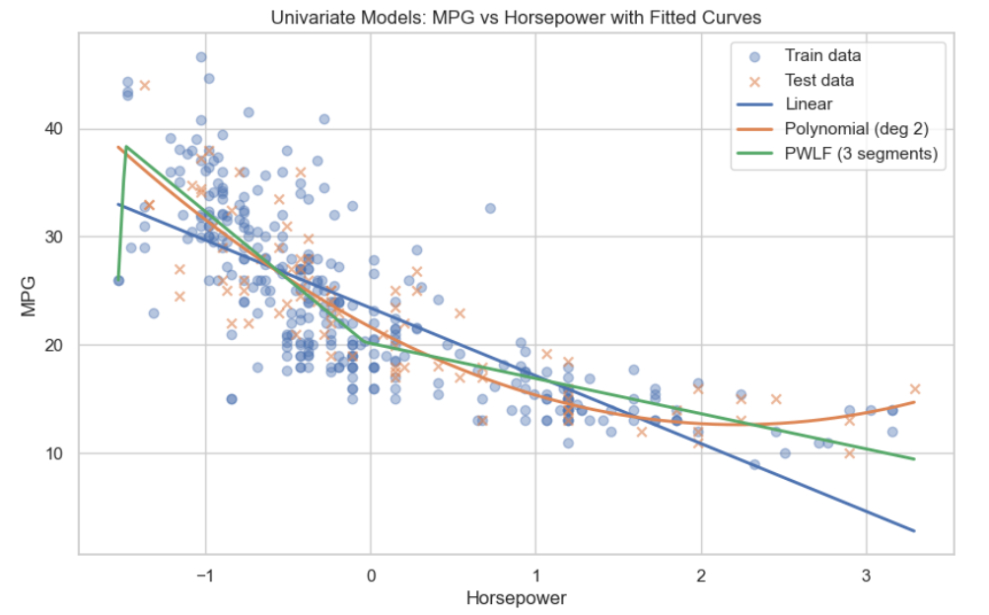
Results: Univariate Models
Key Findings:
Linear Regression performed worst (R² ≈ 0.64)
Polynomial Regression best univariate model (R² ≈ 0.74)
PWLF close behind; better interpretability

Slide 11
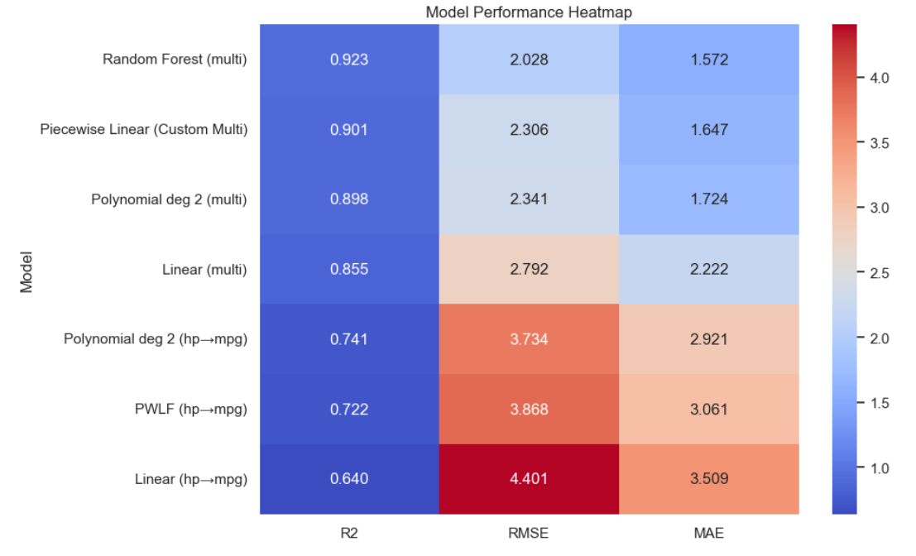
Results: Multivariate Models
Performance Summary:
Linear Regression: R² = 0.855
Polynomial Regression (deg 2): R² = 0.898
Random Forest: R² = 0.923 (Best)
Takeaway:
Adding multiple features improved performance dramatically

Slide 12
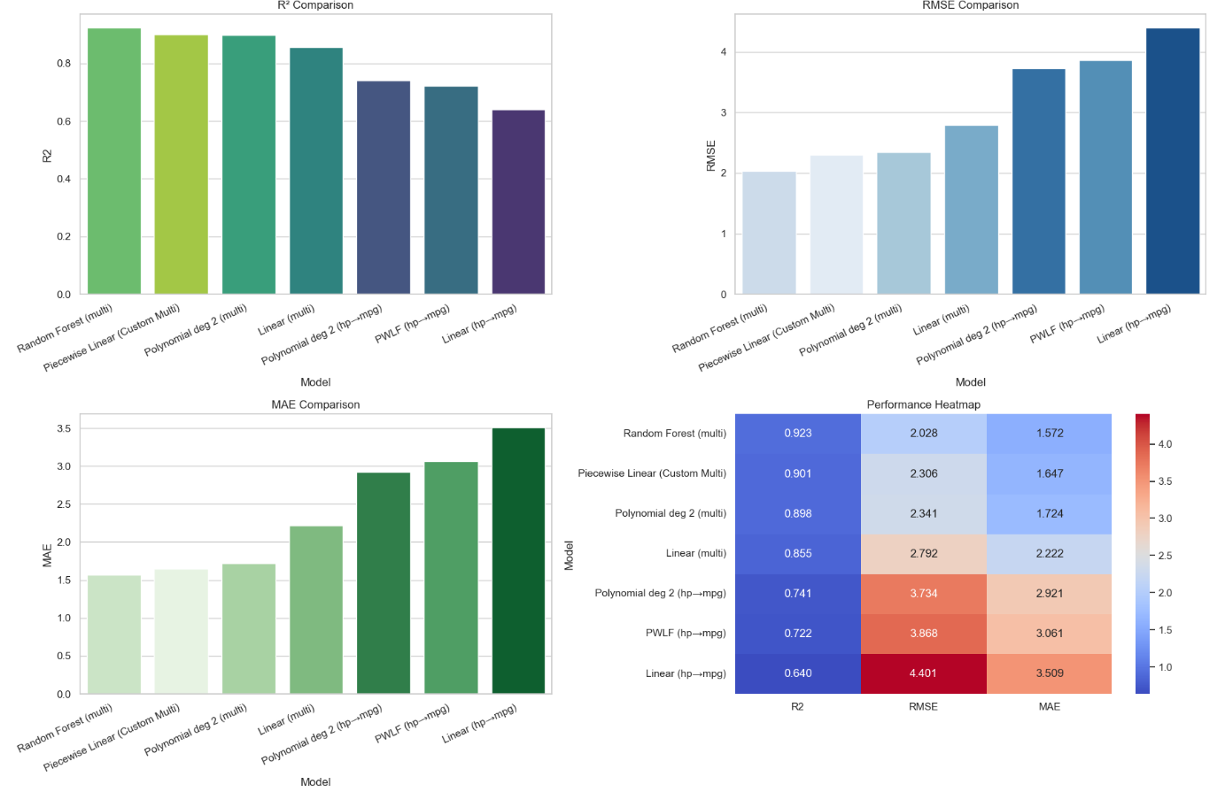
Final Comparative Dashboard
Random Forest outperforms all others:
Lowest RMSE (2.02)
Lowest MAE (1.57)
Highest R² (0.923)
Multivariate PWLF is the second-best model.

Slide 13
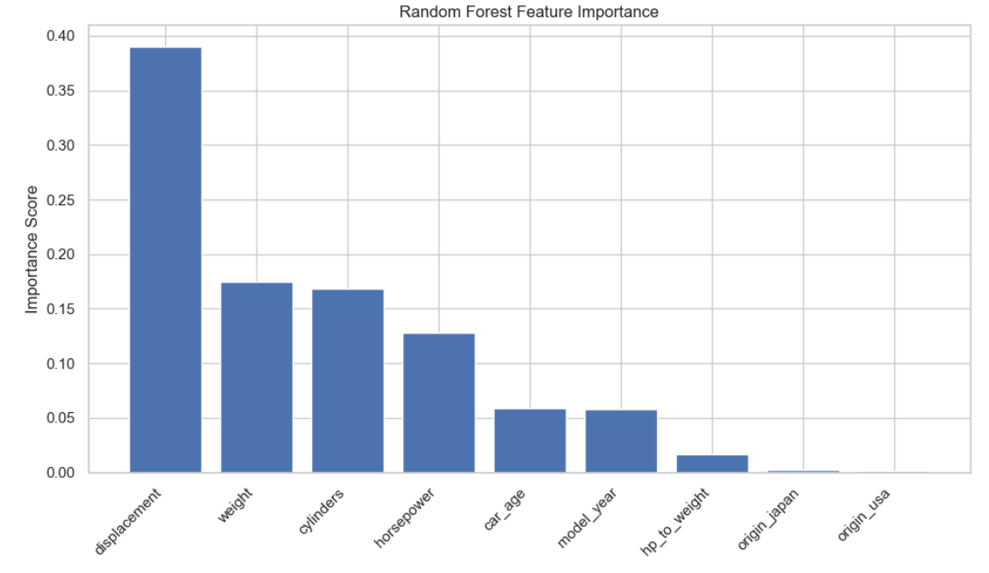
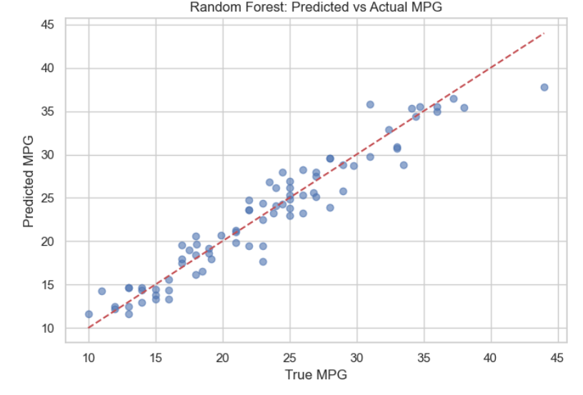
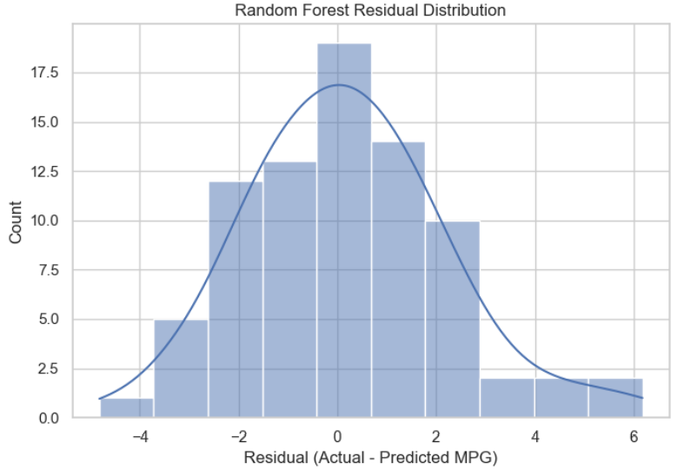
Random Forest Observations

Slide 14
Related Work
Work 1: Fuel efficiency modeling paper (e.g., 2024 regression benchmarking paper).
Used nonlinear models and found tree-based methods outperform linear models.
Our findings align with this trend.
Work 2: Breakpoint-based modeling (PWLF in energy datasets).
Demonstrated piecewise regression improves interpretability.
Motivated our use of PWLF.

Slide 15
What We Learned
MPG prediction is highly nonlinear.
Horsepower alone is insufficient for accurate predictions.
Feature engineering (hp-to-weight, car_age) significantly boosted performance.
Random Forest captured the complex interactions best.
Polynomial models are strong interpretable alternatives
Multivariate Piece Wise Linear Regression Model analysis

Slide 16
Conclusion & Future Work
Conclusion:
Multivariate nonlinear models give the best predictive performance.
Random Forest is the most robust and accurate model.
Future Work:
Hyperparameter tuning
Deep learning models (MLP)
Adding more automotive features (torque, gear ratios)

Slide 17
Thank You

