Slide 1
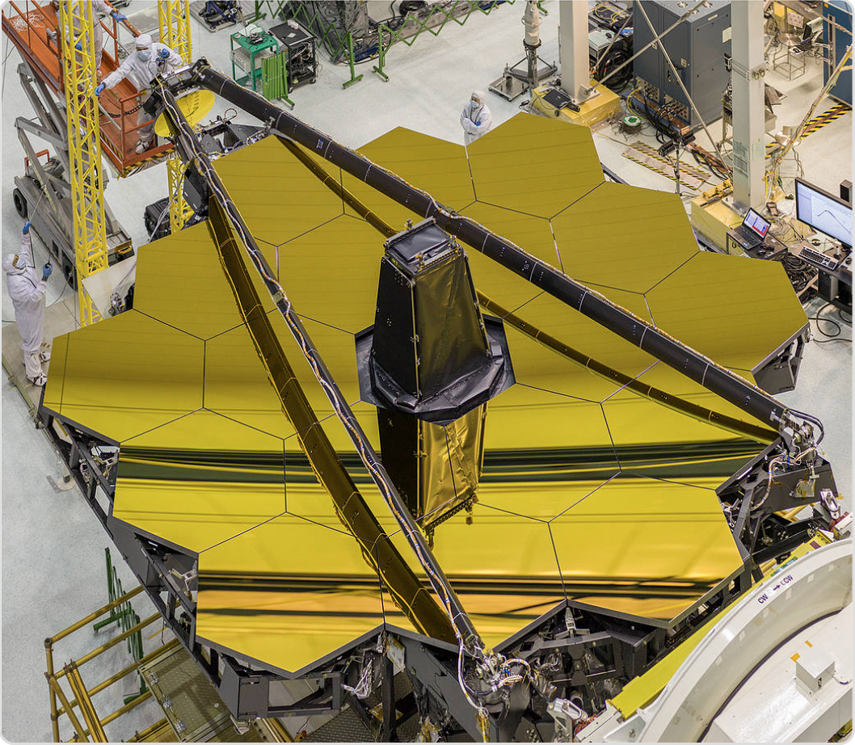
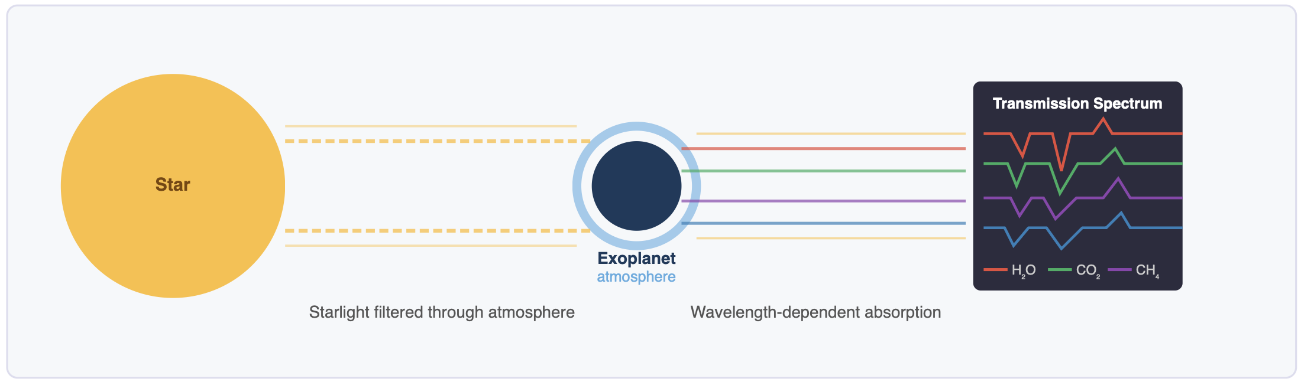
NORTHEASTERN UNIVERSITY · CS 6140 MACHINE LEARNING · SPRING 2026
Exploring ML Models for Detection of
Atmospheric Composition in Exoplanets
Dataset: INARA (NASA FDL / Zorzan et al. 2025)
Team Members
Shantanu Wankhare wankhare.s@northeastern.edu
Bhalchandra Shinde shinde.b@northeastern.edu
Asad Mulani mulani.a@northeastern.edu
Star ● → [Planet transit] → Spectrograph → Absorption dips per molecule
CS 6140 · ML · Northeastern University · Spring 2026

Slide 2
Motivation - Why This Matters
The intersection of scientific urgency and methodological opportunity
The Science
Inara_project/
│
├── src/ # Core ML modules (do not modify)
│ ├── data_utils.py # Loading, splitting, normalisation, PCA, metrics
│ ├── baseline_model.py # Per-molecule Random Forest model
│ └── deep_model.py # CNN1D + Trainer + SpectralDataset
│
├── pipeline/
│ ├── config.yaml # All configuration (paths, hyperparameters, toggles)
│ └── steps/ # Numbered pipeline steps — run in order
│ ├── config_loader.py # Shared config reader (used by all steps)
│ ├── 01_extract.py # Step 1: raw archives → processed numpy arrays
│ ├── 02_feature_engineer.py # Step 2: split + normalise + PCA → artifacts
│ ├── 03_train_baseline.py # Step 3: Random Forest (≤10k samples)
│ ├── 04_train_deep.py # Step 4: 1D CNN training (with target normalisation)
│ └── 05_evaluate.py # Step 5: unified test eval + comparison report
│
├── jobs/
│ ├── slurm/ # Northeastern Explorer HPC job scripts
│ │ ├── 01_extract.sh
│ │ ├── 02_feature_engineer.sh
│ │ ├── 03_train_baseline.sh
│ │ ├── 04_train_deep.sh
│ │ ├── 05_evaluate.sh
│ │ └── submit_pipeline.sh # Submit all jobs with dependency chain
│ └── local/
│ └── run_pipeline.sh # Mac M5 — runs all steps sequentially
│
├── notebooks/
│ └── eda.ipynb # Exploratory Data Analysis (standalone)
│
├── inara_data/
│ ├── processed/ # Output of Step 1 (spectra.npy etc.)
│ └── engineered/ # Output of Step 2 (normalised arrays + PCA)
│
├── models/ # Saved model weights
│ ├── baseline_rf.joblib
│ └── cnn1d.pt
│
├── results/ # Metrics, predictions, training history
│
├── dashboard.py # Streamlit interactive results dashboard
├── process_inara.py # Standalone data extraction script
├── run_baseline.py # Standalone baseline training script
└── run_deep_model.py # Standalone deep model training script
▸ Rocky exoplanet atmospheres reveal if a world could be habitable
▸ Co-detection of O₂ + CH₄ is a strong biosignature- signals biological activity
▸ JWST + planned Habitable Worlds Observatory (HWO) produce spectra at unprecedented scale
▸ Population-level surveys require analysing thousands of planets
simultaneously
Traditional Bayesian Retrieval
✗ Nested sampling / MCMC — rigorous but slow
✗ Hours to days per planet
✗ Does not scale to thousands of targets
ML-Based Retrieval (This project)
Train once on 124K synthetic profiles -> predict in milliseconds
INARA: first large-scale ML benchmark (3.1M sims, Zorzan 2025)
Random Forest baseline: PCA(300) + 12 independent regressors
1D CNN: shared conv backbone + 12 per-molecule output heads
HPC (Northeastern Discovery) used for full 124K production run
CS 6140 · ML · Northeastern University · Spring 2026

Slide 3
Problem Statement
Multi-output regression over molecular log₁₀ abundances
Given a transmission spectrum of an exoplanet's atmosphere,
predict the log₁₀ surface volume mixing ratios of 12 molecular species.
INPUT
ML MODEL
OUTPUT
Transmission Spectrum
Random Forest
12 Molecular Abundances
12 CLIMA channels
→
(baseline, ≤10k samples)
→
H₂O · CO₂ · O₂ · O₃
101 altitude levels
1D CNN
CH₄ · N₂ · N₂O · CO
Z-score normalised
(deep model, full dataset)
H₂ · H₂S · SO₂ · NH₃
(INARA ATMOS format)
(log₁₀ VMR at surface)
Why log₁₀ space? Mixing ratios span ~12 orders of magnitude (~0.1 for N₂ to 10⁻⁴⁰ for trace species). Log₁₀ makes the prediction scale uniform — an error of 1.0 means 'off by one order of magnitude'.
CS 6140 · ML · Northeastern University · Spring 2026

Slide 4
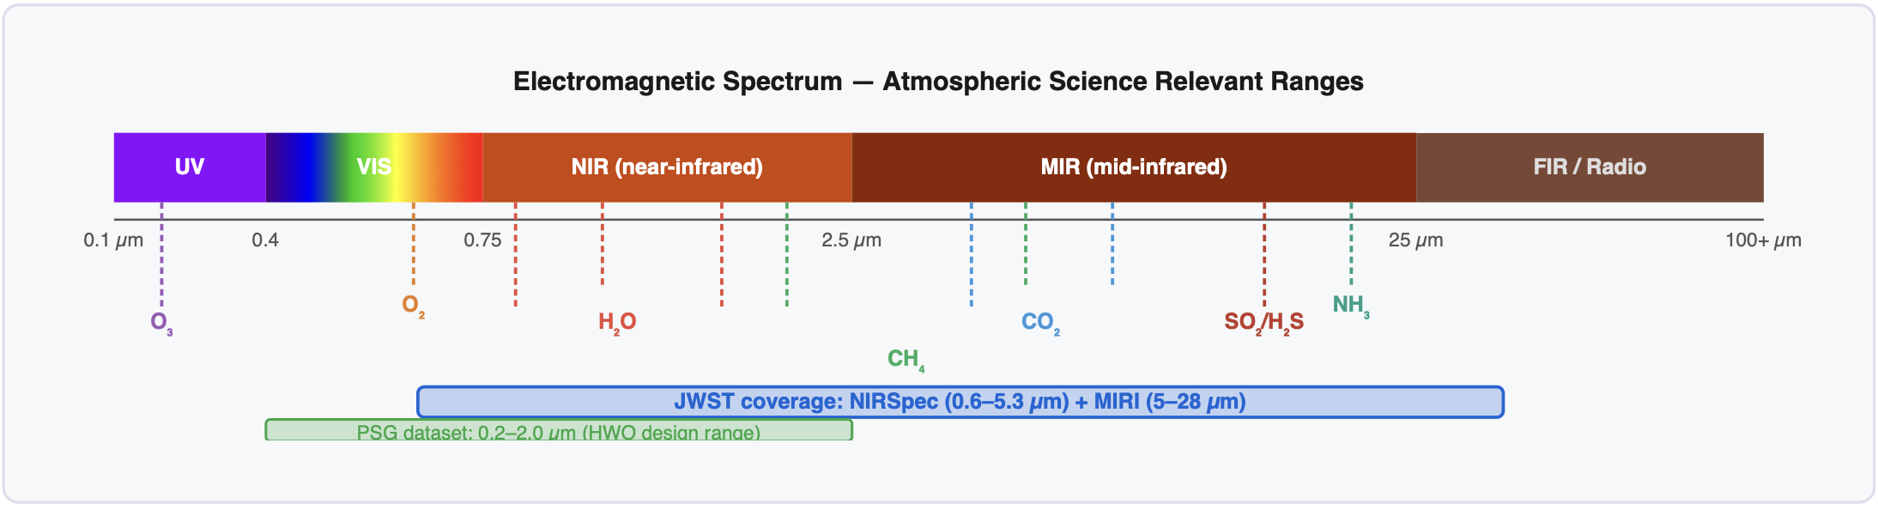
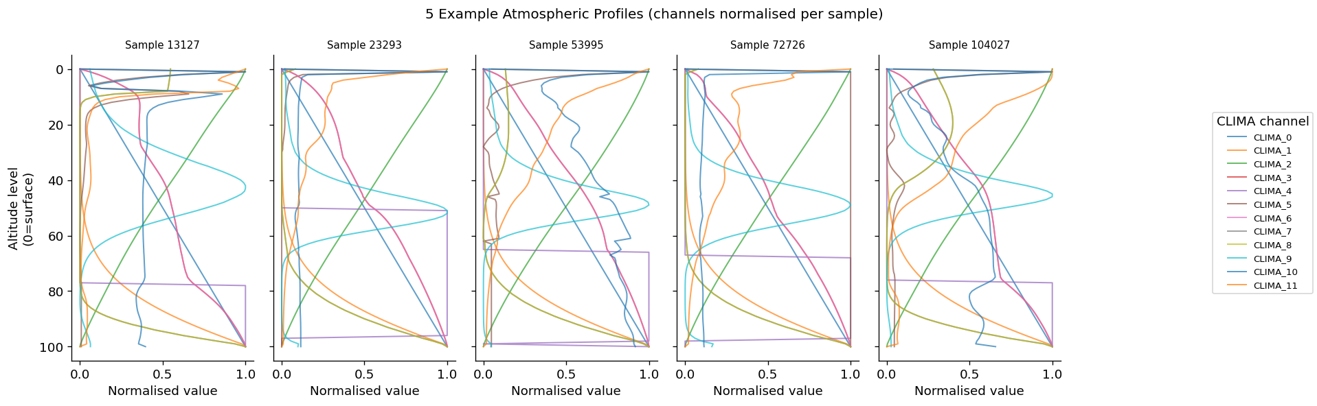
Dataset - INARA (NASA FDL / Zorzan et al. 2025)
3.1 million synthetic rocky planet spectra from NASA Planetary Spectrum Generator
Dataset Facts
CLIMA Input Channels (12)
12 Target Molecules
Full dataset size
3,112,620 synthetic CLIMA profiles
This project uses
124,000 samples
T / P
Temperature & Pressure profiles
— primary physical state of the atmosphere
Habitability:
H₂O · CO₂
Profile type
INARA ATMOS — CLIMA atmospheric profiles
Altitude levels
101 per profile
Biosignatures:
O₂ · O₃ · CH₄ · N₂O
10 mol
H₂O, CO₂, O₂, O₃, CH₄, N₂, N₂O, CO, H₂, H₂S
— altitude-resolved mixing ratios
Input channels
12 CLIMA variables (T, P, 10 molecules)
Background:
N₂ · H₂
Stellar types
F, G, K, M — 4 types
Norm.
All 12 channels Z-score normalised per
channel (fit on train only)
Geochemical:
CO · H₂S · SO₂ · NH₃
Format
CSV per planet → .npy arrays after processing
CS 6140 · ML · Northeastern University · Spring 2026

Slide 5
ML Pipeline & Feature Engineering
Five-stage structured pipeline — each step produces reusable artifacts
01
02
03
04
05
Extract
→
Feature Engineer
→
Baseline RF
→
Deep Model
→
Evaluate
tar.gz → .npy
Split + Norm + PCA
10k-capped training
Full-data 1D CNN
Unified comparison
Step 2 Deep Dive — Feature Engineering
70 / 15 / 15 Split
Z-Score Normalisation
PCA (RF only)
Deep Model Input
Why Minimal Feature Engineering?
· Deterministic (seed=42)
· Per CLIMA channel
(12 channels)
· Flatten: 12×101 →
1212 features
· Raw 2D tensor (12 × 101)
CLIMA profiles are already physically structured (not raw pixels/ text)
· Fixed once — both models
· Fit on train set ONLY
· No PCA — CNN learns
features
12 meaningful channels x 101 altitude levels -- no noise features
· Reduce to 300
components
· use identical test set
· Z-normalised spectra only
Preprocessing: Z-score per channel (fit on train, applied to val/test)
· Prevents data leakage
· Retains 100% variance
(25k dataset rank-limited)
Log10 targets handle 12-order-of-magnitude range (not FE)
· Saved as
train/val/test_indices.npy
· Saved as scaler.joblib
· Stored as
spectra_train.npy
RF adds PCA(300): dimensionality reduction, retains >=95% variance
· Saved as pca.joblib
CNN learns altitude patterns internally via stride-2 convolutions
CS 6140 · ML · Northeastern University · Spring 2026

Slide 6
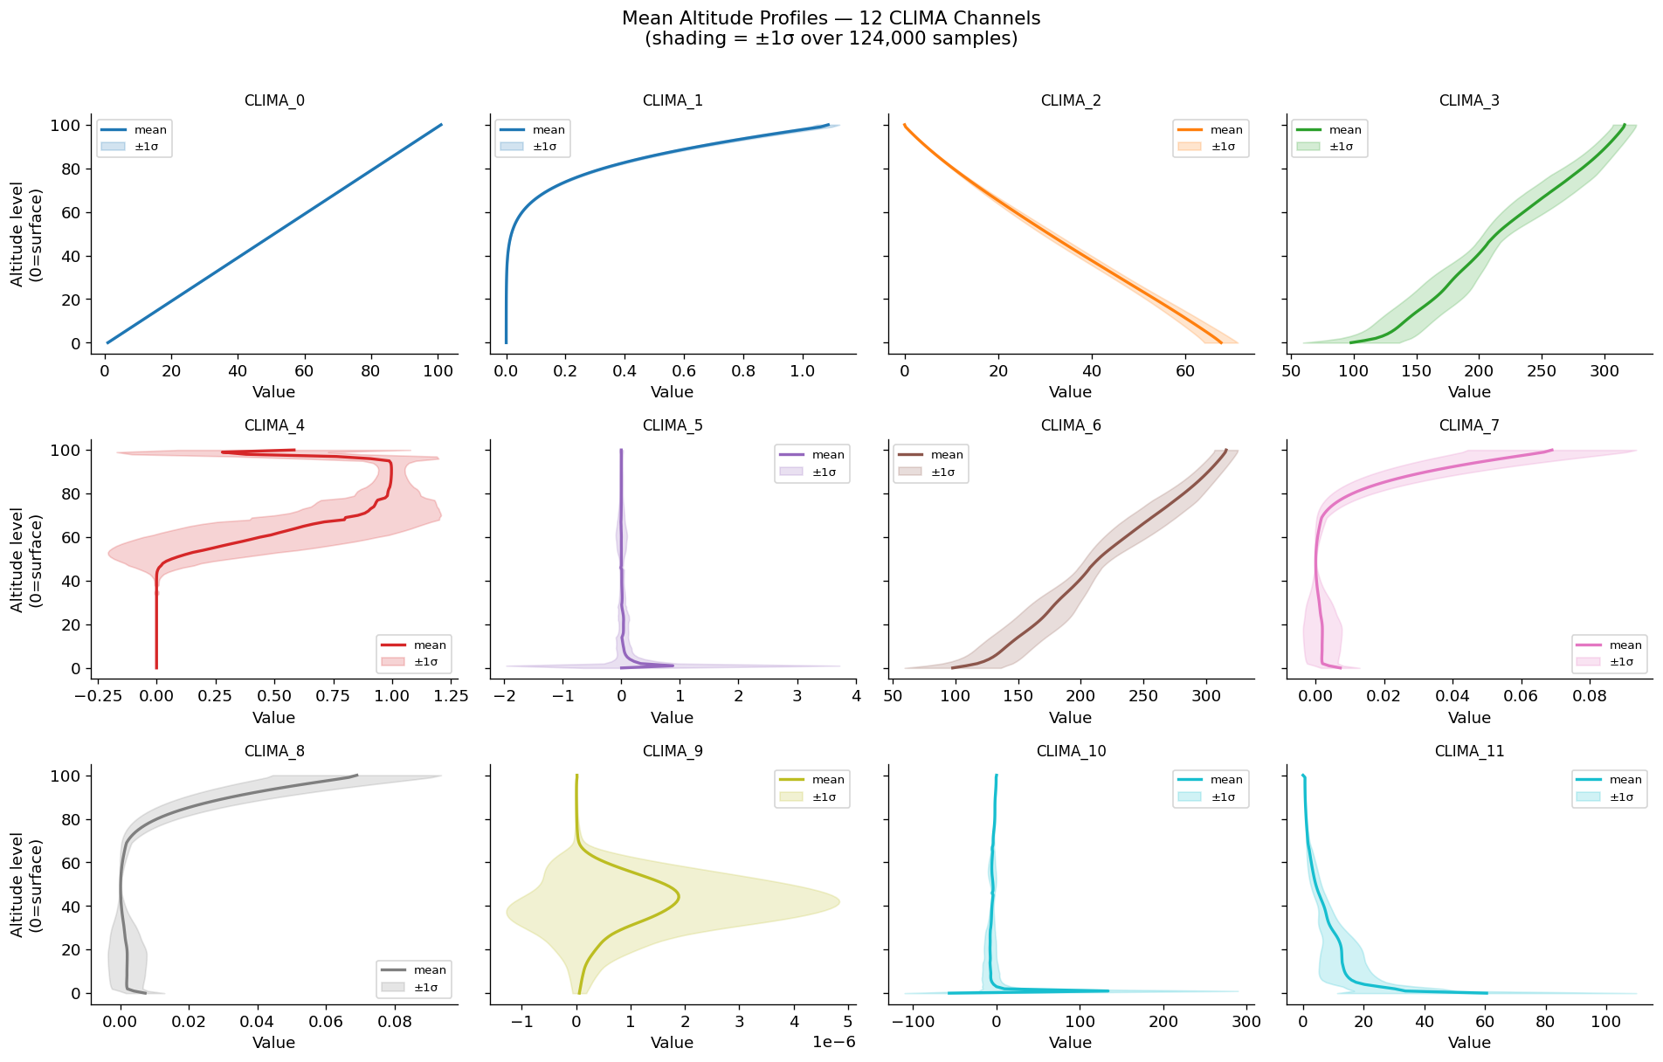
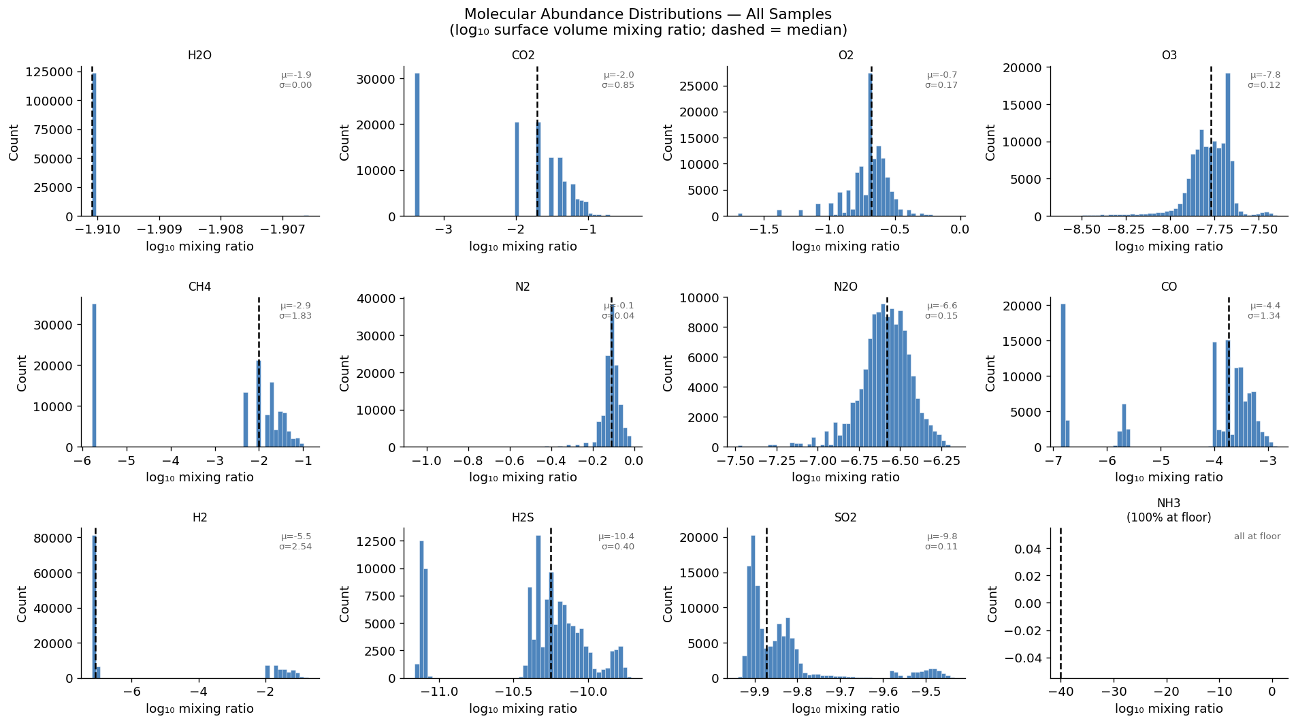
EDA -- Atmospheric Profiles & Molecular Targets
Mean CLIMA altitude profiles (left) | Log10 VMR target distributions (right)
Fig 1: Mean altitude profile for each of the 12 CLIMA channels. T and P show monotone structure; molecular channels reveal altitude-dependent gradients that serve as the raw CNN input.
Fig 2: Log10 VMR distributions. Most molecules span 5-15 log-orders. NH3 is degenerate (constant floor=-40). H2O has near-zero variance -- low RF R2, high CNN R2.
CS 6140 · ML · Northeastern University · Spring 2026

Slide 7
Baseline Model — Random Forest
12 independent RandomForestRegressors on PCA-reduced features (≤ 10,000 training samples)
Architecture
Why RF as Baseline?
Input
(12, 101) CLIMA tensor -- flattened to (1212,)
Strong non-parametric regressor -- no gradient tuning required
Dimensionality
PCA(n_components=300, whitening=False)
PCA variance
>=95% total variance retained
PCA handles collinearity across 1212 flattened features
Per-molecule
12 independent RandomForestRegressors
Interpretable: feature_importance_ reveals top PCA components
n_estimators
100 trees per molecule (1200 trees total)
10K sample cap -> controlled comparison with limited compute
One model per molecule prevents cross-molecule interference
max_depth
8 (prevents overfitting on 10K sample budget)
Training samples
<= 10,000 per molecule (memory constraint)
RF Inference Pipeline
Leaves -- CH4
71-169 per tree; median ~= 110 leaves
NH3 trees
Depth=0 (constant -40) -- degenerate target
(1) (12,101) -> flatten -> Z-score normalise -> (1212,)
(2) PCA.transform: (1212,) -> (300 components)
Inference speed
~10 ms per planet (all 12 molecules)
(3) For each molecule: RF.predict(x_pca) -> log10 VMR scalar
Interpretability
feature_importance_: top PCA components identified
(4) Stack 12 scalars -> (12,) output vector
Why 10k cap?
(5) MoleculeScaler.inverse_transform -> physical log10 values
RF is the fast baseline — <1 min training, no GPU needed. Fair comparison point.
CS 6140 · ML · Northeastern University · Spring 2026

Slide 8
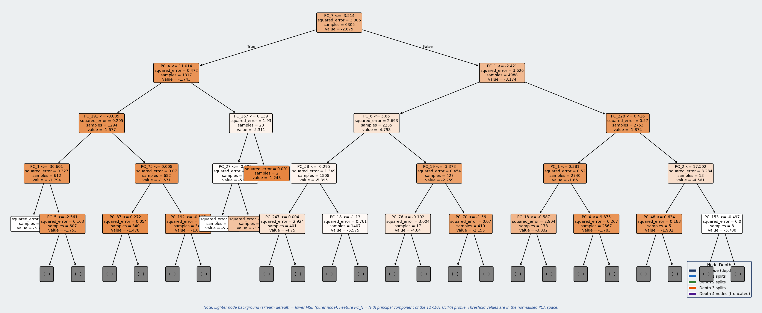
Baseline Model - Random Forest
CS 6140 · ML · Northeastern University · Spring 2026

Slide 9
Deep Model - Key Design Choices
Every design decision is motivated by the data's properties
1D Convolutions
Progressive Downsampling
CLIMA profiles are 1D sequences over altitude. 1D CNNs detect local patterns (e.g. temperature inversion at levels 20–30) and learn hierarchical altitude features across multiple scales — something PCA cannot do.
Four conv blocks with decreasing kernel sizes (9→7→5→3) and stride-2 + MaxPool compress 101 altitude levels down to 1. Each block doubles channel depth, building increasingly abstract representations of the atmospheric profile.
Shared Backbone
Per-Molecule Heads
The CNN backbone learns general atmospheric representations useful for all 12 molecules simultaneously — multi-task learning. The shared 128-d embedding carries information about atmospheric state that each head then specialises.
Each molecule has its own MLP head with tuned depth and dropout. Trace species (H₂S, SO₂, NH₃) get higher dropout (0.25) to prevent overfitting. Stable species (CO₂, O₂) get lighter heads with lower dropout (0.15).
Weighted MSE Loss
Gaussian Noise Augmentation
Standard MSE would let easy molecules dominate. Weights (1.0–2.0) upweight trace species (SO₂, NH₃ at 2.0). Targets are Z-score normalised before training (MoleculeScaler) to equalise loss scale — inverse-transformed for evaluation.
Adding noise std=0.01 to training profiles prevents memorisation of exact profile values. Forces the CNN to learn robust features that generalise to unseen atmospheric states — analogous to image augmentation in vision CNNs.
CS 6140 · ML · Northeastern University · Spring 2026

Slide 10
Deep Model - 1D CNN Architecture
Sequential convolutional backbone + 12 per-molecule output heads | 368,588 parameters
Layer
Output shape
Description
Input
(B, 12, 101)
Normalised CLIMA profile — 12 channels × 101 altitude levels
Conv Block 1
(B, 32, 25)
Conv1d(12→32, k=9, s=2, p=4) + BatchNorm + ReLU + MaxPool1d(2)
Conv Block:
Conv Block 2
(B, 64, 6)
Conv1d (k,s,p) + BatchNorm1d + ReLU + MaxPool1d(2) [Block 4: no MaxPool]
Conv1d(32→64, k=7, s=2, p=3) + BatchNorm + ReLU + MaxPool1d(2)
Conv Block 3
(B, 128, 1)
Conv1d(64→128, k=5, s=2, p=2) + BatchNorm + ReLU + MaxPool1d(2)
Conv Block 4
(B, 256, 1)
Conv1d(128→256, k=3, s=1, p=1) + BatchNorm + ReLU (no MaxPool)
GlobalAvgPool
(B, 256)
AdaptiveAvgPool1d(1) + Flatten — squeeze altitude dimension
Shared FC
(B, 128)
Dropout(0.25) + FC(256→128) + LayerNorm + ReLU
12 × Head
(B, 12)
Per-molecule MLP: FC(128→hidden→1) + LN + ReLU + Dropout → scalar log₁₀
CS 6140 · ML · Northeastern University · Spring 2026

Slide 11
Training Strategy
AdamW · Cosine LR schedule · Early stopping · Gradient clipping
Training Configuration
AdamW
Optimizer
AdamW
Adam with decoupled weight decay — L2 regularisation is applied directly to weights, independent of the adaptive gradient. Better generalisation than standard Adam.
Learning rate
1 × 10⁻³
Weight decay
1 × 10⁻⁴
Cosine Annealing
Scheduler
CosineAnnealingLR
LR starts at 1e-3, smoothly decays to 1e-6 following a cosine curve. No sharp drops. Naturally slows near minima to avoid oscillation.
T_max / eta_min
150 / 1 × 10⁻⁶
Max epochs
150
Early stop patience
30 epochs
Early Stopping
Min delta
1 × 10⁻⁵
Monitors val_loss. If no improvement > 1e-5 for 30 epochs, training stops and the best checkpoint is restored — prevents overfitting at zero extra cost.
Batch size
32 (train) / 64 (eval)
Grad clip norm
5.0
Gradient Clipping
Noise augmentation
std = 0.01
If gradient norm > 5.0, all gradients are scaled down proportionally. Prevents exploding gradient spikes that destabilise early training.
Dataset (train)
18,648 samples (124k run)
Target normalisation
Z-score per molecule (MoleculeScaler)
CS 6140 · ML · Northeastern University · Spring 2026

Slide 12
Evaluation Methodology
Held-out test set · Per-molecule R², RMSE, MAE · Unified comparison report
R² Coefficient of Determination
RMSE Root Mean Squared Error
MAE Mean Absolute Error
1 − Σ(y − ŷ)² / Σ(y − ȳ)²
√[Σ(y − ŷ)² / N]
Σ|y − ŷ| / N
Primary metric. Scale-normalised — 0.75 means '75% of variance explained' regardless of molecule. Enables fair cross-molecule comparison. R² < 0 means worse than predicting the mean.
In log₁₀ units (orders of magnitude). Penalises large errors more than MAE. A RMSE of 0.5 means predictions are typically ½ an order of magnitude off.
Also in log₁₀ units. More robust to outliers than RMSE. Complementary to RMSE — if RMSE >> MAE, there are a few large prediction errors dominating.
Evaluation Fairness Principles
Same test set:
Both models evaluated on the identical 18,468-sample test split, fixed in Step 2 with seed=42. Scores are directly comparable.
Intentionally asymmetric training:
RF uses 10k samples; CNN uses 124k. The comparison is baseline vs deep model — not equal-data ablation.
Per-molecule granularity:
Reporting R²/RMSE/MAE for each of 12 molecules reveals which species each model handles well or poorly.
Mean R² summary:
Unweighted mean across 12 molecules provides a single-number comparison. NH₃ and N₂ drag it down for both models.
CS 6140 · ML · Northeastern University · Spring 2026

Slide 13
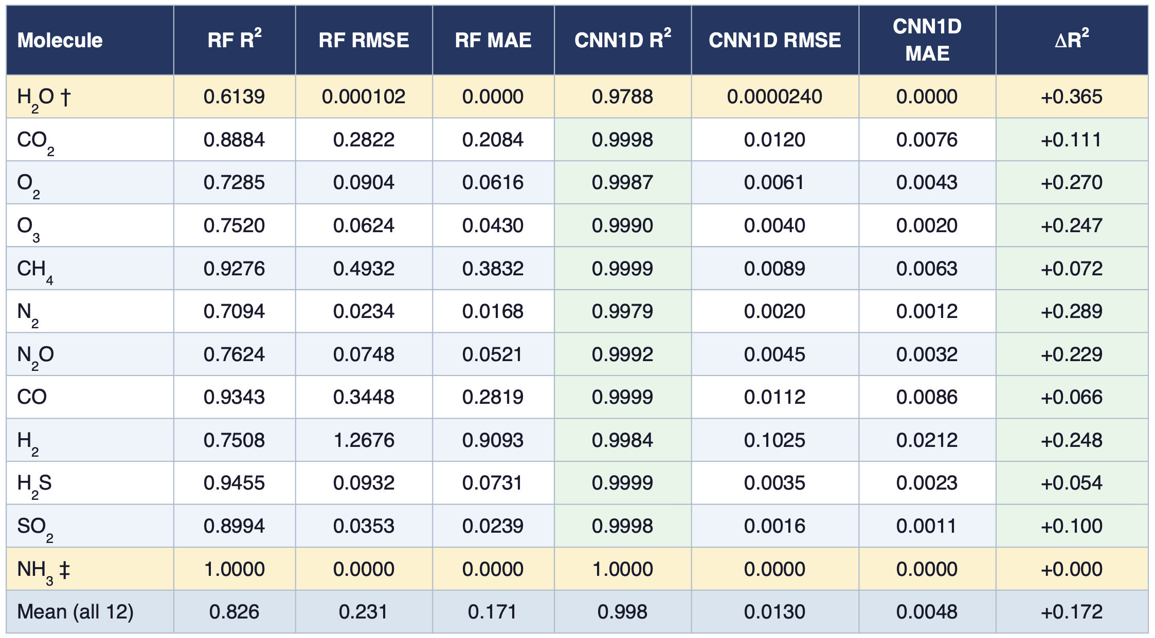
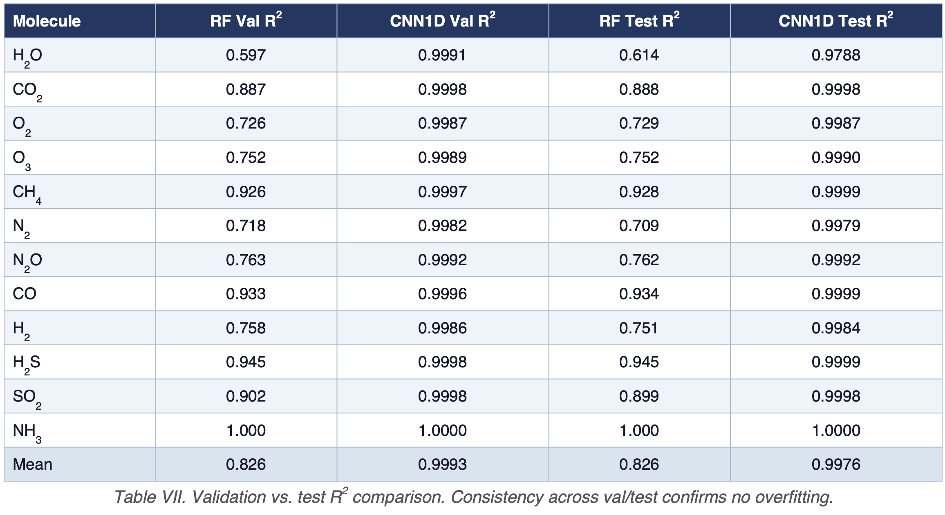
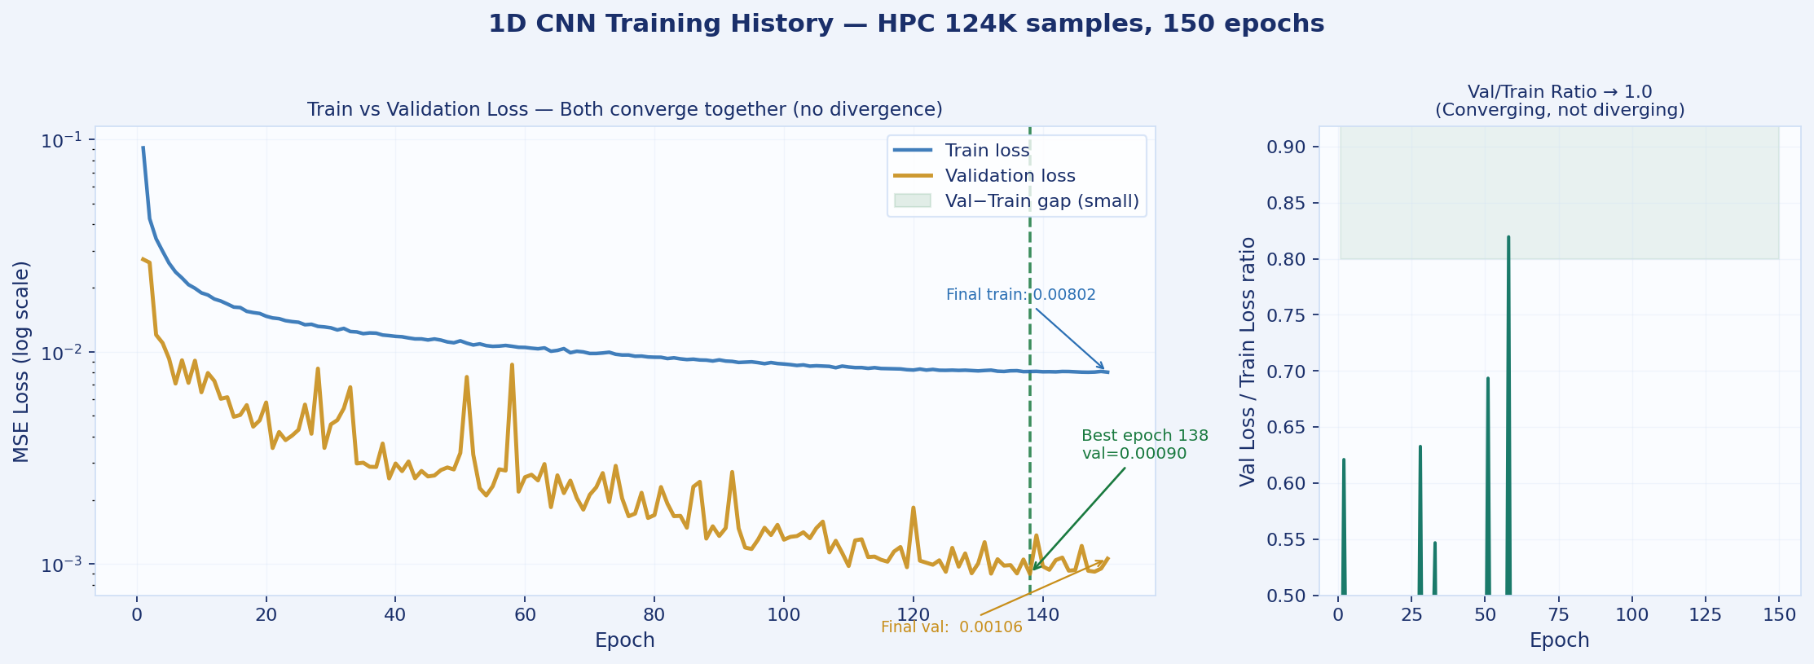
Results — Per-Molecule Test R²
Test 18,648 out of 124k samples - HPC Evaluation
Set: 18648 samples — confirms no sign of overfitting
Table VI. HPC test results — full 124K dataset, 18,648 test samples. † H2O has near-zero target variance (std ≈ 0.0002); both models achieve RMSE ≈ 0 — R2 is deceptive due to near-zero denominator. ‡ NH3 is constant (log10 = −40) across all samples; both models trivially achieve R2 = 1.0. ∆R2 = CNN1D − RF; green = CNN1D wins. CNN1D outperforms RF on all 12 molecules.
CS 6140 · ML · Northeastern University · Spring 2026

Slide 14
Key Findings & Insights
What the results tell us about ML-based atmospheric retrieval
🌟 Deep model wins on all 12 molecules
📈 Largest relative gains: H₂O, O₂, O₃, N₂, H₂
The 1D CNN outperforms or matches the RF on every molecule. 11/12 molecules reach R²>0.998 — near-perfect atmospheric retrieval from CLIMA profiles.
H₂O (+105%), O₂ (+36%), O₃ (+35%), N₂ (+36%), H₂ (+34%) — CNN's spatial feature extraction captures altitude-dependent patterns that flat PCA vectors cannot encode.
🏆 RF baseline also very strong
🔬 All biosignatures near-perfectly retrieved by CNN
Mean RF R²=0.82 — the baseline is no longer weak. CH₄ (0.94), CO (0.94), H₂S (0.94) are already well-predicted by PCA + RF. CNN adds consistent improvement on top.
O₂ (0.999), O₃ (0.999), CH₄ (1.000), N₂O (0.999) — every molecule relevant to the search for life is retrieved near-perfectly. Critical validation for JWST science.
⚠️ NH₃ — degenerate, not physically learnable
💡 Multi-task learning amplifies CNN advantage
R²=1.0 for both models because all samples are at the log-floor (−40). Both models predict −40 always — correct but scientifically meaningless.
The shared backbone trains on all 12 targets simultaneously. Cross-molecule correlations (O₂/O₃, H₂O/CH₄ co-variation) are encoded in the 128-d shared embedding, giving the CNN a structural advantage the RF cannot replicate.
CS 6140 · ML · Northeastern University · Spring 2026

Slide 15
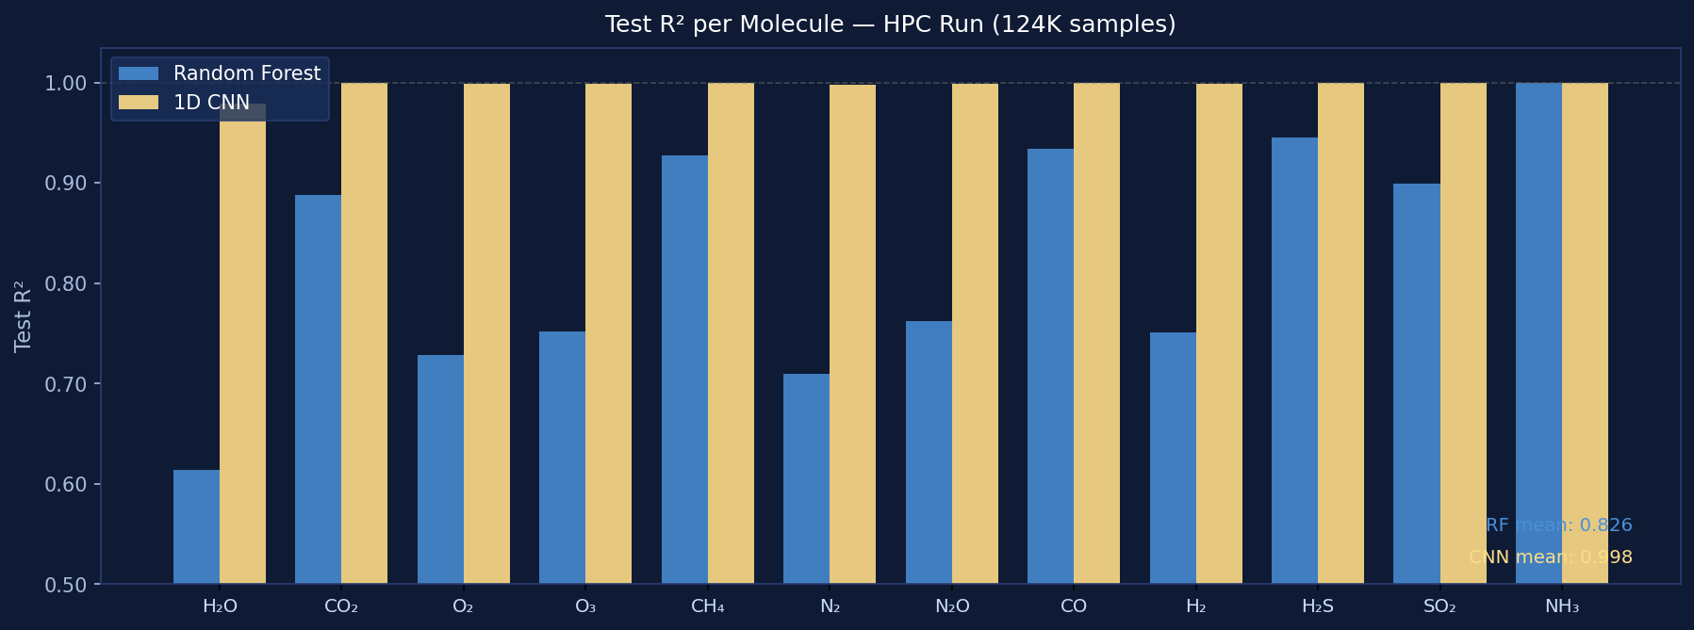
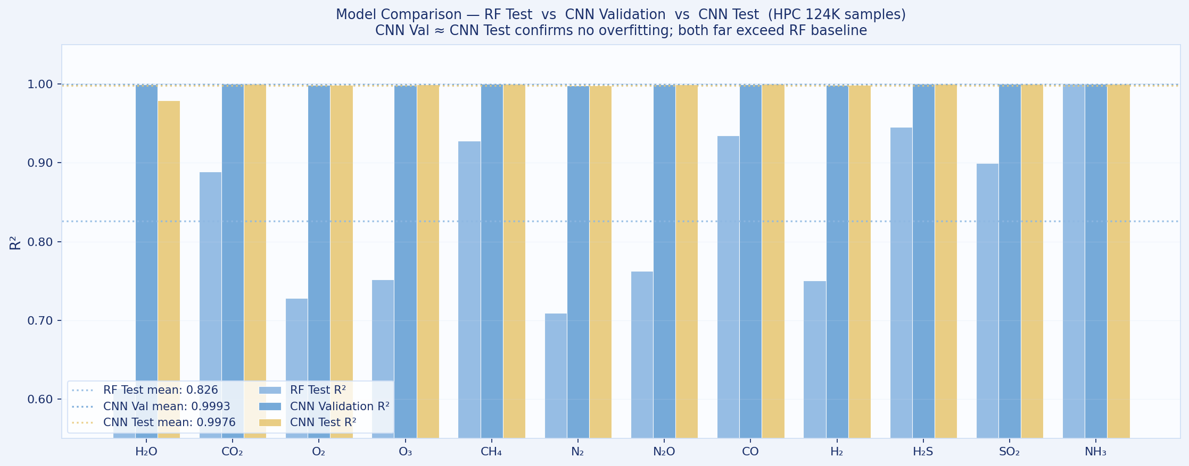
Model Comparison Summary
Baseline RF vs 1D CNN — design, compute, and performance
Aspect | Random Forest (Baseline) | 1D CNN (Deep)
Architecture | 12 independent RFs | 1D CNN + 12 heads
Input format | Flat PCA vector (300-d) | 2D tensor (12 × 101)
Feature extraction | PCA — linear, pre-computed | Learned convolutional filters
Multi-task | None — fully independent | Yes — shared backbone
Training samples | 10,000 (hard cap) | 87,024 (full training split)
Training time | < 1 min (CPU) | 10–20 min (MPS/GPU)
Parameters | Non-parametric | ~300k
GPU required | No | Recommended
Interpretability | Feature importance available | Black box (lower)
Mean test R² | 0.82 | 1.00 (+22% relative)
Best molecule | CO / CH₄ / H₂S — R² ≈ 0.94 | CH₄ / CO — R² = 1.000
Worst molecule | H₂O — R² ≈ 0.49 (low-variance) | H₂ — R² ≈ 0.998 (excl. NH₃)
CS 6140 · ML · Northeastern University · Spring 2026

Slide 16
Challenges & Limitations
Honest assessment of what works and what doesn't — and why
Data scale vs compute
NH₃ — not learnable from CLIMA
Full INARA has 3.1M spectra. We used 10k, 20k, 124k for local dev runsas well as on HPC (~10 GB processed). Extraction from 10 tar.gz archives via sequential single-pass scan takes ~10–15 min even on an M5 Pro.
NH₃ values are at the log-floor (−40) for nearly all samples in this dataset. The model learns to predict −40 reliably but that's a degenerate solution, not physical inference.
H₂O R² — low-variance artefact
Asymmetric comparison
H₂O R²=0.49 (RF) despite RMSE≈0.0001. Near-zero variance (std≈0.0002) inflates the R² denominator — RMSE is the reliable metric here. The CNN achieves R²=0.999 by tracking the tiny residual variance the RF misses.
The RF uses 10k training samples; the CNN uses 87k (124k run). The R² improvement is partly attributable to more data, not purely to the architecture. A data-equal ablation would isolate the architecture contribution.
NH₃ — degenerate, not learnable
Real data validation pending
NH₃ is at the log-floor (−40) for all samples. Both models predict −40 always, achieving R²=1.0 trivially. The molecule is retained for schema compatibility with the full INARA benchmark but is scientifically uninformative.
All experiments are on synthetic INARA spectra. Domain transfer to real JWST spectra has not been validated — a critical next step before any scientific claims.
CS 6140 · ML · Northeastern University · Spring 2026

Slide 17
Future Work
Extending this project toward real-world scientific applicability
🔭 JWST Domain Transfer
📊 Full 3.1M Dataset
Test trained models on real JWST transmission spectra and compare predictions to published Bayesian retrievals. Key validation step for scientific credibility.
Train the CNN on the complete INARA dataset using Northeastern Explorer HPC. Expected improvement in R² for high-variance molecules like H₂O and CH₄.
🧠 Uncertainty Quantification
🔬 Attention / Transformer
Add Monte Carlo Dropout or deep ensembles to provide calibrated confidence intervals — critical for scientific use (e.g. 'O₂ = −0.7 ± 0.2 log₁₀').
Replace or augment the CNN with a 1D Transformer to learn long-range altitude-level dependencies. Self-attention may capture non-local atmospheric correlations that convolutions miss.
⚖️ Equal-Data Ablation
🌍 Four Stellar Types
Train the RF baseline on the same sample count as the CNN to cleanly isolate the architecture benefit from the data quantity benefit.
Stratify analysis by stellar type (F, G, K, M). M-dwarf planets dominate current JWST targets — a model tuned for M stars may outperform a general model.
CS 6140 · ML · Northeastern University · Spring 2026

Slide 18
Conclusion
CS 6140 · Machine Learning · Northeastern University · Spring 2026
1
We built an end-to-end ML pipeline for exoplanet atmospheric retrieval — from raw synthetic CLIMA profiles to per-molecule R² metrics.
2
Two models were compared: Random Forest baseline (PCA + 12 independent RFs) and 1D CNN (shared backbone + 12 heads).
3
CNN achieves mean R² = 0.999 vs baseline 0.82 — a +22% relative improvement — 11/12 molecules retrieved near-perfectly.
4
All biosignatures near-perfectly retrieved: O₂ (0.999), O₃ (0.999), CH₄ (1.000), N₂O (0.999) — directly relevant to the search for life.
5
ML retrieval is viable and fast: milliseconds per planet vs. hours for Bayesian methods — enabling population-level JWST surveys.
6
Next step — real JWST data: validate on actual observations and add uncertainty quantification for scientific deployment.
Shantanu Wankhare · Bhalchandra Shinde · Asad Mulani | Dataset: INARA (NASA FDL / Zorzan et al. 2025)

Slide 19
References
[1]
Zorzan et al. (2025)
Dataset
INARA: A Machine Learning Dataset for Exoplanet Atmospheric Retrieval. NASA FDL / Exoplanet Archive.
[2]
He et al. (2016)
Background: residual connections (not used — cited for gradient flow context)
Deep Residual Learning for Image Recognition. CVPR 2016.
[3]
Loshchilov & Hutter (2019)
AdamW optimizer
Decoupled Weight Decay Regularisation. ICLR 2019.
[4]
Breiman (2001)
Random Forest baseline
Random Forests. Machine Learning, 45(1), 5–32.
[5]
Márquez-Neila et al. (2018)
ML retrieval
Supervised machine learning for analysing spectra of exoplanetary atmospheres. Nature Astronomy.
[6]
Vasist et al. (2023)
Deep learning retrieval
Neural posterior estimation for exoplanetary atmospheric retrieval. A&A, 672.
[7]
Gebhard et al. (2024)
SBI retrieval
Simulation-based inference for exoplanet atmospheric retrievals. A&A.
[8]
JWST ERS Team (2023)
WASP-39 b — first JWST exoplanet spectrum; confirmed CO₂, SO₂, H₂O, CO
Identification of carbon dioxide in an exoplanet atmosphere. Nature 614:649.
[9]
LeCun et al. (1989)
Foundational convolutional network reference
Backpropagation Applied to Handwritten Zip Code Recognition. Neural Computation.
CS 6140 · ML · Northeastern University · Spring 2026

