Slide 1
Project 1 Random Match Probability
10-25-2024
Group 5: Neha Karna, Prafulla Shrestha, Aidan Stewart, Josh Lefdal, Shivam Bhardwaj

Slide 2

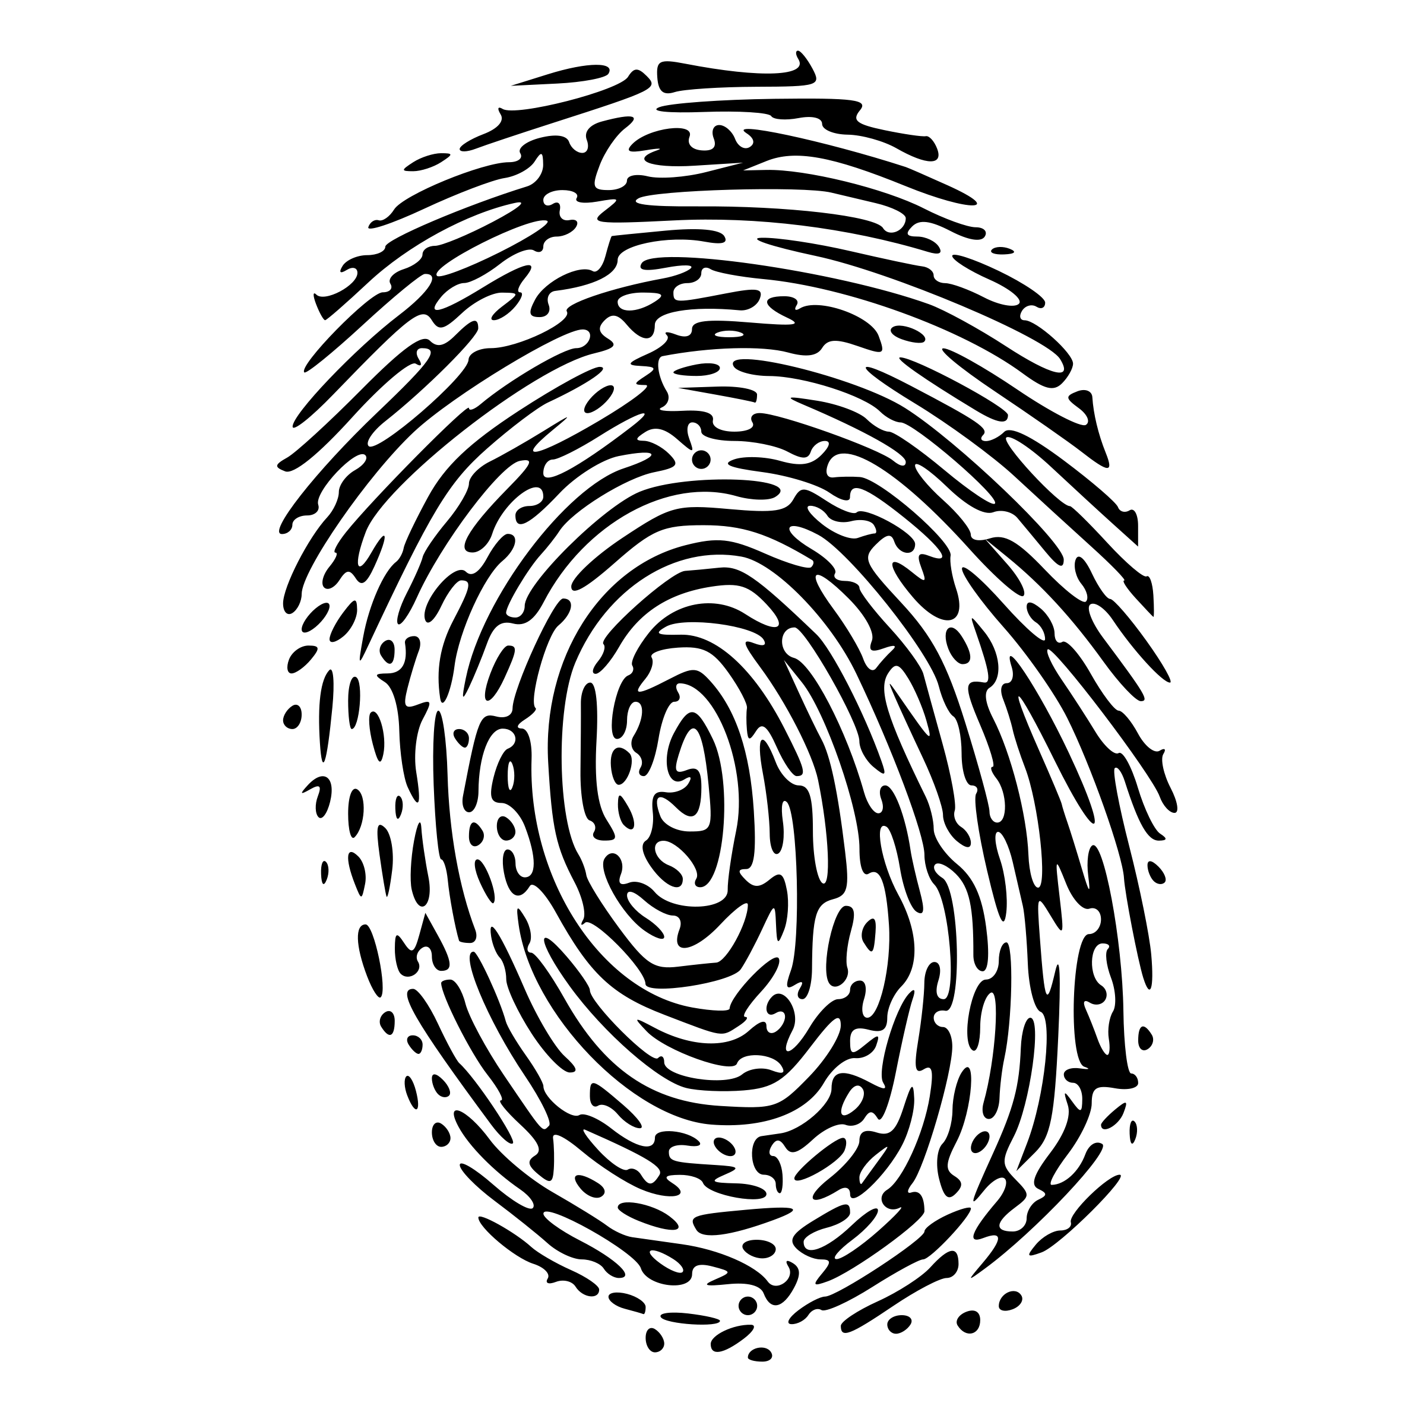
Biometric Identification System
Secure alternative to traditional methods such as cards, keys, PINs (de Luis-García et al., 2003).
Uses traits such as fingerprints, facial recognition, iris scans.
Captures and compares traits to stored templates for authentication.
Error probability increases with the larger number of comparisons.

Slide 3
Random Match Probability (RMP)
RMP measures the likelihood that a biometric identification system (BIS) will mistakenly identify two different profiles as the same person.
The lower the RMP, the more efficient the system.
In forensic DNA analysis, RMP indicates the probability that a random person other than the suspect could have the same DNA profile (National Research Council, 1996).
A lower RMP suggests a higher likelihood that the match is correct.
Our goal: Ensure RMP is below a threshold by focusing on the 1-α upper confidence bound to guarantee system accuracy.

Slide 4

Monte Carlo Simulation
Definition: A method that uses repeated random sampling to estimate outcomes of mathematical functions.
Purpose: We use Monte Carlo simulations to estimate the random match probability (RMP).
Process: Generate random biometric profiles.
Perform large numbers of simulations (varying sample sizes).
Use these results to evaluate and recommend the best upper confidence bound (UB1, UB2, or UB3).
Source: Harrison, 2010

Slide 5
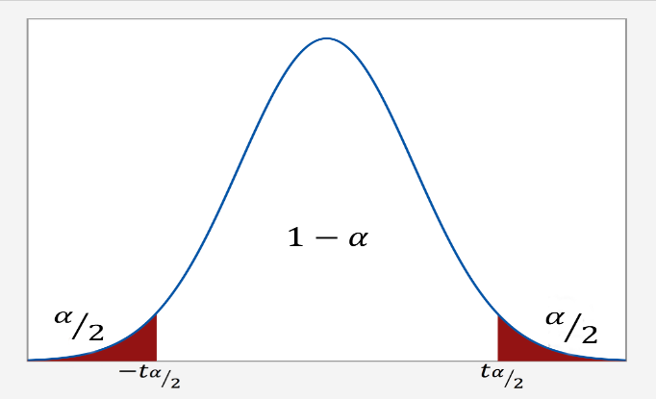
Upper Confidence Bound (UCB)
Confidence Interval: A range of values we expect our estimate (RMP) to fall between if we repeatedly sample our data. The upper and lower values in the confidence interval are the upper and lower confidence bounds, respectively.
Confidence level: The percentage of times we expect to reproduce an estimate between the upper and lower confidence bound.
Upper Confidence Bound: Helps determine the maximum plausible value of the RMP, ensuring the estimate is not overly optimistic.
Goal: Our analysis focuses on three approaches to constructing UCBs (UB1, UB2, UB3).
Source: Bevans, 2023
This Photo by Unknown Author is licensed under CC BY-NC

Slide 6
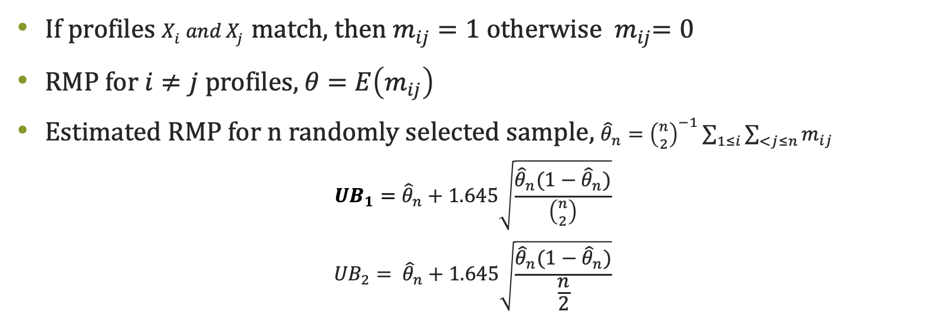
Methods
If profiles $X_{i} and X_{j}$ match, then $m_{ij}=1$ otherwise ${ m}_{ij}=0$
RMP for $i≠j$ profiles, $θ$ $=$ $E\left(m_{ij}\right)$
Estimated RMP for n randomly selected sample, ${\hat{θ}}_{n}={\left({n \atop 2}\right)}^{−1}\sum_{1≤i}{\sum_{<j≤n}{m_{ij}}}$
$${UB}_{1}={\hat{θ}}_{n}+1.645\sqrt{\frac{{\hat{θ}}_{n}(1−{\hat{θ}}_{n})}{\left({n \atop 2}\right)}}$$
$${UB}_{2}= {\hat{θ}}_{n}+1.645\sqrt{\frac{{\hat{θ}}_{n}(1−{\hat{θ}}_{n})}{\frac{n}{2}}}$$

Slide 7
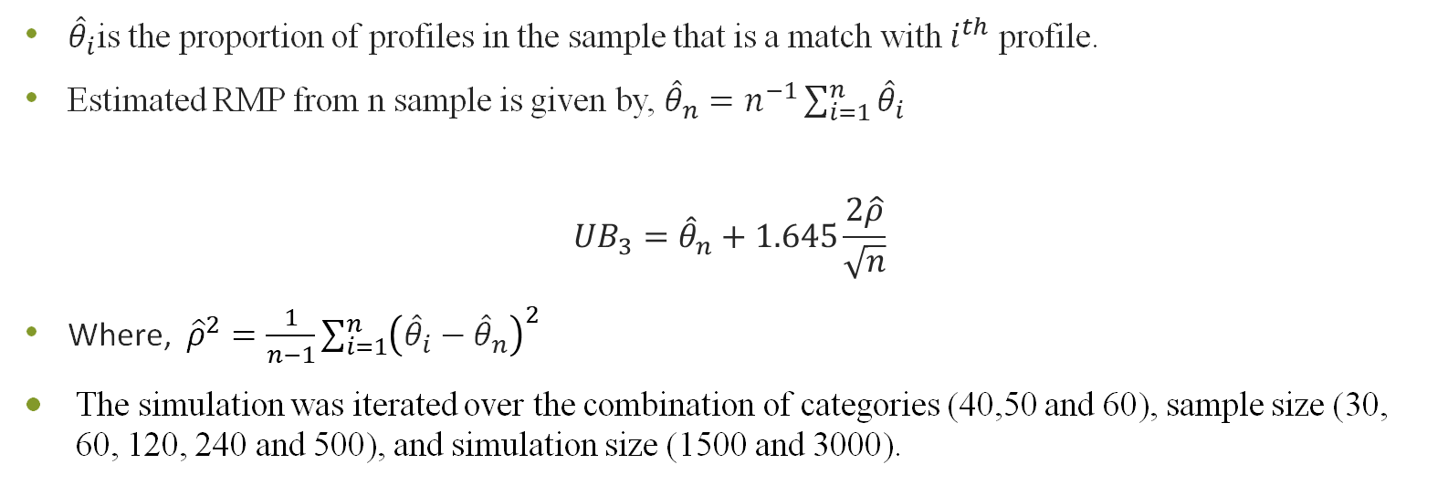
Methods
${\hat{θ}}_{i}$is the proportion of profiles in the sample that is a match with $i^{th}$ profile.
Estimated RMP from n sample is given by, ${\hat{θ}}_{n}=n^{−1}\sum_{i=1}^{n}{{\hat{θ}}_{i}}$
$${UB}_{3}={\hat{θ}}_{n}+1.645\frac{2\hat{ρ}}{\sqrt{n}}$$
Where, ${\hat{ρ}}^{2}=\frac{1}{n−1}\sum_{i=1}^{n}{{\left({\hat{θ}}_{i}−{\hat{θ}}_{n}\right)}^{2}}$
The simulation was iterated over the combination of categories (40,50 and 60), sample size (30, 60, 120, 240 and 500), and simulation size (1500 and 3000).
We assumed both equal and unequal probabilities

Slide 8

UB1: Binomial Assumption (Source: Binomial distribution. (2019, October 31))
Assumes biometric profile comparisons follow a binomial distribution with two possible outcomes: success (match) or failure (no match).
Uses binomial variance to estimate the random match probability and calculates the UCB based on a 90% confidence interval.
UB2: Independent Comparisons Binomial Assumption (Source: Bobbitt, Z. (2021, August 14))
Each comparison is assumed to be independent of the others.
Like flipping a series of coins, where the outcome of one comparison has no effect on others.
Useful for comparisons without any connection between matches.
UB3: A U-Statistic Approach (Source: Statistics How To. (n.d.). U-Statistic.)
Uses U-statistics to create estimators for large datasets.
Employs a kernel function to apply symmetric operations on pairs of data points.
Helps refine the estimation process for more complex biometric systems.

Slide 9
Equal Probabilities
Simulation:3000 |  | UB1 |  |  | UB2 |  |  | UB3
C | sample | RMP | Coverage | Avg UB | RMP | Coverage | Avg UB | RMP | Coverage | Avg UB
40 | 30 | 0.0250 | 0.9430 | 0.0371 | 0.0250 | 1 | 0.0905 | 0.0250 | 0.9533 | 0.0413
40 | 60 | 0.0251 | 0.9510 | 0.0312 | 0.0251 | 1 | 0.0719 | 0.0251 | 0.9667 | 0.0335
40 | 120 | 0.0250 | 0.9563 | 0.0281 | 0.0250 | 1 | 0.0582 | 0.0250 | 0.9750 | 0.0293
40 | 240 | 0.0250 | 0.9593 | 0.0265 | 0.0250 | 1 | 0.0485 | 0.0250 | 0.9777 | 0.0272
40 | 500 | 0.0250 | 0.9610 | 0.0257 | 0.0250 | 1 | 0.0413 | 0.0250 | 0.9767 | 0.0260
50 | 30 | 0.0199 | 0.8747 | 0.0308 | 0.0199 | 1 | 0.0784 | 0.0199 | 0.9460 | 0.0346
50 | 60 | 0.0199 | 0.9510 | 0.0254 | 0.0199 | 1 | 0.0618 | 0.0199 | 0.9647 | 0.0274
50 | 120 | 0.0200 | 0.9593 | 0.0228 | 0.0200 | 1 | 0.0498 | 0.0200 | 0.9717 | 0.0238
50 | 240 | 0.0200 | 0.9583 | 0.0214 | 0.0200 | 1 | 0.0411 | 0.0200 | 0.9777 | 0.0219
50 | 500 | 0.0200 | 0.9627 | 0.0206 | 0.0200 | 1 | 0.0346 | 0.0200 | 0.9813 | 0.0209
60 | 30 | 0.0164 | 0.9477 | 0.0263 | 0.0164 | 1 | 0.0695 | 0.0164 | 0.9483 | 0.0298
60 | 60 | 0.0167 | 0.9497 | 0.0217 | 0.0167 | 1 | 0.0550 | 0.0167 | 0.9630 | 0.0236
60 | 120 | 0.0167 | 0.9507 | 0.0192 | 0.0167 | 1 | 0.0439 | 0.0167 | 0.9750 | 0.0202
60 | 240 | 0.0167 | 0.9633 | 0.0179 | 0.0167 | 1 | 0.0359 | 0.0167 | 0.9853 | 0.0184
60 | 500 | 0.0167 | 0.9540 | 0.0173 | 0.0167 | 1 | 0.0300 | 0.0167 | 0.9753 | 0.0175

Slide 10
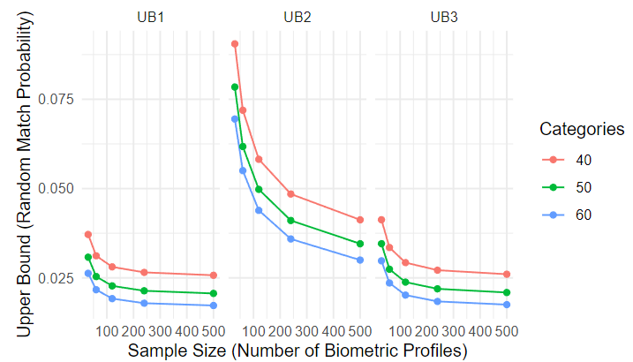
Comparison of Average Upper Bounds: UB1, UB2, and UB3 (Equal Probabilities)

Slide 11
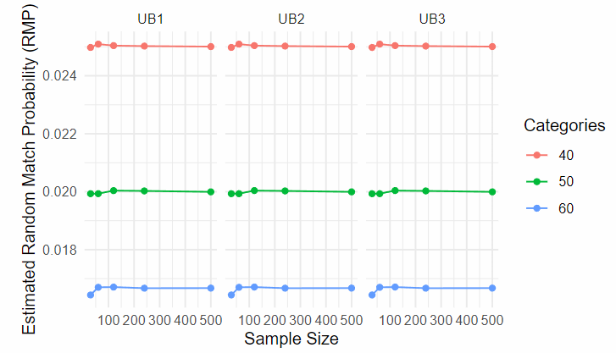
Comparison of Estimated RMP: UB1, UB2, and UB3 (Equal Probabilities)

Slide 12
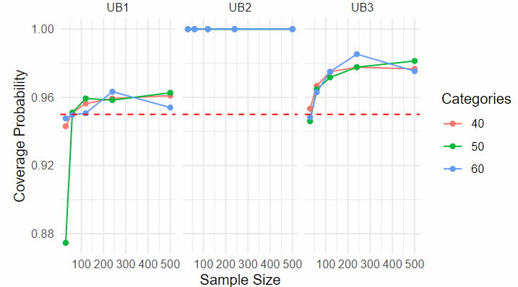
Comparison of Coverage Probability: UB1, UB2, and UB3 (Equal Probabilities)

Slide 13
Unequal Probabilities
Simulation:3000 |  | UB1 |  |  | UB2 |  |  | UB3
C | sample | RMP | Coverage | Avg UB | RMP | Coverage | Avg UB | RMP | Coverage | Avg UB
40 | 30 | 0.0331 | 0.9013 | 0.0470 | 0.0331 | 1 | 0.1082 | 0.0331 | 0.9390 | 0.0529
40 | 60 | 0.0328 | 0.9200 | 0.0397 | 0.0328 | 1 | 0.0861 | 0.0328 | 0.9540 | 0.0434
40 | 120 | 0.0329 | 0.8773 | 0.0364 | 0.0329 | 1 | 0.0708 | 0.0329 | 0.9570 | 0.0388
40 | 240 | 0.0329 | 0.8227 | 0.0346 | 0.0329 | 1 | 0.0597 | 0.0329 | 0.9480 | 0.0363
40 | 500 | 0.0329 | 0.7490 | 0.0337 | 0.0329 | 1 | 0.0515 | 0.0329 | 0.9447 | 0.0350
50 | 30 | 0.0264 | 0.8820 | 0.0388 | 0.0264 | 1 | 0.0935 | 0.0264 | 0.9573 | 0.0439
50 | 60 | 0.0265 | 0.9013 | 0.0328 | 0.0265 | 1 | 0.0746 | 0.0265 | 0.9620 | 0.0359
50 | 120 | 0.0264 | 0.8857 | 0.0295 | 0.0264 | 1 | 0.0604 | 0.0264 | 0.9587 | 0.0315
50 | 240 | 0.0264 | 0.8420 | 0.0280 | 0.0264 | 1 | 0.0505 | 0.0264 | 0.9510 | 0.0293
50 | 500 | 0.0264 | 0.7737 | 0.0272 | 0.0264 | 1 | 0.0431 | 0.0264 | 0.9450 | 0.0281
60 | 30 | 0.0220 | 0.9153 | 0.0334 | 0.0220 | 1 | 0.0834 | 0.0220 | 0.9263 | 0.0380
60 | 60 | 0.0221 | 0.9013 | 0.0278 | 0.0221 | 1 | 0.0661 | 0.0221 | 0.9650 | 0.0305
60 | 120 | 0.0220 | 0.9027 | 0.0248 | 0.0220 | 1 | 0.0531 | 0.0220 | 0.9630 | 0.0265
60 | 240 | 0.0220 | 0.8487 | 0.0235 | 0.0220 | 1 | 0.0441 | 0.0220 | 0.9530 | 0.0246
60 | 500 | 0.0220 | 0.7880 | 0.0227 | 0.0220 | 1 | 0.0373 | 0.0220 | 0.9493 | 0.0235

Slide 14
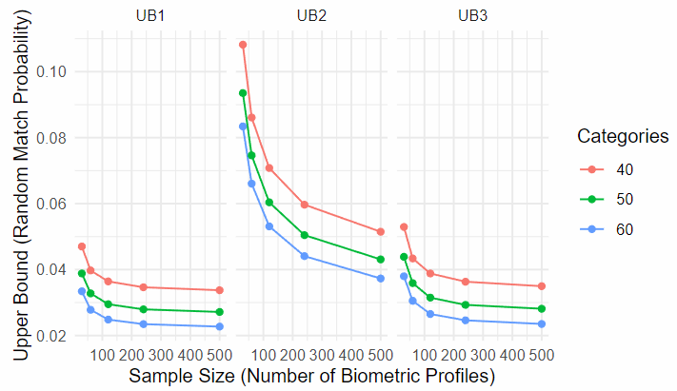
Comparison of Average Upper Bounds: UB1, UB2, UB3 (Unequal Probabilities)

Slide 15
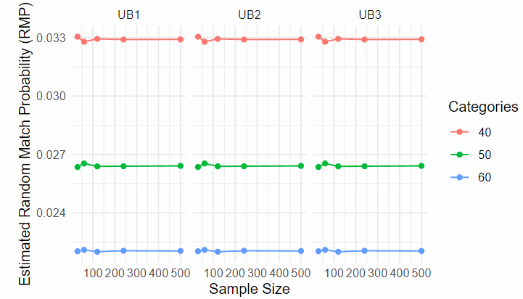
Comparison of Estimated RMP: UB1, UB2, UB3 (Unequal Probabilities)

Slide 16
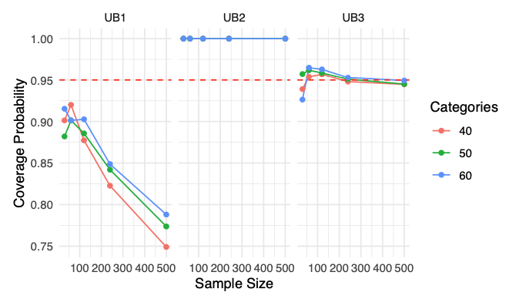
Comparison of Coverage Probability: UB1, UB2, UB3 (Unequal Probabilities)​

Slide 17
Conclusion
UB1 gives the lowest upper bound and has the closest coverage probability to 0.95 in reference to equal probability; hence, it is our recommendation, for equal random match probability to utilize UB1 for the approximate upper confidence bound while using equal probability.
The higher upper bound calculated by UB2 must be one of the reasons for near the 100% coverage probability. However, since we are interested in lower RMP, or alternatively, lower upper bound, we can conclude that UB2 is inefficient.
UB3 was similar to UB1 in coverage probability regarding equal probability, however, UB1 was closer to 0.95. Additionally, while utilizing unequal probability, UB3 was closest to 0.95 and would be our recommendation for the approximate upper confidence bound.

Slide 18
Recommendation
 | Equal Probabilities | Unequal Probabilities | Recommended
UB1 | Lowest Upper bound and coverage probability is greater than 95% | Upper Bound is low but coverage probability is less than 95% | UB1 for Equal Probabilities UB3 for Unequal Probabilities
UB2 | Higher Upper Bound | Higher Upper Bound
UB3 | Upper bound is higher than UB1 | Lowest Upper Bound Coverage probability more than 95%

Slide 19
References
Baumer, Ben & Kaplan, Daniel & Horton, Nicholas. (2021). Modern Data Science with R. 10.1201/9780429200717.
Bevans, R. (2023). Understanding Confidence Intervals | Easy Examples & Formulas. Scribbr. Retrieved October 21, 2024, from https://www.scribbr.com/statistics/confidence-interval/
Binomial distribution. (2019, October 31). BYJUS. https://byjus.com/maths/binomial-distribution/
Bobbitt, Z. (2021, August 14). Cache://www.statology.org/binomial-distribution-assumptions/ - Google search. Statology. https://www.statology.org/binomial-distribution-assumptions/
de Luis-Garcı́a, R., Alberola-López, C., Aghzout, O., & Ruiz-Alzola, J. (2003). Biometric identification systems. Signal Processing, 83(12), 2539-2557. https://doi.org/https://doi.org/10.1016/j.sigpro.2003.08.001
Harrison, R. L. (2010). Introduction To Monte Carlo Simulation. AIP Conf Proc, 1204, 17-21. https://doi.org/10.1063/1.3295638
National Research Council, Division on Earth and Life Studies, Commission on Life Sciences, & Committee on DNA Forensic Science: An Update. (1996). The Evaluation of Forensic DNA Evidence. National Academies Press.
Statistics How To (n.d.). https://www.statisticshowto.com/u-statistic-theils/
Wayman, J. (2000). National Biometric Test Center Collected Works.

