Slide 1
Foundations of a Production Science Product
Brandon Shurick
Senior Data Scientist, Amazon

Slide 2
Concepts
What is this talk, why is it valuable for scientists, and what is missing?
Experiments
Breakthrough
Science Review
Packaging
Code Review
Release
Tests

Slide 3
What is this talk?
Often overlooked concepts from software development with significant utility for data scientists:
Git versioning, code and science reviews
Unit and integration testing
Continuous integration & deployment (CI/CD)
+ Companion code package
Notes:
The first two are essential components of the third
CI/CD = Versioning + Testing + Reviews + Deployments in an automated, continuous process

Slide 4
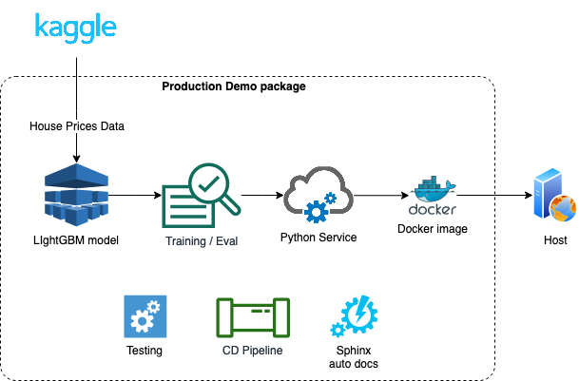
Functional Companion Package
Check out my companion code package for this talk: https://bshurick.github.io/production-demo/

Slide 5
Why is this valuable for scientists?
Speed solutions to production environments
Better align science team and tech team processes
Remove resource barriers that delay innovation
Work effectively as a science team
Notes:
Speed solutions by better aligning science and tech team processes, while also improving collaboration within your own team.

Slide 6
What else would I cover with more time?
Additional software concepts…
Data Engineering, not only SQL
Agile project management with with Scrum or Kanban
Security: IAM, Encryption, Private/public subnets
At minimum, the end of this deck has some valuable links I’ve collected

Slide 7
What else would I cover with more time (2)?
Additional production science topics…
Monitoring and alerts
Slippage; automated retraining
Efficient serving
Infrastructure as code
Microservices vs. standardized artifacts

Slide 8
Versioning and Reviews
What is git, and how can scientists use reviews?

Slide 9
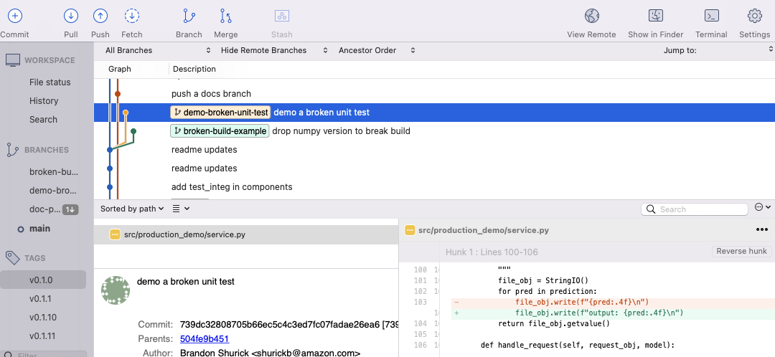
What is git?
(Free) Lightweight versioning tool
Version any file, with notes and tags
Revert or compare to any point in history
Feature branches
Shared server main line

Slide 10
How can scientists utilize code reviews?
Line-by-line commenting for small changes
Any code changes to production code
Versioning experiments
Notebook exports

Slide 11
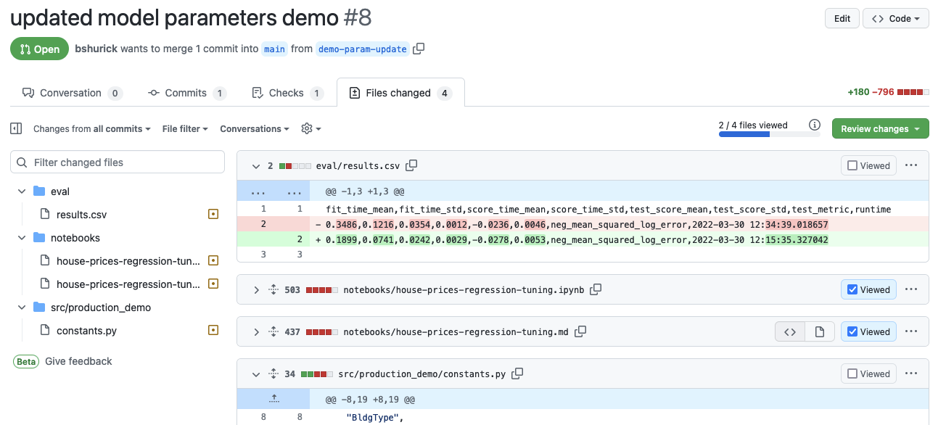
Merge Request (aka “Pull Request”)
Add markdown notebook exports, model performance results, code changes; tag reviewers; leave comments

Slide 12
How are science reviews different from code reviews?
Science reviews are mini peer reviews of research
Code reviews are bite-sized evaluations for code quality and performance
 | Code Review | Science Review
Topic | Refactoring, error fixes, a new feature | Aiming for a scientific breakthrough
Size | Small, 200-400 lines of code per reviewer | Extensive, weeks of research and analysis
Process | Assign individual reviewers via notification | Schedule time with a team or panel of experts
Detail | Descriptive bullets; how it was tested | Detailed paragraphs and visualizations

Slide 13
Builds and testing
What is a build, how should a scientist approach unit tests, and how are integration tests different?

Slide 14
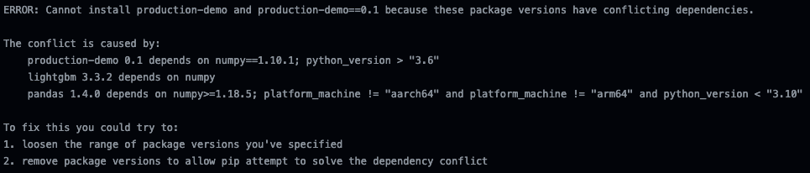
What is a build and why should it matter to scientists?
A build process compiles code for release
Automate tests and documentation
Confidently deploy to multiple environments
A broken build process flagged by a Continuous Integration tool due to mismatching dependencies

Slide 15
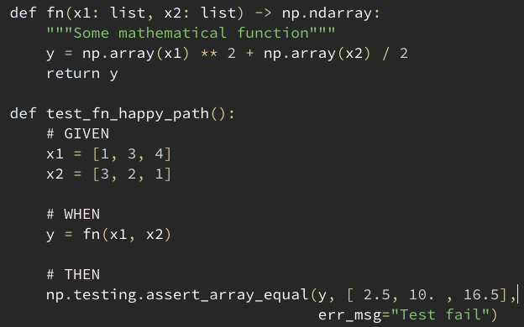
How should a scientist approach unit tests?
Create small, testable classes and functions
Think of breaking edge case paths
Mock calls to external services (unittest.mock)
A simple test that would break only if the function is changed
More example tests in the production-demo package

Slide 16

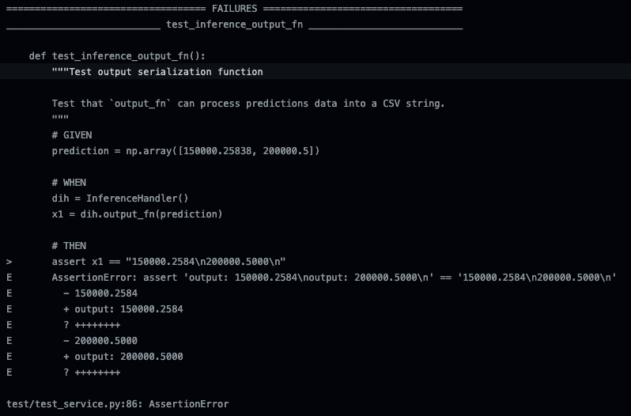
Continuous Integration (CI)
Example CI check from the production-demo package using Github Actions
Details log shows a changed output string broke the tests
Code commits to a shared git repository should include unit test checks via a CI tool – failing tests block (or strongly advise against) integration into the main line

Slide 17
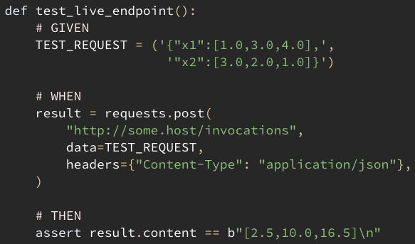
What is the difference between a unit test and integration test?
Unit tests isolate logic, do not interact with services
Integration tests run after code is deployed
Example: send a static input to a hosted model service, receive the expected output
A simple integration test for a hosted version of “fn”
More example integration tests in the production-demo package

Slide 18
Deployment pipelines
What are deployment stages and why do they matter, and how does everything fit together for a science project?

Slide 19
Why should a scientist care about deployment stages?
Multiple identical stages; final “Prod” stage
New features deploy in sequence
Checkpoint tests at each stage

Slide 20
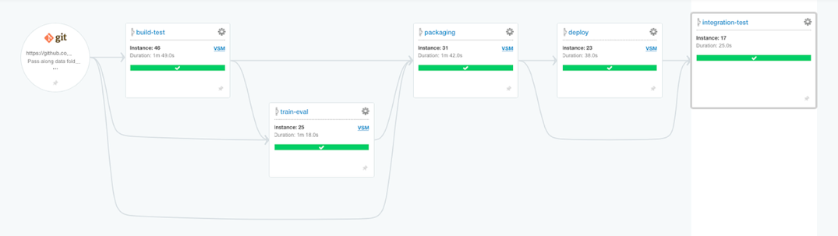
Continuous Deployment (CD) pipeline
Example GoCD pipeline, provided in the production-demo package
GoCD pipeline from code:
https://bshurick.github.io/production-demo/#how-can-i-set-up-a-continuous-deployment-pipeline

Slide 21
Production Science Deployment Process
Science!
Ongoing experiments and analyses
Breakthrough!
Compile mini-publication, initiate science review
Approved!
Move notebook code into a code package, add unit tests
Hold up!
Create or update integration tests
Code review!
CI tool catches issues, reviewers comment & approve
Ship it!
Merge into main line, deploy through pipeline
Science! A scientist runs experiments in a local environment or in some “Alpha” environment, using standard science tools like JupyterLab, Notebook, RStudio, etc.
Breakthrough! Some scientific breakthrough is achieved, and results are compiled into a clean format to discuss with colleagues in a science review.
Approved! Develop a buildable code package with unit tests to cover all lines of code. For a newly trained model, the code package includes an invoke function; separately, trained model artifacts are replicated into each deployment environment.
Hold up! Integration tests may need to be developed or updated to reflect changes - ideally these tests are held in a separate code package that is part of the same deployment pipeline; the change may also require additional infrastructure, which should be added to an infrastructure-as-code package.
Code Review! The changes are committed to git and a git merge request is created, which automatically generates a code review with at least one reviewer required - large changes should add multiple reviewers with notes in the review that provide areas to focus on.
Ship it! Code is merged into the mainline branch and enters the deployment pipeline, where first the build script and unit tests run, then packaging and deployment to each of 3+ stages in sequence, where integration tests pass in at least one pre-Prod environment before moving into Prod.
Science workflow
Development workflow

Slide 22
Extra
Aren’t there some steps you’re missing?

Slide 23
Data Engineering, Not Only SQL
Some teams may have the luxury of using a single production dataset for modeling and can leverage preprocessing utilities from modeling frameworks like Sklearn or TensorFlow; others may need preparation of features from many different data sources
If data preparation is required, Data Engineers are angels that may come to bless away data wrangling pain with a litany of tools and skills
However, data engineers are in heavy demand and not always available
To prevent innovation delay, a scientist may wish to pad their own skills and knowledge in:
[Storage systems] HDFS / S3 / GCS / Azure Storage
[Storage formats] Parquet, ORC, Snappy compression
[Processing frameworks] Spark, Hadoop/YARN
[Batch processing] Spark, Hive
[Fast-response queries from storage] PrestoDB / Athena or Drill / Impala / BigQuery

Slide 24
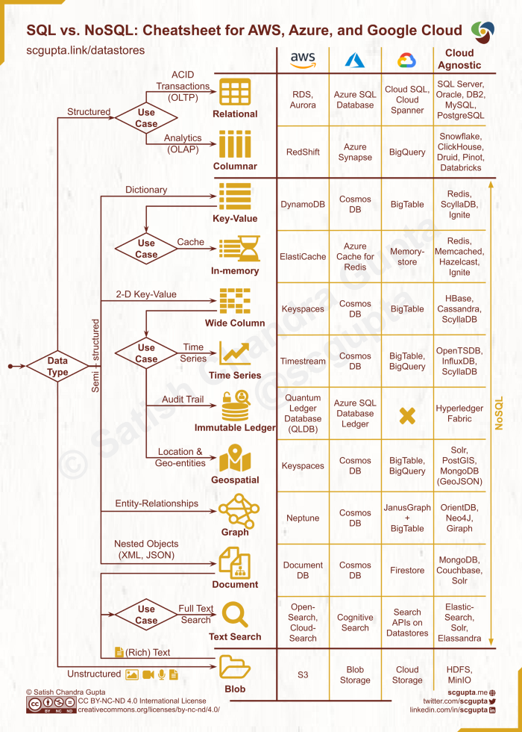
via Satish Chandra Gupta

Slide 25
Agile Project Management
Scrum or Kanban
While scientific experimentation and analysis is hard to project-manage using software development project management frameworks, it nevertheless helps to implement these frameworks in order to stay aligned with partner teams, which may or may not be brought into any given project for a supporting role
For research, the concept of “user story” can be re-framed as “hypothesis test story”
For example, an experiment story might be written like “as a scientist, I want to prove that 1 + 1 = 2, so that I can use the result to divide even numbers”, where the definition of story completion becomes “prove or reject the hypothesis that 1 + 1 = 2”

Slide 26
Security: IAM, Encryption, Private VPC
Science projects should always have security guardrails based on data sensitivity
If this dataset were unintentionally made public, what would be the reaction?
Might it trigger a lawsuit?
Does it expose intellectual property?
As a best practice, anything with a person’s identifiable information included should be stored with server-side encryption, using an encryption tool such as KMS
An Identity and Access Management (IAM) system should restrict access to only team members and development partners, and have periodic auditing
Endpoints and application environments should reside in private subnets, inaccessible from the public internet, while traffic from internal or external users is securely routed through a gateway service such as API Gateway

