Slide 1
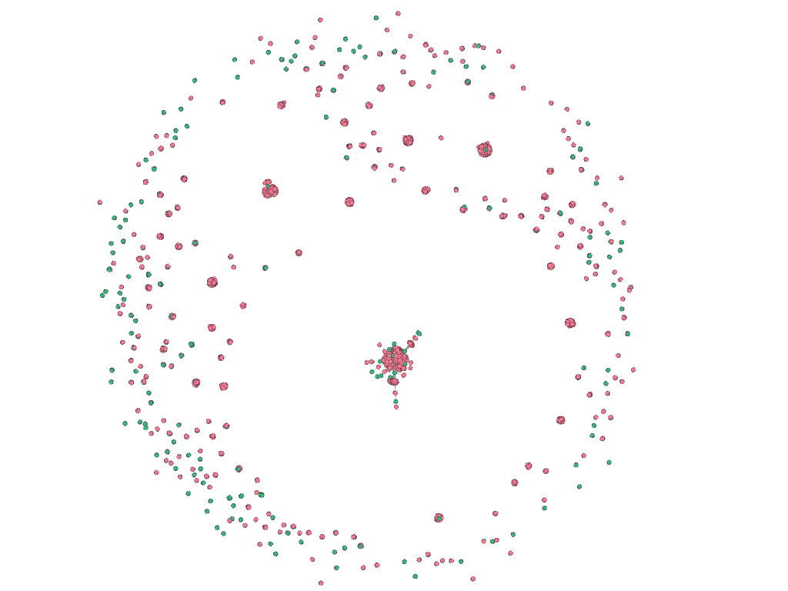
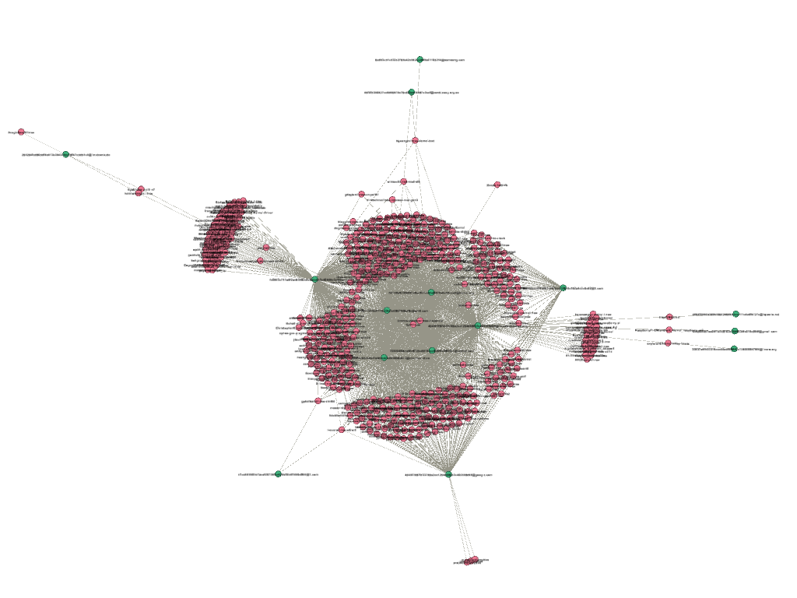
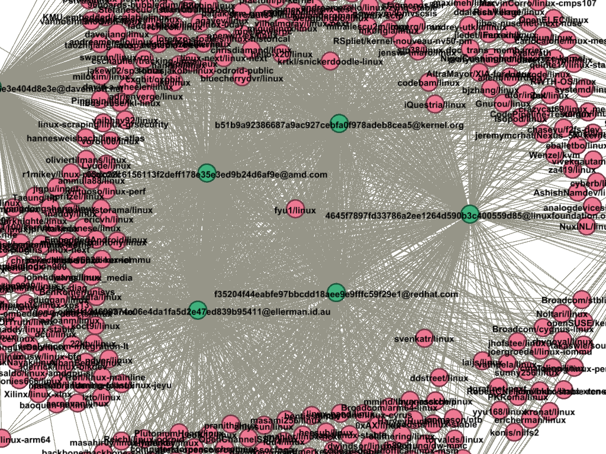
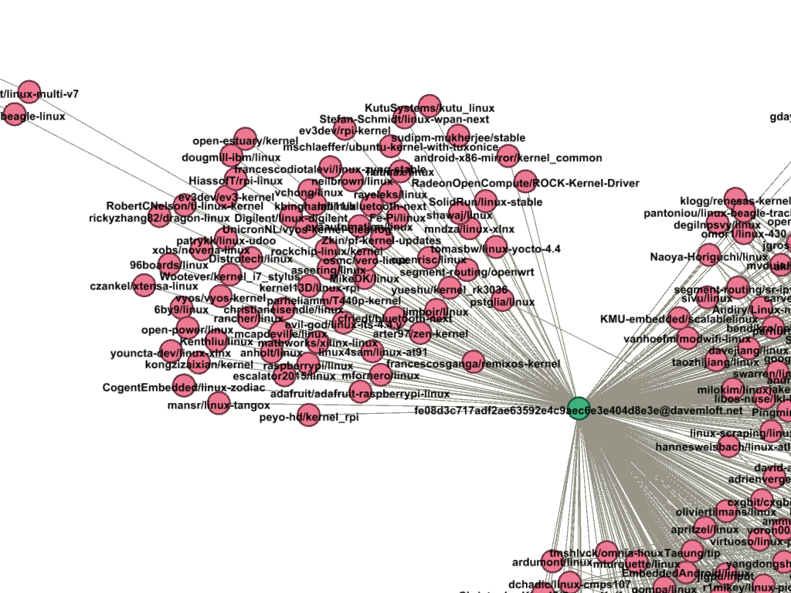
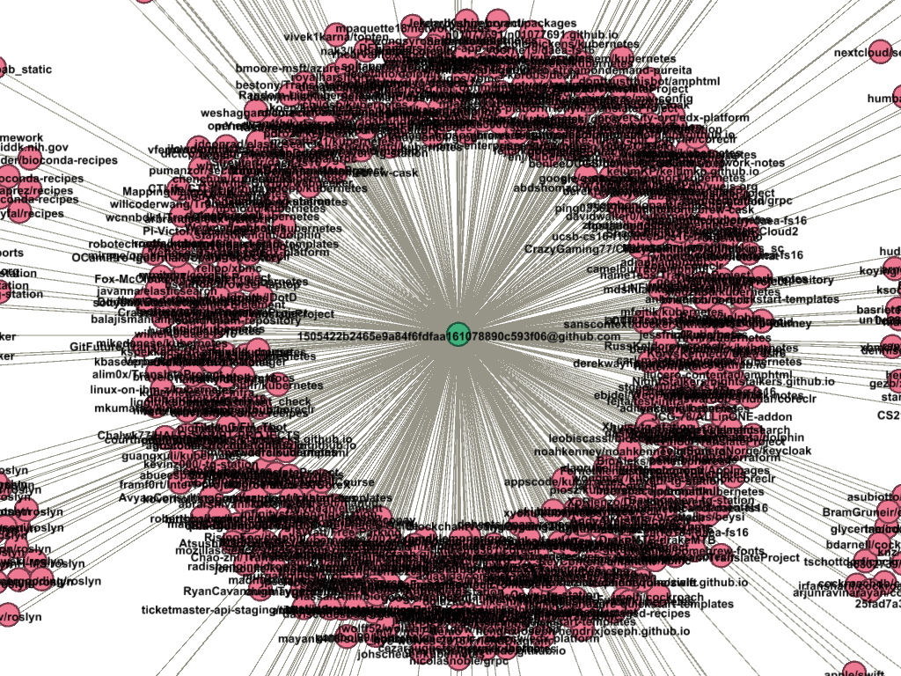
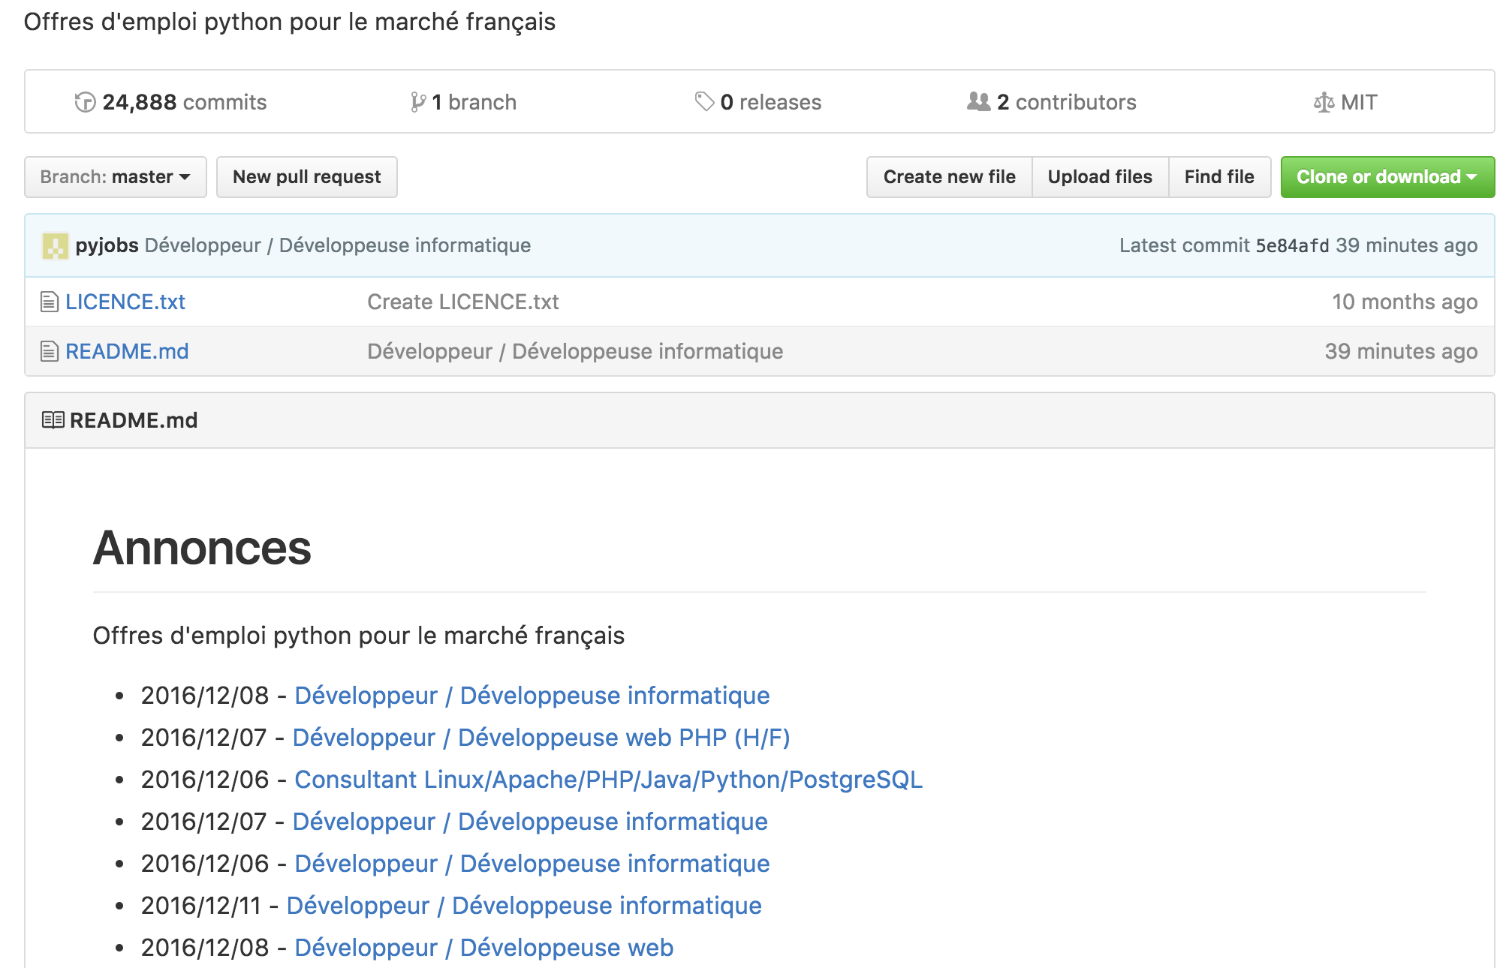
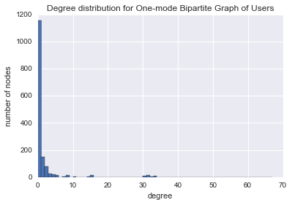
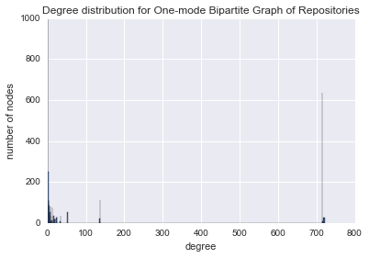
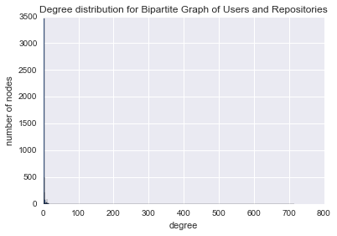
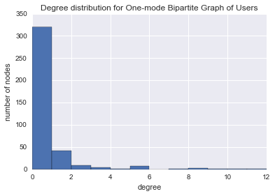
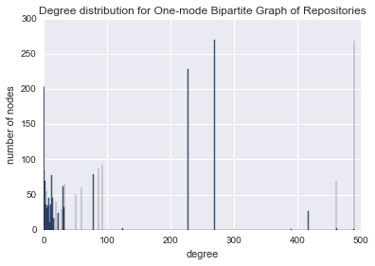
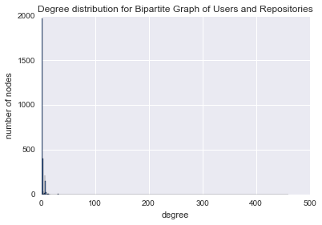
Brian Siao Tick Chong
Freddie Vargus
CS505
Network Analysis of User Communities & Anomalous Activity on GitHub
Motivation
Individual programmers and companies use GitHub as a tool for storing and collaborating on coding projects
Most of this work is free and open source, meaning anyone can submit a Pull Request with some commits that add value to the projects
Users are continuously working with new people and organizations to improve software and are becoming more connected as a result
Results & Analysis
Communities
The distributions followed a power law, meaning they were not random networks
Few nodes with high degrees and many nodes with low degrees
Consistent large spikes in high degree ranges for each month
Extremely large clusters of highly connected repositories within large communities such as Linux; which is prevalent in each month
Datasets
Twelve month’s worth of commit data from Google BigQuery; twelve separate CSV files
Features: committer names, committer emails, name of the repository, total number of commits made to the repository by the user for each month, date of the commit
Cleaned the datasets by removing rows with any invalid emails, and grouped rows by commiter names, emails and repository names to guarantee a unique user in each row
Methods
Qualitative
Analyzed subgraphs and evaluated labels (user emails and repository names)
Strengths: Easy to see who was making commits via their email, and by repo names
Weaknesses: Everything was by inspection so it was difficult to summarize all the data
Quantitative
Analyzed degree distributions of each month’s network to find if it was a random or real life network
Focused on subgraphs with degrees of 5 or greater
Computed clustering coefficients for one-mode projections of the graphs
Strengths: Able to see users and repositories with high degrees and coefficients
Weaknesses: The networks we disconnected, so the clustering coefficients didn’t tell us anything other than that these are now small world networks; they were also not sparsely connected
(Dec. 2015) Bipartite Graph of Users (Green) and Repositories (Red)
Subgraph generated from figure 4C showing Linux community
Zoomed in version highlighting highly connected users
Anomalous Users
Anomalous users that are highly connected to other users are within these networks
They interact with forks of repositories and make commits to repositories related to their own organizations
There are also users that have degrees of zero, but have large numbers of commits
We considered them to be anomalous because of the extremely high number of commits relative to other users
They utilize GitHub as some form of blog or as a data store for some data that is completely unrelated to these communities within GitHub.
Zoomed in on sub-community within Linux (mobile software)
Figures for October 2016 Degree Distributions
An example of an anomalous user with a high number of commits, but with a high a degree due to the commits being spread across hundreds of repositories
Conclusions
Communities are made up of related work and contain users within and outside of GitHub organizations
Typically there is one user that connects a sub-community (very highly connected) to the main community i.e. Android to Linux; they have a large quantity of commits to different repositories and are considered to be anomalous as well
There are also anomalous users that use GitHub as a blog or data store and have extremely high numbers of commits each month; this is usually because the processes are automated
An example of an anomalous user with a high number of commits, but with a degree of zero within our network graphs, due to the commits being contained within only one repository
Figures for December 2015 Degree Distributions
Notes:
<number>
We took a csv file generated by BigQuery, for twelve month’s worth of commit data. The features of this dataset were names of committers, their emails, the name of the repository that the user committed to, the total number of commits they had made to that repository for the month, and the date of the commit. We then cleaned the dataset by removing any rows with invalid emails. Following this, we wanted to make sure each row had a unique user, so we grouped the rows by the committer name, committer email, and repository name.

