Slide 1
Biostatistics
Week 5
Non parametric Wicoxon test on location
sample size calculation / power analysis
multiple testing - Bonferroni correction (for << 100 tests) - False discovery rate, p-value histogram (for >100 tests)
1
Notes:
1
Das ist ein weites feld und wir erkundigen einen kleinen Teil davon

Slide 2
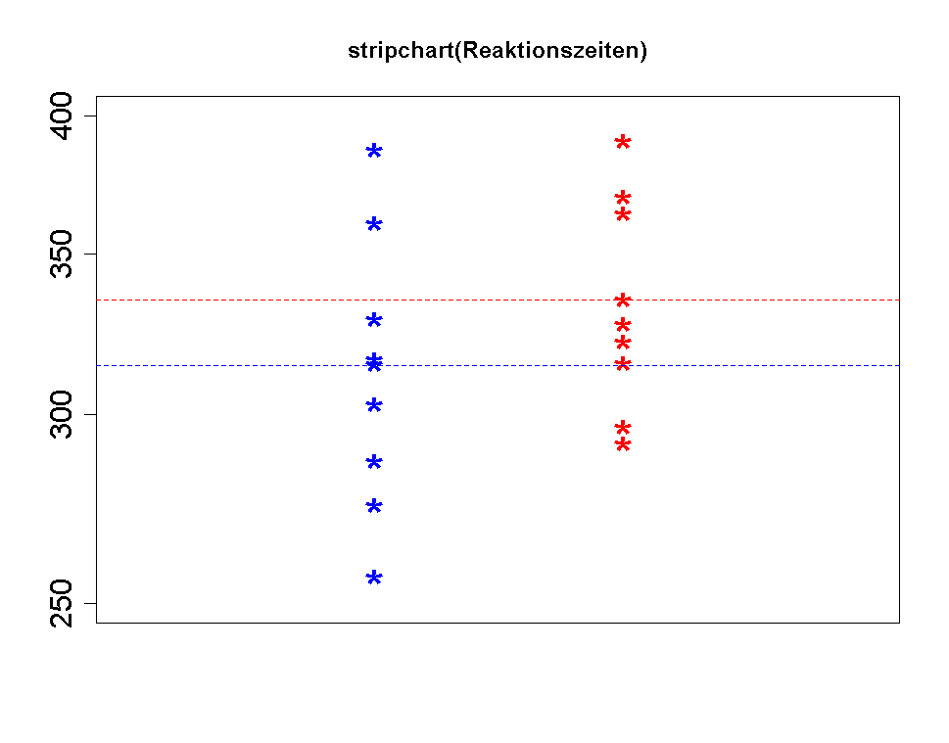
Reminder: Unpaired and paired t-test on location
Independent, unpaired
t.test(g1,g2, mu=0,
var.equal=T, paired=FALSE)
mean 2
y
mu
mean 1
g1
g2
group
Dependent, paired
t.test(g1,g2, mu=0, var.equal=T, paired=TRUE)
y
Breaking the match results in a valid group/treat effect but invalid p-values.
Notes:
In a paired design the observations are not independent. A normal test assumes independence and we need to take it into account if this assumption is not fulfilled. However, that does not imply that a paired design is worse.

Slide 3
Has caffeine intake influence on the reaction time?
10 “patients”
We measure reaction times after treatment with coffee.
Once coffee contains coffeine once not.
Patient | Reaction time with coffeine | Reaction time with decof | diff
1 | 44.5 | 44.9 | 0.4
2 | 55.0 | 54.8 | -0.2
3 | 52.5 | 55.6 | 3.1
4 | 50.2 | 55.2 | 5.0
5 | 45.3 | 55.6 | 10.3
6 | 46.1 | 47.7 | 1.6
7 | 52.1 | 53.0 | 0.9
8 | 50.5 | 49.1 | -1.4
9 | 50.6 | 52.3 | 1.7
10 | 49.2 | 50.7 | 1.5
paired design
H₀: no difference with placebo or drug population center is the same
> t.test(exp$Differenz, mu=0, conf.level=0.95)
One Sample t-test
data: exp$Differenz
t = 2.1842, df = 9, p-value = 0.05678
alternative hypothesis: true mean is not equal to 0
95 percent confidence interval:
-0.08171953 4.66171953
sample estimates:
mean of x
2.29
3
3

Slide 4
Visualization of the data
difference
Patient index
There is a outlier! We must not perform a t-test!
4
4

Slide 5
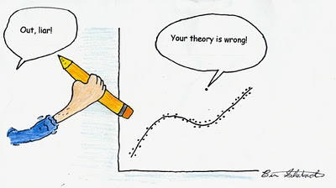
How to handle outliers?
Remove an outlier only, if you are sure that there was an error, e.g. the measurement went wrong.
Otherwise keep outlier an adapt your theory or use methods which can handle extreme values in an adequate way.
5

Slide 6
Look on ranks of the absolute differences
index | abs(d)=│d│ | Rank(|d|) | sign(d)
1 | 0.2 | 1 | -
2 | 0.4 | 2 | +
3 | 0.9 | 3 | +
4 | 1.4 | 4 | -
5 | 1.5 | 5 | +
6 | 1.6 | 6 | +
7 | 1.7 | 7 | +
8 | 3.1 | 8 | +
9 | 5.0 | 9 | +
10 | 10.3 | 10 | +
Idea: Look at sum of ranks of positiv and negative difference – they should be similar if the expected value of d is zero.
Under H₀:
6

Slide 7
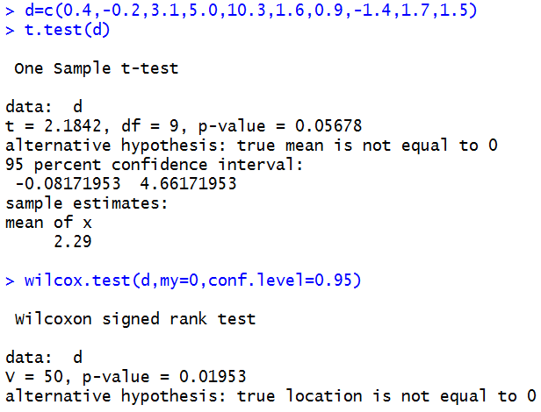
t-test or Wilcoxon-test?
The normality assumption for the t-test is strongly violated, therefore the t-test must not be used.
If the t-test is performed anyway then the results are not reliable and can be completely wrong (especially with small sample sizes).
p<5% ~> H₀ is rejected and we have shown a significante effect of coffein on the reaction time.
The 1-sample wilcoxon-test requires only a symmetric distribution, which is for difference from paired values always fulfilled.
7

Slide 8
When to use non-parametric tests like the wilcoxon-tests?
If data do not follow a Normal-Distribution (and sample is not large)
If there might be outliers
If the sample size is very small (<≈10) and don’t know if data come from N(μ,σ²)
Remark 1: in an unpaired situation there exists also a wilcoxon test, which is known as U-test or Mann-Whitney-test and which also uses a test statistic relying on the ranks of the data.
Remark 2: if the data (in each group) follow a Normal-Distribution, than the t-test has more power than the wilcoxon-test.
Remark 3: for small samples (<10) the normality of data can hardly be checked and the wilcoxon-test should be used if normality is questionable.
8

Slide 9
Two-sample tests
Are the two samples paired or unpaired?
paired
unpaired
form differences and treat them as each value’s
Is each value (differences) normal distributed (or n large)?
Are values in each group i.i.d. normal distributed (or n large)?
yes
no
yes
no
t-Test (s estimated)
z-Test (σ is known) for one sample
Are values symmetrically distributed (always for differences)?
t-Test (s estimated)
z-Test (σ is known) for unpaired sample
U-Test Mann-Whitney Rangsummen Test
wilcox.test(…,paired=F)
yes
Wilcoxon Sign-Rank-Sum-Test
wilcox.test(…,paired=T)

Slide 10
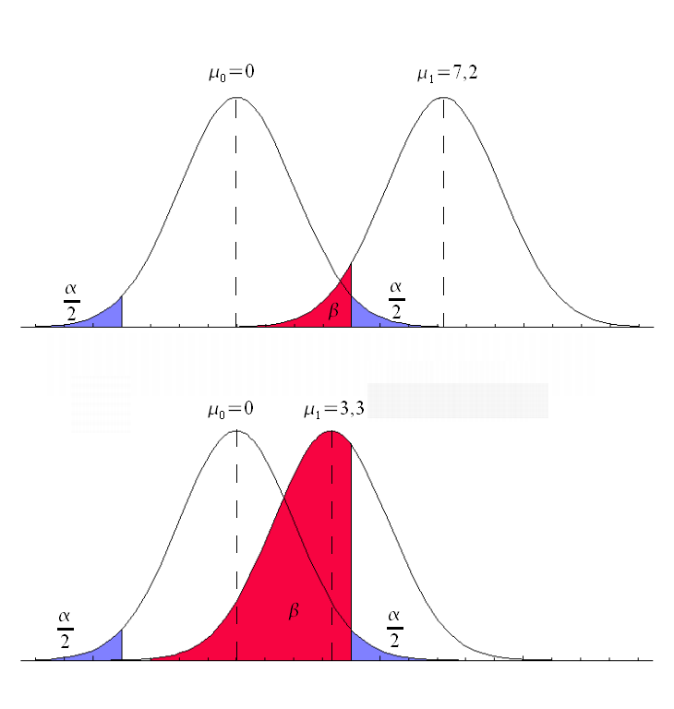
Decision errors revisited
Known old reality
Unknown new reality:
μ=7.2
H₀: μ₀=0
H_{A}: μ_{A}≠0
H₀ is true H₀ is false | negative test accepting H₀ True Negative (the probability for this correct test decision is (1-α) ) False Negative (the probability for a type-II error is β) | positive test rejecting H₀ False Positive (the probability for a type-I error is α) True Positive (the probability for this correct test decision is (1-β)
H₀: μ₀=0 H_{A}: μ_{A}≠0
Reality
μ=7.2
Effect size =
difference between H₀ and unknown new reality

Slide 11
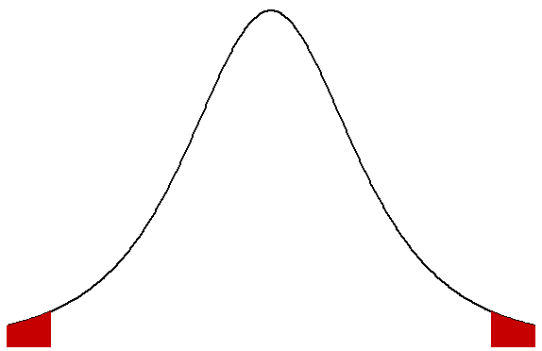
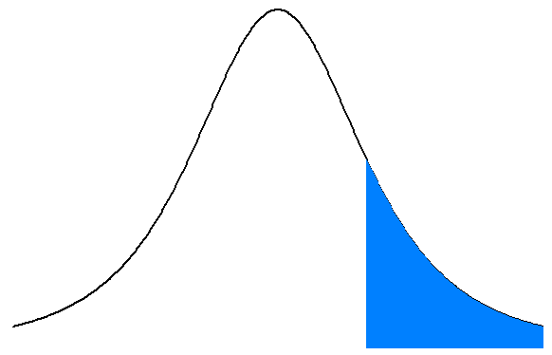
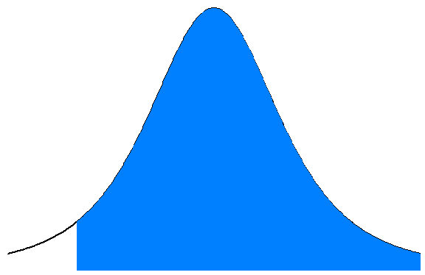
What is the power of a test
μ₀
The power (1–β), of a test is the probability to reject H₀, if H_{A} is true.
The power is given by the blue area.
The larger the difference Δ between H₀ and reality is, the larger gets the power.
However, “reality” is not known -> it is hard to estimate the power.
For a given difference Δ between H₀ and reality the power gets bigger if the width of the distribution of the Test-Statistic, e.g. mean, gets smaller which can be achieved by increasing the sample size.
Since the reality can not be changed, in praxis the only way to increase the power is to increase the sample size.
-α
α
Δ=0
Δ₁
power
Δ₂
H₀ accepting

Slide 12

Sample size calculation
Situation: Your group has developed a new drug for sleeping time elongation.
The new drug is only interesting if its sleeping time elongation surpasses the one from the «golden standard» by at leas 1h (relevant effect). From a pilot study we know the standard deviation of the sleeping time in individual patients is: sd=1 (1h). Given your drug surpasses the old drug by a mean sleeping time extension of 1h - how big should the sample size be chosen, so that you have a power of 80% and simultaneously an α=5% that your test rejects the H₀ and proves the superiority of the new drug?

Slide 13
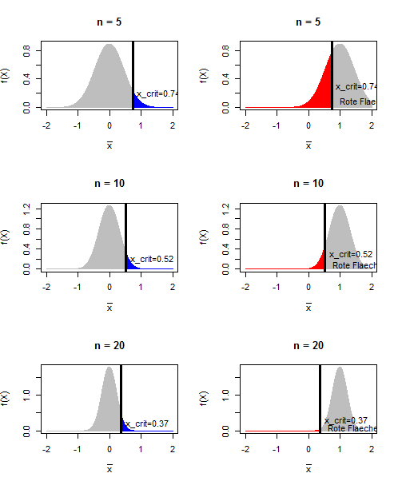
Simulation with n=5,10,20
X: Sleep elongation compared the golden standard drug H₀: E(X)₀=μ_{Δ0}=0
Distribution of under H₀
With a sample of size 5 we would reject H₀, if > 0.74
With a sample of size 10 we would reject H₀, if > 0.52
With a sample of size 20 we would reject H₀, if > 0.37

Slide 14
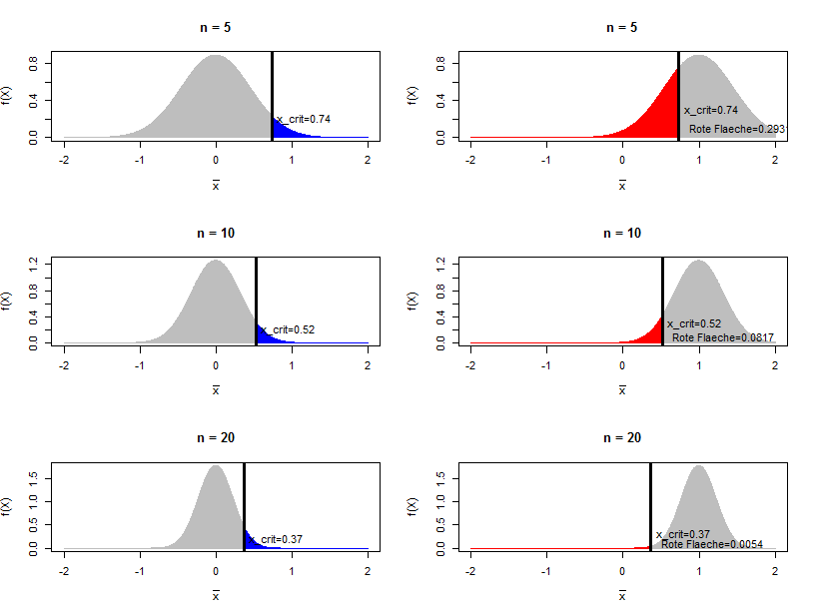
Simulation with n=5,10,20
X: Sleep elongation compared the golden standard drug H₀: E(X)₀=μ_{Δ0}=0 H_{A}: μ_{Δ}=1
Distribution of under H₀
Distribution of given μ_{Δ}=1
n=5: Reject H₀ in 69% of all simulation runs
Power=1-β=69%
0.74
0.74
n=10: Reject H₀ in 92% of all simulation runs Power=1-β=92%
0.52
0.52
n=20: Reject H₀ in 99.5% of all simulation runs Power=1-β=99.5%
0.37
0.37

Slide 15
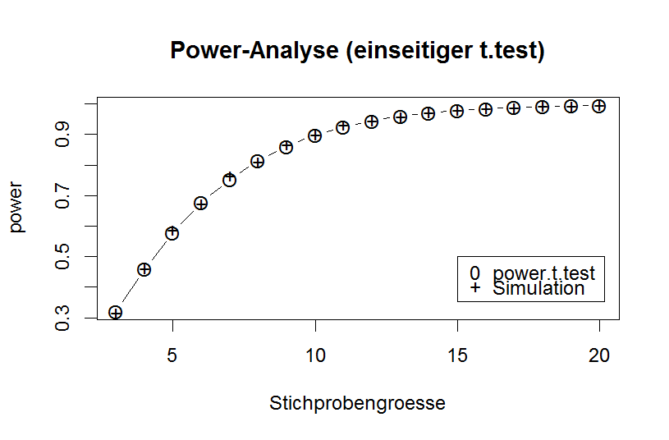
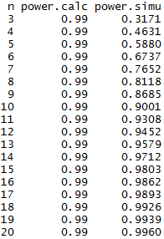
Results
power
Sample size
> power.t.test(power=0.8, delta=1, sd=1, alternative="one.sided",type="one.sample")
One-sample t test power calculation
n = 7.727622
delta = 1
sd = 1
sig.level = 0.05
power = 0.8
alternative = one.sided

Slide 16
How to plan the size of a study?
Choose the test you want to use in your analysis
Determine/Estimate the variation of the observations
fix significance level α (the accepted risk for a type-1-error, typically 5%)
Fix relevant effect size (the minimal effect which is still relevant)
Fix the power which gives the probability to detect an relevant effect (typically 80%)
Choose 1-β
Perform a sample-size calculation to derive the needed sample size at which the required power is given.
Good webpage for sample size calculations – menu based, but shows corresponding R-code:
http://powerandsamplesize.com/Calculators/
16
Notes:
16
16
Das ist ein weites feld und wir erkundigen einen kleinen Teil davon

Slide 17
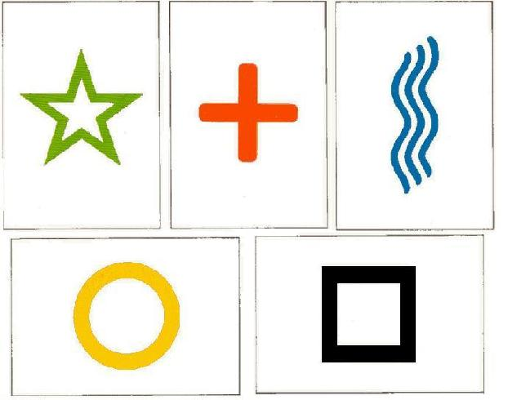
Multiple testing: Rhine Paradox
The parapsychologist Joseph Rhine hypothesized in the 1950’s that some people had Extra‐Sensory Perception (ESP).
He tested for ESP by an experiment where people were asked to guess the color of 10 hidden cards:
red or blue.
He discovered that almost 1 in 1000 had ESP –
they were able to get all 10 right. Surprised???
No, 1 in 1024 is what we would expect to get by chance if everybody is just guessing
17
Notes:
0.5^10 = 0.00097 ist ca 0.001 also 1/1000, 1/(2^10)=1/1024

Slide 18
Multiple testing: Rhine Paradox
He told these people they had ESP and called them in for another test of the same type.
He discovered that all of them had lost their ESP.
What did he conclude???
18

Slide 19
Multiple testing: Rhine Paradox
He concluded that you shouldn’t tell people that they have ESP, because it causes them to loose it.
☺
19

Slide 20
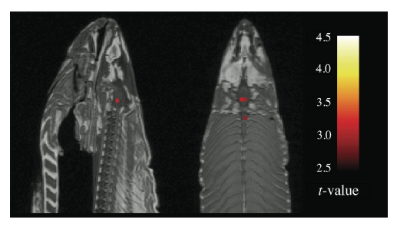
fMRI revealed brain response to trans-species emotional stimuli in a dead salmon
A dead salmon was repeatedly confronted with 2 different human emotional stimuli.
Out of 8064 brain voxels in 16 voxels a significant different activity (p≤0.001!) was observed
This study received 2012 the IG nobel price (for ignoble, improbable research).
Source: http://www.guardian.co.uk/science/2012/sep/21/ig-nobel-awards-dead-salmon
20
Notes:
Magnetic Resonance Imaging
Interspecies stimuli (photos von Menschen wurden gezeigt)

Slide 21

The probability to get by chance a significant test result
The risk to get in one test an false positive result (that is p < α under H0) is only
Assume n independent test‘s (with n independent samples) where the null-hypothesis H₀ is always valid (no effect nowhere)
– the probability draw always the right test decision is:
– the probability of coming up with at least 1 false positive effect is:
the probability of making at least 1 type one error at n trials, when α = 0.01%
21

Slide 22
Bonferroni correction for multiple testing and its effect on the dead salmons reaction
Bonferroni: when performing n independentl tests, conduct each test
at significance level !
When applying Bonferronis rule, we only have a risk of α, to come up with ≥1 false positive effects (that is a significant test result although H₀ is true).
No brain region of the dead salmon showed a significant reaction to smiling people after Bonferroni correction.
☺
22
Notes:
Wir würden gern den Fehler 1. Art „simultan über die ganze Studie“ (familien-weise) kontrollieren, so dass die Wahrscheinlichkeit, dass ein oder mehr Fehler 1. Art gemacht werden, ≤ α ist. There are other methods to correct multiple testing, f.i. die Benjamini–Hochberg-procedure.
That is a conservative correction, that means that the probability of making one or more type one errors among n test‘s is even smaller than a
- Schau dir das an

Slide 23
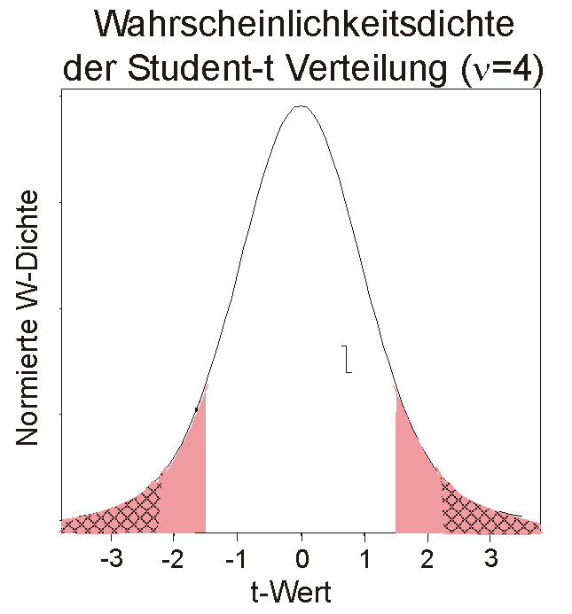
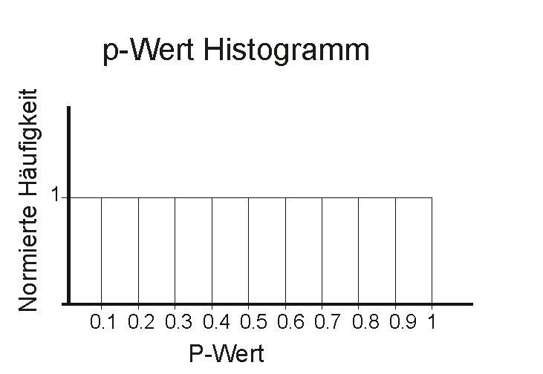
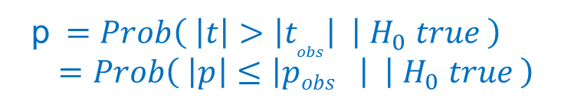
The p-value is uniformly distrubuted under H₀
The p-value corresponds to the probability to get an at least such extreme result as the observed result assuming that the Null-Hypothesis is valid -> the p-value corresponds to the area in the extreme tails
distribution of T under H₀
Given H₀ is true in all tests:
p=0.1: 10% of all tests get a p-value≤0.1 if H₀ is always true
p=0.2: 20% of all tests get a p-value≤0.2 if H₀ is always true
…
t=
|S – K |
√
(s₁² +s₂²)/n
density
if H₀ is always true
density
t_{obs}
t_{c}
-t_{c}
p$=Prob\left( \left|t\right|>\left|t_{obs}\right| | { H}_{0} true \right)$
$=Prob\left( \left|p\right|≤\left|{pobs}_{}\right| | { H}_{0} true \right)$
23

Slide 24
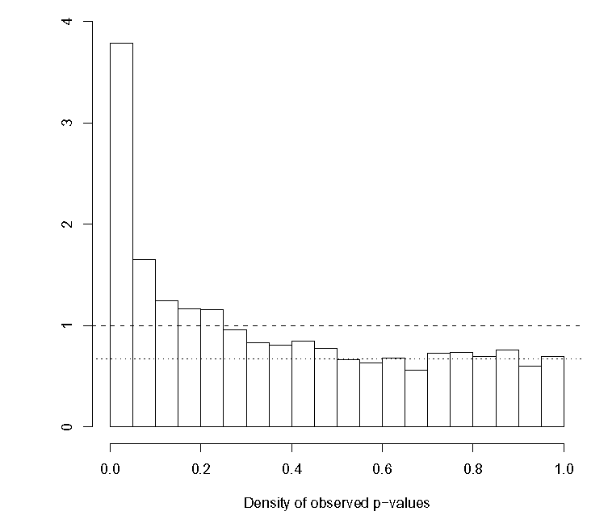
How to estimate the ratio p₀ of truly null voxels?
How to estimate the false discovery rate?
TP
density
False Discovery Rate:
expected height (1) under H₀ always true
observed height (0.7) = proportion of true H₀
0.7
FP
c
α
24
Notes:
Film mit biostatstician meets biologist

Slide 25
Judging a p-value histogram
The p-value histogram helps to judge the results from many independent tests
Flat is Bad!
For all tests n independent H₀ is true
~ 100% of all significant findings are false positive. (see proportion of red area in left bar).
The peak we seak!
For 70% of all tests H₀ is true.
Only ~20% of all significant findings
are false positive (see proportion of red area in left bar).
0.7
α
α
P-Wert
25
This method was proposed from John Storey – see http://www.pnas.org/content/100/16/9440.full
Notes:
Film mit biostatstician meets biologist
How we can measure that a significant result is casually observed at multiple testing?

Slide 26
Take home message Multiple Testing
It is tempting, but not o.k. to forget about all non-significant tests and just publish the significant effects.
You need to take account for the multiple testing - by p-value correction such as Bonferroni correction or - using other measures like FDR or - confirm the “found effect” in a new control experiment.
26

