Slide 1


Weapons of a Pentester
Understanding the virtual & physical tools used by white/black hat hackers
Aleks Security Cyber Security Inc.
www.AleksSecurity.com
www.cyberaware.ca
2015
Nov 7
PRESENTER: Nick Aleks

Slide 2
What is Pentesting?
Why should you even care?
It is a well defined, organized security test – that is not only limited to the IT Dept
“Real-world/Objective” based audit used to identify a corporate security posture
Pentesters use similar methodology, practices and tools that a malicious attacker would use
The name of the game is to identify the true vulnerabilities that could be exploited
Notes:
After you have read what a pentest is:
- So this talk will briefly cover some of the basics of the tools used by hackers, security professionals and

Slide 3
The Methodology
The right tool – for the right job
The tools I will be show casing and demoing are all organized into each step of a penetration test. Below is a list of the steps used when conducting a general penetration test.
1. Active & Passive
2. Finding Active Hosts
3. Vulnerability Exploiting
Footprinting
Scanning
Hacking
Google Hacking
Namespaces
Employee Info
Phone Numbers
Facility Info
Job Information
Interview
Pings/Sweeps
Port Scans
Tracert
Nessus Scan
Walking-in
Metasploit
Social Eng.
Physical Sec.

Slide 4

- USB RUBBER DUCKY–
Humans use keyboards.
Computers trust keyboards

Slide 5
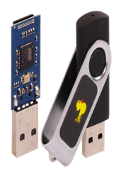
The USB Rubber Ducky - Intro
What is this little USB?
Computers Trust Keyboards!
This little “thumb drive” takes social engineering to the next level – it isn’t really a usb… it’s a keyboard with a encoded payload that automatically types commands into the computer.
USB Rubber Ducky is a Keystroke Injection Platform

Slide 6

Key Features – Great Community
What makes this cool?
Simple & Customize Pre-assembled attacks from online repositories
Online tool kit for simple reconnaissance, scanning, exploration, and reporting
Simple ducky payload generator for Linux with Password Cracker, Meterpreter and Netcat Integration
Ducky-Decode firmware and encoder adding mass storage, multiple payloads, multilingual and much more

Slide 7
DEMO

Slide 8
Use Cases
A review of some of the things you can use it for
Recon
Computer Information User Information USB Information Shared Drive Information Program Information Installed Updates User Document List Basic Network Information Network Scan Port Scan Copy Wireless Profile Take Screen Captures Copy FireFox Profile Extract SAM File
Exploitation
Find and Upload File (FTP) Disable Firewall Add User Open Firewall Port Start Wi-Fi Access Point Share C:\ Drive Enable RDP Create a Reverse Shell Local DNS Poisoning Delete a Windows Update
Reporting
Save Report to Target Machine FTP Report to External Host Email Report to GMAIL Account Save Files to USB Drive

Slide 9

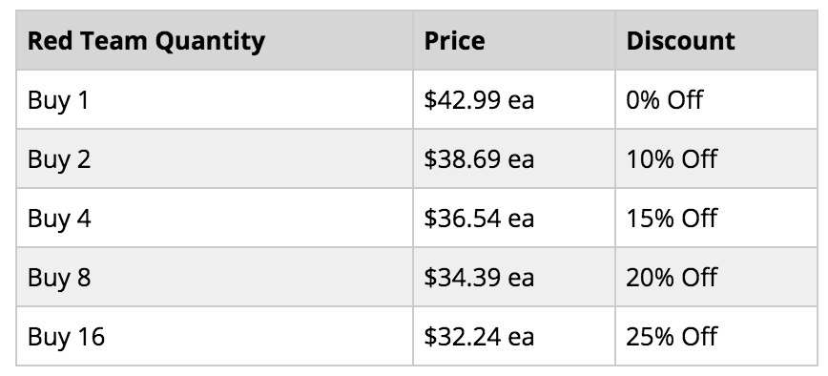
Ducky Price
Where to go if you want your own
Buy it here:
http://hakshop.myshopify.com/products/usb-rubber-ducky-deluxe?variant=353378649

Slide 10


- WIFIPHISHER–
Social Engineering Software

Slide 11

Wifiphiser
What is it?
Wifiphisher is a security tool that mounts automated phishing attacks against WiFi networks in order to obtain secret passphrases or other credentials. It is a social engineering attack that unlike other methods it does not include any brute forcing.
Step 1
Victim becomes deauthenticated from their access point
Step 2
Victim joins a rogue access point.
Github
https://github.com/sophron/wifiphisher
Step 3
Victim is being served a realistic router config-looking page
Step 4
Victim types password

Slide 12
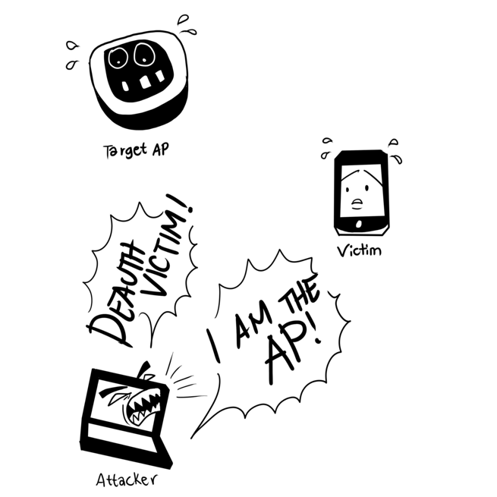

Slide 13
Key Features
What makes this cool?
All it takes is one person to fall for the attack and the entire network becomes compromised.
Encryption type doesn’t matter.
WEP/WPA/WPA2
Open source. Python, HTML, CSS, JS

Slide 14
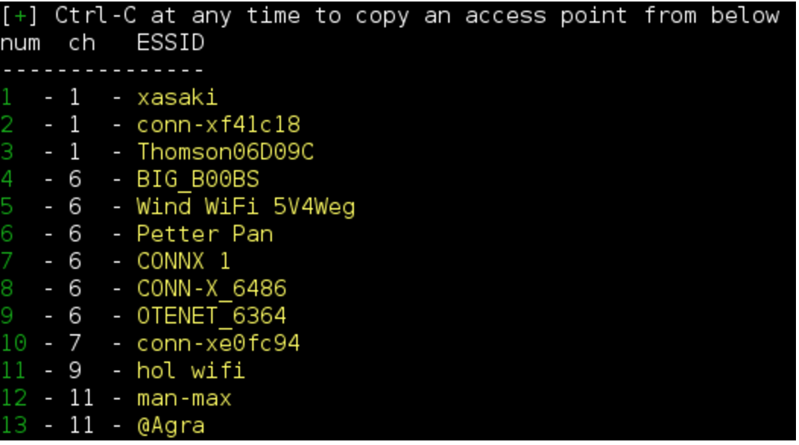
SSID Listing
Take a look at wifiphiser

Slide 15
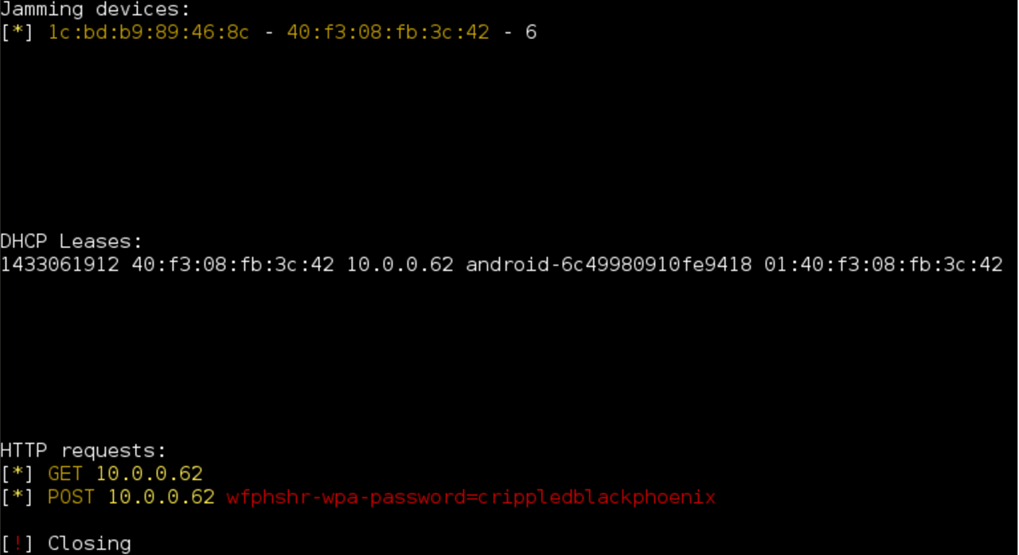
Jamming Interface

Slide 16
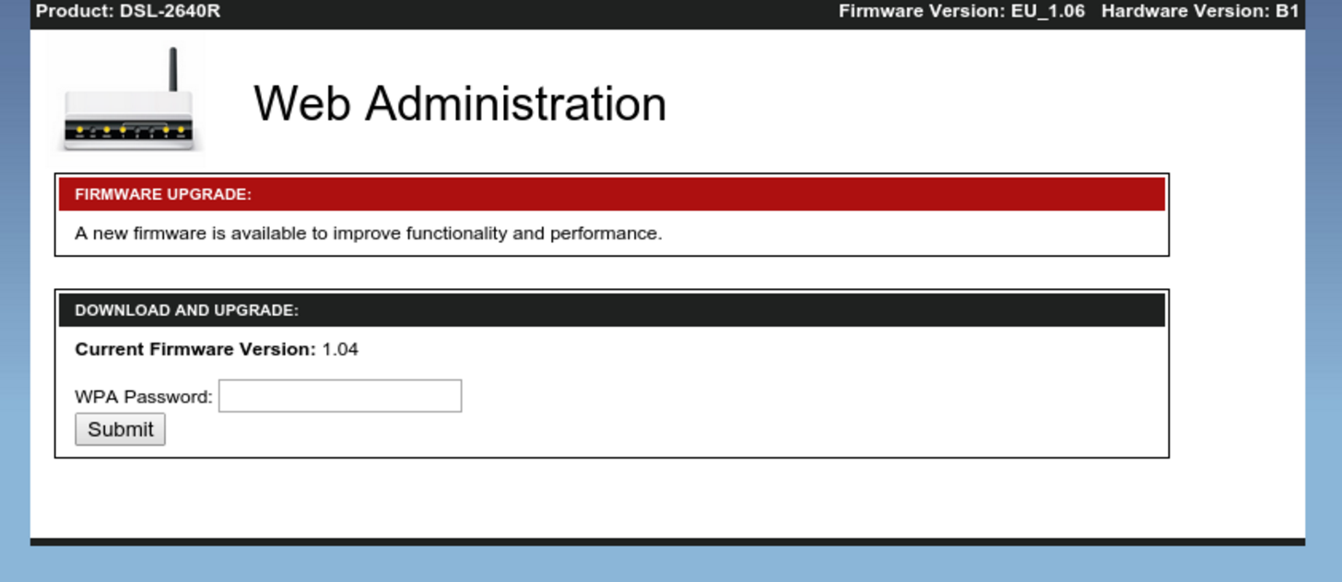
Router firmware upgrade

Slide 17
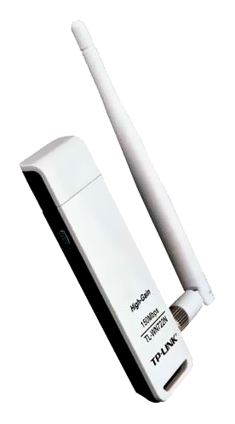
The Requirements
How can we start playing with wifiphisher
Needs
TP-LINK TL-WN722N
Kali Linux
Two wireless network cards, one capable of injection
150 Mbps
4dBi detachable antenna
$12 on amazon

Slide 18

- LAN Turtle–
Dropp’n shells everywhere

Slide 19
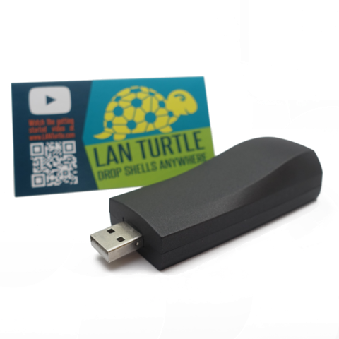
The LAN Turtle
What is this little USB?
The LAN turtle is a covert Systems Administrative
And Penetration testing tool.
It is a stealth remote access, network intelligence gathering
and man-in-the-middle
Housed within a generic “USB Ethernet Adapter Case”, the LAN turtles appearance allows it to blend into many environments
Drop it on a LAN and access it from anywhere via SSH, Meterpreter and Open VPN.

Slide 20
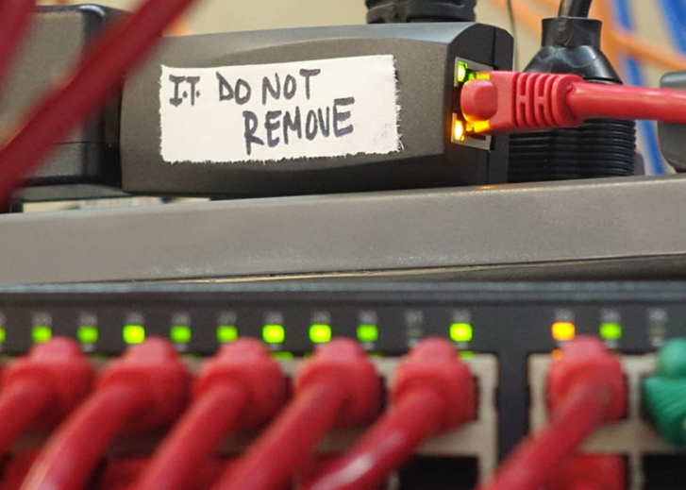
Key Features
What makes you like turtles?
Works like a standard USB Ethernet adapter, bridging the connection and powering the device
Connects to any standard Ethernet network. Static or DHCP with the MAC address of your choice
Simple ducky payload generator for Linux with Password Cracker, Meterpreter and Netcat Integration
Open source downloadable modules (netcat, autossh,

Slide 21
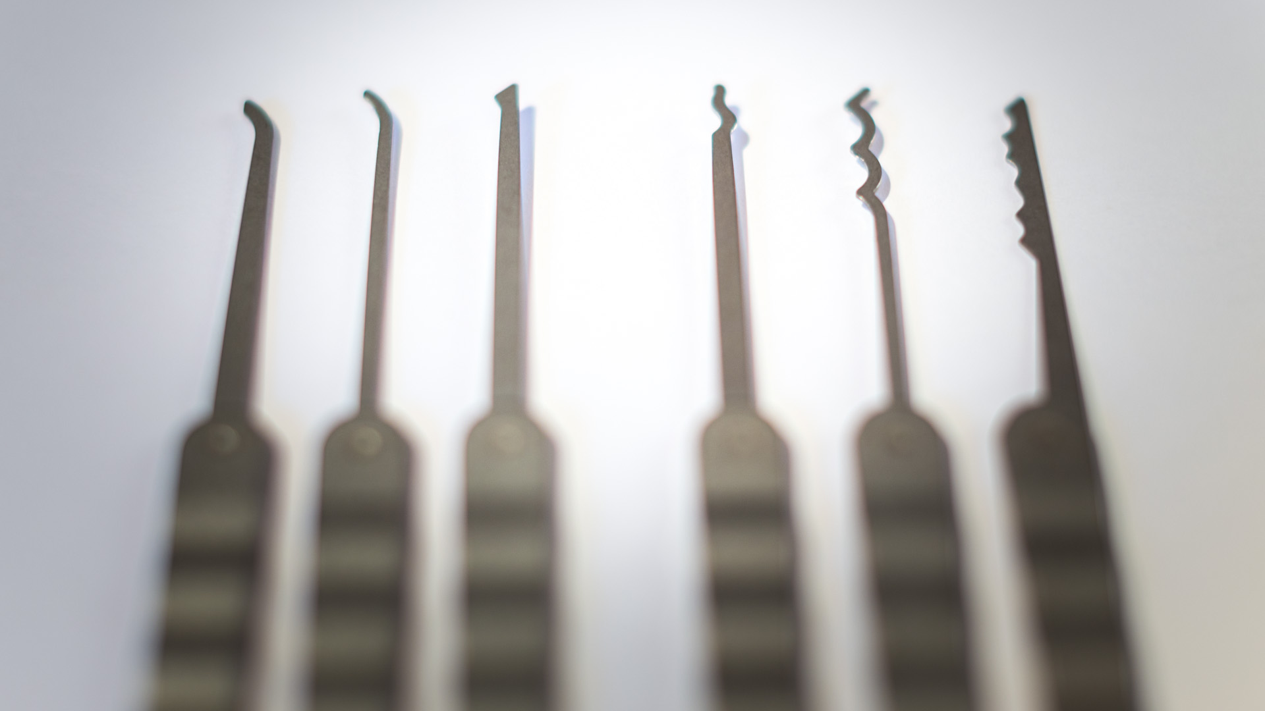
- Lockpicking–
Physical Security Hacking

Slide 22
Physical Security
Pentesting physical security controls
Usually, when talking about computer or network security, most of the focus is, of course, on the digital side. We've talked about firewalls, intrusion detection systems, security software, and so on. But the physical side of security is often just as important, if not more. All the firewalls in the world won't help you if your server is hosted on premises, inside some closet where any customer or employee can go in, pick it up, and walk out the door. That's why things like locks, biometric scanners, and cameras are important.
Cameras
Mantraps
RFID TAGS
Biometric Scanners
Locks
Motion Detectors

Slide 23
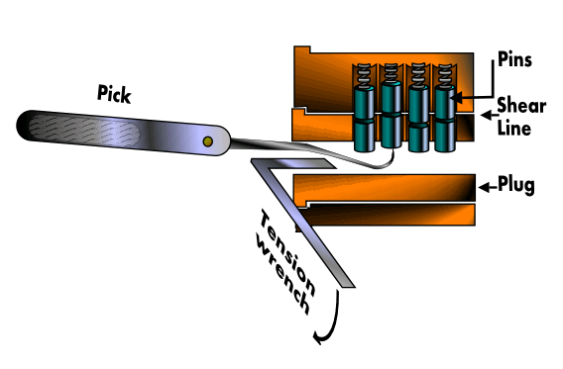
The Art of picking
How does one pick a lock?
A tension wrench (or torque wrench) is used to apply a torque to the cylinder, while a lock pick (or picklock) is used to push individual pins up until they are flush with the shear line.
Raking or scrubbing a pin tumbler lock is usually done before individual pins are pushed up. While applying torque with the tension wrench, a lock pick with a wide tip is placed at the back of the lock and quickly slid outwards with upward pressure so all the pins are pushed up.

Slide 24
Snap gun
The automated lock picking gun
How does it work?
The snap gun strikes all of the bottom pins at once with a strong impact, and then withdraws again. The bottom pins transfer their kinetic energy to the top pins and come to a complete stop without penetrating the lock housing.
How long does it take?
10-30sec

Slide 25
DEMO
https://www.youtube.com/watch?v=eIjkgTKRF9c

Slide 26
Questions?

