Slide 1


Weaving Security Blankets
Make your own bespoke defensive toolkit
Presentation by Max Cizauskas
For BSides Toronto 2015
Notes:
InSecurity podcast in-security.org
Around 10 years of professional infosec experience
Manager of Endpoint Protection in cybersecurity team

Slide 2
Benefits to you
1) More effective coverage of the tools you have
2) Clear out agent cruft
3) Free up resources to do more
Notes:
I'm going to present to you how to get better coverage with your security tools, reduce the agent cruft on your systems and free up some resources to do fill the gaps in your toolkits.

Slide 3

Agent Fatigue
https://flic.kr/p/9ZeoJG
Notes:
Who's got agent fatigue? Who has so many security controls on their corporate laptop that it takes 5 minutes to log in and get up and running?
Or who wishes they had enough to slow an asset down?
We'll do something about that, but first we need to some introspection and figure out why we're in the mess we are.

Slide 4
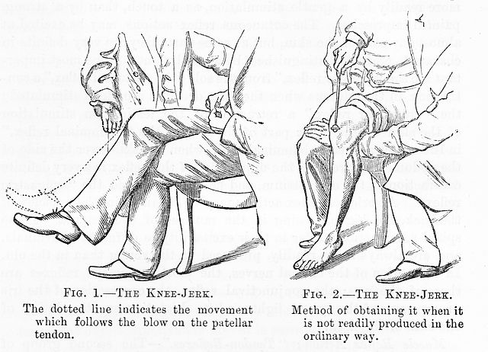
Reason why we're here
Wikipedia
Notes:
In my company I know that we have a combination of knee jerk reactions when things went wrong and we weren't properly covered,

Slide 5
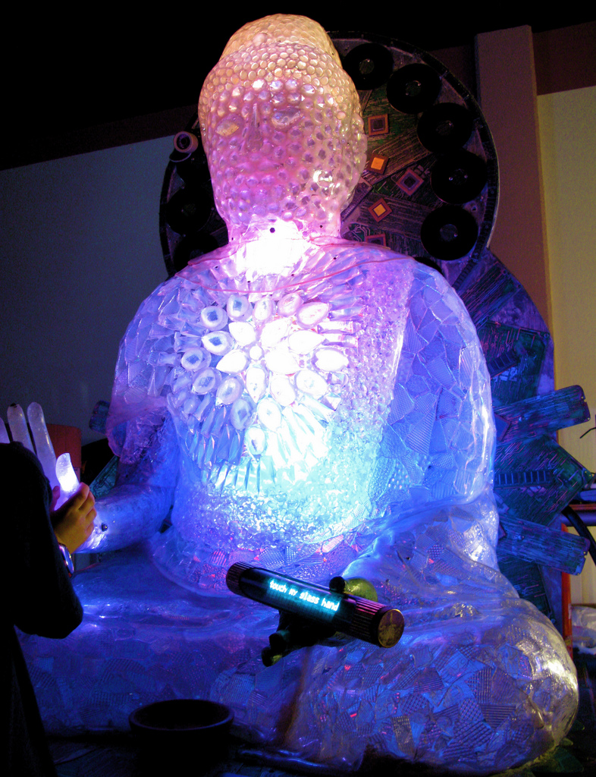
More reasons
https://flic.kr/p/4M2YVp
Notes:
A little bit sold on the newest blinky light box without looking how it fits overall

Slide 6
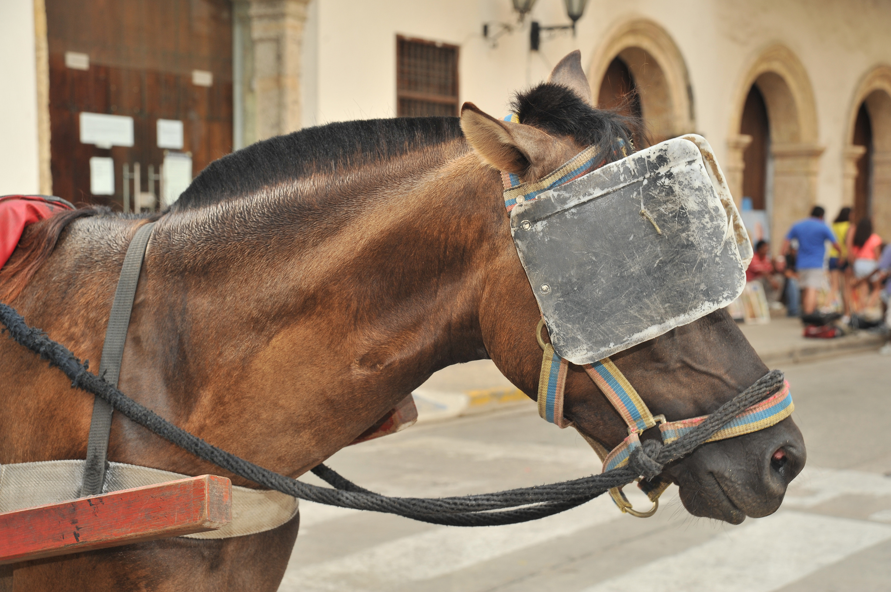
Because… reasons
https://flic.kr/p/dbWTNt
Notes:
and a lack of re-evaluation (or only upgrading things as-is). So how do we get better?

Slide 7
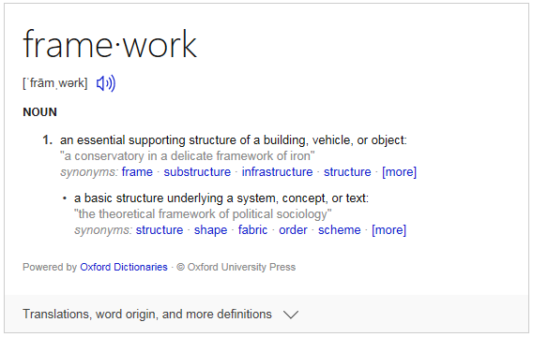
Framework
Notes:
What is a framework? A holistic yet basic structure underlying everything you do for cybersecurity
What is a framework not? Products! Too detailed or prescriptive

Slide 8

Imma let you finish, but...
https://mlpforums.com/topic/29711-my-feelings-on-the-new-admin/
Notes:
ISO/IEC 27032:2012 (guidelines for Cybersecurity)?
NIST framework for improving critical infrastructure Cyber Security 1.0
How about the ASD top 35?
SANS top 20?
Fine… Where can I get my magic one size fits all framework?
- Hold up.. there's something I need to tell you about

Slide 9
Culture affects framework
Build our own
Free tools & become experts
Buy vs. Build
Outsource it all
Notes:
Culture is also going to have a big impact on the framework you develop. What I call Enterprise Philosophy to getting things done. Here's some examples: Build your own everything, Use free tools and become experts in managing it, Buy before build or outsource it all. There's no right or wrong, just different frameworks necessary

Slide 10
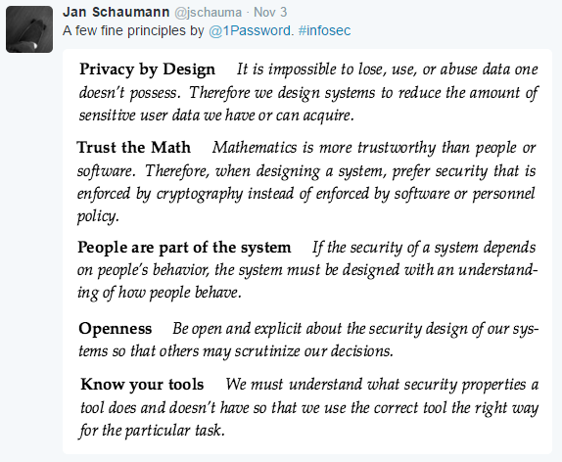
Security principles statement
Notes:
PRIVACY BY DESIGN – TRUST MATH – ACCOMMODATE HUMAN BEHAVIOUR – BE TRANSPARENT – KNOW YOUR TOOLS
Every company is different. Some a bit, some a lot. I watched a 0x07 BruCon presentation by Mark Hillick of Riot games about leveling up their security. They built this around their philosophy of being the most player focused company in the world. I say this to illustrate the difference between your company or my company's objectives. This is what I mean when I say it depends on your company

Slide 11
Prerequisites
Prevention
Detection
Response
Notes:
If you only do the first 3 your stuck in a vicious cycle

Slide 12
Prerequisites
Prevention
Deterrent
Detection
Analysis
Response
Notes:
You need analysis of what you're against and the industry as a whole

Slide 13
Framework
Governance (policies, standards, procedures, relationships, measurements, education)
Information oversight
Access management
Threat projections
Infrastructure protection (physical & logical)
Penetration detection
Incident management

Slide 14
Another way
Network
Assets
Physical
Logical
Protecting
Governance
attack
(re)defining
Monitoring
misuse
awareness
effectiveness
Responding
Root cause
analysis
recovery
Notes:
Any deeper into detail and you’re defining capabilities. Do that for the area you’re responsible, and make the other people do it for the area they’re responsible for.
Remember capabilities are not products themselves, but key features of those or requirements you need filled by products
Once you’ve got capabilities defined it’s time to…

Slide 15
Measure capabilities
Stop
Look
Listen
Notes:
Measure them.
Ask around for what tools are being used.
Interview people to figure out what features are licensed
Is it deployed everywhere?
Map it out!

Slide 16
Matrix of capabilities
Notes:
Master view, or broken down by logical reasons (platform or geographic region)
O is licensed but not used
X is licensed and used
Product C and E overlap. Maybe geographic differences, platform differences, or maybe one hand doesn’t know what the other one is doing
Capability 4 is a gap

Slide 17

Cross reference with threats
https://flic.kr/p/8PDoAN
Notes:
If you model against threats, use those as scenarios

Slide 18

Prioritize based on risks
wikipedia
Notes:
Fill those gaps based on prioritization against risks
Risk = probability x impact
Doing the next steps in having the political talks about products to meet capability needs and effectiveness discussions can…

Slide 19

Get from this...
https://flic.kr/p/8PDoAN
Notes:
Immature
Overlap
Gaps in coverage

Slide 20

… to this
https://www.pinterest.com/lovelypitusa/crochet-men/
Notes:
Handsome
Full coverage
Functional

Slide 21
Questions?
Comments!
feedback@in-security.org
@inSecurityShow
Notes:
This is my first presentation. Please let me know what you think of it by providing feedback to those feedback@in-security.org or tweeting @inSecurityShow

Slide 22
References
NIST Framework for Improving Critical Infrastructure CyberSecurity 1.0 Feb 12 2014
ISO/IEC 27032:2012 Information Technology – Security Techniques – Guidelines for cybersecurity
SANS Top 20 Critical Security Controls
Australian Signals Directorate Strategies to Mitigate Targeted Cyber Intrusion

