Slide 1
Reduce Your AD Attack Surface: Securing the Forest through the Trees Joe Bate and Cheryl Biswas
Notes:
Our talk on The AD forest within the Identity and Access Management Ecosystem

Slide 2
Joe Bate
I am here because I am passionate about security.
(And tired of dealing with bad AD Deployments)
You can find me at @bionicspy
Cheryl Biswas
I am here because you cannot know enough when it comes to AD.
You can find me at @3ncr1pt3d

Slide 3
Disclaimer
The content of this presentation is strictly an opinion and not to be considered fact. It is not a replacement for your own research and due diligence.
These are own personal opinions and in no way represents the opinion of our respective employers.

Slide 4
So You Think You Know AD …
Let’s see about that, shall we?
Notes:
So you think you know AD?
Think you've covered all the bases? While we aren't going to pretend to tell you all there is to know about AD in 25 minutes, we are going to set you up for a definite win.
Because it's all about your IAM Ecosystem. We'll step you through, layer by layer, to understand how what you do right - or wrong - impacts the whole. At the end of our talk, you'll know what you need to know to go back and properly configure your systems so that you aren't easy pickings for the wolves in the AD forest.

Slide 5
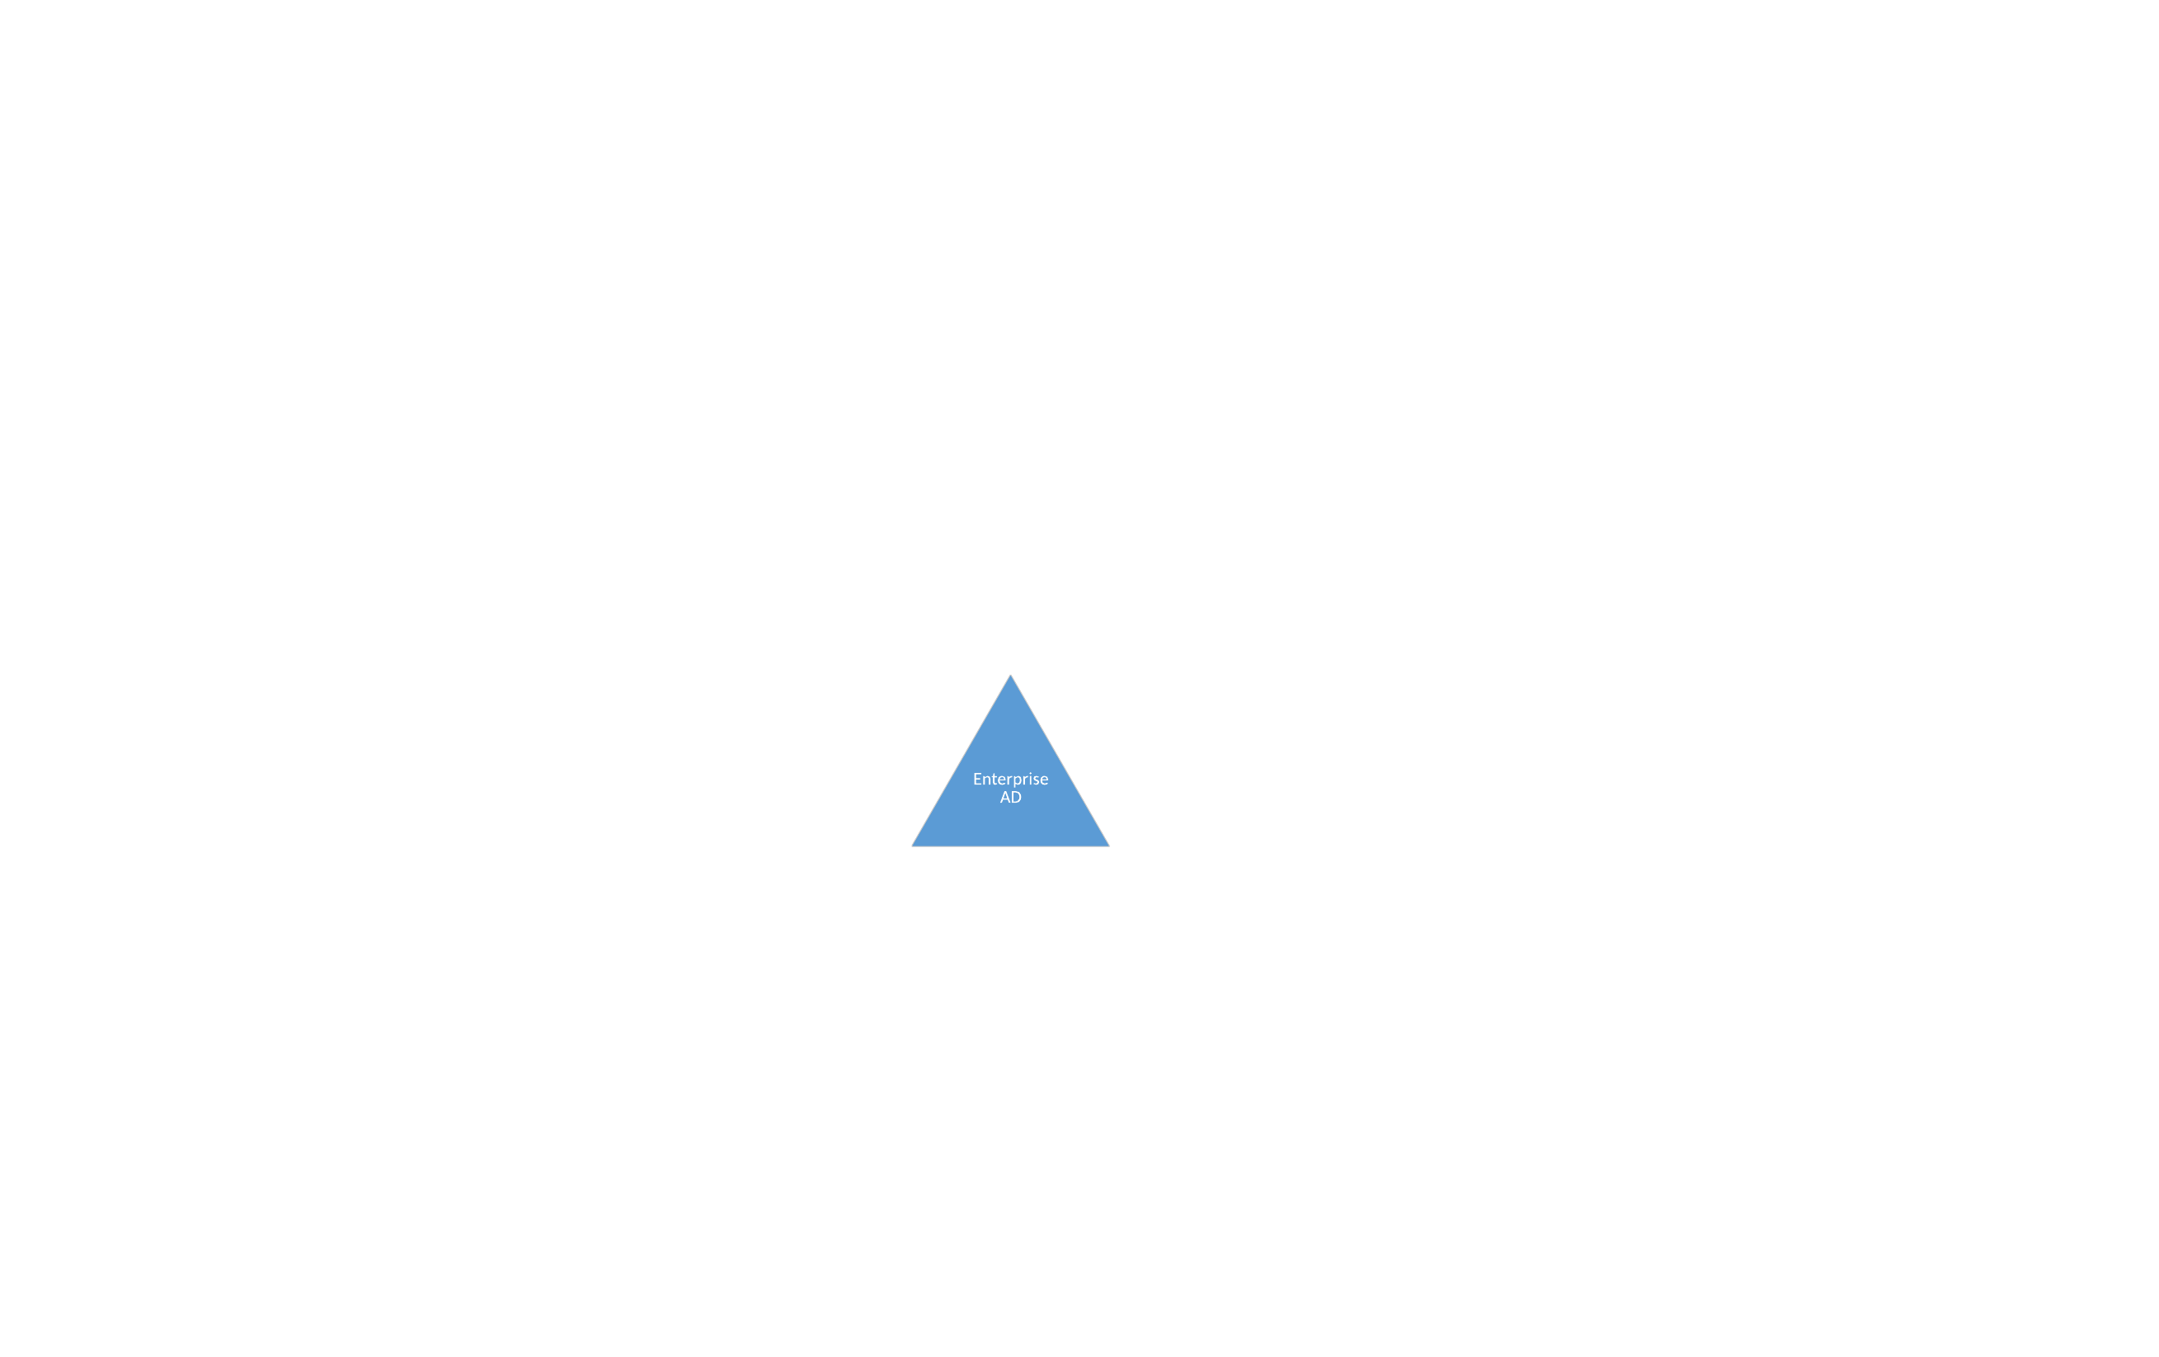
What is Active Directory?
Considerations
Anyone can deploy it, few do it well
Notes:
What is Active Directory?
Active Directory is a repository for Authentication and Authorization Information.
It is not an Identity Management Solution
It is definitely not secure out of the box
It is only as good as the controls, process and procedures you implement to manage it

Slide 6
Domain admin for you and you and you! Domain admin for everyone!
Notes:
This is a common reality
My favourite AD incident, to date:
From first touch of a desktop, to Monaro Coin Miner on EVERY domain member in under 20 mins
Only touching 2 machines
Default GPO refresh rate 15 mins

Slide 7
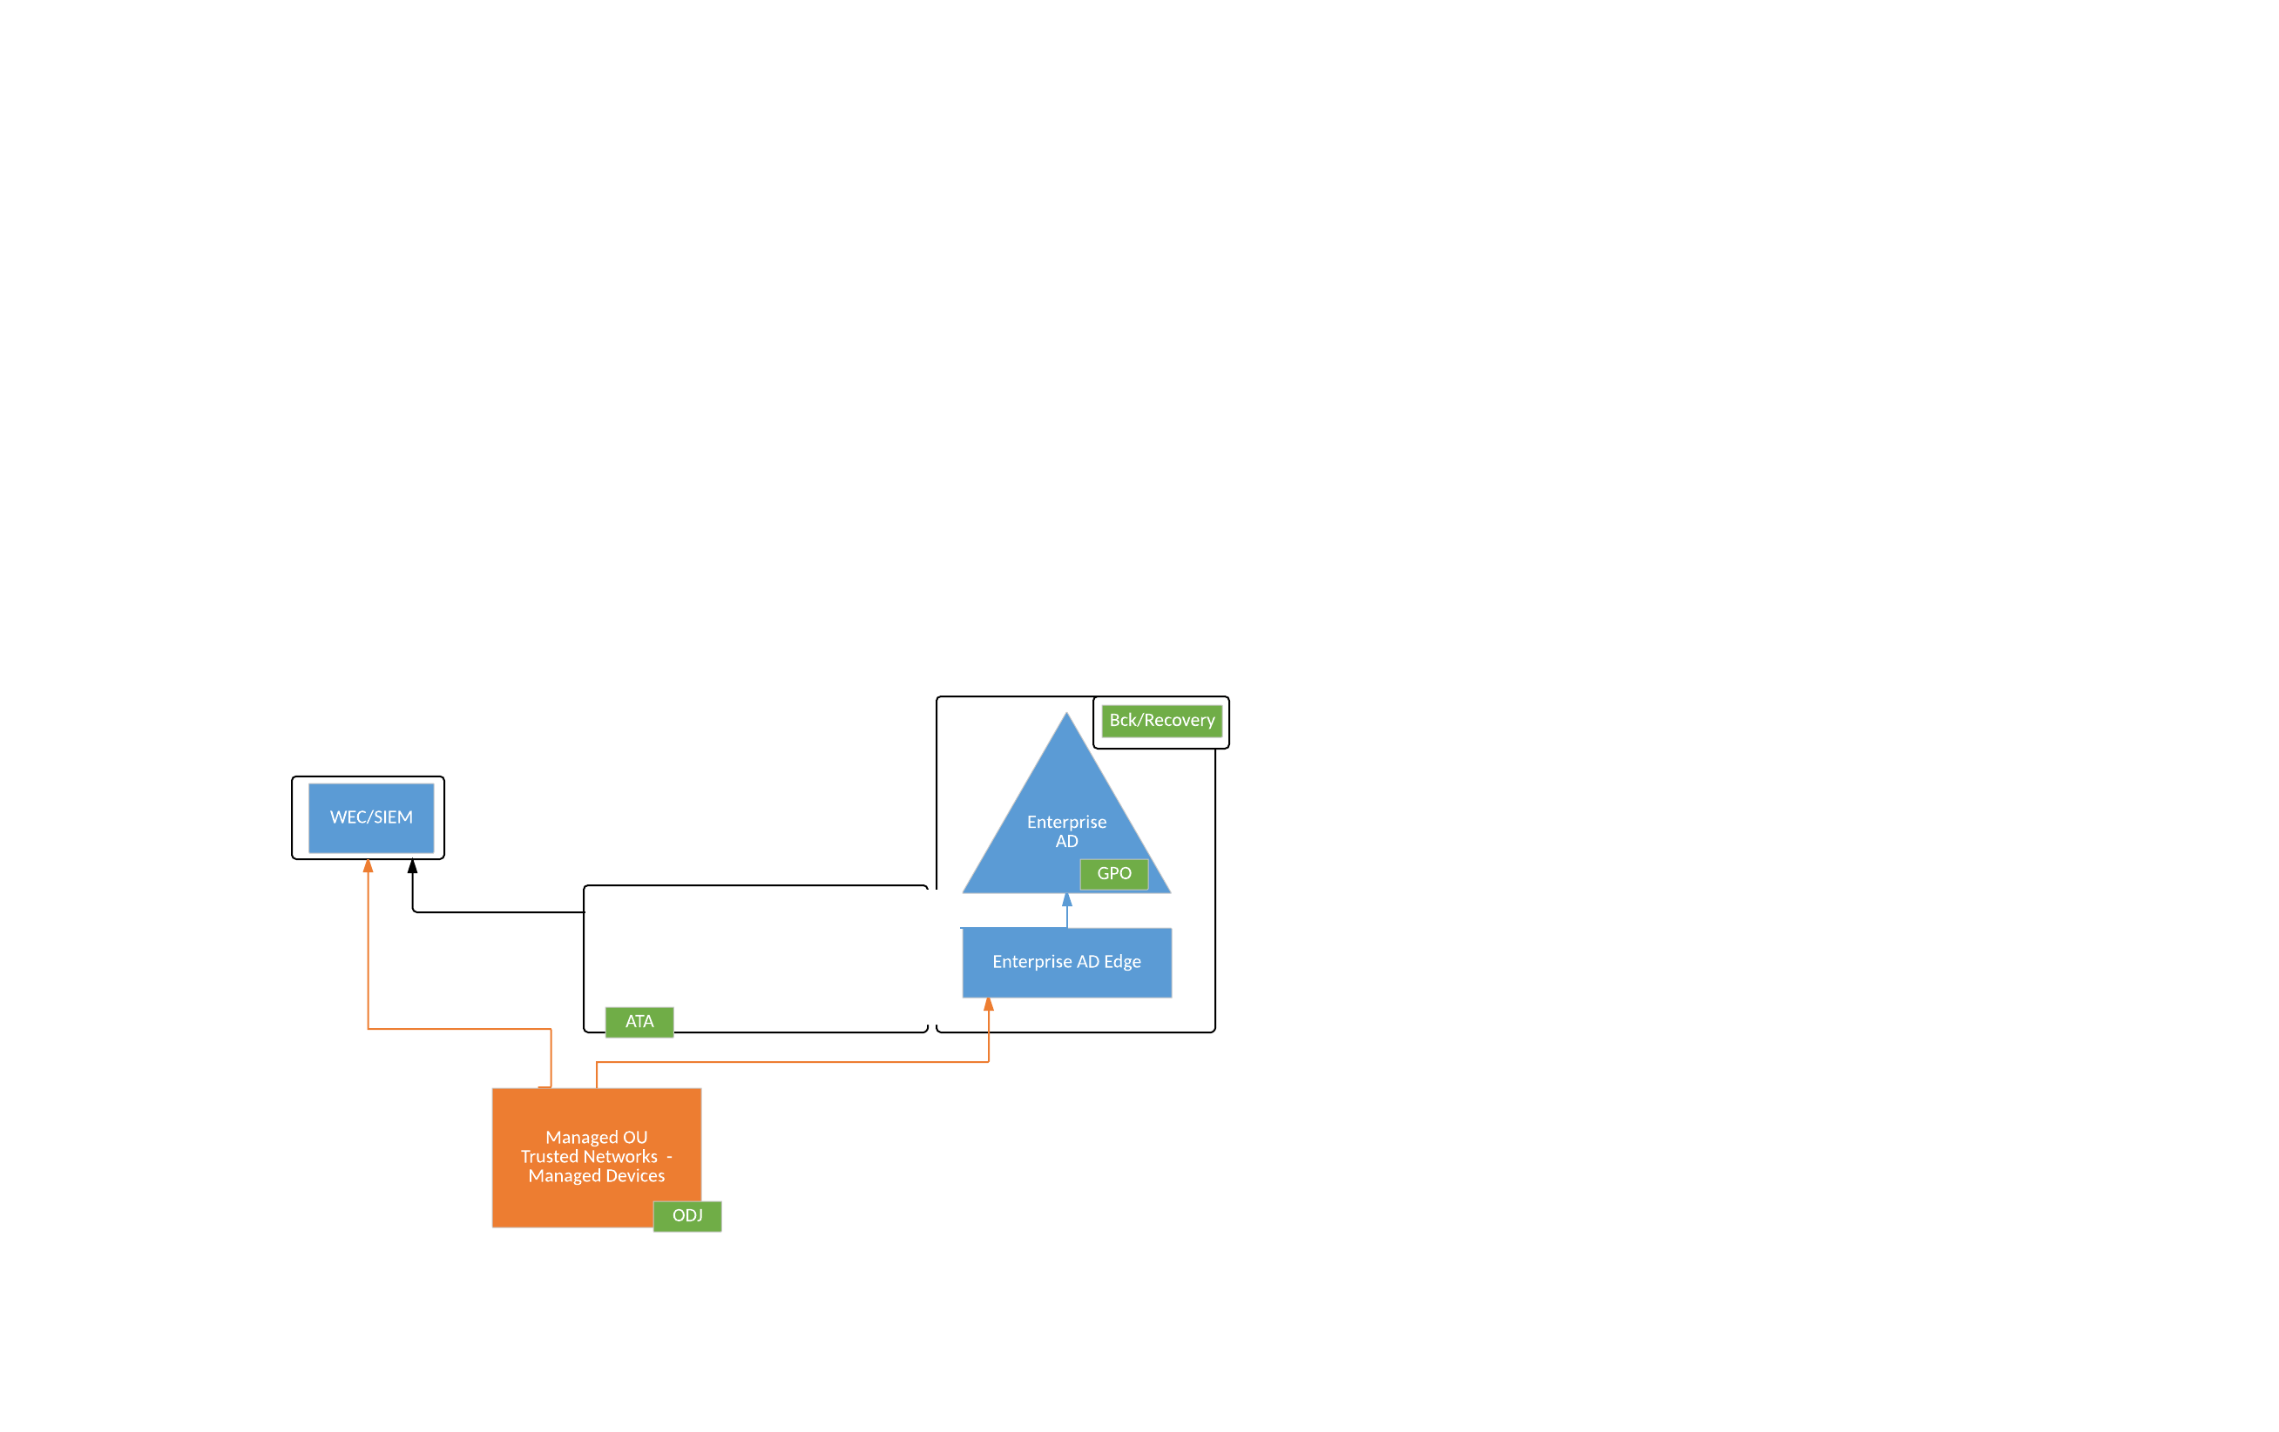
Secure THE Core
Considerations
Physical Security
Redundancy
Business Continuity
Reduce the Attack Footprint
Monitor for Attacks
Forests, Domains, Sites and Folders Design
Notes:
Physical Security
The physical security of your Domain Controllers is paramount, whether they be physical or virtual machines.
Physical Machines should have TPM chips and BitLocker, be in a secure area (behind at least 2 locked doors) with auditable access.
Virtual Machine Images must be protected at all times, should be on isolated, strictly controlled storage, with strong auditable access.
Operational Backups, Snapshots and clones of Domain Controllers should be treated with the same care as the controllers themselves.
Redundancy
Avoid the “inverted pyramid of pain”.
Diversify your DC placement, to remove SPoF (such as storage, servers, networks, buildings, etc)
Do not have all virtual machines, if the virtual environment(s), like vSphere, is AD integrated.
Ideally, minimum DCs in 3 different networks in at least 2 different Geographic Locations
Business Continuity
Business Recovery and Continuity planning is essential
Machine and AD Object Level Backup and Recovery
Attacks are inevitable. It is not a matter of if your AD is compromised, it is a matter of when. Have your recovery/rebuild plan ready
Reduce the Attack Footprint
Leverage network Segregation (Firewalls & VLANs) to isolate Domain Controllers from all less secure systems, such as domain member servers, workstations, etc.
Consider Read-Only Domain Controllers for authentication in less secure environments (DMZ’s, Uncontrolled networks, Unmanaged device environments, etc.) or where the security of the physical or virtual machine cannot be ensured.
Some optional services such as Dynamic DNS from Trusted Systems, may still require access to the RWDCs, but this very limited to the State of Authority (SOA) and is Kerberos Authenticated. Everything else can be block
Limit the RODCs to only necessary information. Silo Privileged Accounts such as “Domain Admins” should NEVER be a member of “Allowed RODC Password Replication Group”. This level of privilege should only be used on DC’s and potentially a dedicate Management Machine.
Monitor for Attacks
Centrally collect and analyze Logs from Critical Servers (the box that creates the log should not be to box that stores the log) is critical
Traditional Agent based log collection, which secure, guarantee log delivery in near real-time is typically preferred
Centrally of all logs from desktop, mobile and member servers is highly recommended but can also be a challenge and is really unnecessary.
Native Windows Eventlog Collection (WEC) Services can be a great alternative means of secure (requires CA) scalable collection of critical IOCs from these system as a bridge to SIEM, without have to have agents on every device.
The are many types of attacks not all can be detected through logs
Microsoft Advance Threat Analytics (ATA) is a tool which help augment traditional log analytics, by providing behavioural analytics on domain controller, particularly pass-the-hash detection, which is not identifiable through traditional log analytics
Forest, Domain, Site and Folder Design
There are many approach, you will need to determine what meets your business needs
Separate SITEs for RODCs and DCs
Consider separate Admin Domain for Privileged Accounts (MS Recommendation)
Have clear Folder structure for standard centrally managed vs divisionally managed (My Approach)
SD3 (Security by Design, Secure by Default, Secure Deployment) – All Core GPO’s by default
In my world, you cannot even login under Local Settings GPOs sets the admins and users groups
SOLO (Divisional Managed) –Only All Machine GPO Applied, all other settings fall to division with, expectation that they meet or exceed the controls provided by SD3
Develop Naming conversion for everything

Slide 8
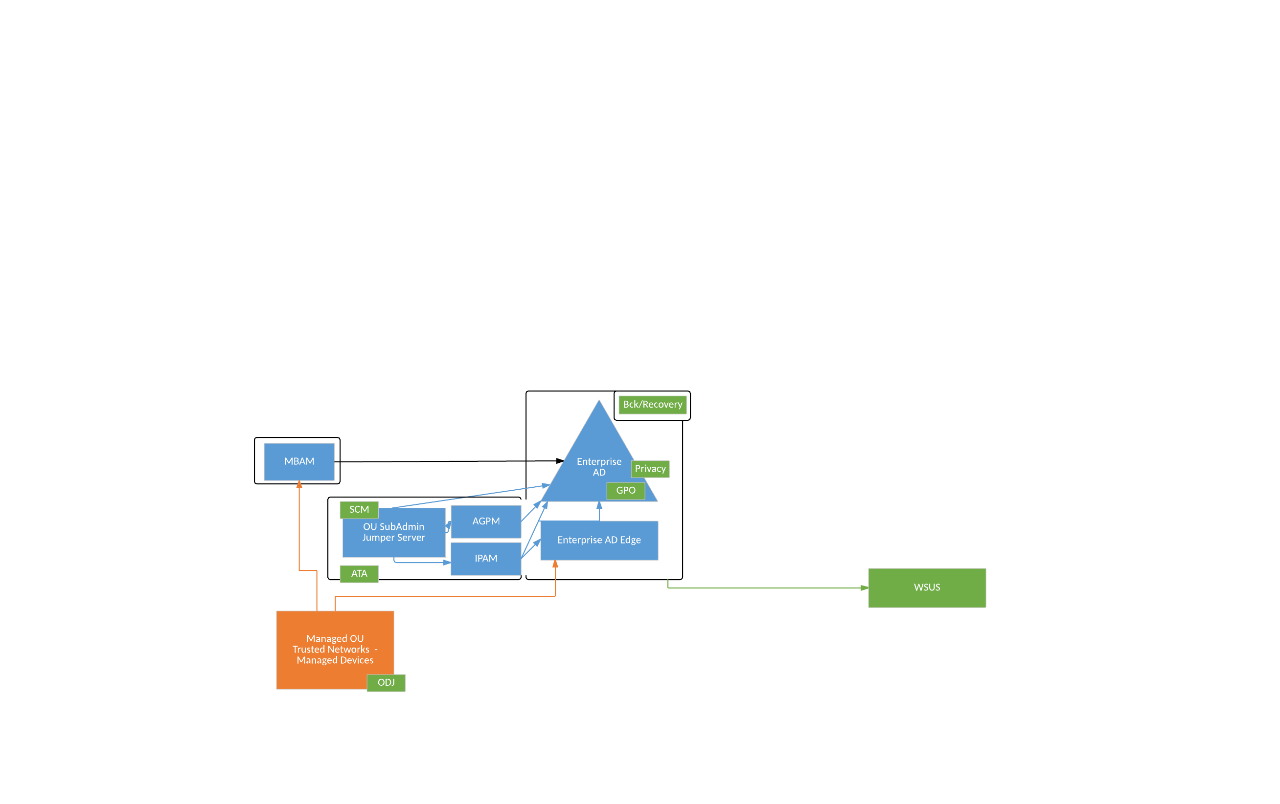
Secure Management
Considerations
Edge (RODCs)
Privileged Management
Harden Your Systems
Harden Your GPOs
IP Asset Management
Harden Group Membership
Notes:
Edge Services (RODCs)
When using RODCs there are limitations
You cannot join the domain through a RODC, using traditional join method
You must use a Offline Domain Join (ODJ) process and procreate the machine object.
Domain Join no longer requires domain privileged [Good]
You can change your password through RODC [Good]
You cannot use BitLocker without MBAM [Challenge]
Machines cannot write their encryption keys to AD [Good] AD is very porous
You get centralized reporting of devices and their encryption status [Good]
LAPS does not work
Unfortunately you will need a proper Privileged Identity and Access Management Solution [Not so Good]
AD Management Tools on Desktops, have limited Read-Only Access [Excellent]
Privileged Management
Dedicated Management Machine(s) for AD Management Tools, accessible only via trusted sources
Authenticate as authorized user and escalate privilege for the tool required (i.e. ADUC, ADAC, GPM)
Do NOT replicate these accounts with write privileges to RODC’s
Limit the privileges to only the area of responsibility
Include Microsoft AD Replication Status or similar tool in your toolbox
Strongly control access to the Management Machine (IP Restrictions, Group Restrictions, Strong Authentication….)
Harden Your Systems
DO NOT cascaded credentials across systems (i.e. Local Administrator Account different on every host)
Use GPOs to harden and configure your systems
Make it hard for the attacker, block local changes to critical settings and for them be GPO. If setting is changed it reverts back.
There are many approaches to GPO hierarchy design (This is the approach I use)
All Machines
Specific Platform
Application
Server Local Setting
There are hundreds-thousands of setting that need to change from the default on any given system.
A few critical ones include:
Reducing credential caching for default 50 to 1 or none, except clusters where 3 is likely sufficient
Enabling Auditing
Enforcing firewall running
Consider Including Security Compliance Manager (SCM) in your management toolbox.
Compare you GPOs against industry Best Practices (Microsoft and CI Security etc) as part of your control gap analysis. It is also a great tool for understanding GPO settings, there meaning and impacts
If you do not have anything today, just starting with the SCM defaults is already a big win.
Patching is a critical component of hardening your systems
WSUS services offer significant benefits over windows update
Ability to customize deployment schedules, block undesirable packages and enable centralized reporting of patching status of each machine, when using domain integrated WSUS replica
Scheduling capacities enable tiered patching (i.e. Early Adopts, delay, Odd Servers & Clusters, delay, Even Servers) to help reduce and control service impact
It is recommended to leverage different WSUS replicas for critical (I,e. DCs) and non-critical systems (i.e. Desktops)
Harden Your GPOs
Microsoft by default does not capture what was change in a GPO, just who and when
Advance Group Policy Manager (AGPM) is an extension to Group Policy Manager (GPM) which adds protections from unauthorized change, approval workflows and versioning
At minimum this gives you the ability to revert back to know good
AGPM Policy management is selective so it does not need to be applied to all GPOs but should be applied to the GPOs setting core security controls
IP Asset Management
In DHCP enabled environments, knowing who had what IP at what time is essential.
In a pure homogeneous Microsoft deployment, IPAM may be all you need, but in a more heterogeneous environment you many need something more.
Even when leverage another Enterprise IPAM solution MS IPAM is a great resource for assisting in troubleshooting MS DNS replication issues
Harden Group Membership
AD is extremely porous and by default every user, can see the membership of every group. This can lead to targets attacks (knowing who the privileged users are), or more extreme cases like stalking
Consider removing “Authenticated User” and “Self” from all groups, by default.
This way the user sees all the groups, but only every sees themselves as member [Excellent]
Add “Authenticated Users” back only to the Groups you intent the membership to be publically read [Good]
Add “Self” to groups you want the members of the group to be able to see membership of [OK]
Poorly written ldap applications which query user objects for memberof rather the querying the group for its members does not work. [Bonus]
Performance implication of poorly written application against large user populations avoid.
You will have to grant service accounts access to the specific groups there are required to see [Pain, by Good]
Also reduces token bloat, only the select groups required for that application are included, not all 2000+ groups the users is a member of. [Bonus]

Slide 9
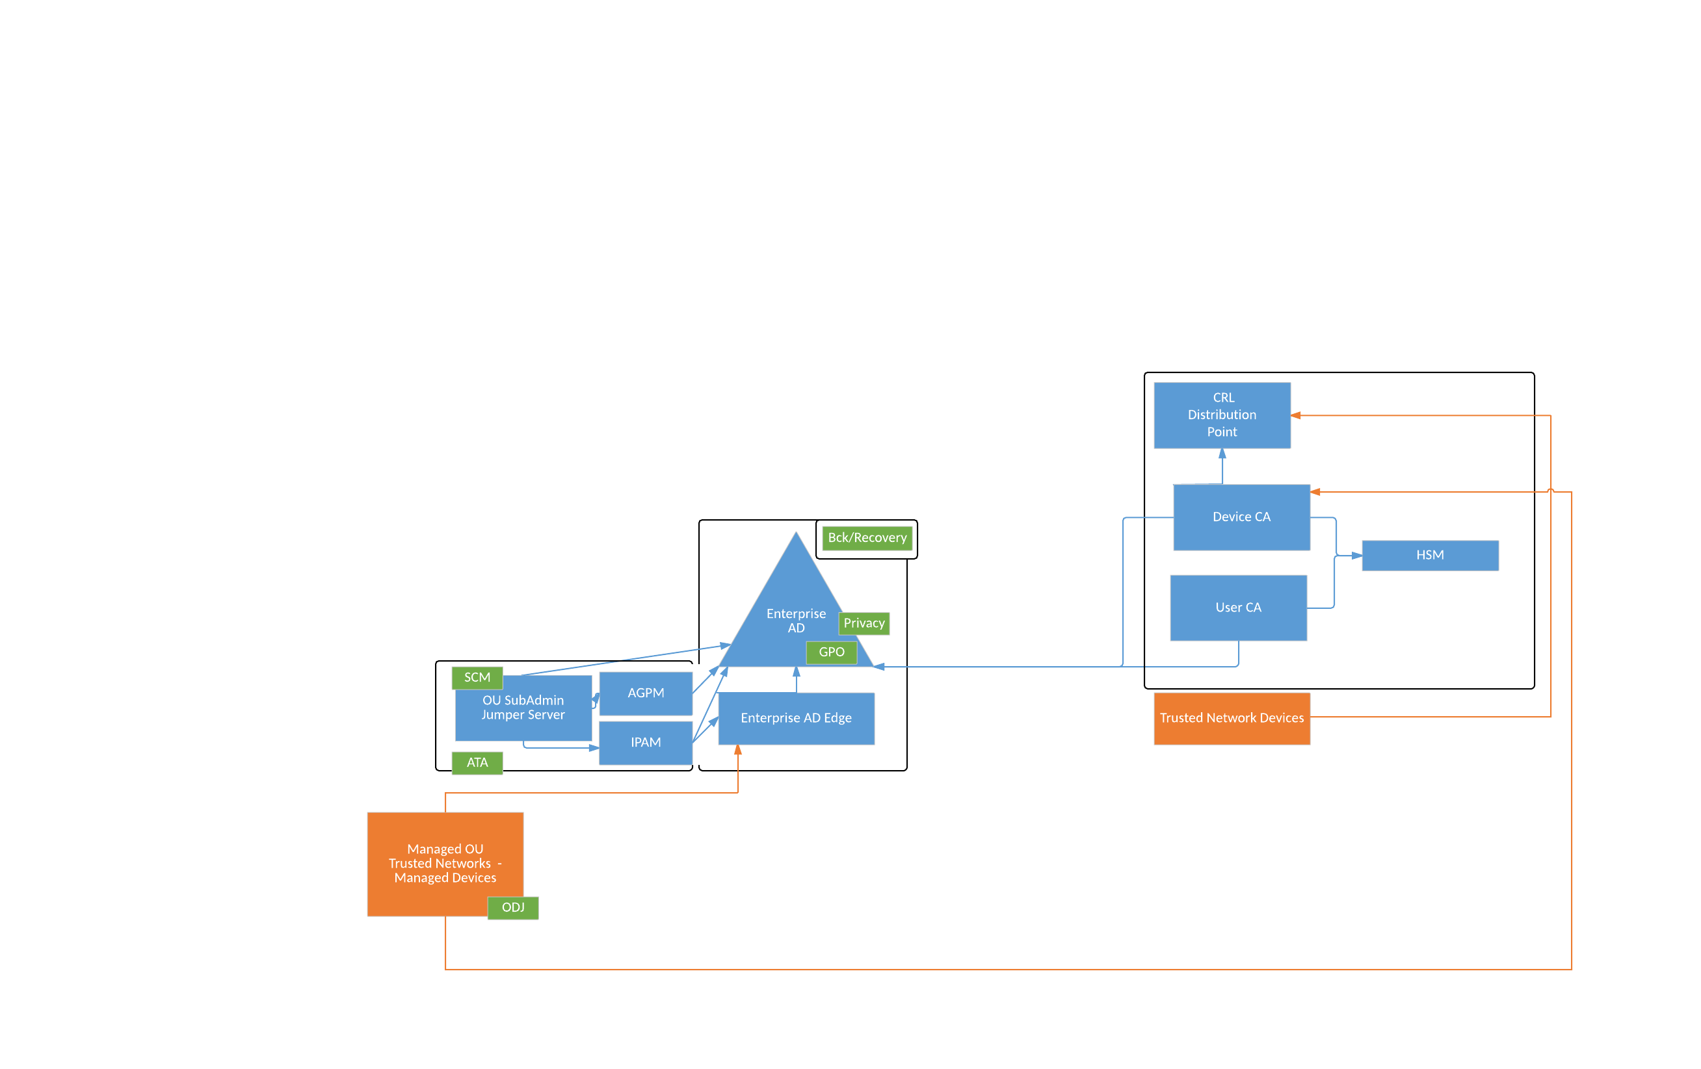
Secure Communications
Considerations
Secure Communications
Separate User and Machine CAs
HSM/Trusted Root
Public CRL
Notes:
Secure Communications
By default Active Directory communications are in the clear, with the exception of RDP
RDP by default uses self-signed Certificate
Native Active Directory communication leverage Kerberos for authentication so at least the authentication is some what protected
However, authorization information is still in the clear
Non-Native LDAP communication is not preventable, which would expose the credentials on the wire
In order to Secure Active Directory Communications you need to have an Integrated Certificate Authority (CA)
Even the implementation of the CA and the distribution of certificates does not enforce communication encryption by default.
You MUST suppress the advertise of default unencrypted DNS service records and configure DNS to deliver appropriate service records for encryption.
Add a basic GPO that applies to every computer object, which ensures the Root CA is in the machines trusted roots, enable auto-enrollment and set the Remote Desktop Certificate to the Computer Certificate
No user should every accept a certificate error. Let’s break this bad culture habit.
Separate User and Device Certificate Authorities
The exposure profile and risks are dramatically different for the CA providing machine certificates from the one that provides User certificates.
As a result they should NOT be the same instance.
HSM/Trusted Root
The integrity of your Root CA is paramount, if it is compromised, there is nothing left to trust.
The root CA should not be either the CA for device certificates or user certificates.
It should be HA-HSM, HSM as a Service, CA as a Service or Offline.
Public CRL
By default Microsoft CA writes the CRL to Active Directory, great for client connected to trusted networks, but what about mobile users
Create a Public Certificate Distribution Point, and put a copy of the CRL (Daily Full) and the Delta CRL (Hourly Delta) there.
Ensure the URL of the public distribution point(s) is included in the certificate template
There is no risk, I can think of where this is a threat. (open to hearing other thoughts)
An attacker may be able to detect that certificate for the user or machine he/she just compromised has be revoked

Slide 10
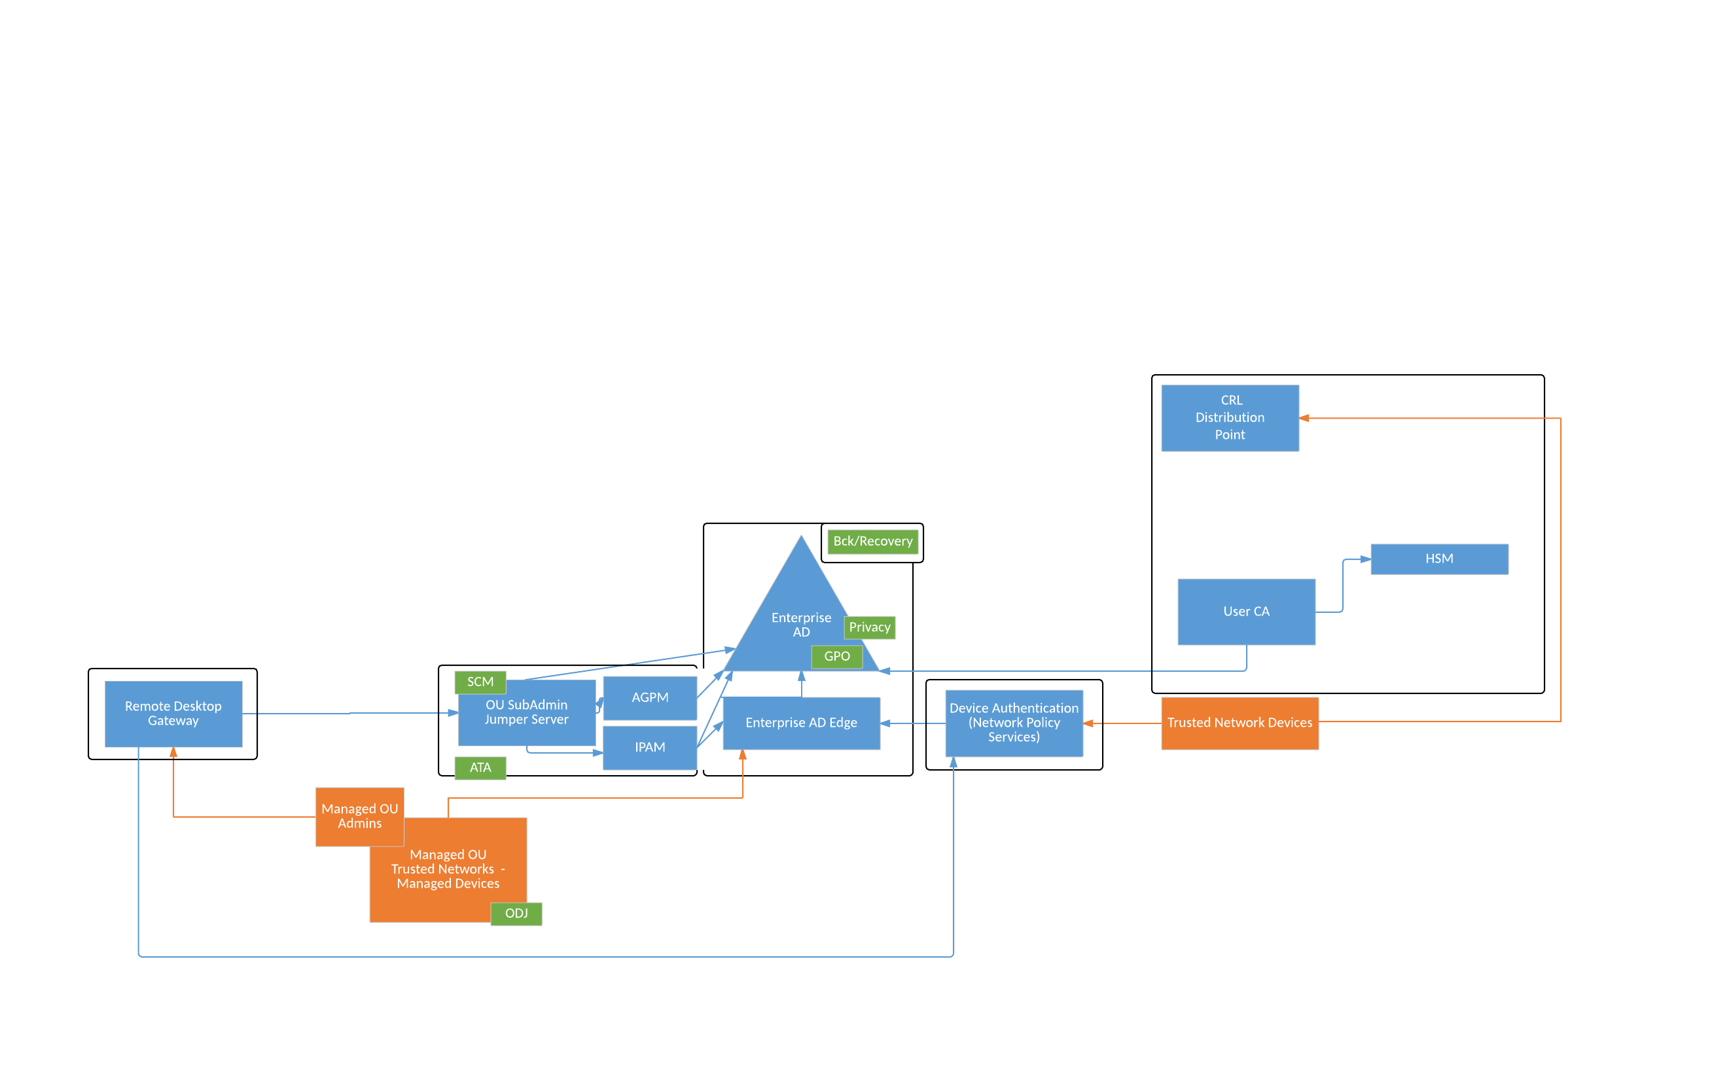
Secure Network Access
Considerations
Secure Remote Desktop Access
Network Access Control
Secure Remote Access
Notes:
Secure Remote Desktop Access
RDP is one of the most attacked protocol, limit access to you systems via Remote Desktop Gateway (RDG).
This reduces the threat vector to the end point be fronting it with policy and granular access control [Good]
Ability to control advance feature through policy
For example by policy disable remote printing, remote clipboard sharing and remote drive mapping at the gateway
These are an exception, not the norm to further reduce the vectors for data loss to untrusted systems
This gives you central control and central visibility into who is logging into which devices [Good]
Centrally enforce Enforce Strong Authentication [Good]
Network Access Control
RDG requires NPS to bridge the authentication to AD and enforce access policies
Separating this NPS (Radius) deployment from RDG enables you to leverage id for authentication brokering for:
Wifi
802.1x (minimal NAC)
Device Authentication (admin access to routers, switches, firewall)
User authentication for VPNs
Secure Remote Access
There are many methods and technologies for securing remote access (VPNs, Always on VPNs….) you will need to evaluate and choose what is right for your needs
In all cases, enforce strong authentication at this edge.

Slide 11
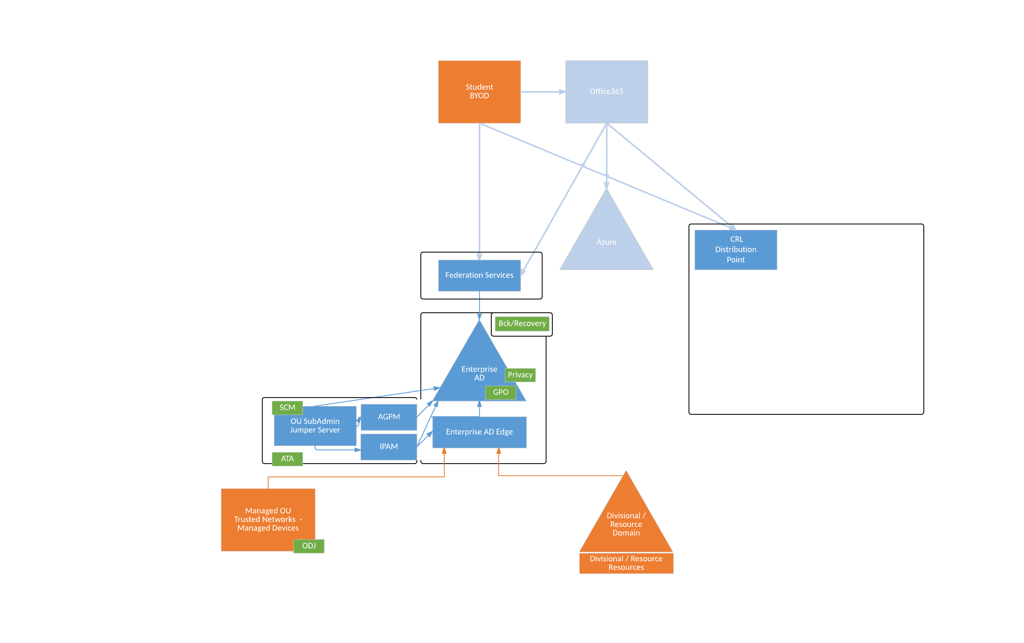
Extending Identity Services
Considerations
Federation
Domain and Forest Trusts
LDAP Services
Notes:
Federation
Not all systems your users, will require access to will be within your control or AD integrated.
Maintain the identity of your users is these services is crucial
The inclusion of Federation service is nearly essential these days as more cloud service adoption arises
Native ADFS a good start for smaller deployments however, as you expand and mature, there are other products and services like PING or Canadian Access Federation (CAF) which are better suited for dealing with external Service Providers at scale.
Domain and Forest Trusts
Centralize users administration to one domain, where possible.
Establish One-Way Trusts from Resource Domains.
Never Trust a less secure domain. Ensure Domains that trust you are maintained with the same level or higher of rigor that you run this domain.
LDAP Services
Inevitably you are going to end up with application that only support LDAP/s
I strongly recommend creating a load balance vip in front a some RODCs specifically for this purpose. This enables you to:
patch the server, with minimal interruption to services
Identify rogue applications directly leveraging a specific RODCs
Easily identify and block miss behaving application, without blocking the underlying machine, if it a member.
Enforce LDAPs (tcp/636) only integration for the protection of credentials in flight, and easily distinguish from potentially unencrypted LDAP (tcp/389)

Slide 12
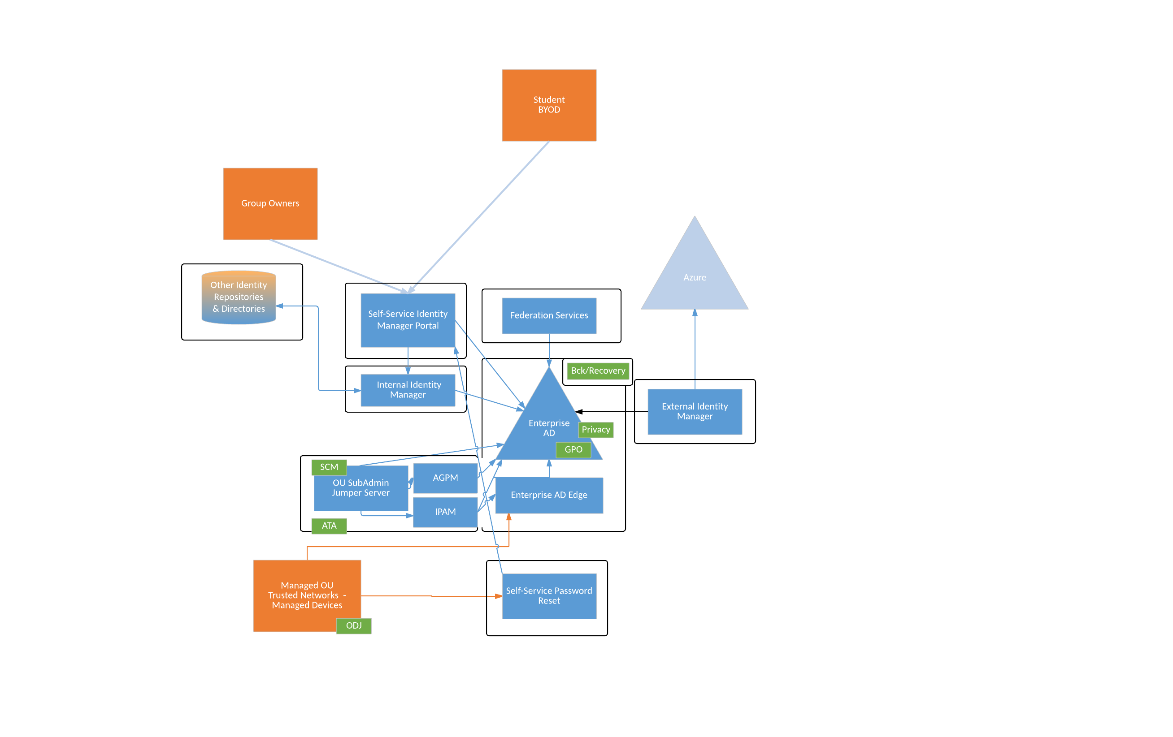
Managing Identity
Considerations
Classes of Identities, Identity Assurance and Credential Assurance
Internal Identity Manager
External Identity Manager
Self-Service Identity Portal
Self-Service Password Reset
Group Management
Notes:
Scratch the surface, as this is massive topic…
Active Directory is not the Authoritative Source for Identities
HR System for employee records
Other for client records
Where possible, move away from the creation and management of accounts via AD management tools
Classes of Identities, Identity Assurance and Credential Assurance
If you want the identity to have value you have to treated it as such, and manage it from creation trough to retirement
Classes of Identities
Personal Accounts
Individual identifiable user
Functional Account
Service Accounts (Machine to Machine, No Human Interaction)
Privileged Accounts
Support IDs
Fire/Recovery IDs
Identity Assurance (the rigor for proving identity to get an account)
Excellent Guidance/Regulations
Private Sector – NIST SP-800
Public Sector – Canadian Standard for Identity and Credential Assurance
Credential Assurance (confidence in the users ability to retain control of the identity they were issued)
Internal Identity Manager
Brokers the flow of Identity information into AD, ensure accounts maintained based on current data from Authoritative Sources, such as:
A new employee is higher, the person is on-boarded to HR system and it triggers creation of Person Identity, imagine that
A employee leaves the organization, the HR system is updated with the date of termination and the account is automatically disabled.
External Identity Manager
It is highly recommended that the Internal and External Identity Managers are separated
They may or may not be the same technology
Unlike Internal Identity Manager, External Identity Manager does not need to write to Active Director only Read
It would take a push a subset of permitted information, say first, last, email to an external party such as O365
Some information like passwords NEVER sync.
Self-Service Identity Portal
A Portal or Ticket System that enables users to request changes, to their account. i.e. Change Preferred name, Request Access to a Group
Self-Service Password Reset
Nearly a MUST today, allowing people to be involved enables social engineer, if processes are not rock solid.
Leverage OTP technologies, avoid Q&A unless you are willing to go as far as dynamic attribute lookups (current balance of your account)
Group Management
Move away from Individual Group Management where possible
Move to Basis, Reference and Service Groups (Compound groups)
i.e. email (+Student +Staff +Faculty +email Whitelist –email Blacklist –Identity Assurance <=1 -Credential Assurance <=1 –Blocked –Retired)
Think of the flexibility.
Say a union goes on strike
Add union Basis Group to Blocked List. Instant Removal of Services
Both from there protection (i.e. no corporate spying) and your (protection from damages)
Have individuals who cross picket line, no problem
Service owners can add the individuals to service whitelist for the select services they are willing to provide.

Slide 13
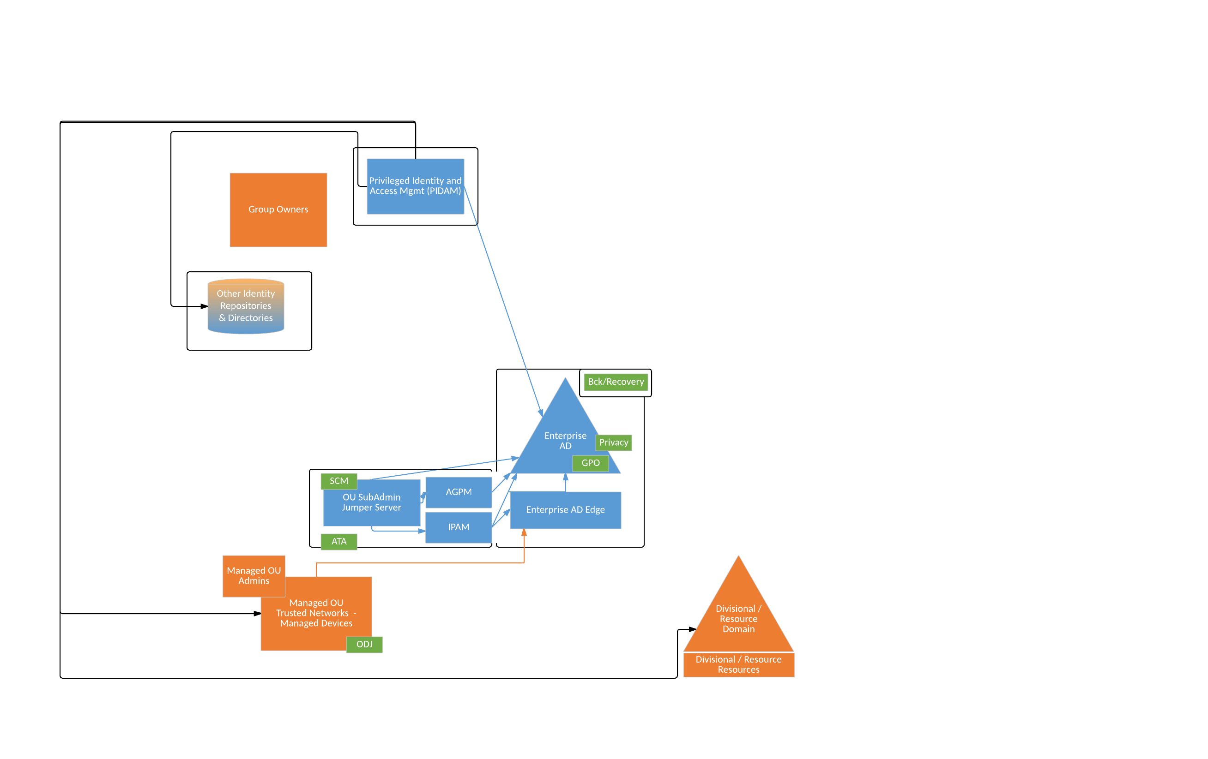
PIDAM
Considerations
Manage Privileged Identities
Manage Privileged Access
Strong Authentication Along will not Save you
Notes:
Privileged Identity and Access Management is a complicated topic. A talk unto itself.
There are many tools in the space, not all are created equal… do your due diligence
Most security product vendors such at security
Protect it, like what it is…. THE KEYS TO THE KINGDOM
Saw one bad deployment or a less than ideal product, own within an hour of being turned on.
Manage Privileged Identities
Only create privileged accounts for people who need it daily
NEVER assign ongoing privilege to a Personal Identity
Separate Account for Privileged Access or JIT (still has risks but better than nothing)
Move to Check-In/Out Model, where possible, to grant access temporarily as the need arises
Change password automatically after use.
When not using RODCs LDAPs is a great interim step to address immediate issues with Local Administrator Access management for desktops and non-critical domain members
Removes common issue where the same Local Administrator credential is deployed automatically, potentially enable lateral movement form a compromised machine
However
It can only do one account, typically the local Administrator [No Good]
AD is very porous and storing Local Administrator password as unencrypted attribute of the machine object, is vulnerable to bad management practices [Bad]
Please DO NOT consider using for Critical Systems.
Manage Privileged Access
Isolate privileged access to controlled, trusted areas
Leverage privilege session management to record, access to high value targets like DCs
Strong Authentication Along will not Save you
PIN encrypted Smart Card Authentication, still boils down to an authentication token on the machine which can be vulnerable to pass-the-hash

Slide 14
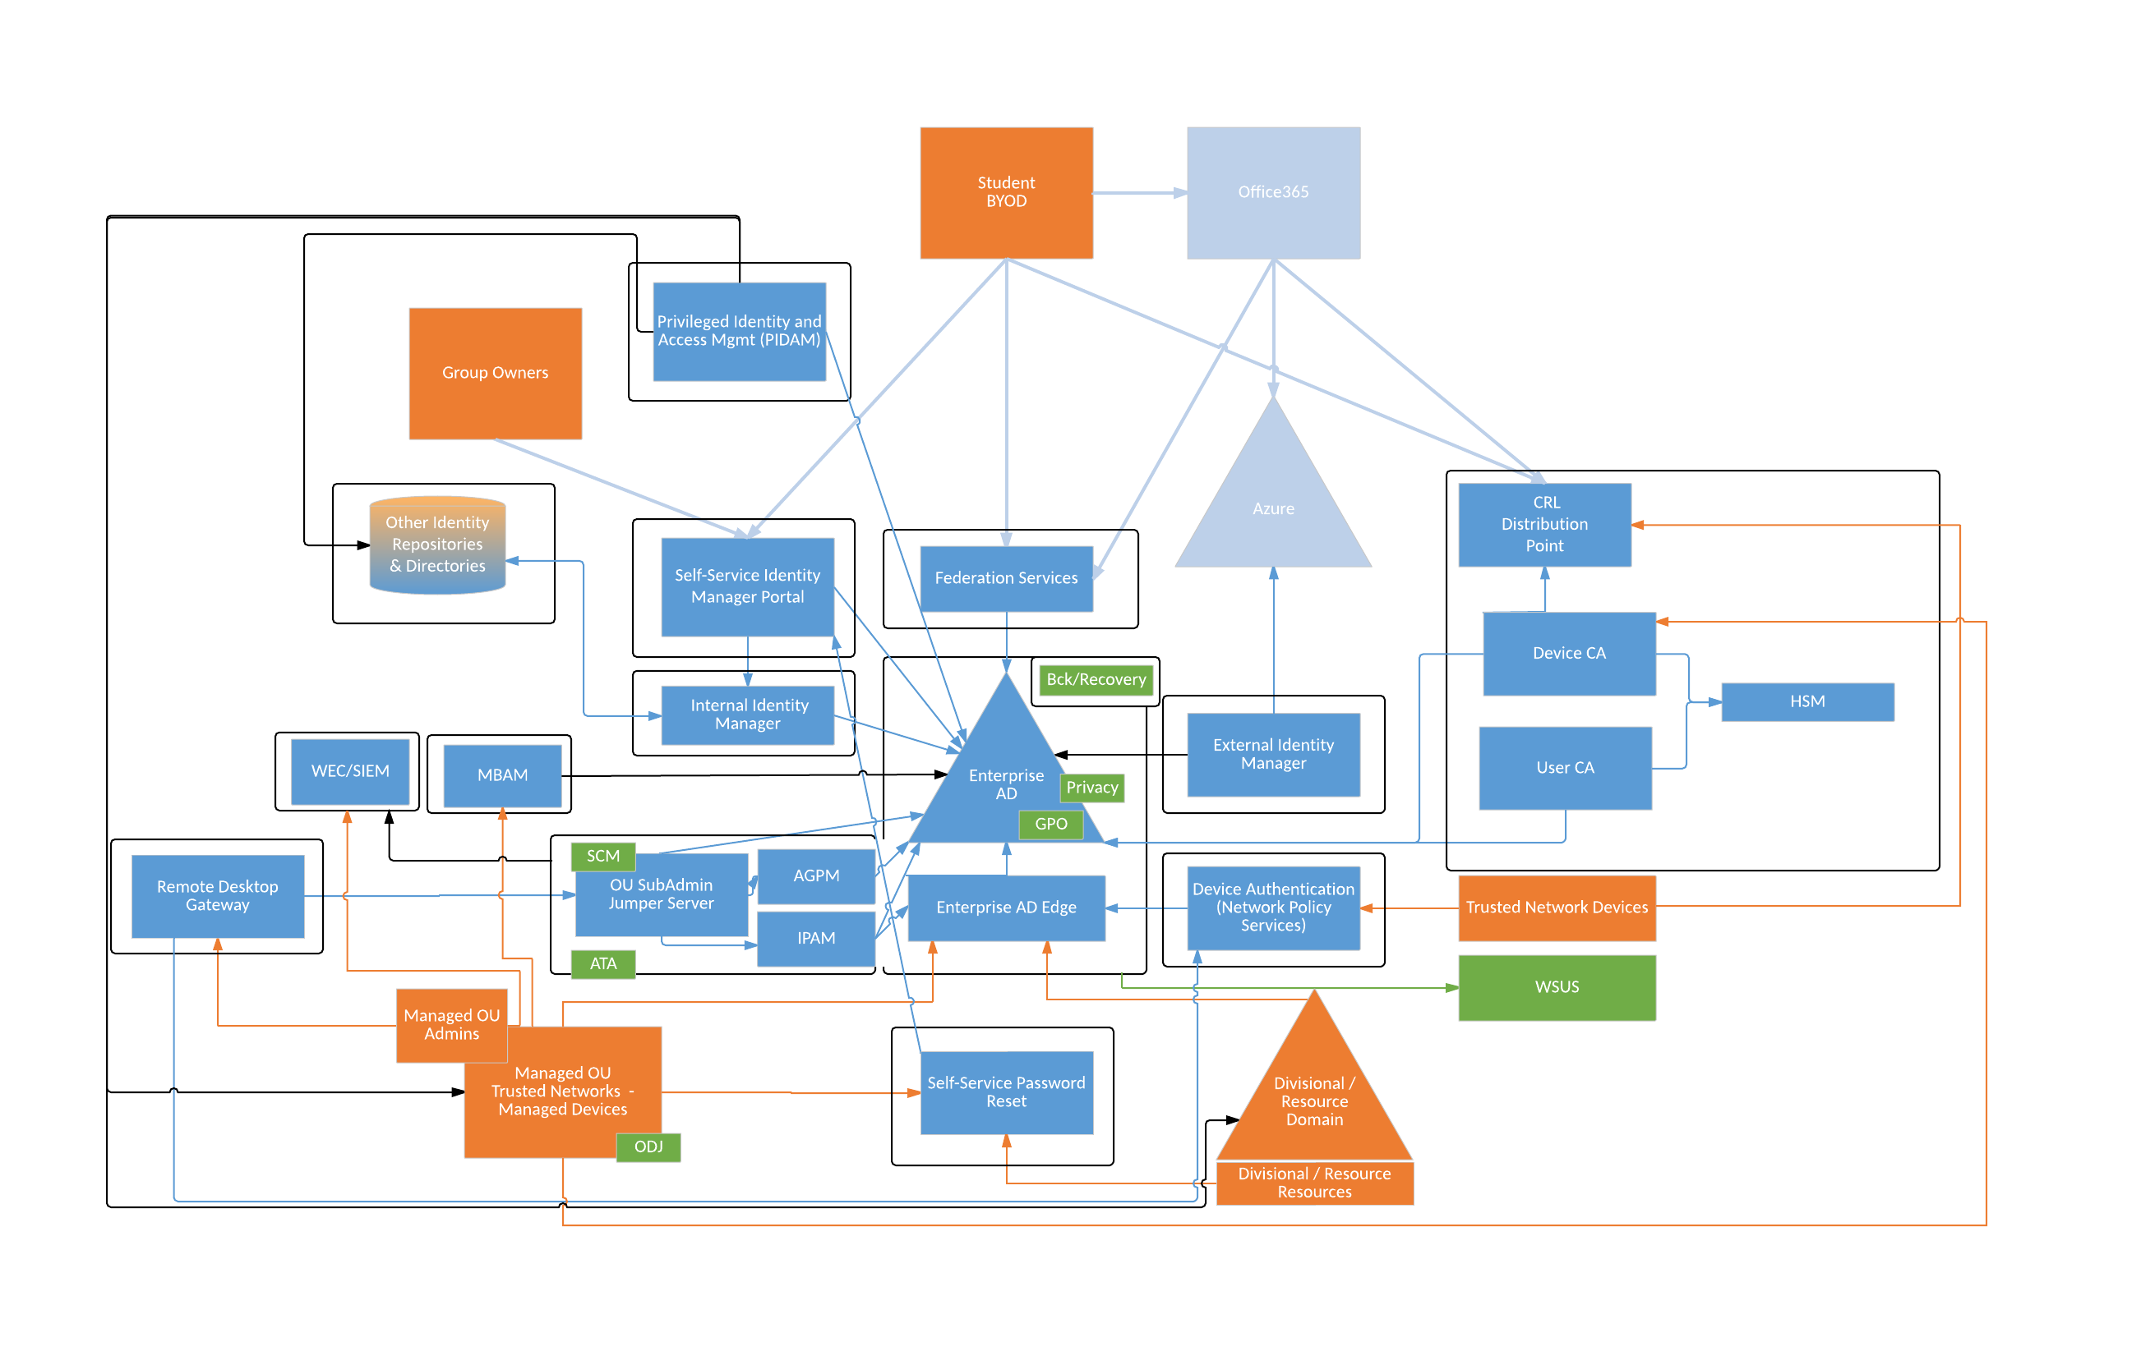
Active Directory ECOSYSTEM
Considerations
What role does Active Directory play in your organization?
How strong is your Active Directory Deployment?
Notes:
Active Directory is a repository for Authentication and Authorization Information.
It is not an Identity Management Solution
It is a small piece of a much larger Ecosystem
It is only as good as the investment you put into it
It can go wrong really fast, if you do not take care in its implementation

Slide 15
Q & A Time
Incase that wasn’t enough

Slide 16
Thank you!
Didn’t get a chance to ask your question?
Joe Bate (@bionicspy)
Cheryl Biswas (@3ncr1pt3d)

