Slide 1
Distance and Clustering
XDAS 2019
Kris Gunsalus

Slide 2
Outline
Review
Normalization
Differential expression
FDR
Distance measures
Clustering
Hierarchical
K-means
ALSO SEE LECTURE NOTES ON CLUSTERING!

Slide 3
Genome-wide expression analysis
Goal: to measure RNA levels of all genes in a genome under various experimental conditions
RNA levels vary with:
Cell type
Developmental stage
External stimuli
Disease state
Time and location of expression provide information on genes’ function and interactions, and can be useful for many purposes, including disease diagnostics and medical applications.
Notes:
Once every gene in a genome has been identified, it becomes feasible to measure each gene’s expression. One of the first goals along this line has been to measure the steady-state abundance of RNA made from each gene. There have also been ongoing attempts to measure the level of all proteins. The levels of RNA vary depending on the cell type, the developmental stage, environmental stimuli, etc. For example, the RNAs expressed in a heart cell differ greatly from those expressed in a brain cell, and the RNAs expressed in fetal blood differ from those expressed in adult blood. In addition, exposure to high heat triggers the production of heat-shock RNAs, which are not present under normal conditions. Therefore, determination of the RNA levels found at a particular time and in a specific cell or organ can provide important information as to the function of the genes responsible for this expression. In addition, the spectrum or profile of RNAs found in a particular cell can be used as a means of disease diagnosis. For example, different types of cancer have been shown to have different RNA profiles.

Slide 4
Normalizing the data
Sensitivity of RNA-seq is a function of
Number of reads per transcript
Transcript length
Size of the library (total # of reads)
FPKM (Fragments per Kilobase TPM (Transcripts per million reads)
of exons per million reads)
RPK = R/N
R
R
NT
FPKM =
RPK
∑RPK / 1M
TPM =
RPK
∑RPK
TPM = *1M
R = # of unique reads for the gene
L = length of the gene (sum of exons in nt)
N = Size of the gene in kb (sum of exons / 1000)
T = total number of reads in the library mapped to the genome / 1,000,000

Slide 5
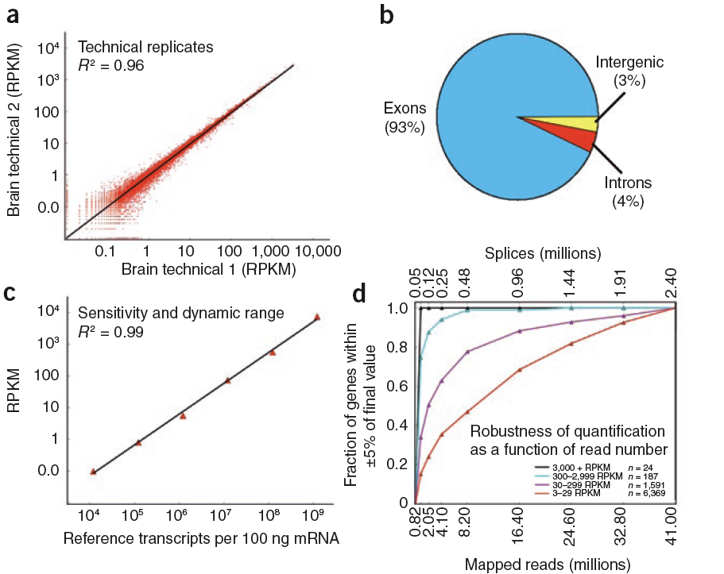
Reproducibility, linearity and sensitivity
Notes:
Figure 2 | Reproducibility, linearity and sensitivity. (a) Comparison of two brain technical replicate RNA-Seq determinations for all mouse gene models (from the UCSC genome database), measured in reads per kilobase of exon per million mapped sequence reads (RPKM), which is a normalized measure
of exonic read density; R2 = 0.96. (b) Distribution of uniquely mappable reads onto gene parts in the liver sample. Although 93% of the reads fall onto exons or the RNAFAR-enriched regions (see Fig. 3 and text), another 4% of the reads falls onto introns and 3% in intergenic regions. (c) Six in vitro–synthesized reference transcripts of lengths 0.3–10 kb were added to the liver RNA sample (1.2 × 104 to 1.2 × 109 transcripts per sample; R2 > 0.99). (d) Robustness of RPKM measurement as a function of RPKM expression level and depth of sequencing. Subsets of the entire liver dataset (with 41 million mapped unique + splice + multireads) were used to calculate the expression level of genes in four different expression classes to their final expression level. Although the measured expression level of the 211 most highly expressed genes (black and cyan) was effectively unchanged after 8 million mappable reads, the measured expression levels of the other two classes (purple and red) converged more slowly. The fraction of genes for which the measured expression level was within ±5% of the final value is reported. 3 RPKM corresponds to approximately one transcript per cell in liver. The corresponding number of spliced reads in each subset is shown on the top x axis.

Slide 6
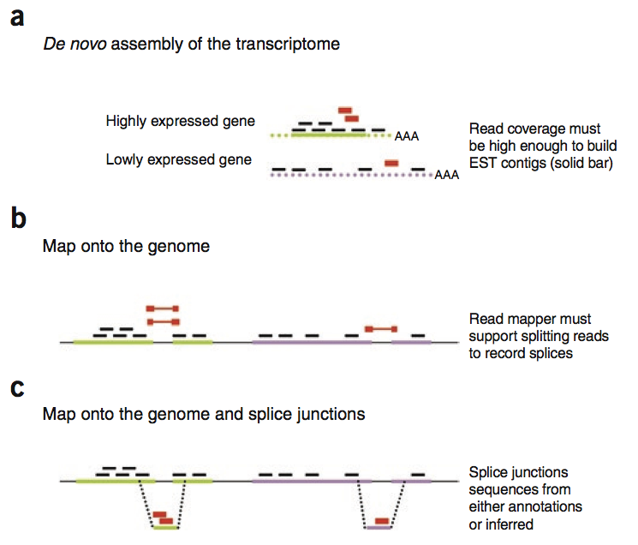
RNA-seq provides more information than just expression level

Slide 7
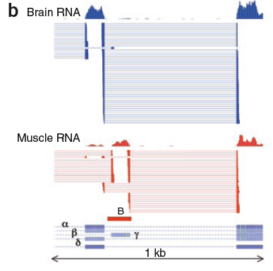
Candidate new and revised exons

Slide 8
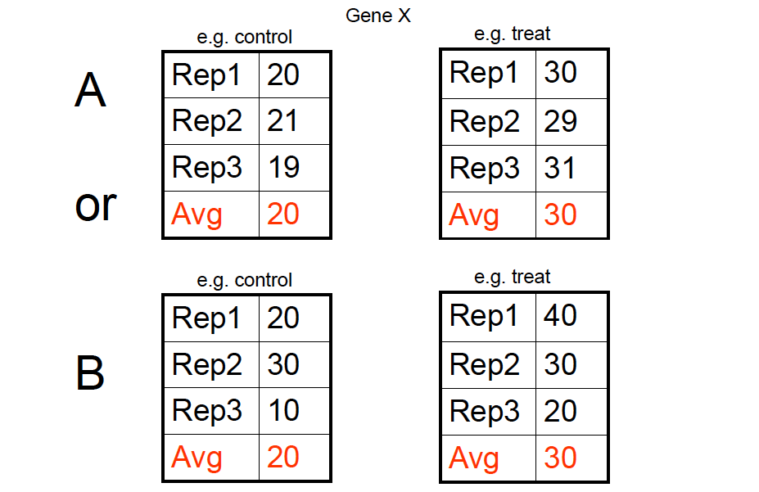
Evaluating expression differences: Which Looks Better ?

Slide 9
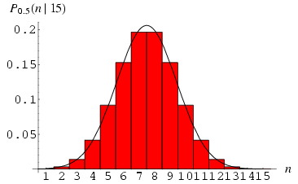
Multiple Measurements of the Same Genes Expression
Bell curve
Normal distribution
Gaussian distribution
Frequency of bin
gene expression level bin

Slide 10
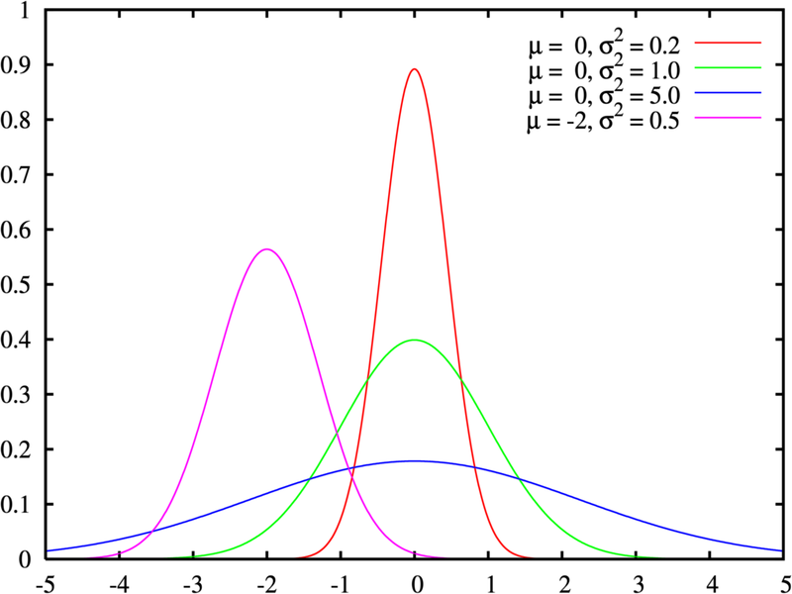

Frequency of measurement
mean of measurements

Slide 11
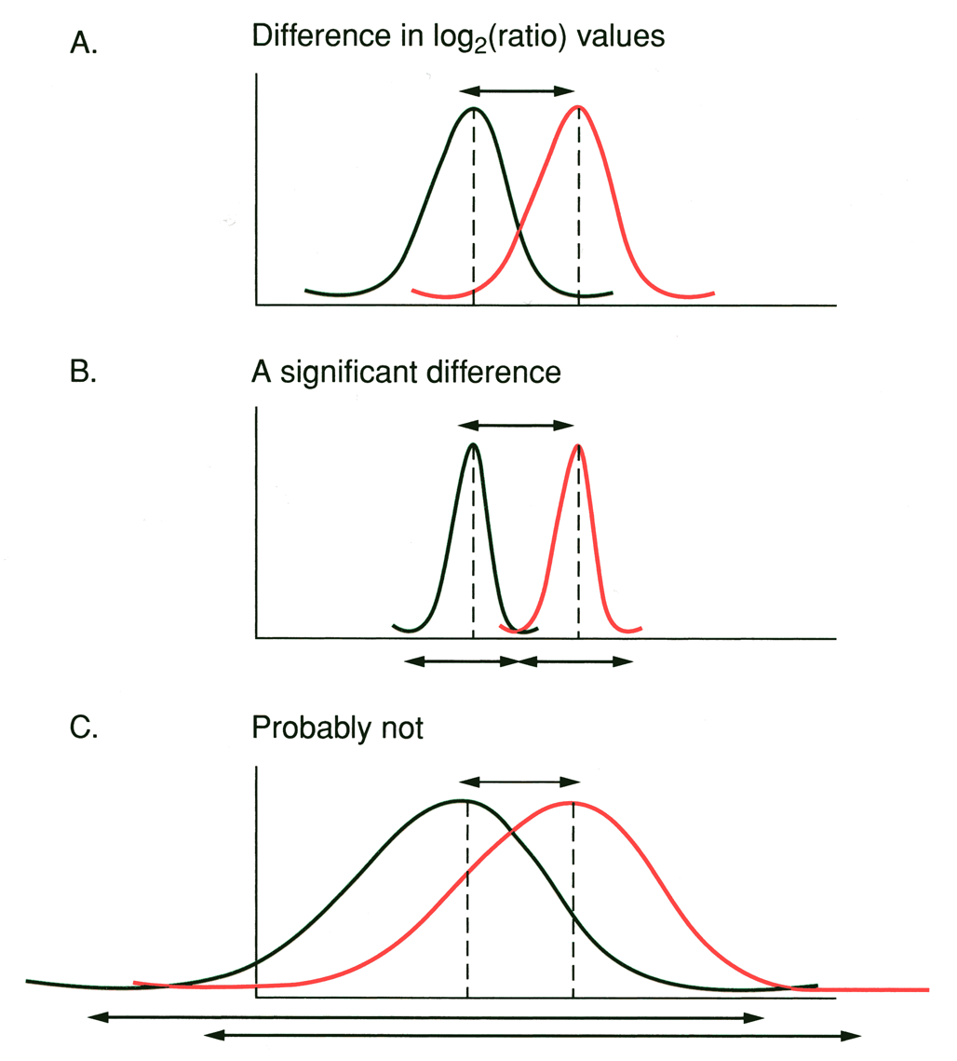
What is a “significant” difference in gene expression ?
Consider the expression level of a single gene measured in two conditions (A vs B).
For each gene, multiple replicates of the same condition measure a distribution of values centered on the mean.
A fixed fold-change cutoff asks for a minimum separation between the average peaks in A and B.
A
B
0
10000
20000
40000
50000
60000

Slide 12
What is a “significant” difference in gene expression ?
Consider the expression level of a single gene measured in two conditions (A vs B).
For each gene, multiple replicates of the same condition measure a distribution of values centered on the mean.
A fixed fold-change cutoff asks for a minimum separation between the average peaks in A and B.
The difference in log₂(ratio) values between the means in both samples relative to the variability of measurements within each sample will determine whether the observed difference is significant.
A
B
signal
noise
difference between groups
variability with groups
=
0
10000
20000
40000
50000
60000

Slide 13
What is a “significant” difference in gene expression ?
A simple statistical test of significance is the Student’s t test.
The t test statistic can be used to asses the signal-to-noise ratio for an observed difference in expression of a particular gene in two experimental conditions.
Average log₂(ratio) in condition A
Standard deviation of the mean
N_{A}
1
N_{A}
N_{A}
∑ [X_{Ai} — X_{A}]²
N_{A}
X_{A} = ∑X_{Ai}
σ_{A} =
i-1
60000
i-1
X_{A} - X_{B}
t =
signal
noise
difference between groups
variability with groups
=
=
σ_{A}² + σ_{B}²

Slide 14
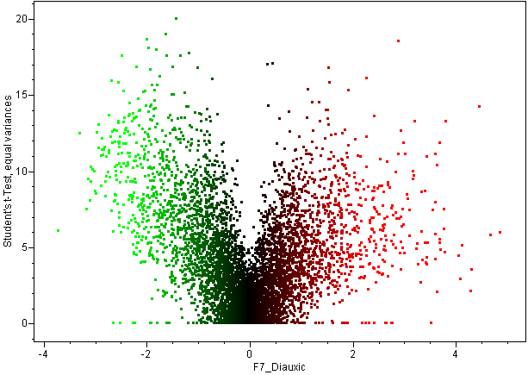
Volcano plot fold-change vs. significance
p=10⁻¹⁸
-log (p-value)
p=10⁻³
p=10⁻²
Log ratio
Log ratio
A volcano plot is a scatter plot of -log (p-value) from a t-test or one-way ANOVA, versus log ratio. It allows you to visualize fold-change and statistical significance at the same time, so that one can find genes that are significant and have large fold change, or genes that are significant but have small fold change.
P-values should be corrected for multiple hypothesis testing, such as with FDR, to control for Type I errors
Notes:
A volcano plot is a scatter plot of -log (p-value) from a t-test or one-way ANOVA, versus log ratio. It allows you to visualize fold-change and statistical significance at the same time, so that one can find genes that are significant and have large fold change, or genes that are significant but have small fold change.

Slide 15
Common Analysis Tasks
Pattern Analysis
Identify up- and down-regulated genes.
Find groups of genes with similar expression profiles.
Find groups of experiments (tissues) with similar expression profiles.
Find genes that explain observed differences among tissues (feature selection).

Slide 16
Characteristics of RNA-seq Data
Extremely high dimensionality
Experiment = (gene₁, gene₂, …, gene_{N})
Gene = (experiment₁, experiment₂, …, experiment_{M})
N is often on the order of 10⁴
M is often on the order of 10¹
Noisy or missing data
Very lowly expressed genes are detected less reproducibly
Especially relevant to limited sample sizes, e.g. single cell analysis

Slide 17
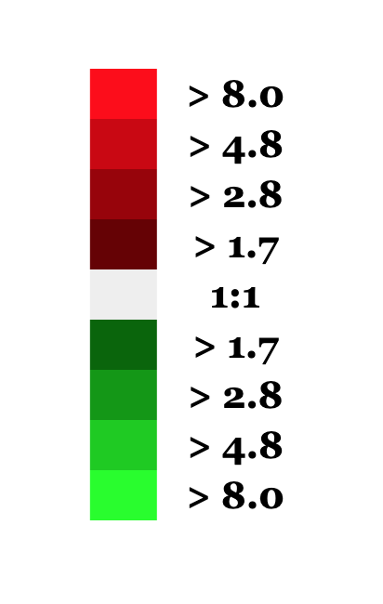
Gene expression profiling
Experiment 1
Experiment 10
Experiment 2
Experiment 3
Experiment 4
Experiment 5
Experiment 6
Experiment 7
Experiment 8
Experiment 9
Gene 1
Gene 2
Gene 3
Gene 4
Gene 5
…
…
Gene 10,000
How can we find patterns in the data?

Slide 18
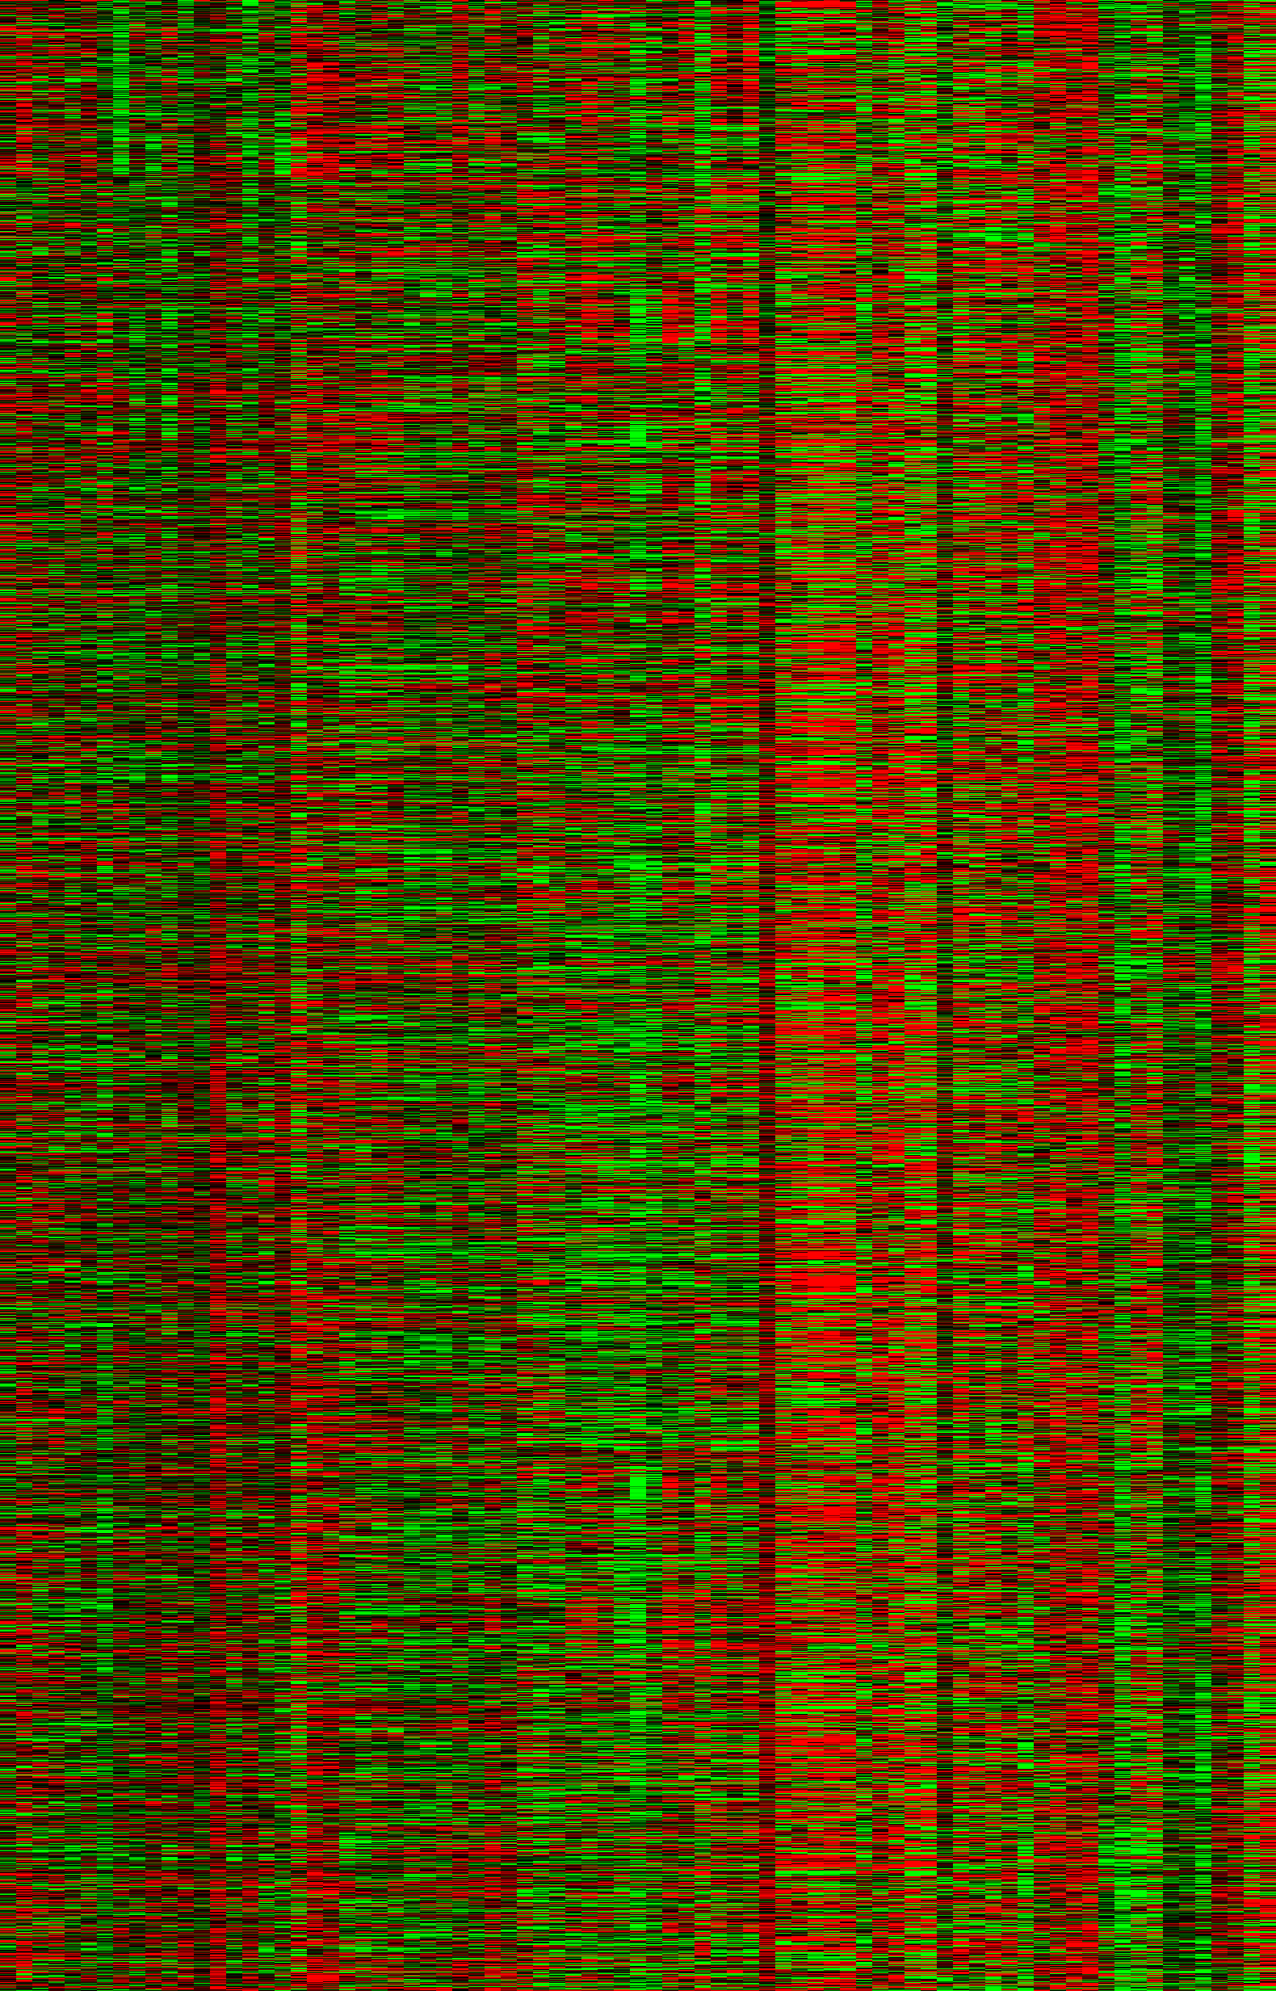
Gene expression matrix
Experiments (j)
The matrix entry at (i, j) is the expression level of gene i in experiment j.
Experiments could be:
Time series
Different treatments
Different tissues
…
Genes (i)

Slide 19
Types of analysis
Unsupervised learning: learn from data only
visualization: find structure in data
clustering: find clusters/classes in data
Supervised learning: learn from data plus prior knowledge
regression: predict a real value
classification: predict discrete classes
SVM, random forests, Bayes, KNN, neural networks

Slide 20
A series of experiments
Expression level
Experiments
A 2-D plot of expression level for a single gene in many different conditions.
The data points are connected by lines just to help visualize the changes in level between conditions.

Slide 21
Gene expression in multiple dimensions
Consider 3 experiments: x, y, and z
y
z
x
The expression vector for each gene can be represented as a point in 3-dimensional space, in which each axis represents a different condition.
Genes with similar expression patterns fall nearby one another in this multi-dimensional space.

Slide 22
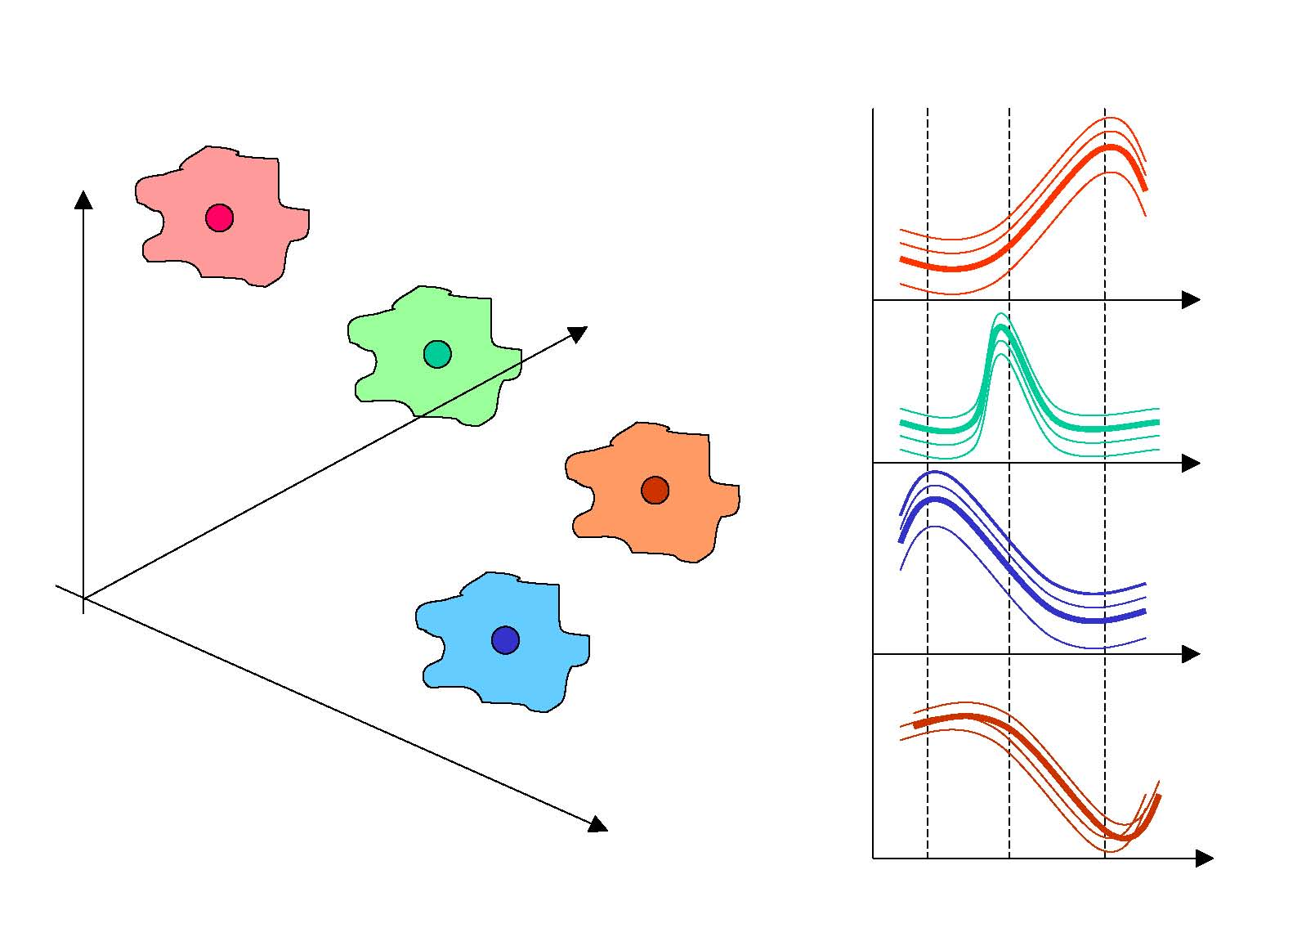
Gene expression in multiple dimensions
Consider 3 experiments: x, y, and z
y
y
z
z
x
x
The expression vector for each gene can be represented as a point in 3-dimensional space, in which each axis represents a different condition.
Genes with similar expression patterns fall nearby one another in this multi-dimensional space.
Genes with similar expression profiles are likely to have common or related functions, and possibly to be co-regulated.
Similarly, conditions can be classified into different groups based on similarities in their expression profiles (all or subsets of genes).

Slide 23
Coordinated gene expression
Which genes are co-expressed?
Hierarchal clustering
K-means clustering
Self-organizing maps
Principal component analysis

Slide 24
Root of clustering approaches:
a pairwise matrix of distances
 | gene 1 | gene2 | gene 3
gene 1 | 1 | 0.5 | 0.8
gene 2 | - | 1 | 0.6
gene 3 | - | - | 1
This matrix describes all the pairwise relationships (distances) between the elements you are trying to group (genes in this case)
But how to define distance?
Notes:
Video 3

Slide 25
Calculating Distance
Distance is the most natural method for numerical data
Lower values indicate more similarity
Distance metrics
Euclidean distance
Manhattan distance
Etc.
Does not generalize well to non-numerical data
What is the distance between “male” and “female”?

Slide 26
Distance Measures
Euclidian distance metric
Pythagorean theorem: a² = b² + c²
Euclidian distance in 3 dimensions between two points, x=(x₁,x₂,x₃) and y=(y₁,y₂,y₃):
d₁₂ = (x₁-y₁)² + (x₂-y₂)² + (x₃-y₃)²
In n-dimensions:
d = ∑(x_{i} - y_{i})²
Pearson correlation and Pearson distance (semi-metric)
n
∑(x_{i}-x)(y_{i}-y)
∑(x_{i}-x)² ∑(y_{i}-y)²
r =
i=1
60000
-1 ≤ r ≤ 1
d = 1 - r
0 ≤ d ≤ 2
High degree of similarity implies a small distance and vice versa

Slide 27
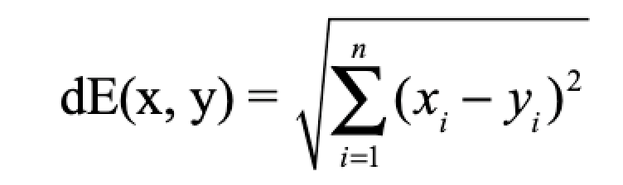
Euclidean distance
520
Gene expression
1090
experiments
Implication for gene expression:
the magnitude of expression values will determine distances

Slide 28
Covariance and Correlation
Start with the concept of covariance:
Cov_{xy} =
Σ (x_{i}-x)(y_{i}-y)
n
-1
i=1
n
But … covariance ranges from -∞ to +∞
Gene expression
1
Normalize the measure using the variance of two measurements, VarX and VarY
experiments
Σ (x_{i}-x)(y_{i}-y)
n
Pearson correlation coefficient
i=1
n
Pearson correlation has the nice property of varying between -1 and 1
r =
√ (VarX)(VarY)
Implication for gene expression:
the shape of gene expression responses will determine similarity

Slide 29
Grouping Objects: Clustering
Given a collection of objects, put objects into groups based on similarity.
Grouping complex entities such as expression data can be a fuzzy problem.
Expression data are complex because each gene can have a value for many experiments (“high dimensionality”)

Slide 30
Clustering approaches
Agglomerative: hierarchical
Divisive: partitioning methods

Slide 31
Hierarchical Clustering
Find the pair(s) with the highest pairwise similarity (distance measure)
Join these as a group and calculate an “average” profile
(single, average, or complete linkage)
Iteratively join groups until all are linked
E
F
A
B
C
D
A B C D E F

Slide 32
Linkage Methods
Single linkage:
Use the distance between
the closest two points
between each pair of clusters

Slide 33
Linkage Methods
Complete linkage:
Use the distance between
the furthest two points
between each pair of clusters

Slide 34
Linkage Methods
Centroid linkage:
Find the central point within each cluster based on all pairwise differences between them
Use the distance between the centroids between each pair of clusters

Slide 35
Linkage Methods
Average linkage:
Use the average distance between
each pair of points
between each pair of clusters
In phylogenetics, UPGMA (unweighted pair-group method with arithmetic means) uses average linking.

Slide 36
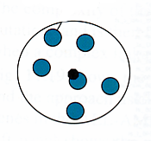
Summary: Linkage Methods
Single linkage
Complete linkage
Centroid linkage
Average linkage
Minimum distance
Maximum distance
Mean distance
Average pair-wise distance
Notes:
Animations have to be fixed

Slide 37
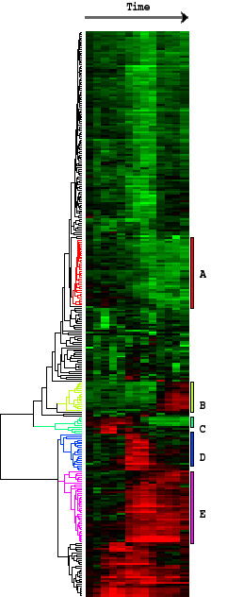
End Result
Conditions
Place genes with similar expression profiles into clusters.
Similarity is defined by Pearson correlation.
Genes
(clustered by similarity in expression profiles)
Genes are grouped according to similarities in their expression levels across a variety of conditions.

Slide 38
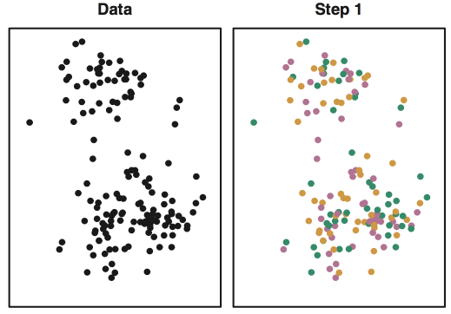
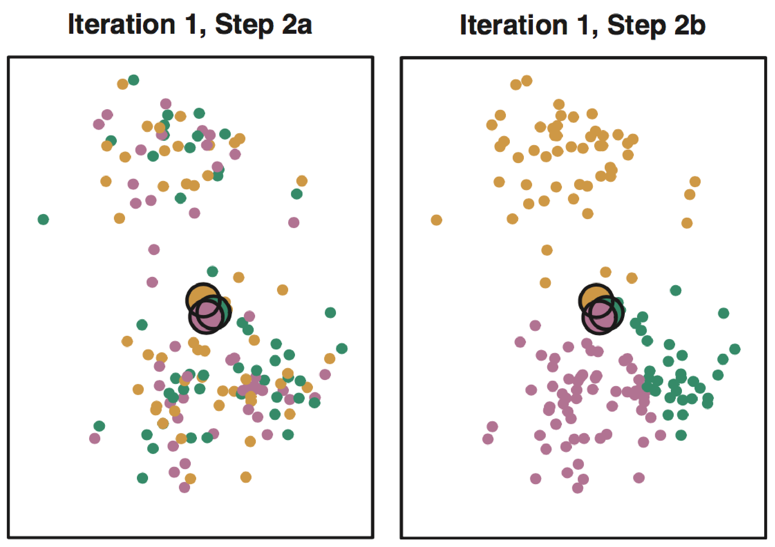
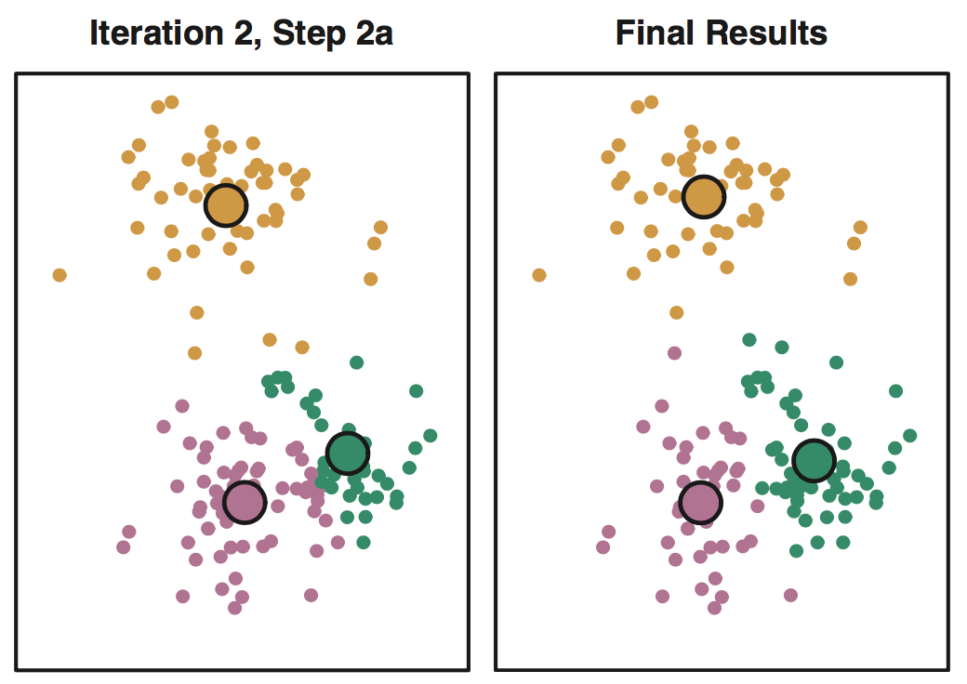
K-means: Example, k = 3
Step 1: Choose k and assign points randomly to different groups.
Step 2: Compute centroids (big dots) and reassign points to nearest centroids
Step 3: Re-compute centroids, repeat until stable (right: after 10 iterations)

Slide 39
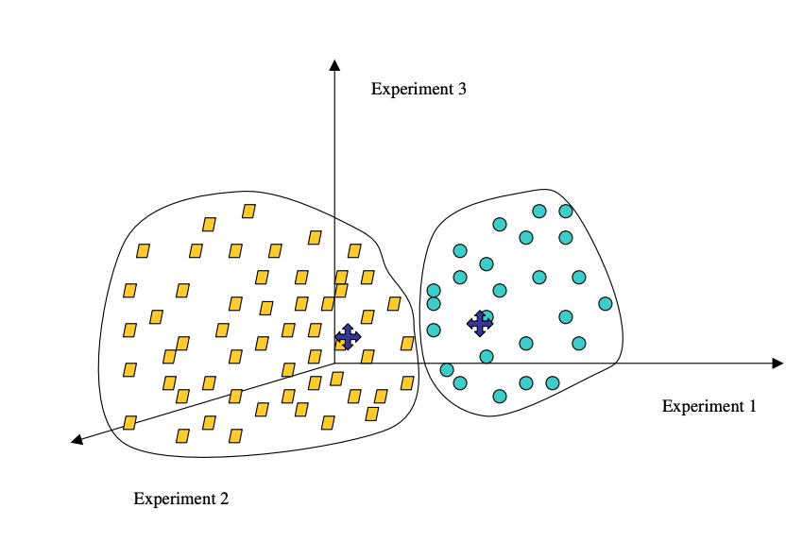
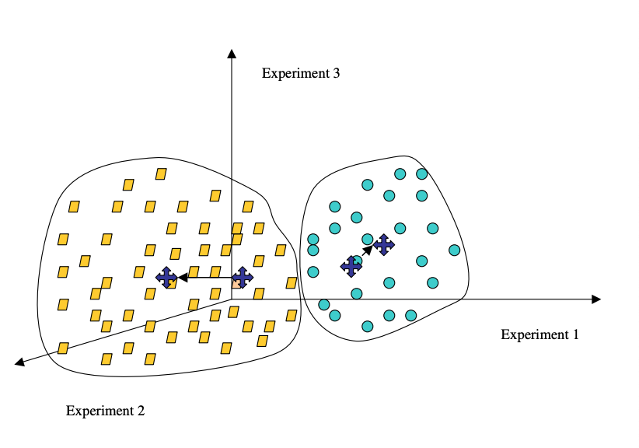
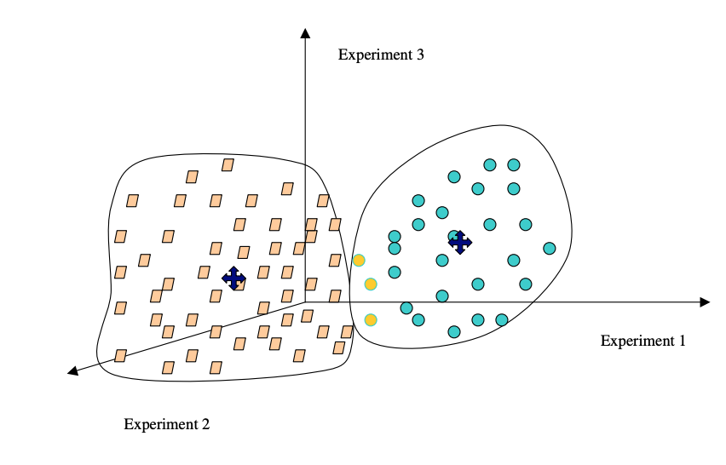
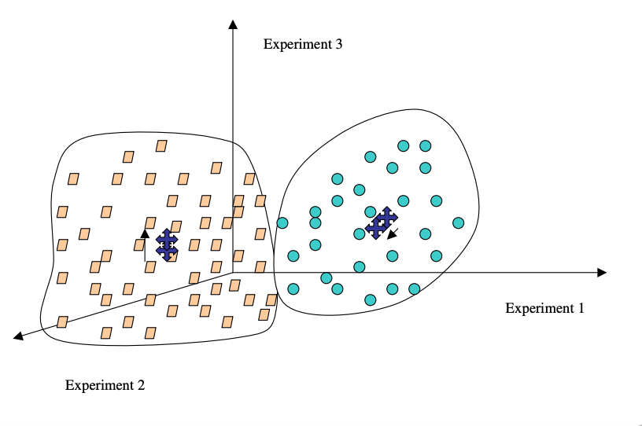
K-means in action:
tends to create round clouds
1
2
3
Source: Sorin, Drăghici. Statistics and Data Analysis for Microarrays Using R and Bioconductor, Second Edition by Chapman and Hall/CRC Series: Chapman & Hall/CRC Mathematical and Computational Biology, 2016
Notes:
1: Top Left
2: Top Right
3: Bottom Left
4: Bottom Right
Take image from the book, Ch 7 “Clustering” p. 585

Slide 40
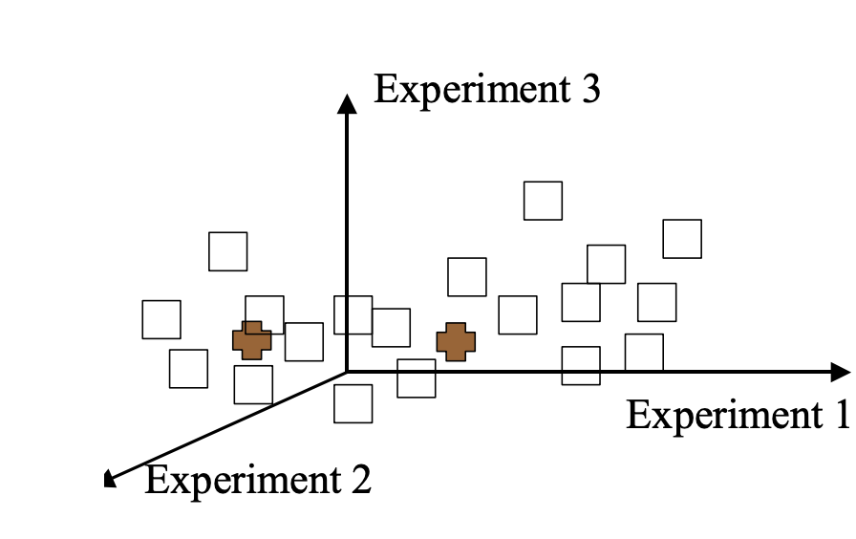
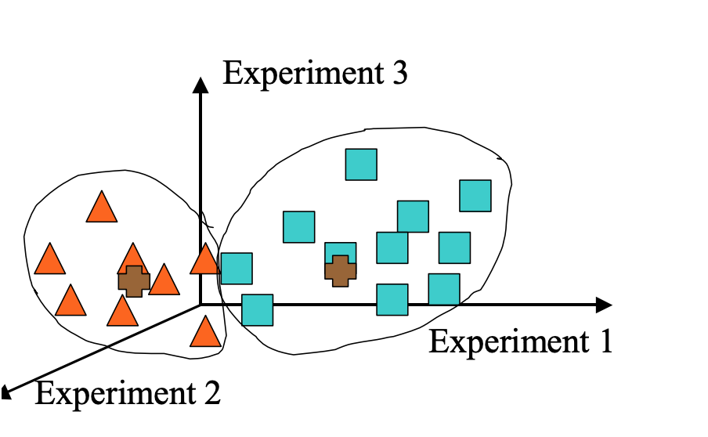
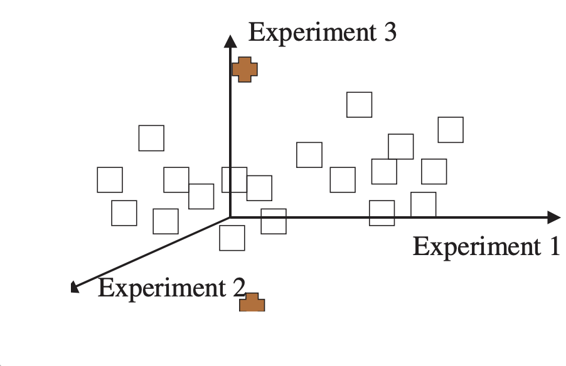
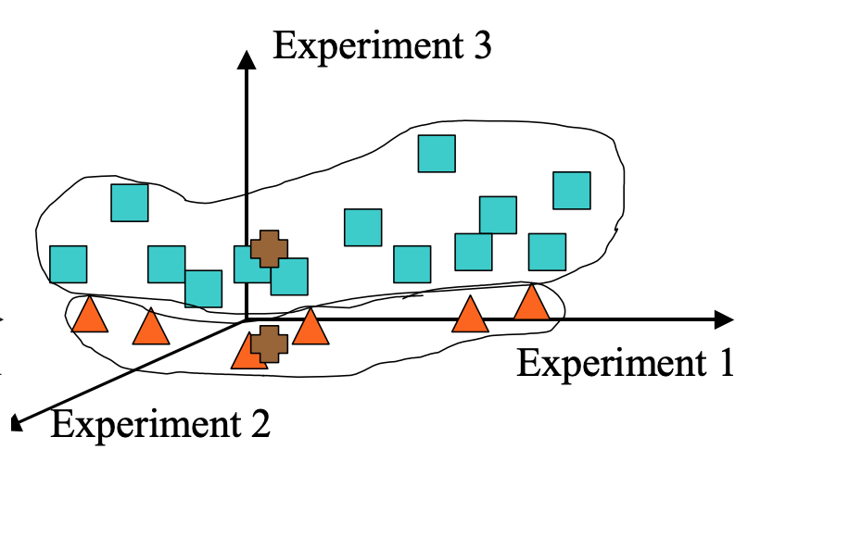
K-means: Weaknesses Can give you a different result each time with exactly the same data
Initial centroids
Initial centroids
Source: Sorin, Drăghici. Statistics and Data Analysis for Microarrays Using R and Bioconductor, Second Edition by Chapman and Hall/CRC Series: Chapman & Hall/CRC Mathematical and Computational Biology, 2016
Notes:
[Show the white points first, then the brown points, then show areas around red triangles and blue squares]
Take image from the book, p.586
Remake in AI, and bring in each layer at a time
Also, in Rise make an animated GIF

Slide 41
K-means: Weaknesses
Must choose parameter k in advance, or try many values.
Data must be numerical and must be compared via Euclidean distance (there is a variant called the k-medians algorithm to address these concerns)
The algorithm works best on data which contains spherical clusters; clusters with other geometry may not be found.
The algorithm is sensitive to outliers -- points which do not belong in any cluster. These can distort the centroid positions and ruin the clustering.

Slide 42
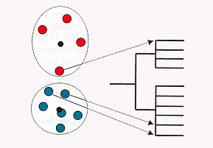
Clustering has no one answer
Given a collection of objects, put objects into groups based on similarity.
It really depends on how you measure similarity/dissimilarity
Problem: Sometimes genes with pretty similar expression can end up in different clusters!

Slide 43
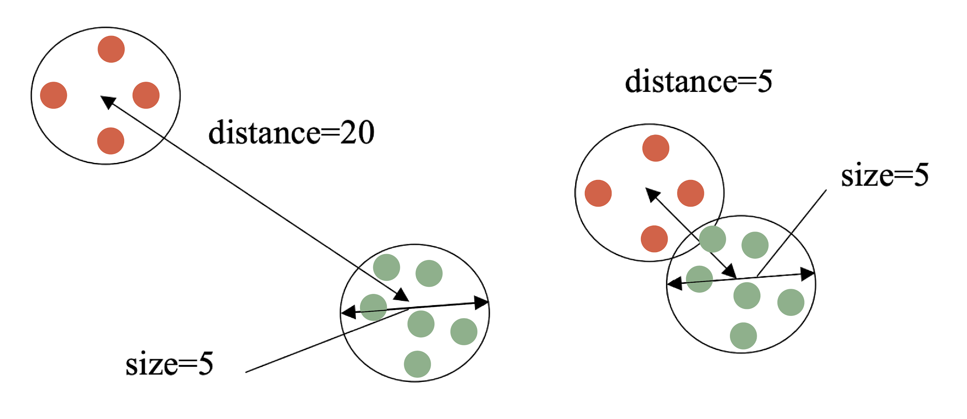
Judging Clustering Quality:
Silhouette width
Ideally, we want well separated, distinct groups
Maximize between-cluster distance
Minimize within-cluster distance
Sil_{i} = (b_{i}-a_{i})/max(a_{i},b_{i})
a_{i}: average within cluster distance with respect to gene i
b_{i}: average between cluster distance with respect to gene i
Source: Sorin, Drăghici. Statistics and Data Analysis for Microarrays Using R and Bioconductor, Second Edition by Chapman and Hall/CRC Series: Chapman & Hall/CRC Mathematical and Computational Biology, 2016
Notes:
Take image from the book
p.587

Slide 44
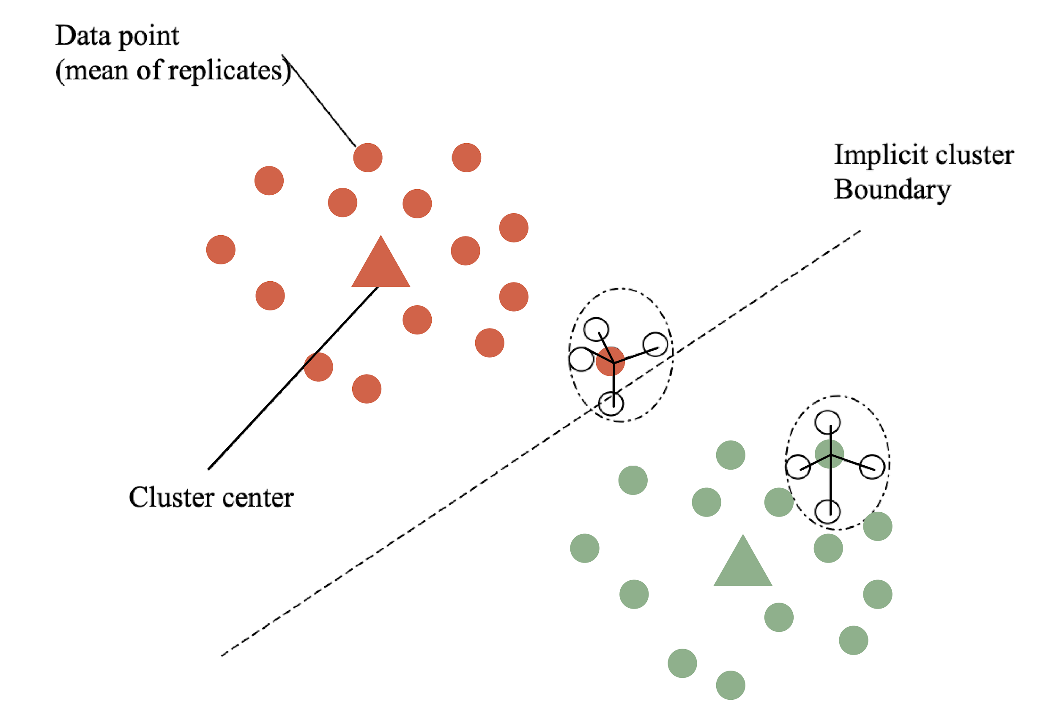
Measuring the Quality of Clusters
This point has a low a_{i} and a big b_{i} so a high Silhouette value
These points have a low a_{i} and a big b_{i} so a high Silhouette value
Oblong clusters will lead to low or negative Silhouette widths

Slide 45
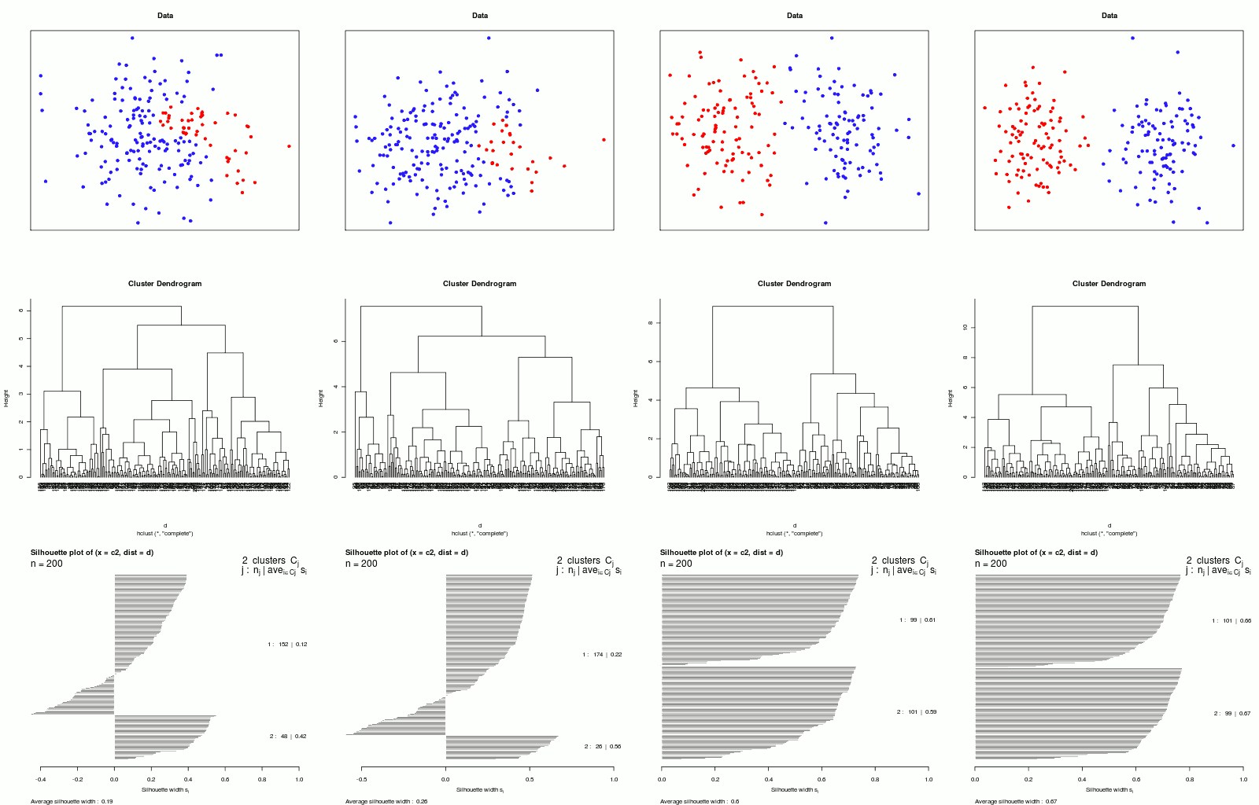
Silhouette plots
1: 99 genes
s_{avg} = 0.61
2: 101 genes
s_{avg} = 0.59
Silhouette width, s_{i}
_{Average silhouette width: 0.6}

Slide 46
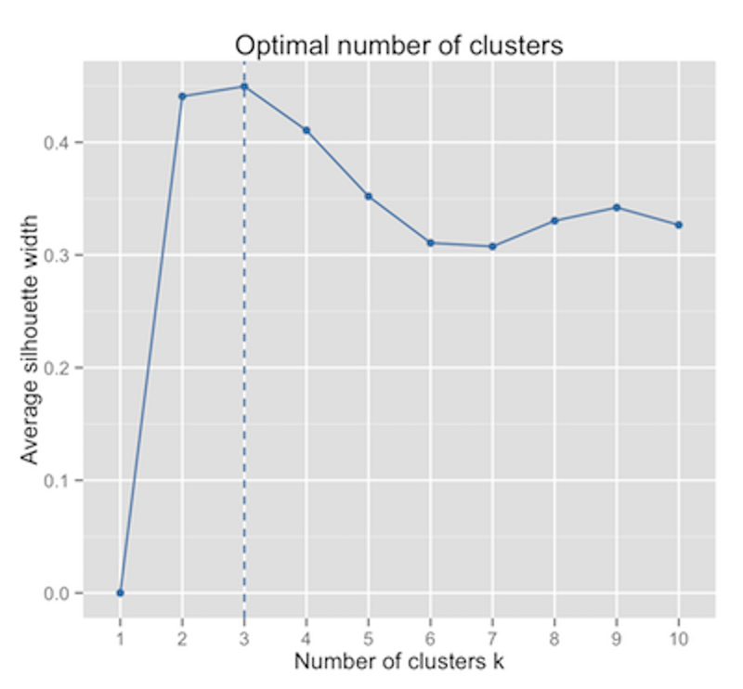
Silhouette plots
Four different datasets:

Slide 47
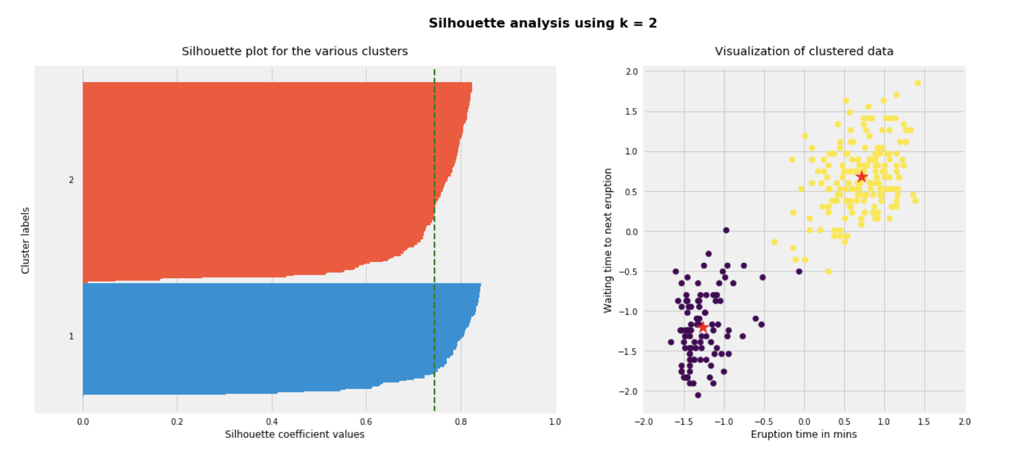
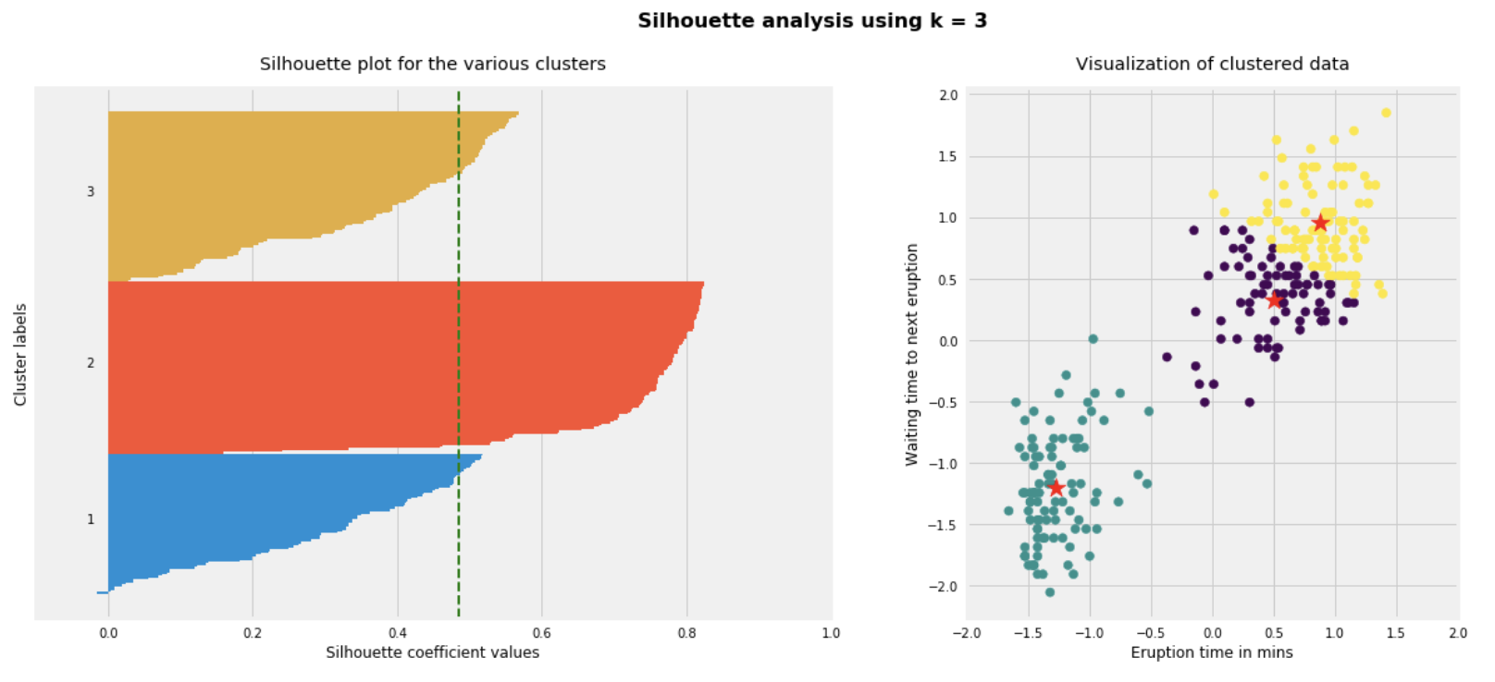
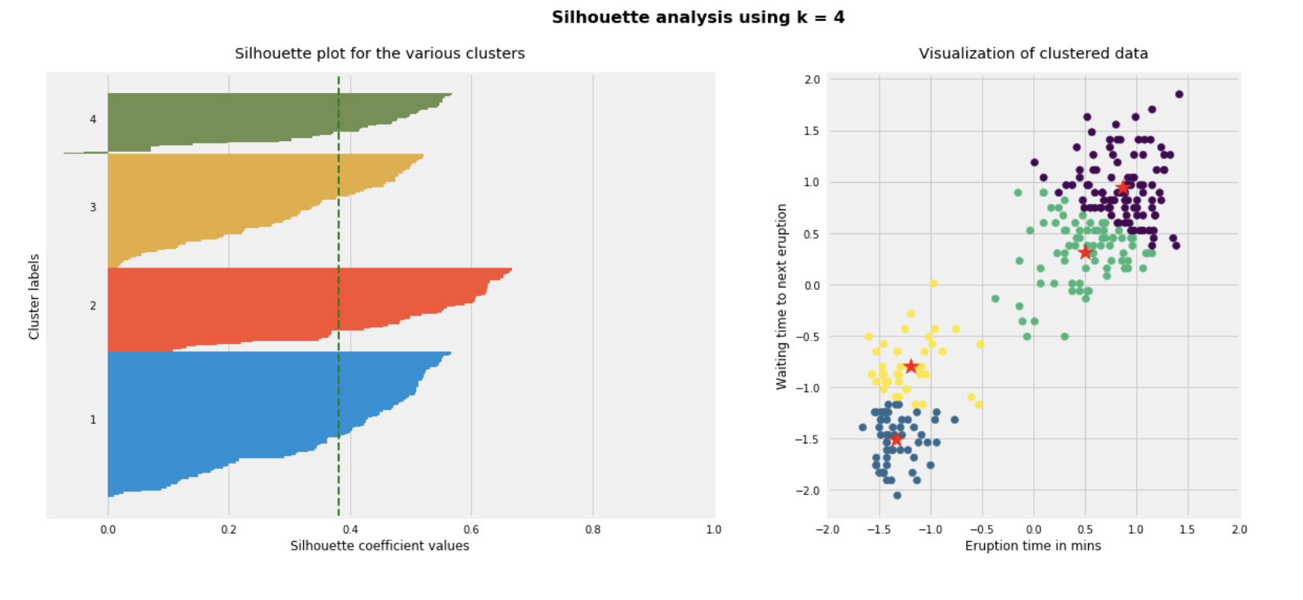
Another example
The partitioning with k = 2 has the highest average silhouette width, and thus provides the most distinct clusters.
k = 2
You may have additional data, however, suggesting that there really are more than 2 groups
(e.g. single-cell data in which the yellow and purple clusters can be distinguished based on coherent expression of cell-type-specific markers / gene sets)
k =3
k = 4

Slide 48
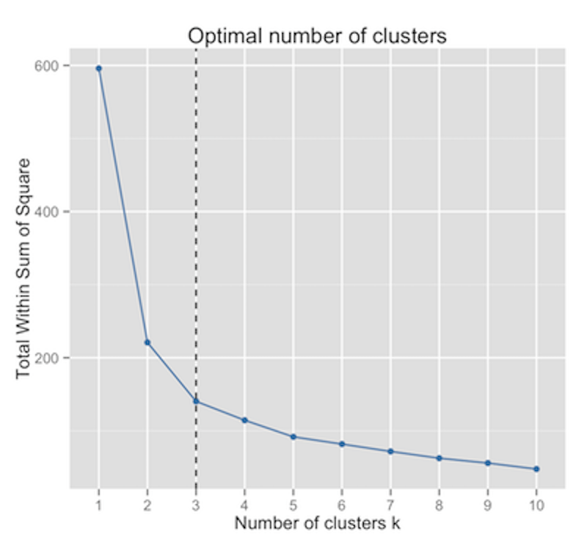
Choosing the right number of clusters
Maximum average silhouette width
Elbow method

