Slide 1
Clustering Methods
XDASI Fall 2021
Kris Gunsalus

Slide 2
Outline
Clustering
Distance measures
Hierarchical
K-means
Evaluating cluster quality

Slide 3
Genome-wide expression analysis
Goal: to measure RNA levels of all genes in a genome under various experimental conditions
RNA levels vary with:
Cell type
Developmental stage
External stimuli
Disease state
Time and location of expression provide information on genes’ function and interactions, and can be useful for many purposes, including disease diagnostics and medical applications.

Slide 4
Common Analysis Tasks
Pattern Analysis
Identify up- and down-regulated genes.
Find groups of genes with similar expression profiles.
Find groups of experiments (tissues) with similar expression profiles.
Find genes that explain observed differences among tissues (feature selection).

Slide 5
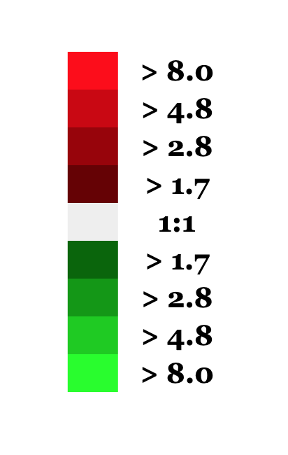
Gene expression profiling
Experiment 1
Experiment 10
Experiment 2
Experiment 3
Experiment 4
Experiment 5
Experiment 6
Experiment 7
Experiment 8
Experiment 9
Gene 1
Gene 2
Gene 3
Gene 4
Gene 5
…
…
Gene 10,000
How can we find patterns in the data?

Slide 6
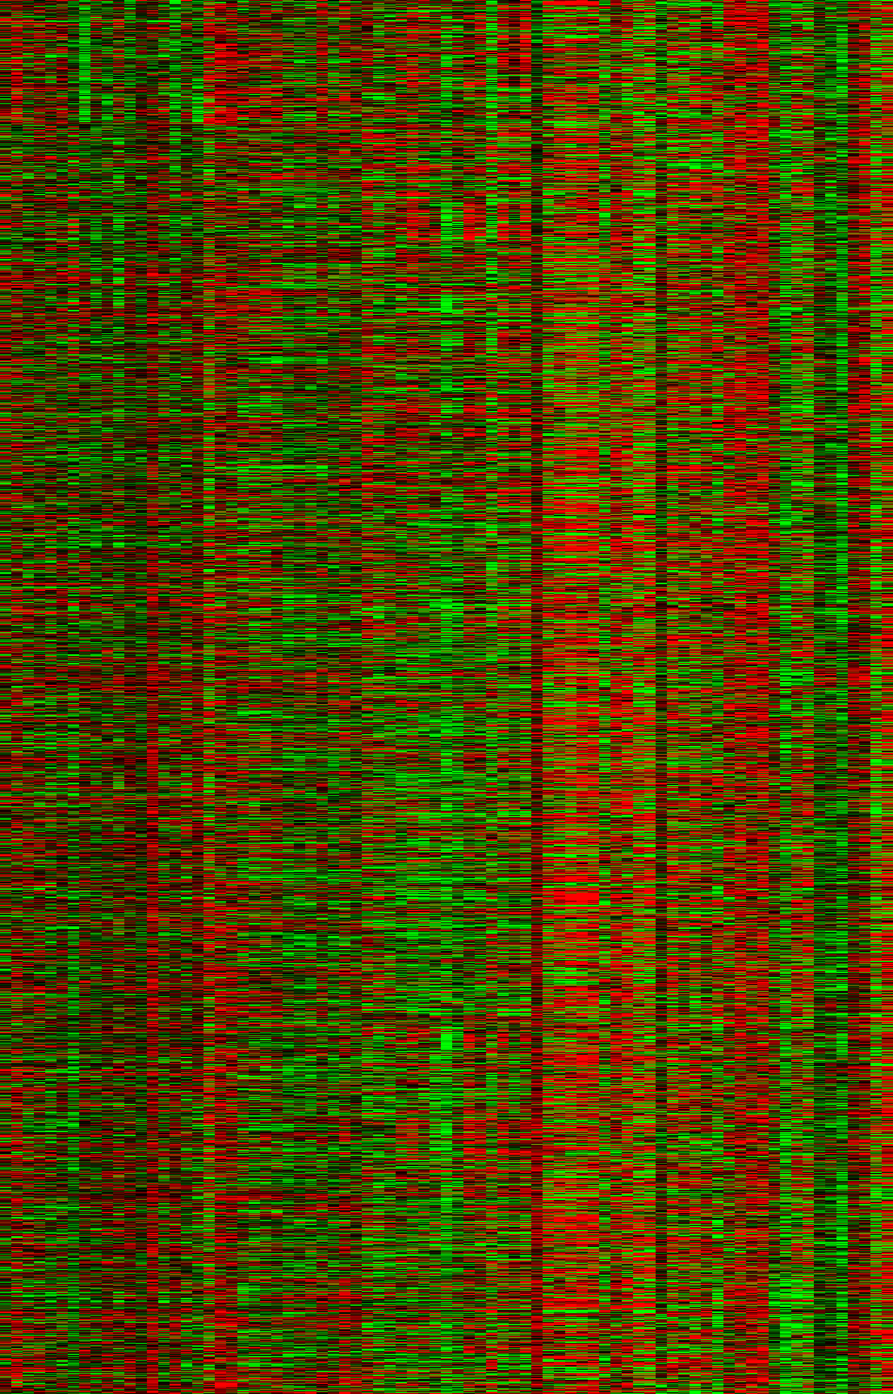
Gene expression matrix
Experiments (j)
The matrix entry at (i, j) is the expression level of gene i in experiment j.
Experiments could be:
Time series
Different treatments
Different tissues
…
Genes (i)
Note: it is possible to find patterns even in totally random data!

Slide 7
Types of analysis
Unsupervised learning: learn from data only
visualization: find structure in data
clustering: find clusters/classes in data
Supervised learning: learn from data plus prior knowledge
regression: predict a real value
classification: predict discrete classes
SVM, random forests, Bayes, KNN, neural networks

Slide 8
A series of experiments
Expression level
Experiments
A 2-D plot of expression level for a single gene in many different conditions.
The data points are connected by lines just to help visualize the changes in level between conditions.

Slide 9
Gene expression in multiple dimensions
Consider 3 experiments: x, y, and z
y
z
x
The expression vector for each gene can be represented as a point in 3-dimensional space, in which each axis represents a different condition.
Genes with similar expression patterns fall nearby one another in this multi-dimensional space.

Slide 10
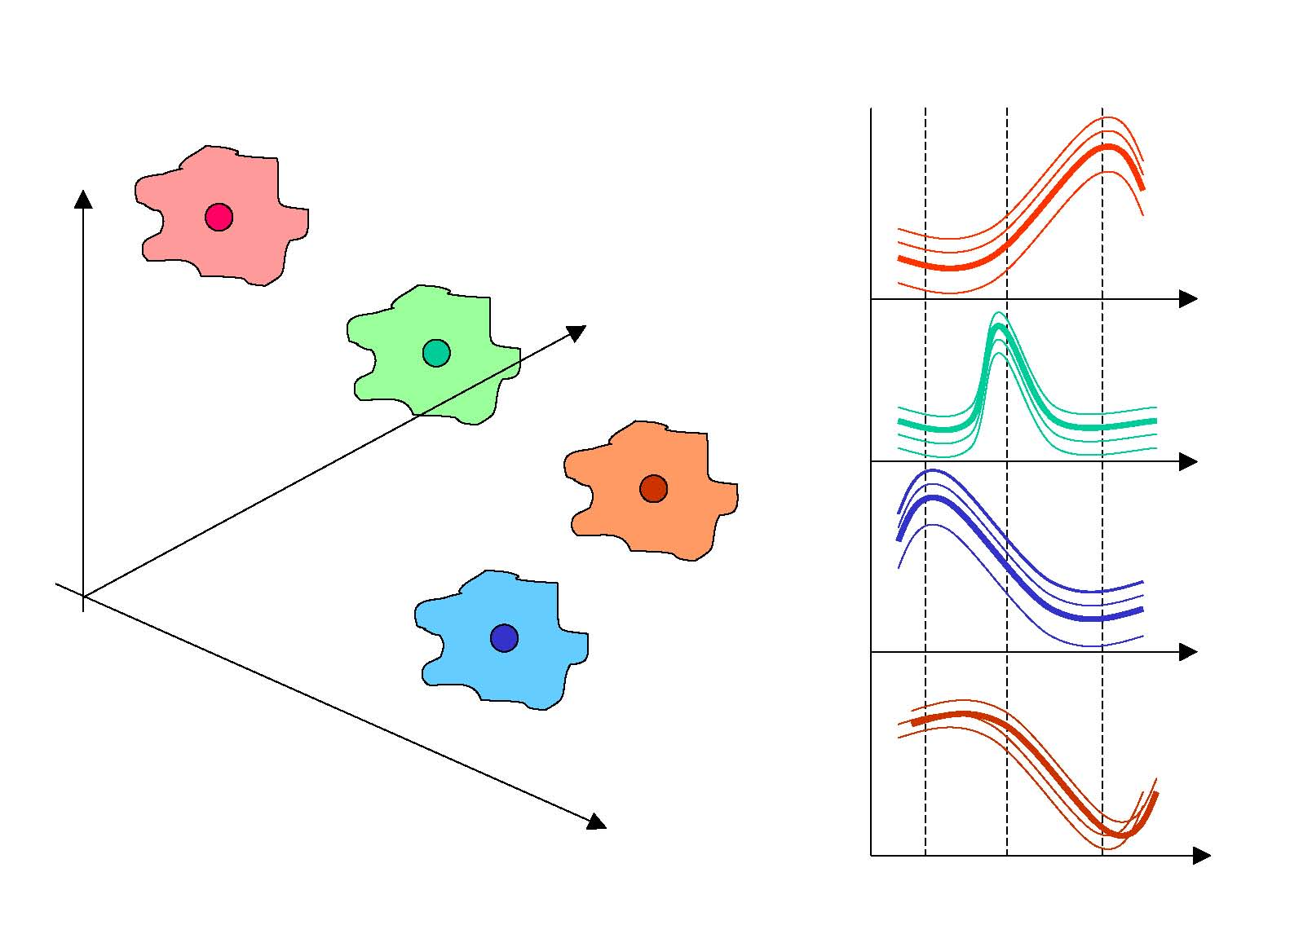
Gene expression in multiple dimensions
Consider 3 experiments: x, y, and z
y
y
z
z
x
x
The expression vector for each gene can be represented as a point in 3-dimensional space, in which each axis represents a different condition.
Genes with similar expression patterns fall nearby one another in this multi-dimensional space.
Genes with similar expression profiles are likely to have common or related functions, and possibly to be co-regulated.
Similarly, conditions can be classified into different groups based on similarities in their expression profiles (all or subsets of genes).

Slide 11
Coordinated gene expression
Which genes are co-expressed?
Hierarchal clustering
K-means clustering
Self-organizing maps
Principal component analysis

Slide 12
Root of clustering approaches:
a pairwise matrix of distances
 | gene 1 | gene2 | gene 3
gene 1 | 1 | 0.5 | 0.8
gene 2 | - | 1 | 0.6
gene 3 | - | - | 1
This matrix describes all the pairwise relationships (distances) between the elements you are trying to group (genes in this case)
But how to define distance?
Notes:
Video 3

Slide 13
Calculating Distance
Distance is the most natural method for numerical data
Lower values indicate more similarity
Distance metrics
Euclidean distance
Manhattan distance
Etc.
Does not generalize well to non-numerical data
What is the distance between “male” and “female”?

Slide 14
Distance Measures
Euclidian distance metric
Pythagorean theorem: a² = b² + c²
Euclidian distance in 3 dimensions between two points, x=(x₁,x₂,x₃) and y=(y₁,y₂,y₃):
d₁₂ = (x₁-y₁)² + (x₂-y₂)² + (x₃-y₃)²
In n-dimensions:
d = ∑(x_{i} - y_{i})²
Pearson correlation and Pearson distance (semi-metric)
n
∑(x_{i}-x)(y_{i}-y)
∑(x_{i}-x)² ∑(y_{i}-y)²
r =
i=1
60000
-1 ≤ r ≤ 1
d = 1 - r
0 ≤ d ≤ 2
High degree of similarity implies a small distance and vice versa

Slide 15
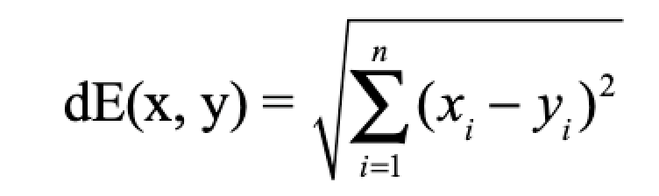
Euclidean distance
520
Gene expression
1090
experiments
Implication for gene expression:
the magnitude of expression values will determine distances

Slide 16
Covariance and Correlation
Start with the concept of covariance:
Cov_{xy} =
Σ (x_{i}-x)(y_{i}-y)
n
-1
i=1
n
But … covariance ranges from -∞ to +∞
Gene expression
1
Normalize the measure using the variance of two measurements, VarX and VarY
experiments
Σ (x_{i}-x)(y_{i}-y)
n
Pearson correlation coefficient
i=1
n
Pearson correlation has the nice property of varying between -1 and 1
r =
√ (VarX)(VarY)
Implication for gene expression:
the shape of gene expression responses will determine similarity

Slide 17
Grouping Objects: Clustering
Given a collection of objects, put objects into groups based on similarity.
Grouping complex entities such as expression data can be a fuzzy problem.
Expression data are complex because each gene can have a value for many experiments (“high dimensionality”)

Slide 18
Clustering approaches
Agglomerative: hierarchical
Divisive: partitioning methods

Slide 19
Hierarchical Clustering
Find the pair(s) with the highest pairwise similarity (distance measure)
Join these as a group and calculate an “average” profile
(single, average, or complete linkage)
Iteratively join groups until all are linked
E
F
A
B
C
D
A B C D E F

Slide 20
Linkage Methods
Single linkage:
Use the distance between
the closest two points
between each pair of clusters

Slide 21
Linkage Methods
Complete linkage:
Use the distance between
the furthest two points
between each pair of clusters

Slide 22
Linkage Methods
Centroid linkage:
Find the central point within each cluster based on all pairwise differences between them
Use the distance between the centroids between each pair of clusters

Slide 23
Linkage Methods
Average linkage:
Use the average distance between
each pair of points
between each pair of clusters
In phylogenetics, UPGMA (unweighted pair-group method with arithmetic means) uses average linking.

Slide 24
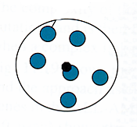
Summary: Linkage Methods
Single linkage
Complete linkage
Centroid linkage
Average linkage
Minimum distance
Maximum distance
Mean distance
Average pair-wise distance
Notes:
Animations have to be fixed

Slide 25
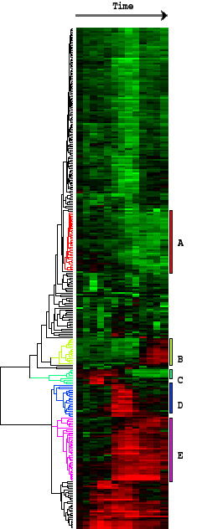
End Result
Conditions
Place genes with similar expression profiles into clusters.
Similarity is defined by Pearson correlation.
Genes
(clustered by similarity in expression profiles)
Genes are grouped according to similarities in their expression levels across a variety of conditions.

Slide 26
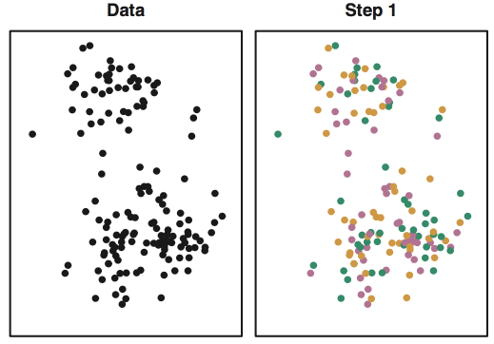
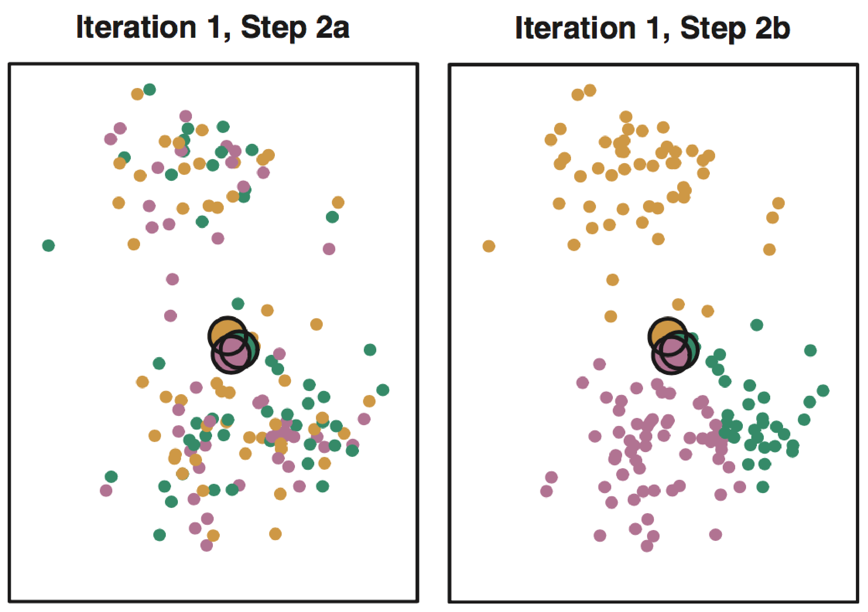
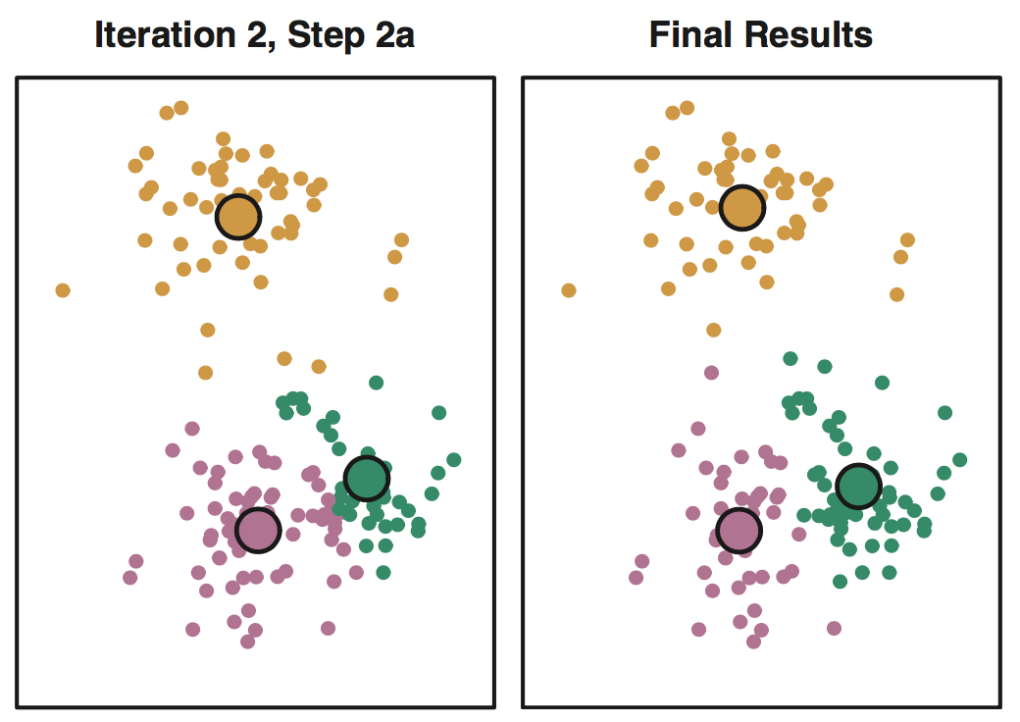
K-means: Example, k = 3
Step 1: Choose k and assign points randomly to different groups.
Step 2: Compute centroids (big dots) and reassign points to nearest centroids
Step 3: Re-compute centroids, repeat until stable (right: after 10 iterations)

Slide 27
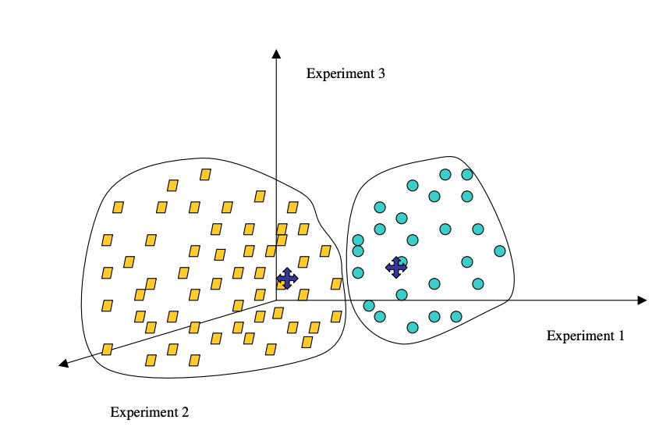
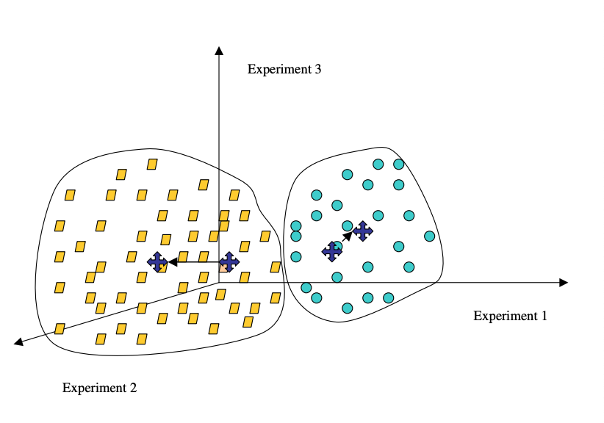
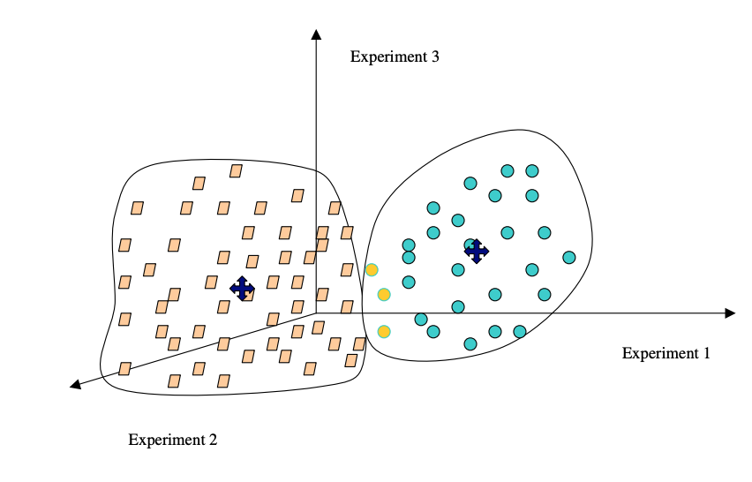
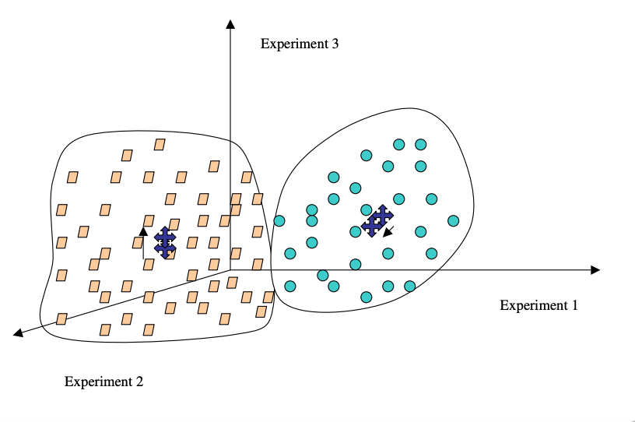
K-means in action:
tends to create round clouds
1
2
3
Source: Sorin, Drăghici. Statistics and Data Analysis for Microarrays Using R and Bioconductor, Second Edition by Chapman and Hall/CRC Series: Chapman & Hall/CRC Mathematical and Computational Biology, 2016
Notes:
1: Top Left
2: Top Right
3: Bottom Left
4: Bottom Right
Take image from the book, Ch 7 “Clustering” p. 585

Slide 28
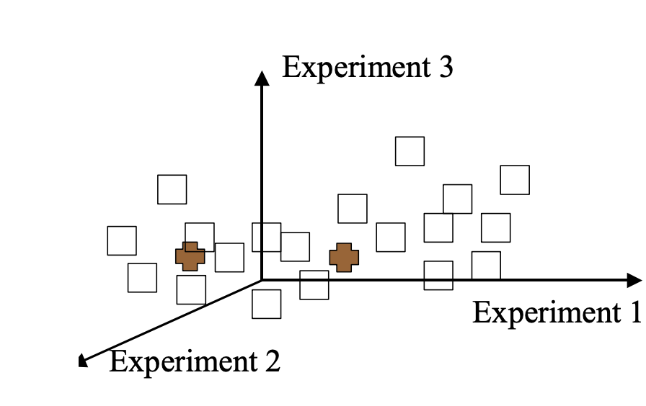
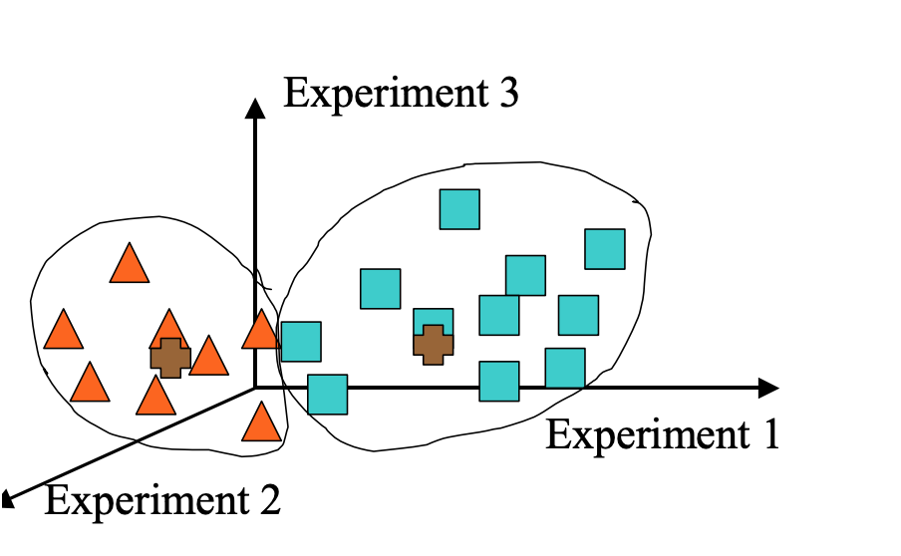
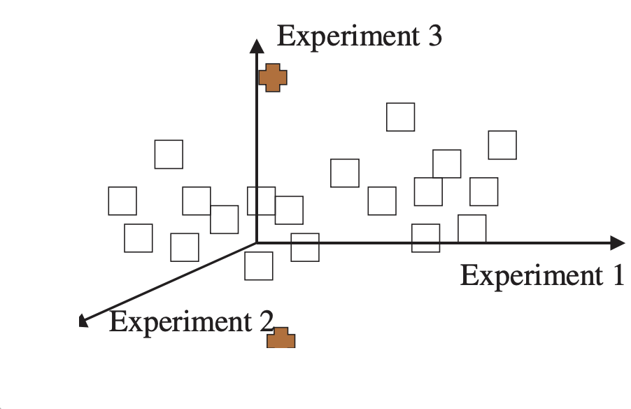
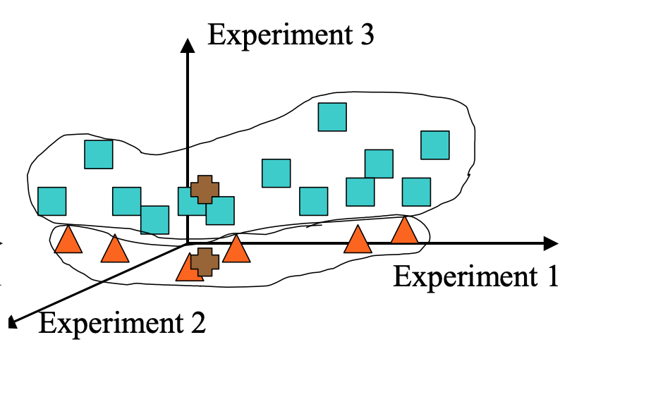
K-means: Weaknesses Can give you a different result each time with exactly the same data
Initial centroids
Initial centroids
Source: Sorin, Drăghici. Statistics and Data Analysis for Microarrays Using R and Bioconductor, Second Edition by Chapman and Hall/CRC Series: Chapman & Hall/CRC Mathematical and Computational Biology, 2016
Notes:
[Show the white points first, then the brown points, then show areas around red triangles and blue squares]
Take image from the book, p.586
Remake in AI, and bring in each layer at a time
Also, in Rise make an animated GIF

Slide 29
K-means: Weaknesses
Must choose parameter k in advance, or try many values.
Data must be numerical and must be compared via Euclidean distance (there is a variant called the k-medians algorithm to address these concerns)
The algorithm works best on data which contains spherical clusters; clusters with other geometry may not be found.
The algorithm is sensitive to outliers -- points which do not belong in any cluster. These can distort the centroid positions and ruin the clustering.

Slide 30
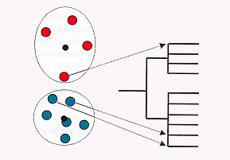
Clustering has no one answer
Given a collection of objects, put objects into groups based on similarity.
It really depends on how you measure similarity/dissimilarity
Problem: Sometimes genes with pretty similar expression can end up in different clusters!

Slide 31
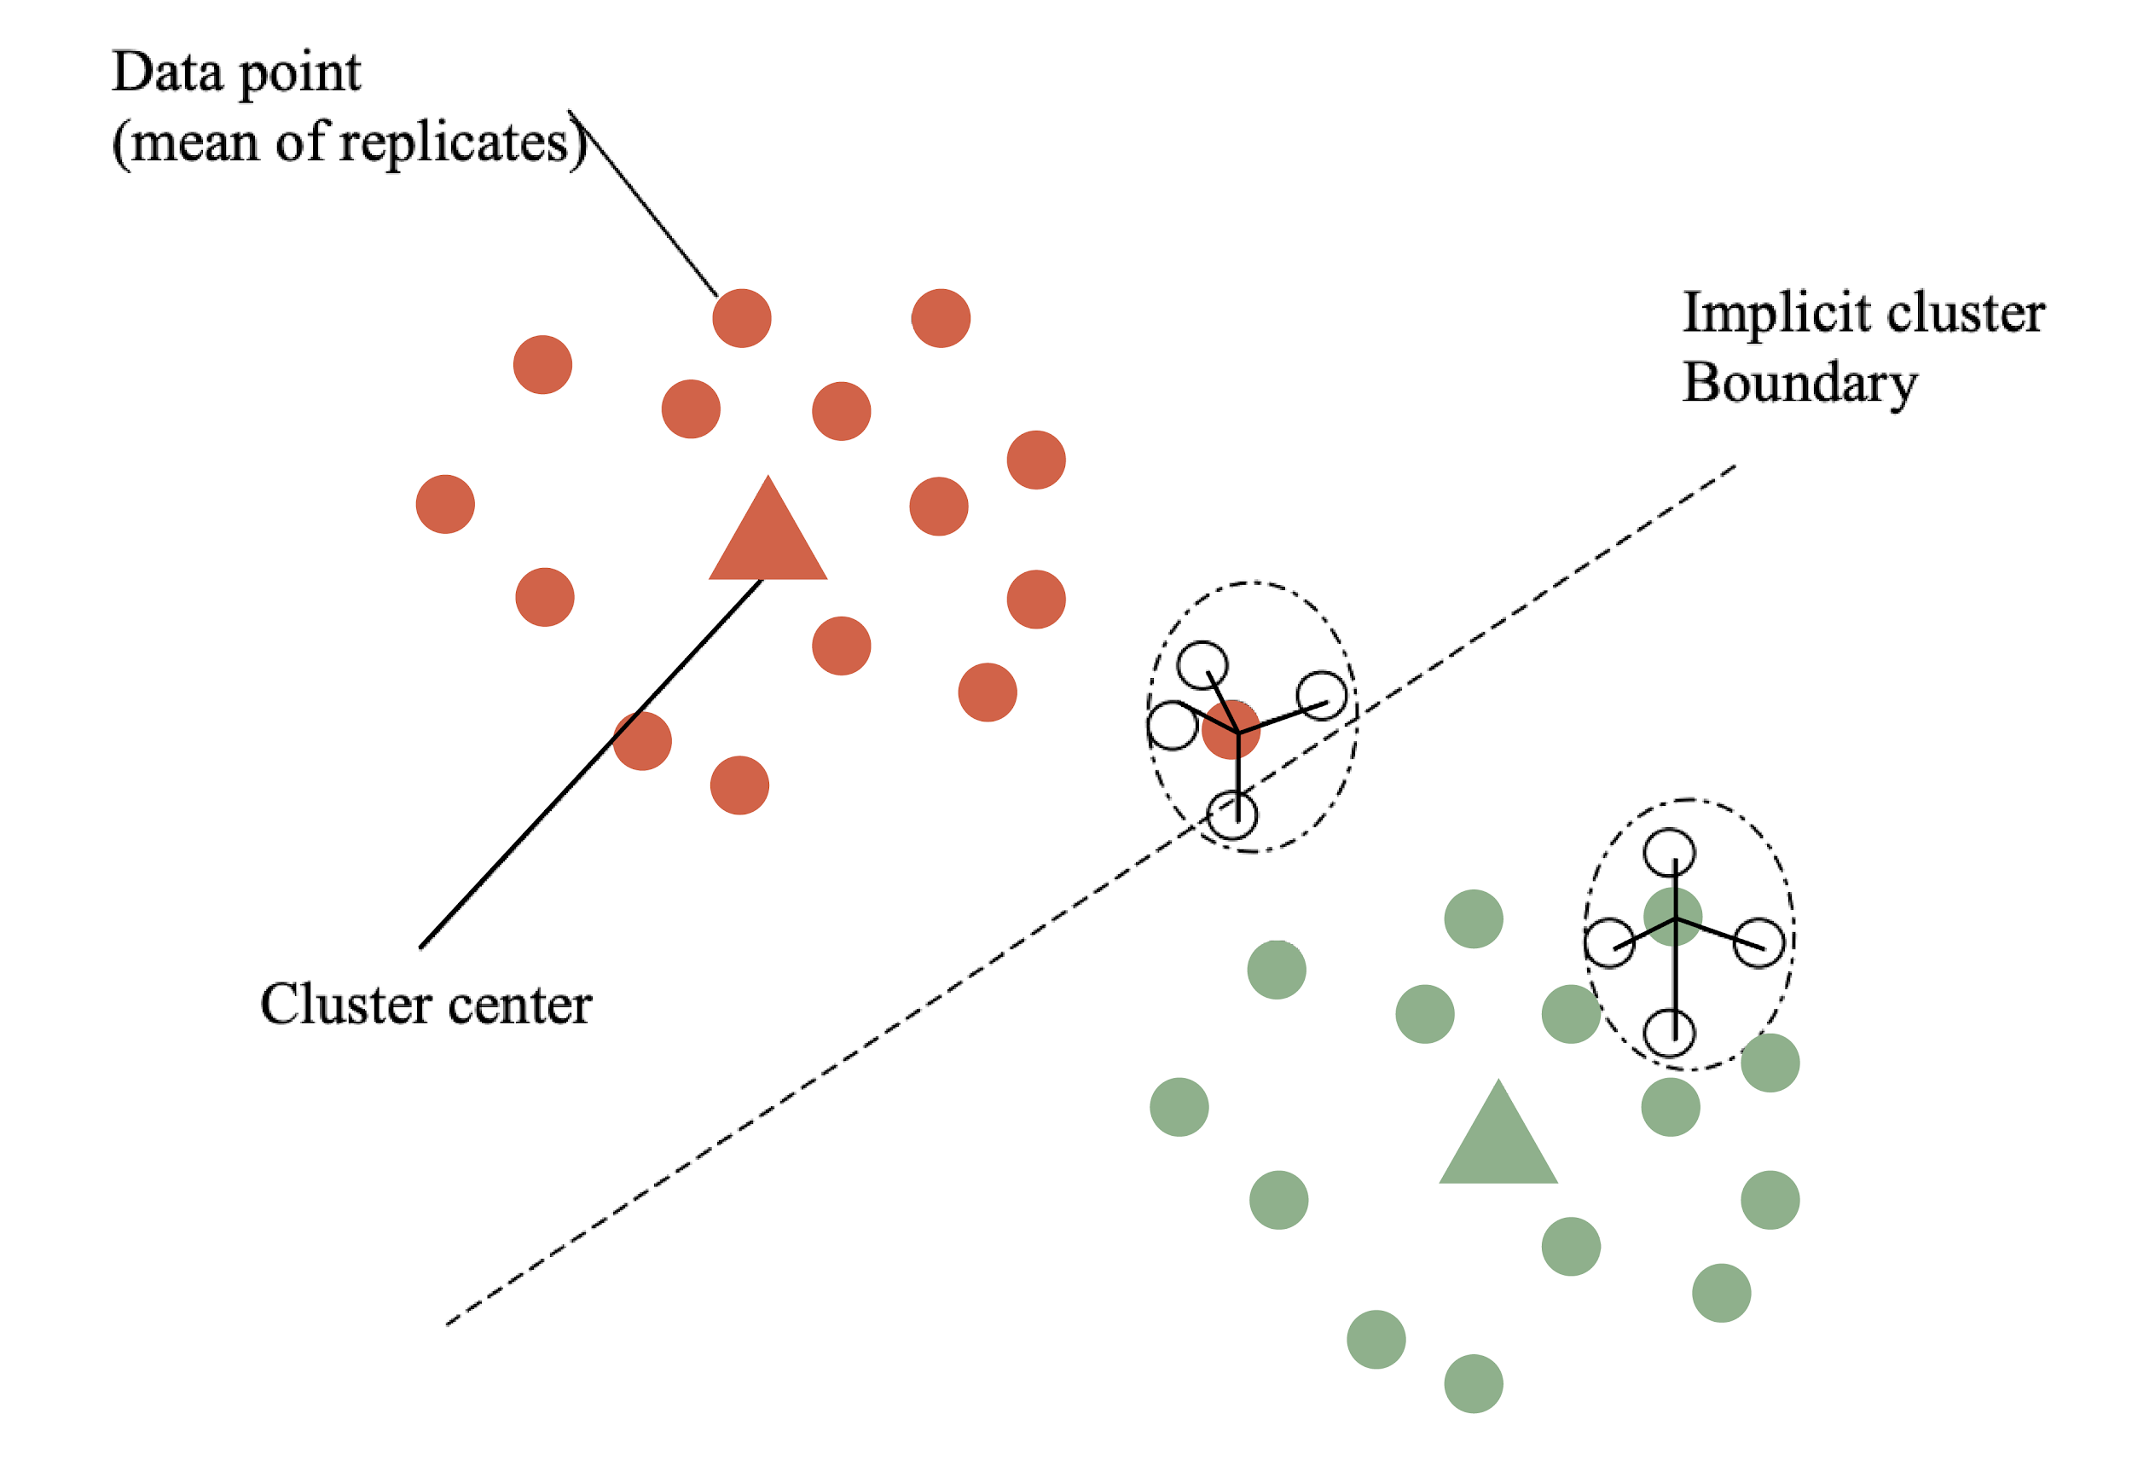
Measuring the Quality of Clusters
This point has a high a_{i} and a low b_{i} so a low Silhouette value
These points have a low a_{i} and a big b_{i} so a high Silhouette value
Can use bootstrapping to measure confidence in cluster assignment

Slide 32
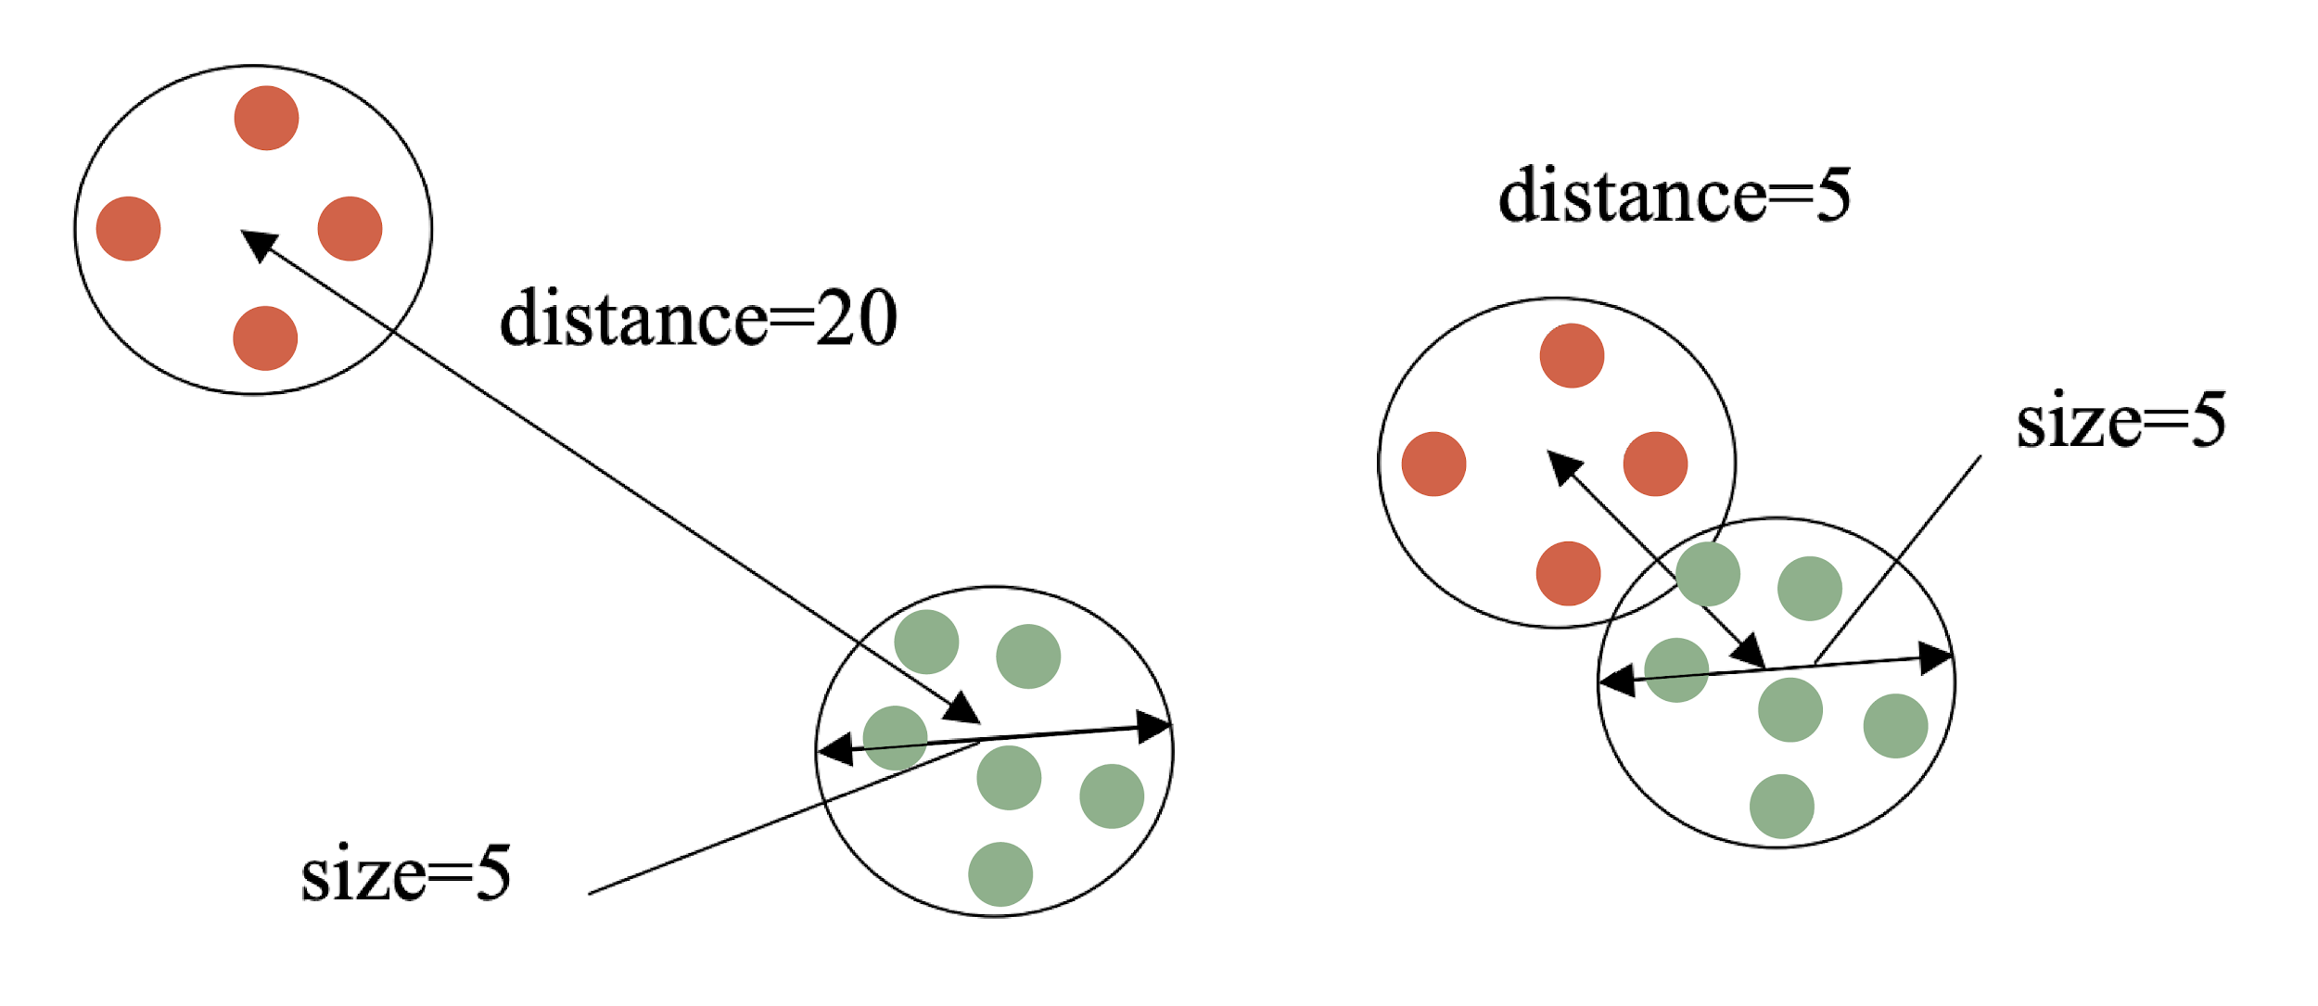
Judging Clustering Quality:
Silhouette width
Ideally, we want well separated, distinct groups
Maximize between-cluster distance
Minimize within-cluster distance
s(i) = (b_{i}-a_{i})/max(a_{i},b_{i})
a_{i}: average within cluster distance with respect to gene i
b_{i}: average between cluster distance with respect to gene i
s(i) will be negative when i is more more similar to points in another cluster than to points in the same cluster
Notes:
Take image from the book
p.587

Slide 33
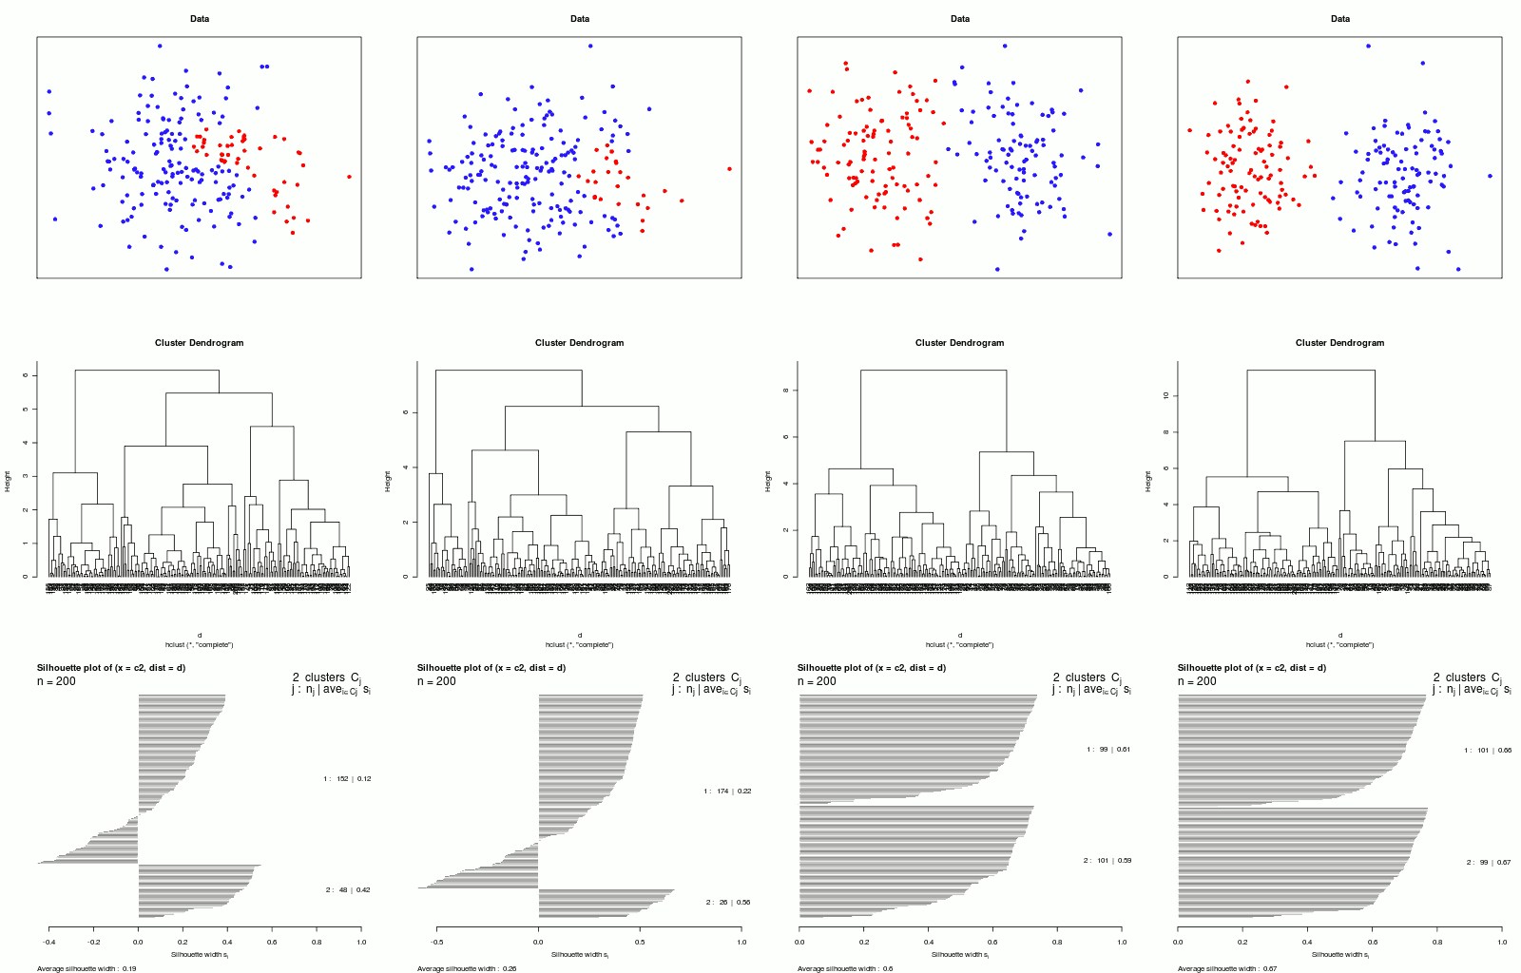
Silhouette plots
1: 99 genes
s_{avg} = 0.61
2: 101 genes
s_{avg} = 0.59
Where to cut the tree?
Silhouette width, s_{i}
_{Average silhouette width: 0.6}
Ideally we would like to maximize the average silhouette distance

Slide 34
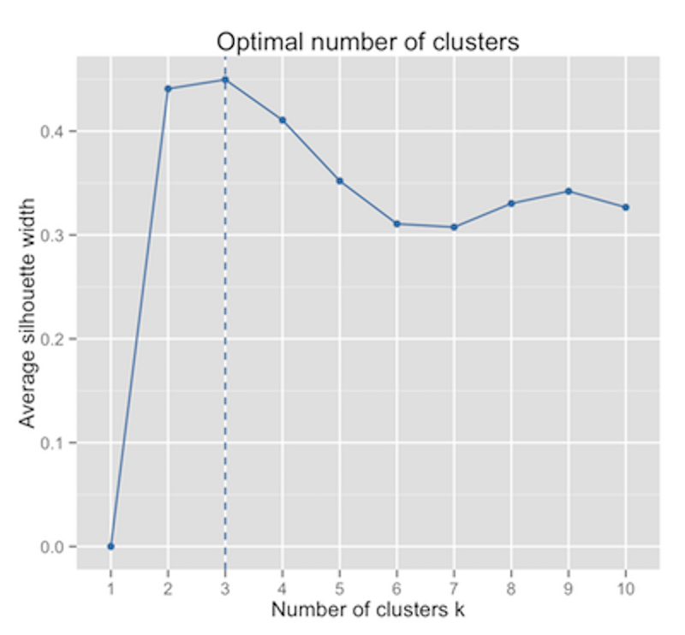
Silhouette plots
Four different datasets:
S_{avg} = 0.55
S_{avg} = 0.12
S_{avg} = 0.57
S_{avg} = 0.42

Slide 35
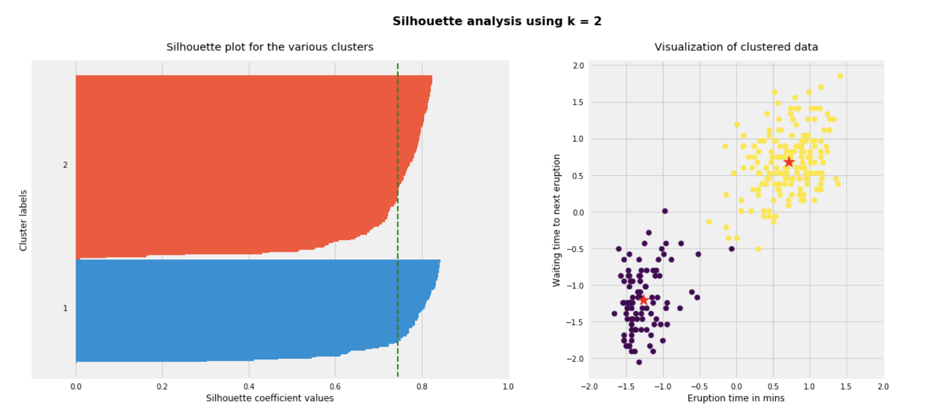
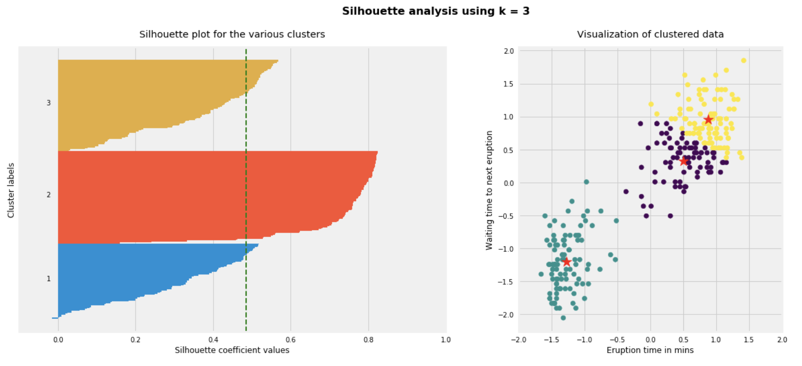
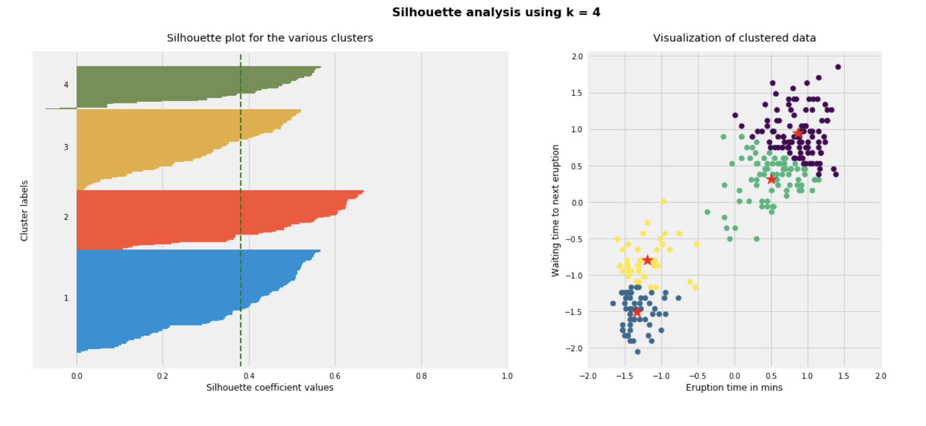
Another example
The partitioning with k = 2 has the highest average silhouette width, and thus provides the most distinct clusters.
k = 2
You may have additional data, however, suggesting that there really are more than 2 groups
(e.g. single-cell data in which the yellow and purple clusters can be distinguished based on coherent expression of cell-type-specific markers / gene sets)
k =3
k = 4

Slide 36
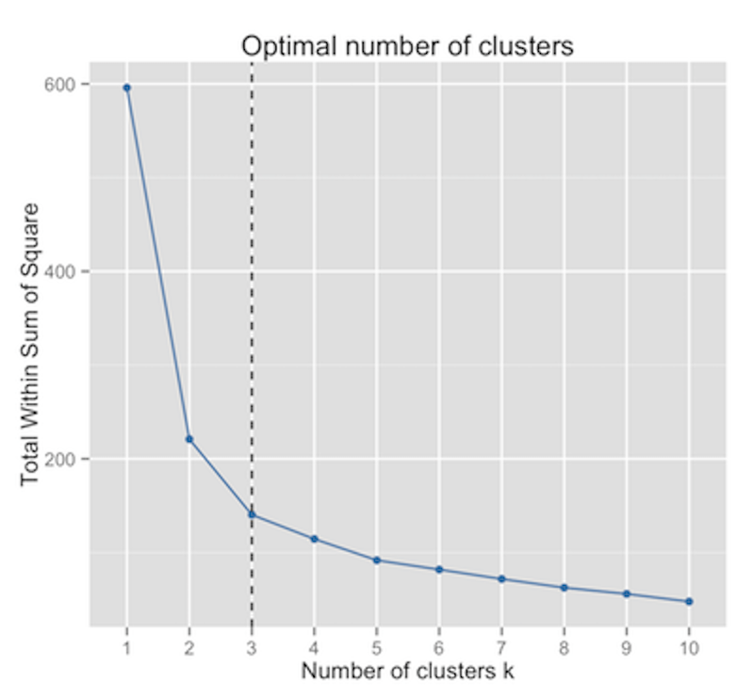
Choosing the right number of clusters
Maximum average silhouette width
Elbow method
Can also use the Gap statistic, which measures within-cluster variation relative to expectation for a reference distribution with no clustering (want to maximize the difference between these)

