Slide 1
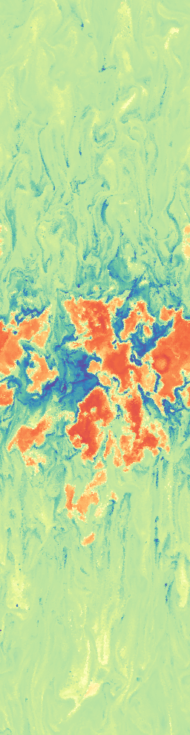
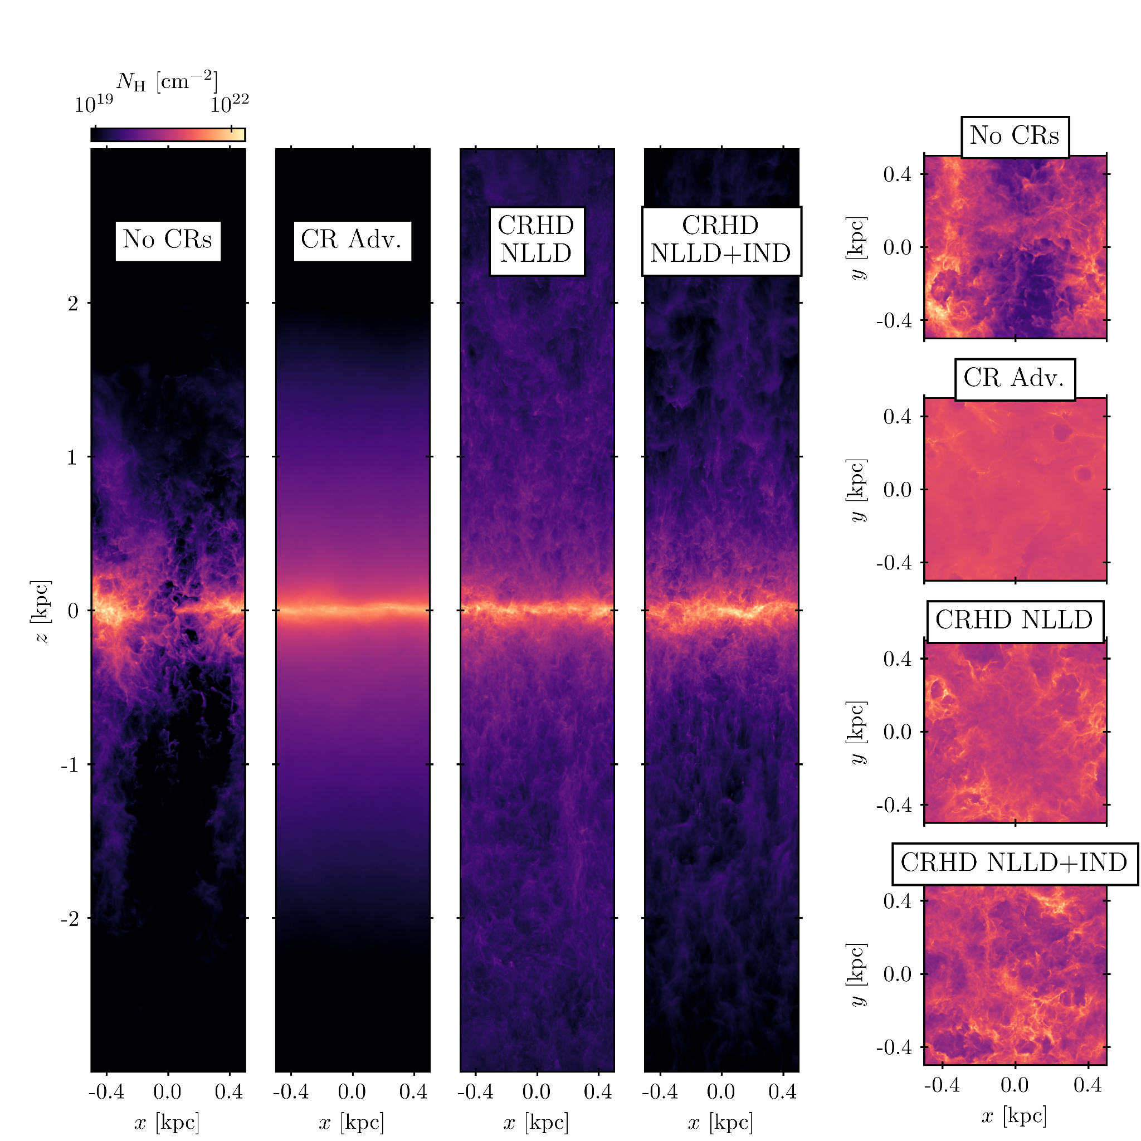
Too Hot, Too Cold, or Just Right? Simulating Cosmic Ray-Driven Galactic Winds with Resolved ISM and Ion-Neutral Damping
Brandon Sike (UM), Mateusz Ruszkowski (UM), Christoph Pfrommer (AIP), Timon Thomas (AIP), Matthias Weber (AIP), Peng Oh (UCSB), Oleg Gnedin (UM), Bill Chen (UM), with funding from NSF, ACCESS, NASA, and UM.
AAS 245 Winter; January 14, 2025

Slide 2
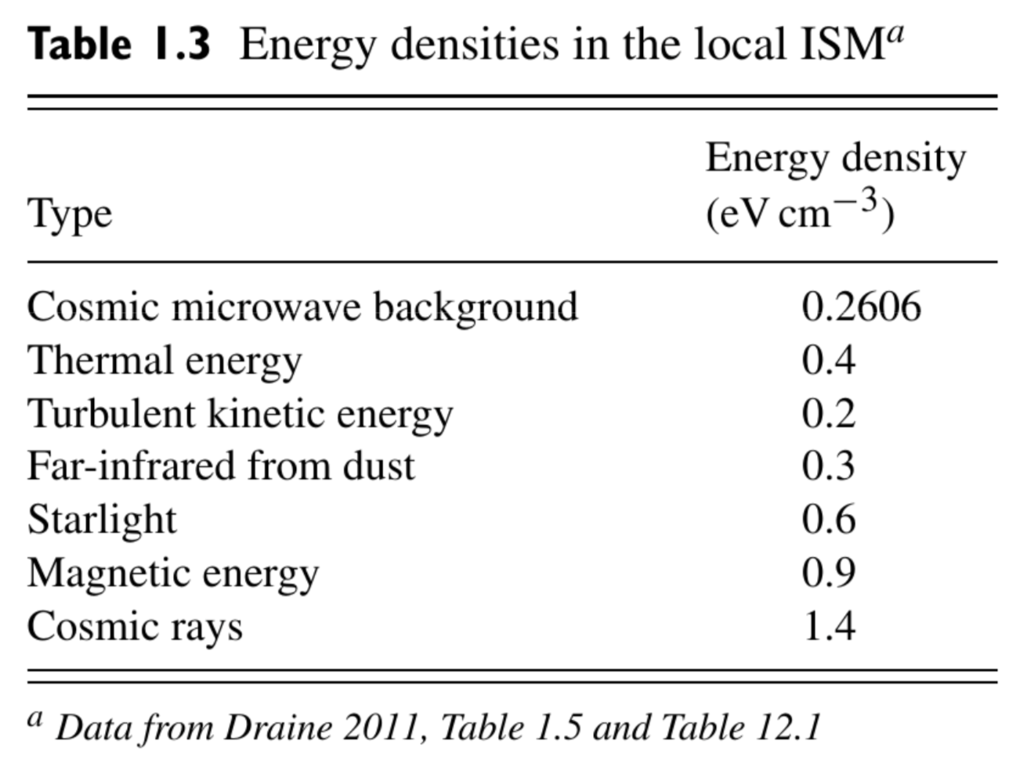
Cosmic Rays in Galaxies
Relativistic, charged particles which behave as a fluid over galactic scales.
Equipartition with other energy densities in the ISM.
Provide a source of pressure, contribute to heating, drive molecular chemistry, trace magnetic field topology.
Notably, cosmic rays can exchange momentum and energy with the gas over long time and distance scales.
Ryden & Pogge: Interstellar and Intergalactic Medium (2021) with data adapted from Draine (2011), with cosmic ray data from Voyager measurements (Webber & Yushak 1983).

Slide 3
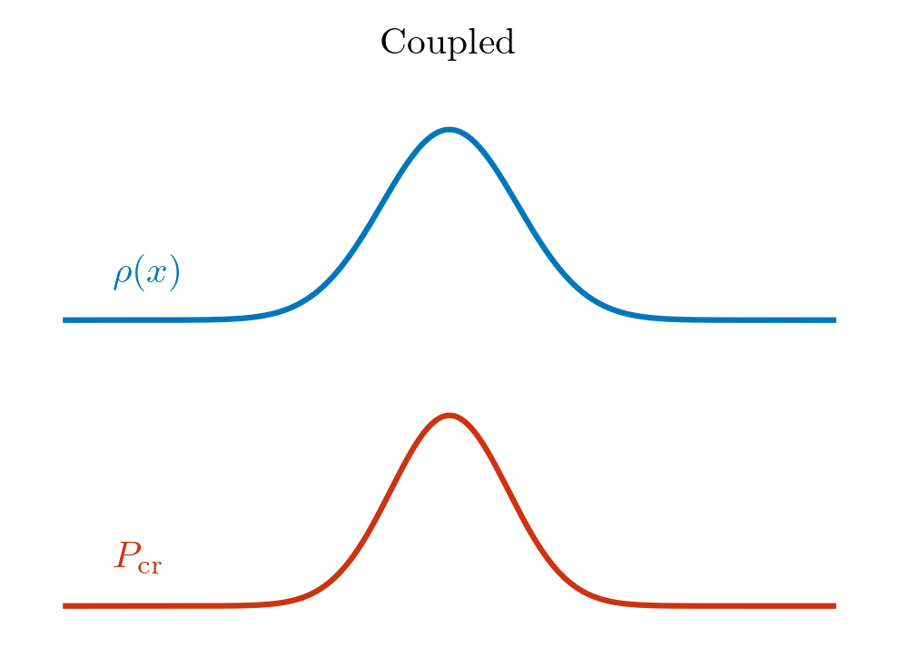
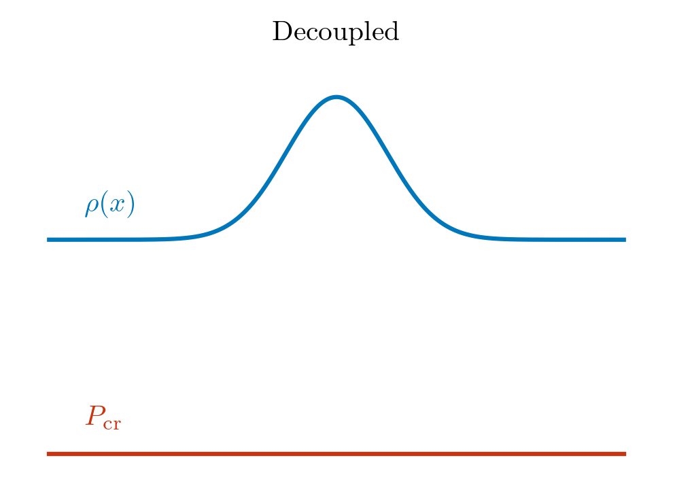
CR Transport: Ion-neutral damping
Ion neutral damping (IND) is ~frictional loss from self-confining Alfvén waves by ion/neutral collisions. The loss of these self-confining Alfvén waves decouples CRs from neutral regions.
Add IND
X

Slide 4
The Questions:
How does CR feedback affect the steady-state SFR and galactic outflow?
How do CRs interact with multiphase gas in the wind?
Does ion-neutral damping prevent CRs from providing effective feedback?

Slide 5
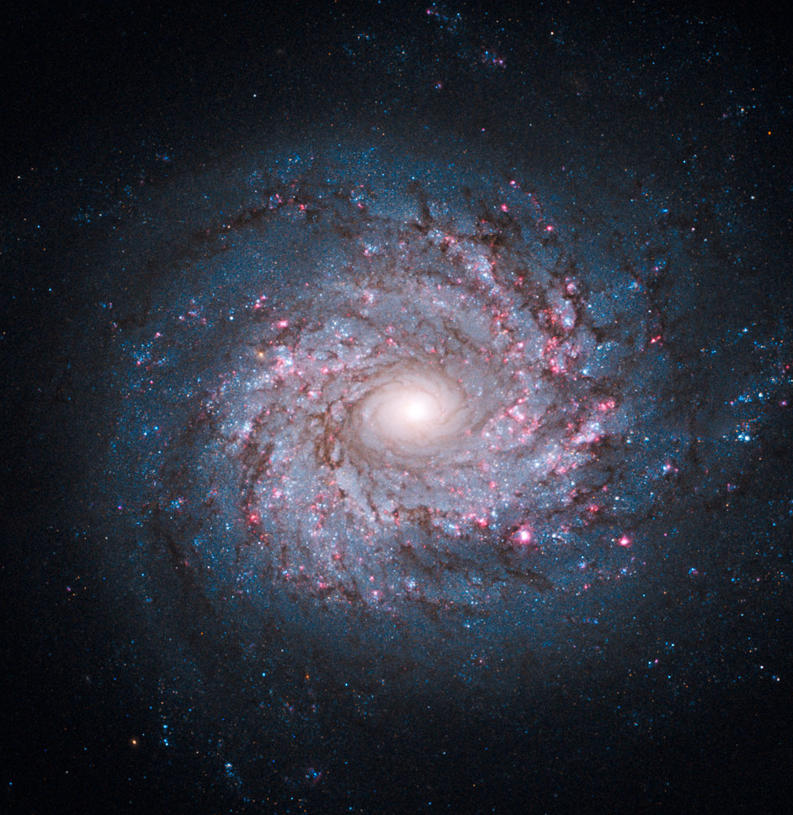
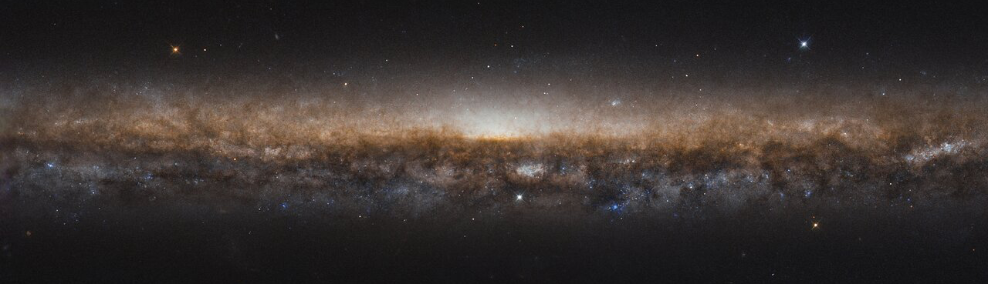
Simulation Model: ISM Tallbox
Use AREPO (Springel 2010).
1 kpc * 1 kpc * 8 kpc.
Σgas = 10 Msun / pc^2.
10 Msun resolution in the ISM.
~3 pc resolution in the wind.
Live MHD, stellar feedback.
Nonequilibrium ionization model CRISP.
Two-moment CR transport model following self-confined behavior.
Face-on spiral galaxy NGC 3982, NASA, ESA, and the Hubble Heritage Team (STScI/AURA)
Edge-on spiral galaxy NGC 5907, ESA/Hubble & NASA, R. de Jong. Acknowledgement: Judy Schmidt (Geckzilla)

Slide 6
3 Cases
(“MHD”): No CRs.
(“CRMHD”): Add CRs with uniform coupling of CRs to gas.
(“CRMHD+IND”): Add ion-neutral damping; CRs decouple from neutral gas.
“Full physics,” expected to be most realistic.

Slide 7
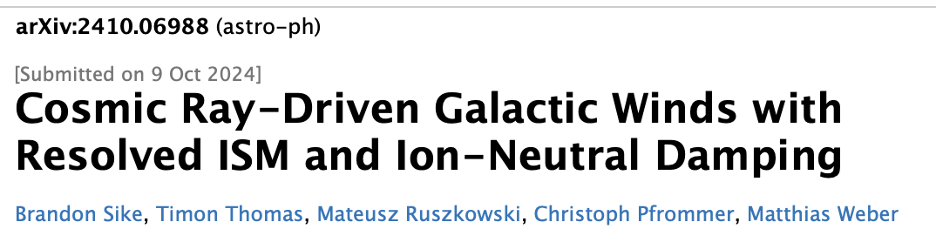
Results

Slide 8
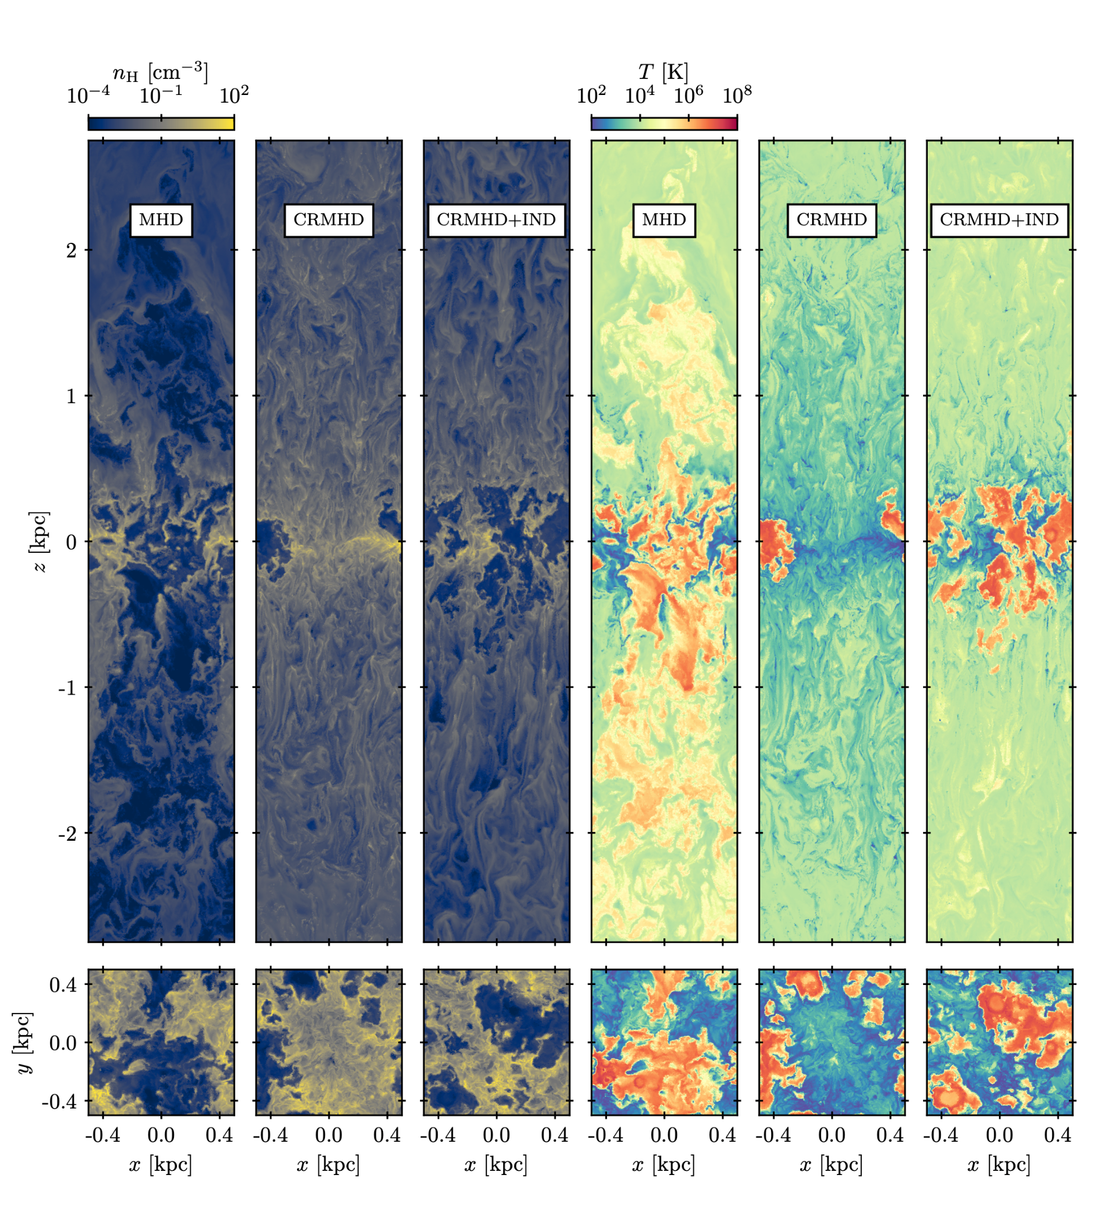
Slices
Produce a variety of multiphase galactic winds and ISMs.
Immediate visual differences between the three cases, primarily in the wind but also in the ISM.

Slide 9
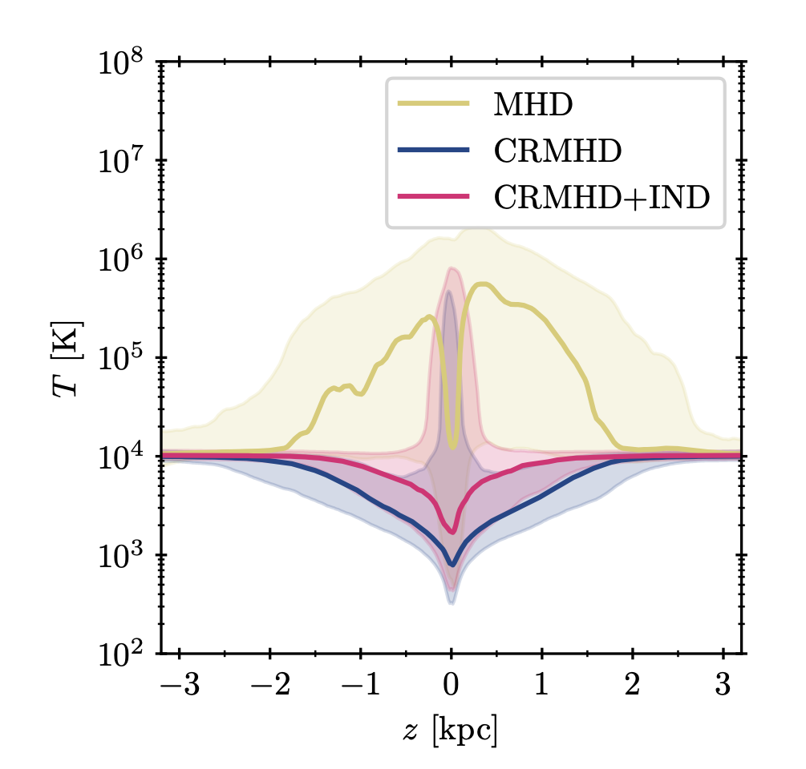
Temperature Profiles
MHD is the hottest; supernovae-driven.
CRs in CRMHD can couple to cold gas in the wind, CRs in CRMHD+IND cannot.
CRs make the wind colder, IND makes the wind moderately warmer.

Slide 10
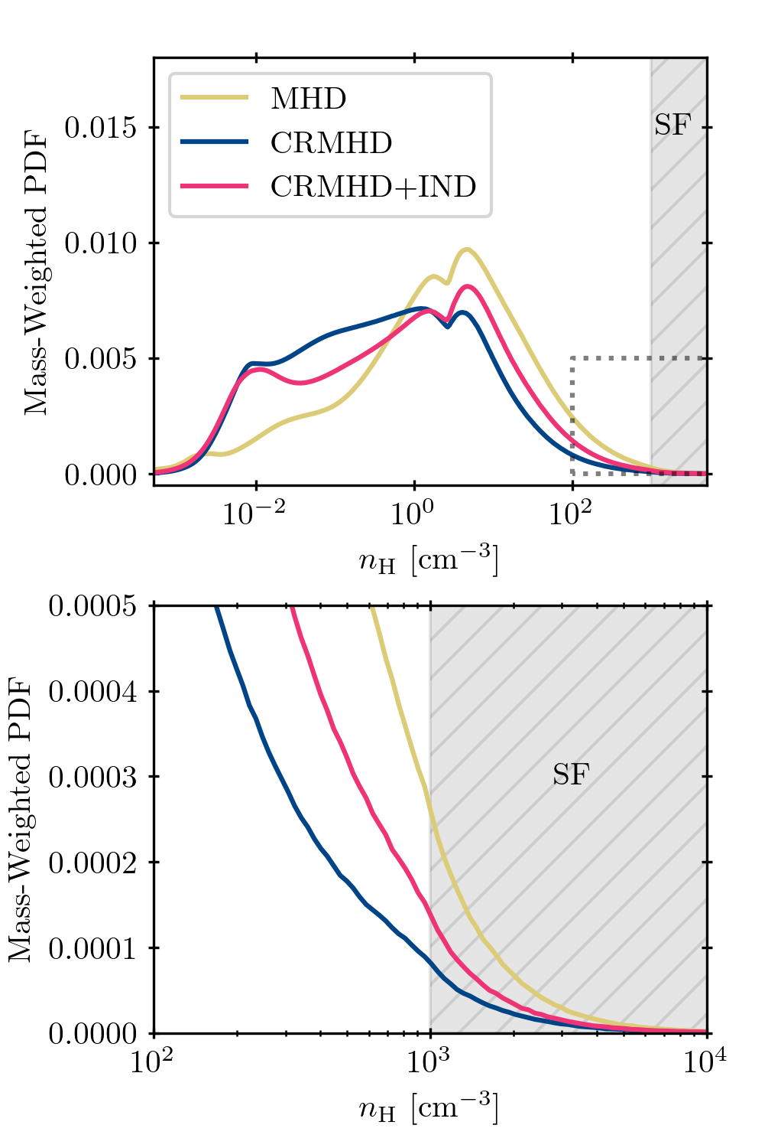
Star Forming Conditions
Amount of mass above the star formation threshold is directly linked to the SFR.
CRs reduce the amount of star-forming gas.
IND decouples CRs from dense, neutral gas, allowing gas to reach star-forming densities with less resistance.
Add IND

Slide 11
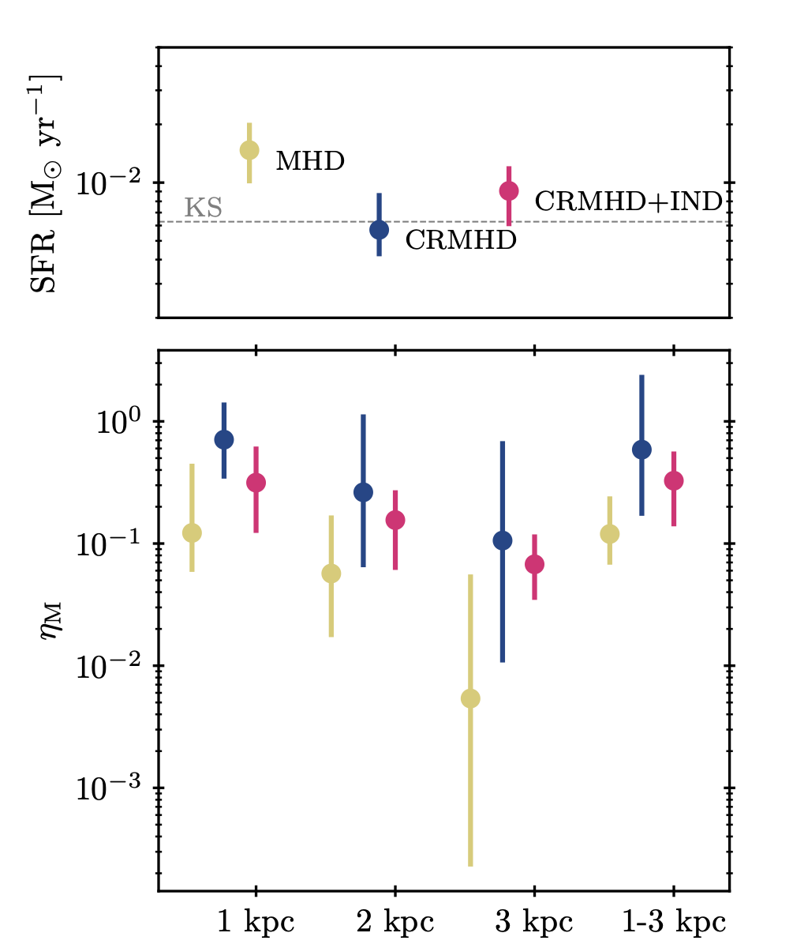

Mass Loading Factors
MHD case has the lowest mass-loading factors, and the outflow becomes very weak by |z|=3kpc.
SFRs are not different enough to explain the differences in mass loading factors.
Ion-neutral damping does not prevent CRs from expelling mass in the outflow.

Slide 12
Summary
Ion-neutral damping does not prevent CRs from providing effective feedback.
Ion-neutral damping reduces the effect of CRs on the SFR.
Full-physics CR-driven wind is primarily warm with moderate mass loading.
See astro.brsike.com/aas2025 for slides and contact information

