Slide 1

DevOps
What is it? What is its business value?
Steve Bogdan
Lead Systems Engineer
steve@fpcomplete.com
Notes:
Intro
Reason for this lecture
Why do DevOps? Because it’s latest cool thing everyone is talking about?
Because it can provide substantial benefit and value to the business

Slide 2
The IT Revolution
Information technologies are the dominant value creation driver for most businesses, therefore it is imperative that IT operations deliver value quickly and efficiently
Notes:
In today’s world - go digital or go home
Technology is no longer a tool for saving costs; it's a platform for growing revenue and increasing market share in ultra-competitive markets
Being able to differentiate quickly

Slide 3

Notes:
IT failures hurt businesses, can have impact reaching beyond the business

Slide 4
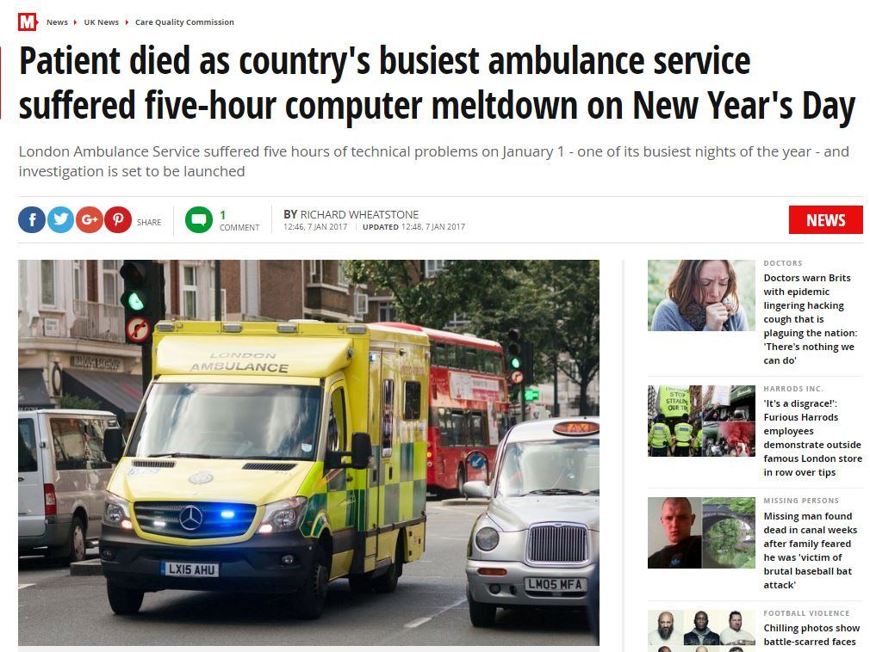

Slide 5
More Common Than You Think
86% of companies suffered an IT failure in the last year
60% of these companies listed human error as the most common cause of downtime
50% of human errors are related to change/configuration/release/integration and handoff issues
81% of companies that suffered failures have had the exact same failure recur after the initial incident
Notes:
Even though they don’t make the news often, these types of incidents are frighteningly common
What’s the cost to business?
Lost revue, lost productivity, damage to reputation, loss of customers
Costs aren’t always apparent, but what if the company received a bill?
More and more we can use technology and architecture to prevent outages due to hardware, power, internet failures. So let’s use technology to eliminate human errors

Slide 6
DevOps is Not…
Just developers taking over operation’s jobs and doing it themselves
Just implementing a set of tools
Just culture change
Just a job title
Notes:
Before I get into what DevOps is…
Handing the keys to the kingdom over
DevOps is how both developers and operators work
Communication problem? Silo?
About addressing a single aspect that creates the IT bottleneck

Slide 7
DevOps Definitions
DevOps is an enterprise software development phrase used to mean a type of agile relationship between Development and IT Operations. The goal of DevOps is to change and improve the relationship by advocating better communication and collaboration between the two business units.
DevOps is an operational philosophy that promotes better communication between development and operations as more elements of operations become automatable

Slide 8
DevOps Definitions
DevOps is the practice of operations and development engineers participating together in the entire service lifecycle, from design through the development process to production support
DevOps is a term used to refer to a set of practices that emphasizes the collaboration and communication of both software developers and other IT professionals while automating the process of software delivery and infrastructure changes. It aims at establishing a culture and environment where building, testing, and releasing software can happen rapidly, frequently, and more reliably.

Slide 9
DevOps Definitions
DevOps represents a change in IT culture, focusing on rapid IT service delivery through the adoption of agile, lean practices in the context of a system-oriented approach. DevOps emphasizes people (and culture), and seeks to improve collaboration between operations and development teams. DevOps implementations utilize technology — especially automation tools that can leverage an increasingly programmable and dynamic infrastructure from a life cycle perspective.
DevOps is the combination of cultural philosophies, practices, and tools that increases an organization’s ability to deliver applications and services at high velocity: evolving and improving products at a faster pace than organizations using traditional software development and infrastructure management processes. This speed enables organizations to better serve their customers and compete more effectively in the market.
DevOps is the end to end automation of software development and delivery
Notes:
Key points:
Collaboration
Communication
Culture
Automation

Slide 10
DevOps Definition
DevOps is about enabling the fast flow of planned work, whether it be development, testing, deployment, or release while maximizing reliability and security.
DevOps is the umbrella under which a broad set of practices and tools produce this outcome
Set of best practices for service lifecycle management
Notes:
DevOps is about speeding up all activities in involved in delivering software/IT services
Expands SDLC to the entire software pipeline

Slide 11
But What DevOps Really Is
A new way of working with a very important goal -- improving IT service delivery
A way to solve the workflow problem between Dev and Ops
Getting more business value from IT
Transitioning the view of IT from less of terms of TCO to increasingly being measured by ROI
Notes:
What’s really broken in traditional IT practices is the hand off from dev to ops
Referred to as “tossing steaming piles of code over the wall”

Slide 12
DevOps Adopters Are More Agile
30x
More frequent deployments
200x
Faster deployment lead times

Slide 13
DevOps Adopters Are More Reliable
60x
The change success rate
168x
Faster mean time to recover
Notes:
Drastically reduces the disasters known as ‘Deployments’

Slide 14
DevOps Adopters Are More Productive
22%
Less time spent on unplanned work
50%
Less time spent remediating security issues
Notes:
Number of work request are reduced

Slide 15
DevOps Adopters Win in the Market Place
2x
More likely to exceed profitability, market share, and productivity goals
50%
Higher market capitalization growth over 3 years
Notes:
Because they can capture new market opportunities faster

Slide 16
DevOps Adopters Have Happier Employees
2.2x
More likely to recommend their organization to their friends

Slide 17
Benefits of DevOps
Produces higher quality code with greater stability
Reduces costs
Reduces amount of unplanned work
Reduce stress and chaos of deployments
DevOps teams work 35% fewer after-work hours
Notes:
Executable documentation
Too much time spent maintaining current deployments
You shouldn’t be finding issues at deployment time
Frees up time for more value add work

Slide 18
How does DevOps Improve IT Ops?
Use of automation to speed execution and reduce errors
Faster provisioning of compute resources
Expands responsibility for quality
Deploying smaller more frequent code releases reducing risks
Automating deployments and recovery processes reduces service outages
Notes:
Saves time – 15 min/day = 2.7 days a year
Saves time 2 ways
Eliminates tribal knowledge – executable documentation

Slide 19
DevOps Gives Businesses Competitive Advantage
A study conducted by Deloitte concluded that “the ability to innovate, at an accelerated pace, will be the most important capability differentiating the success of companies”
Companies that trail behind on the technology curve will lose their competitive edge
Customer expectations challenge business more than ever and they have little patience for underperforming or outdated apps
Notes:
DevOps adoption is accelerating - more and more companies are adopting DevOps
The technology curve is accelerating also
Look at open positions for DevOps Engineers
It’s likely that your competition is doing DevOps or soon will be
With a click of a mouse a customer can find someone else to fulfill what they’re looking for

Slide 20
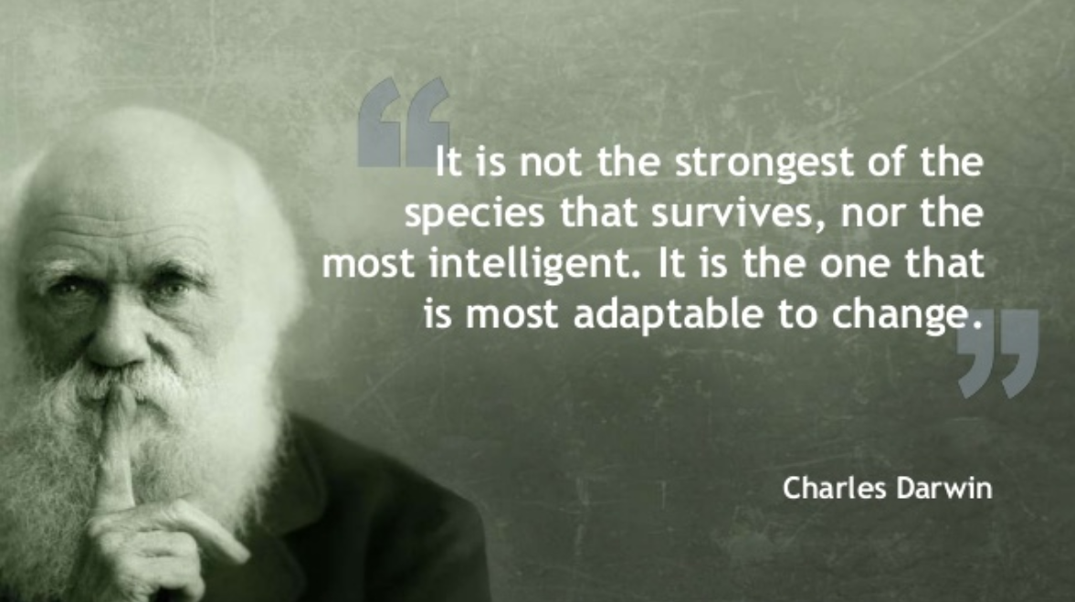
Things Are Changing Faster – Can You Keep Up?
Notes:
DevOps allows you to innovate and adopt new technologies faster
Today, it’s not about the big eating the small, it’s about the fast overtaking the slow

Slide 21
Improves Performance By Delivering Value Sooner
Value
Time
Notes:
There’s no value to your service until it’s in the hands of your users
If you spend too long on delivering something, there’s a chance something will change before you can deliver
There’s other problems to this approach

Slide 22
What are DevOps Practices?
Infrastructure as code
Code/artifact repository
Version control
Continuous integration
Continuous testing
Continuous delivery
Containerization
Automated release
Notes:
Immutable infrastructure
Repeatability
Fast feedback

Slide 23
Infrastructure as Code
Fast
Readable
Auditable
Repeatable
Versioned
Notes:
Eliminates IT bottleneck of dev waiting on infrastructure – self service
Eliminates the fragility caused by one off changes over time
Makes configuration management easier
How do you know how your servers are configured?
Can you reproduce a server exactly?
How do you troubleshoot an issue?
Key component of immutabilityUse same source controls used by developers

Slide 24
Continuous Integration
Isolated changes are immediately tested and reported on when they are added to a larger code
Immediate feedback on code developer is working on
All check ins are validated by automated build, and automated unit, integration, and acceptance testing
Notes:
Work with smaller change sets
Find and fix bugs earlier before the become painful and expensive to fix
Fast feedback motivates developers to care about quality
If needed, rollback to error free state only looses small amount of change

Slide 25
Continuous Delivery
Provides feedback on the production readiness of a system
Provides push-button deployments on demand
Reduces deployment risks
Notes:
Goal is to ensure that code is always in a deployable state
Between CI and CD, allows for delivery of minimum change that brings value
With faster feedback, it allows you to deliver something closer to what that customer wants

Slide 26
Containerization
Portable – write once, run anywhere
Creates an atomic unit
Faster and easier to deploy
Allows for rapid scaling up/down
Notes:
Packages code with dependencies

Slide 27
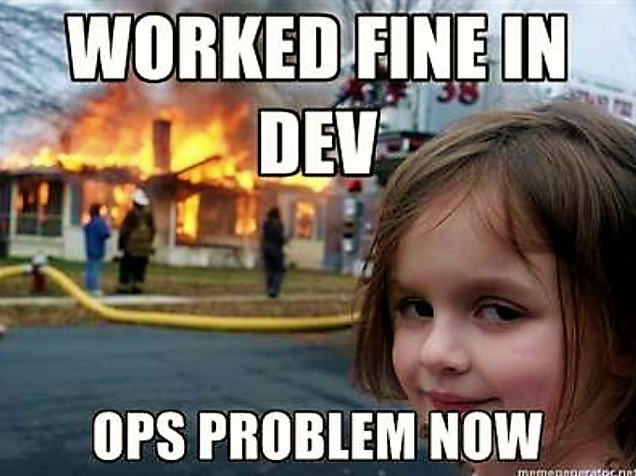
Notes:
What breaks things?
(When talking about quality show again with point about motivation)

Slide 28

A new release was just pushed to production?
Didn’t notice

Slide 29
Questions?

Slide 30
Dev vs Ops
Opposing forces
Dev wants to create change
Ops wants stability, therefore opposes change
Development process is agile, Ops process is Static
But change is required for business
DevOps enables the change needed while reducing the firefighting

Slide 31
How does DevOps Improve Performance?
Reduced batch size
Reduce pain of releases
(Goes with automated testing and burning down pic) Improve Quality - Fast feedback loops - people are self motivated to improve quality if they can see quickly that what they are doing has problems. But if there is a long delay their motivation drops significantly.

Slide 32

Dev vs. Ops
“It works on my machine…”
“It’s not the server, it’s your code.”

Slide 33
Questions/Observations
Shouldn’t Quality be (built in) addressed before QA?
Shift left!
How long would it take your organization to deploy a single new line of code?
Do you know how any of your servers are precisely configured?
When I say automated testing, I don’t mean “When I push my code to production, the users automatically start testing it”
Deployment is different than release/break them apart!
Software is changing industries
The best people to support a complex app are the ones who built it
Shadow IT problem
All companies are in the software business
Would you rather have your employees spending time fixing things or building things of value?
What’s the result of an error in prod?
What would be the effect if you received a bill for the cost of downtime every time there was an outage?

Slide 34
Pain Points
Long and painful testing cycles
Releases that are infrequent
The quality of your products is poor
Solutions that don’t satisfy customers
More time spent testing, deploying, releasing, and fixing rather than designing and building
Production incidents result from errors in manual configurations and releases

Slide 35
Problems
Finance having to approve new environments adding delays of months to a project
System administrators spend as much as 50% of their time on routine, repetitive tasks
Developers spending time waiting on environments
Think about the number of ways IT slows progress
Ops doesn’t have spare capacity
Support team constantly fighting fires
Time spent on unplanned work steals time away from planned work
Releases are usually painful events that are dreaded by ops
That and ensuing issues leading to fire fighting impact IT quality of life

Slide 36
The problem in a Nutshell
Everything needs software
Software runs on a server to become a service
Delivering a service from inception to its uses is too slow and error prone
This loses you money (delay = loss)
Therefore IT is frequently the bottleneck in the transition of “concept to cash”
Inconsistent or unknown state of servers

Slide 37
Symptoms
Defects released into production causing outages
Problems appear only in some environments
Long delays while dev, QA, or another team waits on resource or response from other teams
“Manual error” is commonly cited as the root cause of an outage
Releases slip/fail
Quality of life issues in IT

Slide 38
DevOps Benefits
DevOps enables companies to seize market opportunities
For businesses to survive, IT must transform from a back-office concern that needed to “keep the lights on” to key part in how the business competes every day
devops is not about a technology, devops is about a business problem
Changes IT from being a business bottleneck to a business enabler
Devops is about improving business performance by delivering value earlier
(Want to) Speeds delivery while improving system stability
DevOps helps you to adopt new technology faster
Reduce time wasted fixing things i.e. – firefighting
Enables dev to provision without ops putting up roadblocks
Frees up ops to concentrate on value-added functions

Slide 39
Why do DevOps?
The benefits of a DevOps approach are many, including:
Everything needs software
Improved deploy frequency which can lead to faster time to market
Lower failure rate
Shortened lead time
Faster mean time to recovery (recover automatically)
Zero touch build and deploy
Customer expectations around convenience, cost, and experience are ever increasing and challenge business more than ever (with a click of a mouse I can find someone else to fulfill what I’m looking for) Customers have little patience for underperforming or outdate apps
Customers have little patience for underperforming or outdated apps. With the speed of a click of a mouse they can find someone else to fulfill what they are looking for.
DevOps is no longer a fringe movement, it is a competitive necessity
#1 Reason to adopt Devop? Because your competitors are
The fast overtaking the slow
Deliver better software faster
Eliminates IT as a bottle neck for the business
Reduce development costs
Increase capacity to innovate

Slide 40
development team tested new code in an isolated development environment
Immutable hardware – eliminate the one off changes that over time

Slide 41
Outline
Why I’m giving this lecture
Why was DevOps developed?
Over the years we’ve gotten better at developing software, but operations has been lagging behind
Impact of unplanned outages – Most can be prevented!
Quality issues lead to…
Service outages
Waste
Ops spending a significant amount of time fixing issues
Lost opportunity – traditional method of provisioning environments
Things started to improve with new technology – virtual machines

Slide 42
Intro
Failures
Definitions
DevOps benefits
To do all these thing we have to fix existing IT problems
How doe DevOps work?

Slide 43
What’s wrong with traditional methods?
Requirements
Design
Development
Test
Deploy

