Slide 1

Advanced DCS CSCI 8780 Paper presentation
The Chubby lock service for loosely-coupled distributed systems
- Mike Burrows, Google Inc.

Slide 2

Contents
Introduction
Background & Motivation
Design Overview
Evaluation of Proposed Solution
Claimed Contribution
Future Scope
Conclusion

Slide 3
Disclaimer
Building Chubby was an engineering effort to help Goggle developers with coarse-grained synchronization within their systems; it was not research. We claim no new algorithms or techniques. The purpose of this paper is to describe what we did and why, rather than to advocate it.

Slide 4

1. Introduction
Chubby lock?
Lock service intended to provide coarse-grained locking in a loosely-coupled distributes system.
In particular leader election
Chubby also provides low-volume storage to be used as a repository for distributed systems' configuration changes.
Terminology:
Coarse-grained: A single lock that covers many objects
Loosely-coupled

Slide 5

1. Introduction
Coarse locking in Chubby:
Long duration
Infrequent Acquisition
Reduced overhead on Lock Server
Alternative of Chubby Lock: Zookeeper

Slide 6
1. Introduction
Some points on Chubby:
Client interface like simple file system
Performing whole file read write
Augmented with advisory locks
Notifications of events like file modification
Metric:
1 chubby cell(instance of chubby) serves ten thousands 4-processor machines connected by 1 Gb/s Ethernet

Slide 7
1. Introduction
Chubby main features:
Coarse locking design
Implemented as simple library for easy to use
Sessions and keepalives
Strong naming architecture for files and directories
Async event delivery (similar to pub/sub)
Leverage caching

Slide 8
1. Introduction
Distributed Consensus Problem:
Election of primary among peers.
Need a solution using asynchronous communication

Slide 9
1. Introduction
Distributed Consensus Problem:
Election of primary among peers.
Need a solution using asynchronous communication
Asynchronous Consensus solved by:
Paxos protocol

Slide 10
2. Background and Motivation
Pre-Chubby ?
Most distributed system at Google used:
ad-hoc methods for primary election – when work could be duplicate without harm.
Operator intervention – when correctness was essential

Slide 11
2. Background and Motivation
Primary Goal:
Reliability & Availability to large set of clients.
Easy to understand semantics
Secondary Goal:
Throughput
Storage capacity

Slide 12
3. Design Overview
Lock Design
Coarse grained – responsible for a resource for hours or days and less load on servers
Cooperative – doesn’t block other clients from accessing the resource
Write lock – only one client has the lock and can write to whole file
Read lock – many clients can hold read lock
Sequencers handles synchronization of lock interactions
Locks are advisory not mandatory – conflict during write

Slide 13
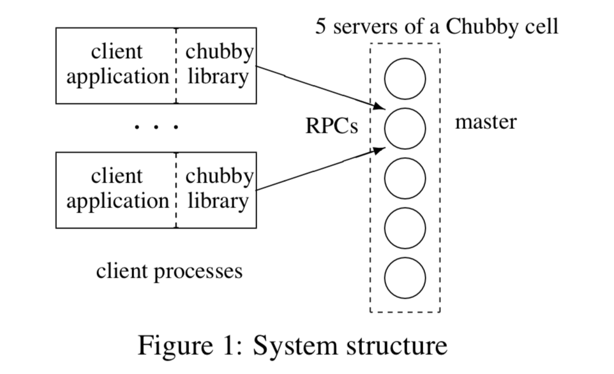
3. Design Overview
System Architecture:
Replicas: Small set of servers(typically 5)
Master: elected by distributed consensus protocol.
Master lease: interval of few seconds
Replicas maintain copy of single DB – but only master initiated read or write
Client finds master by sending DNS request to replicas listed.
Written in C++

Slide 14
3. Design Overview
Request handling:
Write request
Propagated to all replicas via consensus
Acknowledged when it reached majority replicas.
Read request
Satisfied by master alone.
Provided master lease has not expired ?
When Master fails?
Replicas run election protocol when lease expires.
New master elected in few seconds.

Slide 15
3. Design Overview
When Replica fails?
Find fresh machine from pool (by simple replacement system)
Deploy lock binary on the machine
Update the DNS updating IP address in DNS listing (master polls DNS periodically)
Updates the list of cell’s members in cell’s DB (consistent using replication protocol)
Obtains recent copy of DB from combination of backups stored on file servers.
Once processes request that current master is waiting to commit.
Finally, allowed to vote for new master

Slide 16
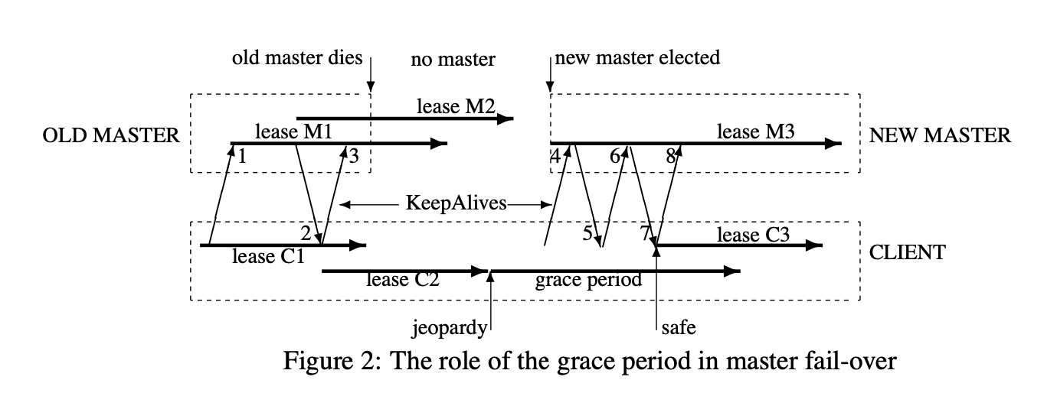
4. Design Overview
Fail-overs

Slide 17
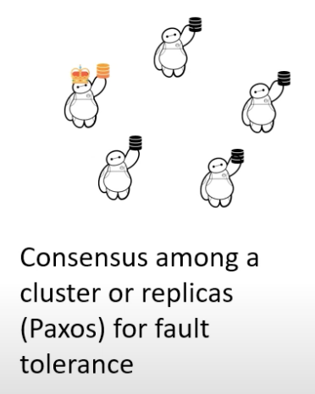

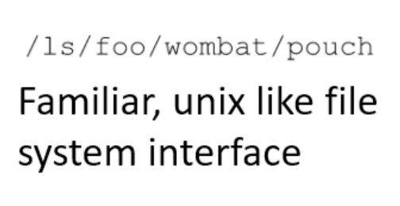
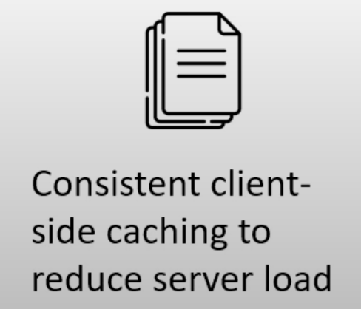
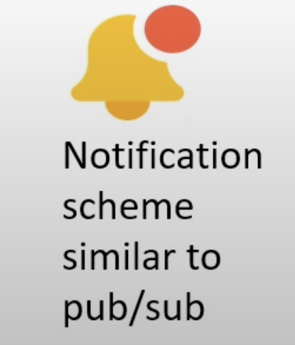
3. Design Overview
Lock Design + Distributed Systems Foundations

Slide 18

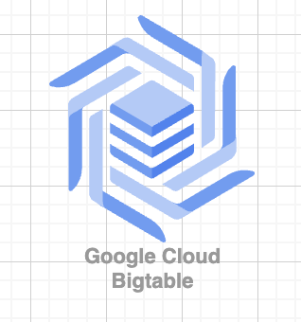
4. Claimed Contribution
GFS uses Chubby lock to appoint a GFS master server.
BigTable uses it for:
To elect master
To allow the master to discover the server it controls
To permit clients to find the master
Both uses Chubby as a well-known and available location to store a small amount of meta-data.
Using Chubby as the root of their distributed data structure.

Slide 19

5. Future Scope
Chubby has become Google’s primary internal name service.
Standard repository for files that require high availability (ACL files).
Used caching, protocol-conversion servers, and simple load adaptations.
Expected to scale it further via proxies.

Slide 20
6. Conclusion
Chubby is a lock service developed to Google’s Developers.
Chubby’s client library is written in C++, over 7000 lines of code.
Chubby lock is NOT open source.
References:
https://static.googleusercontent.com/media/research.google.com/en//archive/chubby-osdi06.pdf
https://www.youtube.com/watch?v=XA2o4kyj8bc

Slide 21
The End

