Slide 1
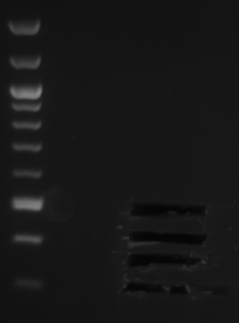
Wt + mutant yeast mRNA + spike-in (A₄₂)
(2 biological replicates each)
AAAAAAAAAAAAAAAAA
limited G-tailing
AAAAAAAAAAAAAAAAAGGGGGG
cDNA synthesis initiation
AAAAAAAAAAAAAAAAAGGGGGG
1
TTCCCCCC
2
AAAAAAAAAAAAAAAAAGGGGG
VNTTTT
Fragmentation of cDNA
Illumina library generation (modifications)
Gel size selection (4 technical replicates each), barcoded
Sequence all 16 libraries on one Illumina Hiseq2000 lane 2x101bp

