Slide 1

The Car and Goat Problem: Solution
The FDA vs Pharma Dilemma
Algorithmic Foundations of Computational Biology - Course 6
_{Professor Istrail}

Slide 2
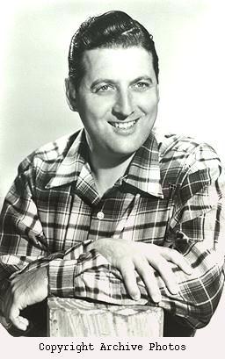

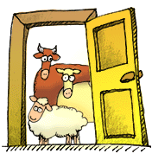

The Car and Goat Problem
Algorithmic Foundations of Computational Biology - Course 6
_{Professor Istrail}
Monty Hall, the master of ceremonies for the game show, “Let’s Make a Deal,” confronts you with three closed doors, one of which hides the car of your dreams. Behind each of the other two doors, however, is standing a smelly goat. You must choose a door to win whatever is behind it.
You decide on a door, and announce your choice.
Your host then opens one of the other two doors and reveals a goat.
He then ask you whether you would like to switch your choice to the unopened door that you did not originally choose.
Is it in your advantage to switch??????
Monty Hall’s game show:
“Let’s Make a Deal”

Slide 3
PROBABILITY THEORY
Algorithmic Foundations of Computational Biology - Course 6
_{Professor Istrail}
Probability measures uncertainty
Experiments are performed involving chance or randomness –they are things that can be repeated.
Suppose you roll a pair of dice once.
you get a pair of numbers (a,b) such that
a = 1,…,6 and b = 1,…,6
(1,1),(1,2),(1,3),(1,4),(1,5),(1,6),
(2,1),(2,2),(2,3),(2,4),(2,5),(2,6),
(3,1),(3,2),(3,3),(3,4),(3,5),(3,6),
(4,1),(4,2),(4,3),(4,4),(4,5),(4,6),
(5,1),(5,2),(5,3),(5,4),(5,5),(5,6),
(6,1),(6,2),(6,3),(6,4),(6,5),(6,6)
Sample Space
Outcomes

Slide 4
PROBABILITY THEORY (cont)
Algorithmic Foundations of Computational Biology - Course 6
_{Professor Istrail}
The things that we measure are called events
“Rolling a 7” = {(1,6), (2,5), (3,4), (4,3),(5,2),(6,1)}
We say that the experiment of rolling out a pair of dice give rise to a Sample Space S which is just the 36 outcomes possible, and an event is just a set of some of these outcomes.

Slide 5
PROBABILITY THEORY (cont)
Algorithmic Foundations of Computational Biology - Course 6
_{Professor Istrail}
Tossing a coin twice
Outcome example: {H,T}
Sample Space S={{H,H}, {H,T},{T,H}, {T,T}}
Event A: “at least one Head occurs”
A= {{H,H}, {H,T},{T,H}}

Slide 6
PROBABILITY THEORY (cont)
Algorithmic Foundations of Computational Biology - Course 6
_{Professor Istrail}
Sample space provides a mathematical model of real-life situations for which it is supposed to be an abstraction
Mathematical analyses can only be performed on the abstract objects of the sample space and not on real-life situation itself
Since the abstraction resemble the real world you may think that the mathematical relationships you found have something to do with the real world
You can perform now scientific experiments to check out the real world situation

Slide 7
PROBABILITY THEORY (cont)
Algorithmic Foundations of Computational Biology - Course 6
_{Professor Istrail}
If you were successful, the mathematical model helped you decipher the real world – you will know this because the results of your experiments are consistent with the mathematical relationships your obtained from the model
It could, of course, also happen that your mathematical model was too simple, or otherwise in error and did not give a true picture of the real world. In such a case, the mathematical relationships, while true for the model, cannot be verified by the laboratory experiments. We then need another better model.

Slide 8
PROBABILITY THEORY (cont)
Algorithmic Foundations of Computational Biology - Course 6
_{Professor Istrail}
The Sample Space constructed to model a real life situation is a figment of the imagination of the observer of that situation, it depends on what the observers thinks is important. It is not in general unique, and it depends on the subjective interpretation of what is the relevant information.

Slide 9
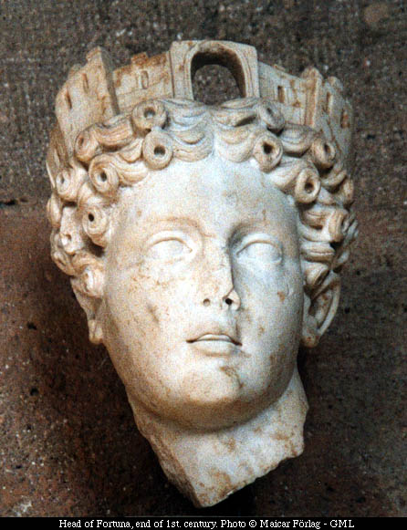
Algorithmic Foundations of Computational Biology - Course 6
_{Professor Istrail}
Tyche or Fortuna, the Goddess of Probability
A Greek goddess, originally of fortune and chance, and then of prosperity. She was a very popular goddess and several Greek cities choose her as their protectress. In later times, cities had their own special Tyche. She is regarded as a daughter of Zeus (Pindar) or as a daughter of Oceanus and Tethys (Hesiod). She is associated with Nemesis and with Agathos Daimon ("good spirit"). Tyche was portrayed with a cornucopia, a rudder of destiny, and a wheel of fortune. The Romans identified her with their Fortuna.

Slide 10
PROBABILITY THEORY (cont)
Algorithmic Foundations of Computational Biology - Course 6
_{Professor Istrail}
Consider the Sample Space S, say with the 36 outcomes of rolling a pair of dice.
To each of the outcome in the sample space associate a number between 0 and 1 such that the sum of these numbers over all outcomes is equal to 1.
The number associated with a particular outcome is called the probability of the outcome, and the entire assignment of probabilities to outcomes is called a probability distribution on S.

Slide 11
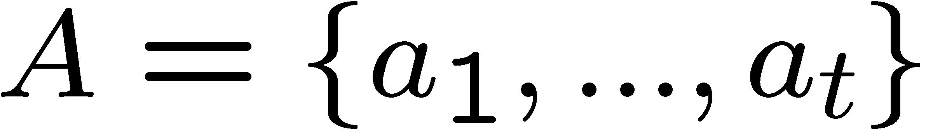
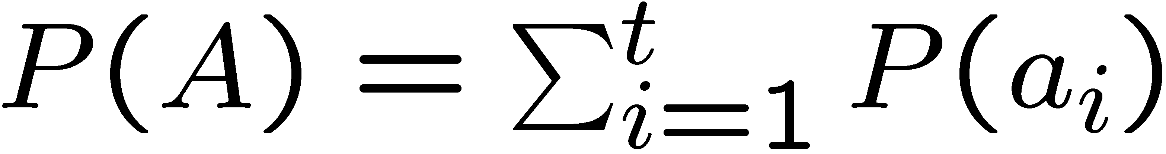
PROBABILITY THEORY (cont)
Algorithmic Foundations of Computational Biology - Course 6
_{Professor Istrail}
We now define the probability for any event A in the sample space S.
If A is the empty set, P(A)=0.
If then
So given the probability distribution on S we can figure out the probabilities of all events in S.

Slide 12
PROBABILITY SPACE
Algorithmic Foundations of Computational Biology - Course 6
_{Professor Istrail}
The sample space with its probability distribution is called a probability space.

Slide 13
The Car and Goat Problem
Algorithmic Foundations of Computational Biology - Course 6
_{Professor Istrail}
Monty Hall, the master of ceremonies for the game show, “Let’s Make a Deal,” confronts you with three closed doors, one of which hides the car of your dreams. Behind each of the other two doors, however, is standing a smelly goat. You must choose a door to win whatever is behind it.
You decide on a door, and announce your choice.
Your host then opens one of the other two doors and reveals a goat.
He then ask you whether you would like to switch your choice to the unopened door that you did not originally choose.
Is it in your advantage to switch??????
Monty Hall’s game show:
“Let’s Make a Deal”

Slide 14
Solution to the Car and Goat Problem
Algorithmic Foundations of Computational Biology - Course 6
_{Professor Istrail}
Construct sample space to model the experiment.
What is the experiment ?
Want to translate the story into a precise mathematical formulation

Slide 15
Solution to the Car and Goat Problem (cont)
Algorithmic Foundations of Computational Biology - Course 6
_{Professor Istrail}
There are three actions:
First you make your initial choice of one of the three possible doors
Monty Hall chooses one of the other doors with a goat behind it
You switch/You do not switch your choice

Slide 16
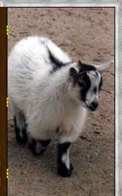
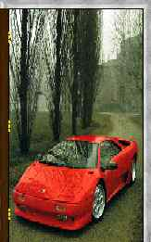
Algorithmic Foundations of Computational Biology - Course 6
_{Professor Istrail}
Solution to the Car and Goat Problem (cont)
Now suppose that the door with the car behind it is labeled 1, and the remaining two doors with goats are labeled 2 and 3.
What is a typical outcome of this game ?

Slide 17
Algorithmic Foundations of Computational Biology - Course 6
_{Professor Istrail}
Solution to the Car and Goat Problem (cont)

Slide 18
Algorithmic Foundations of Computational Biology - Course 6
_{Professor Istrail}
Solution to the Car and Goat Problem (cont)
Example: (1,2,3,L) means “you choose door 1 (with the car behind it), Monty Hall opens door 2, and since you switch, you might switch to 3, thereby losing the car”
The SWITCH sample space is:
Sswitch={(1,2,3,L), (1,3,2,L), (2,3,1,W),(3,2,1,W)}
We could also use a sample space
S’switch={(1,2,3),(1,3,2),(2,3,1),(3,2,1)}
Clearly these are the only “plays” possible for our game.

Slide 19
Algorithmic Foundations of Computational Biology - Course 6
_{Professor Istrail}
Solution to the Car and Goat Problem (cont)
We want a probability distribution for our sample space.
Real life situation: how do we choose a door ? You probably guess at random. That is, you choose all possibilities equally likely. That is you choose a uniform distribution. Each door has probability 1/3 of being chosen
Event: “Choose door 2” ={(2,3,1,W)} prob 1/3
Event: “Choose door 3”={(3,2,1,W)} prob 1/3
Event: “Choose door 1”={(1,2,3,L),(1,3,2,L)} prob 1/3

Slide 20
Algorithmic Foundations of Computational Biology - Course 6
_{Professor Istrail}
Solution to the Car and Goat Problem (cont)
Event “You win” ={(2,3,1,W), (3,2,1,W)}
Probability(“You win”)=1/3 + 1/3=2/3
Event “You lose” ={(1,2,3,L),(1,3,2,L)}
Probability(“You lose”)=1/3

Slide 21
Algorithmic Foundations of Computational Biology - Course 6
_{Professor Istrail}
Solution to the Car and Goat Problem (cont)
The NO-SWITCH sample space is:
Sno-switch={(1,2,1,W), (1,3,1,W), (2,3,2,L),(3,2,3,L)}
Similarly,
Event “You win” ={(1,2,1,W), (1,3,1,W)}
Probability(“You win”)=1/3
Event “You lose” ={(2,3,2,L),(3,2,3,L)}
Probability(“You lose”)=1/3+1/3=2/3
Conclusion: SWITCH is Better!

Slide 22
The FDA vs. Pharma Dilemma
Algorithmic Foundations of Computational Biology - Course 6
_{Professor Istrail}
Consider three Pharmas (pharmaceutical companies) A, B, C.
They each sent a new drug to FDA for approval, and this is public knowledge.
The news from the FDA is that two of them will not be approved.
Pharma A asks the FDA to tell them the identity of a Pharma other than A who’s drug is not going to be approved.
FDA refuses and their PR representative explains that “the probabilty for A not to get its drug approved is 2/3. So your probablity to get approved is 1/3.
If we tell you that B’s drug, say, is not approved, then you would be one of the two Pharmas whose drug fate is unknown, and your probability of not getting approved would consequently decrease to ½. So your probability to get approved will be now much bigger: ½.
Since we cannot be unfair to the other Pharmas, we cannot reveal this information.”
Is the FDA PR Rep correct in her reasoning ?

