Slide 1
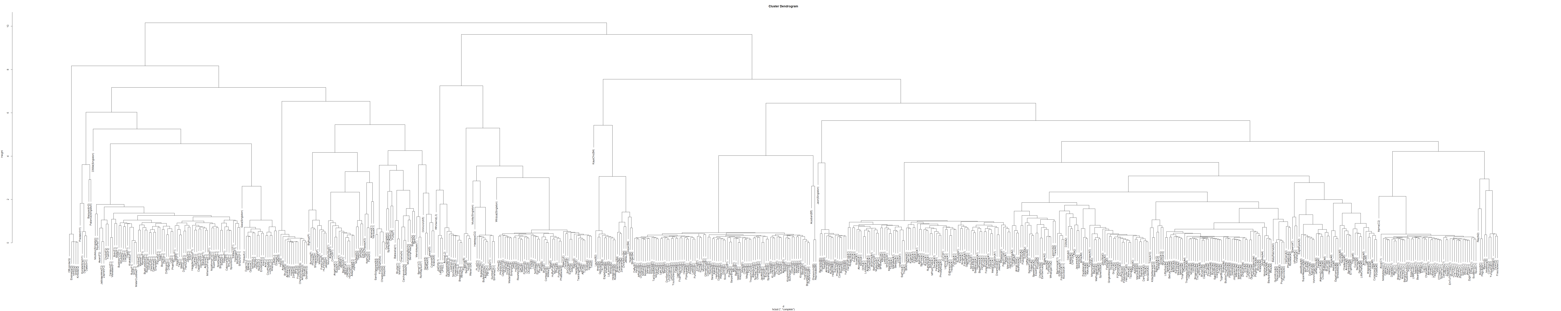
Hierarchical cluster on TUD distance reconstructs subcluster and cluster relationships

Slide 2
Hierarchical cluster on TUD distance reconstructs subcluster and cluster relationships

Slide 3
Hierarchical cluster on TUD distance reconstructs subcluster and cluster relationships

Slide 4
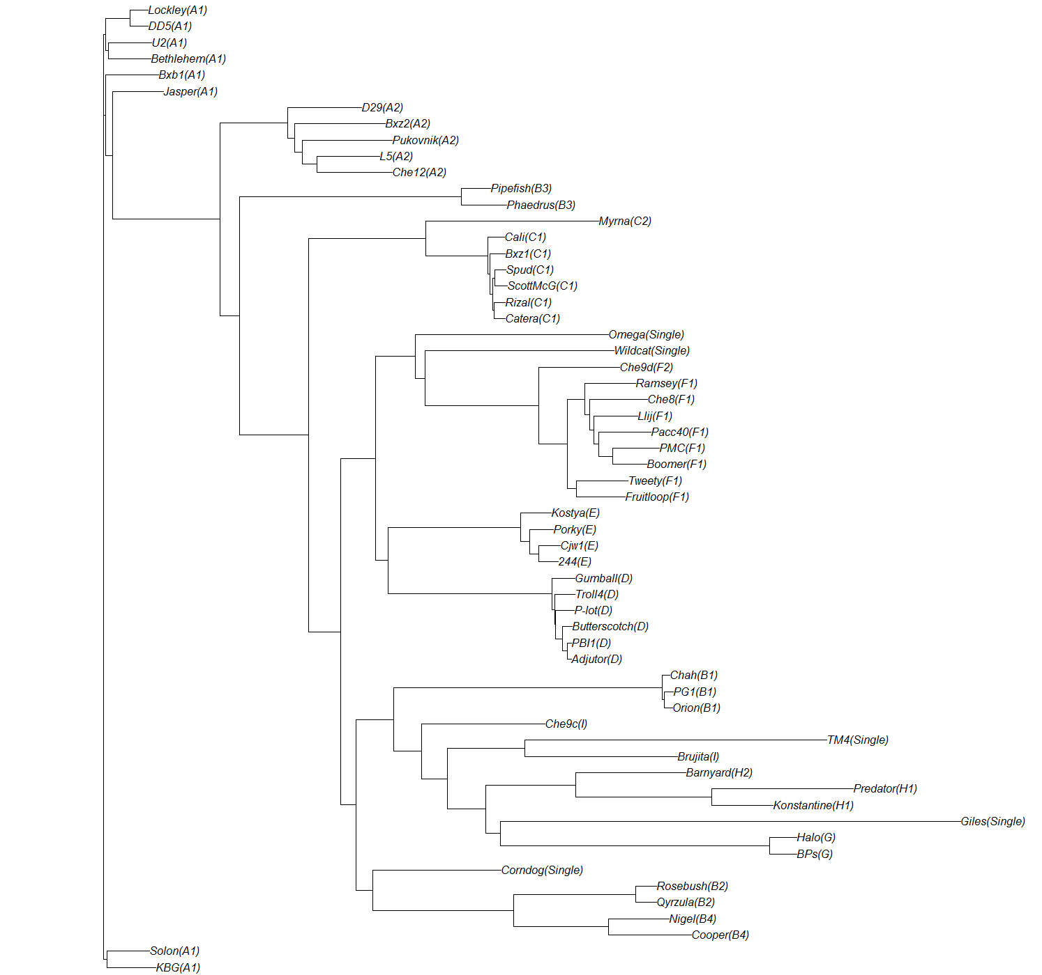
Neighbor joining tree from TUD distance

Slide 5
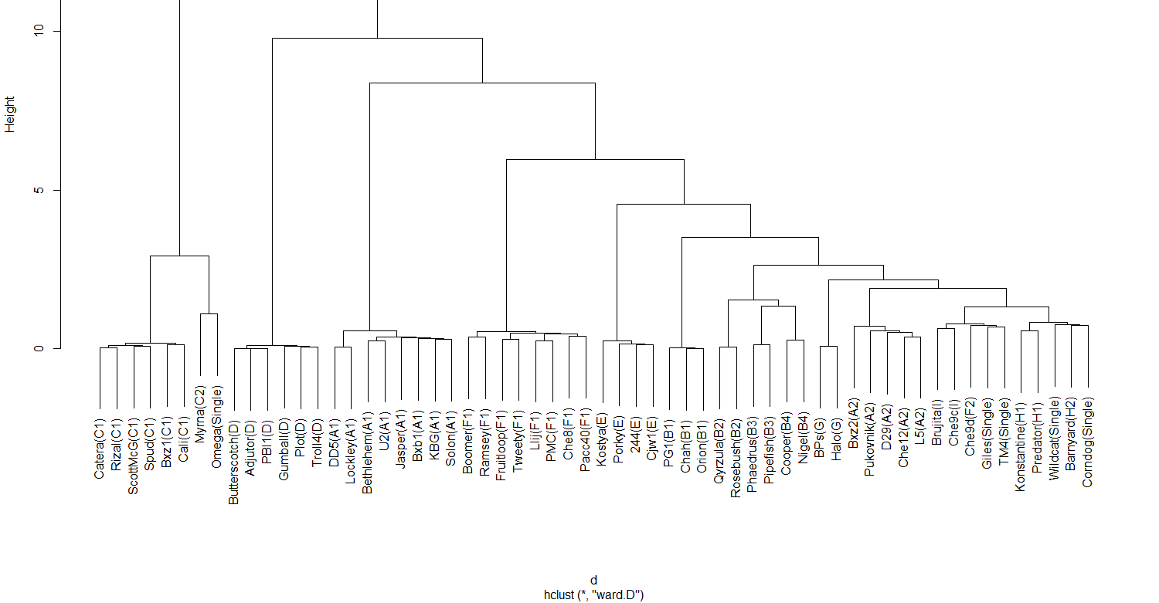
Hierarchical clustering from pairwise global alignment reconstructs subcluster assignments, but not inter-subcluster relationships

Slide 6
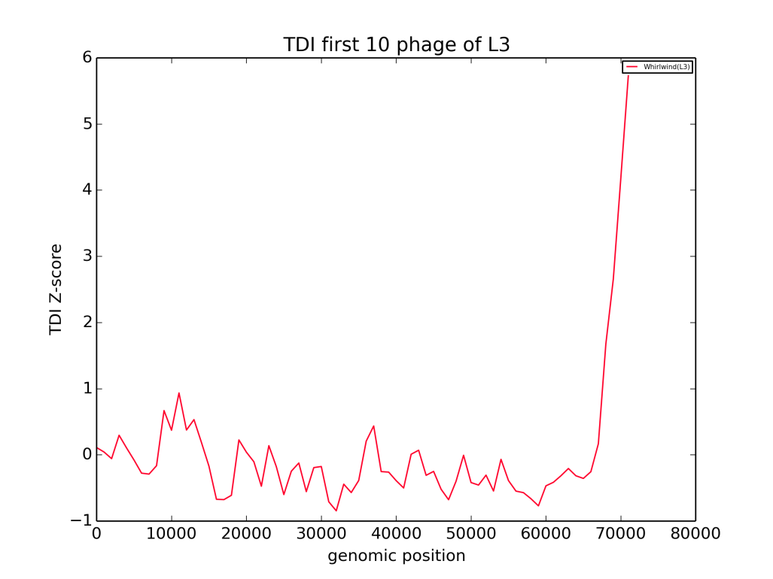
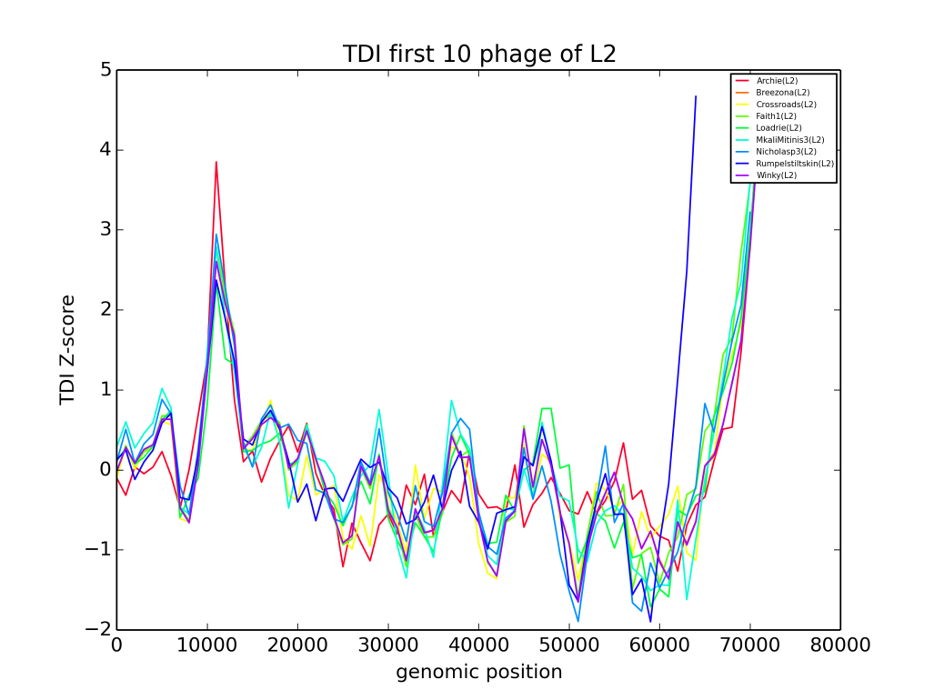
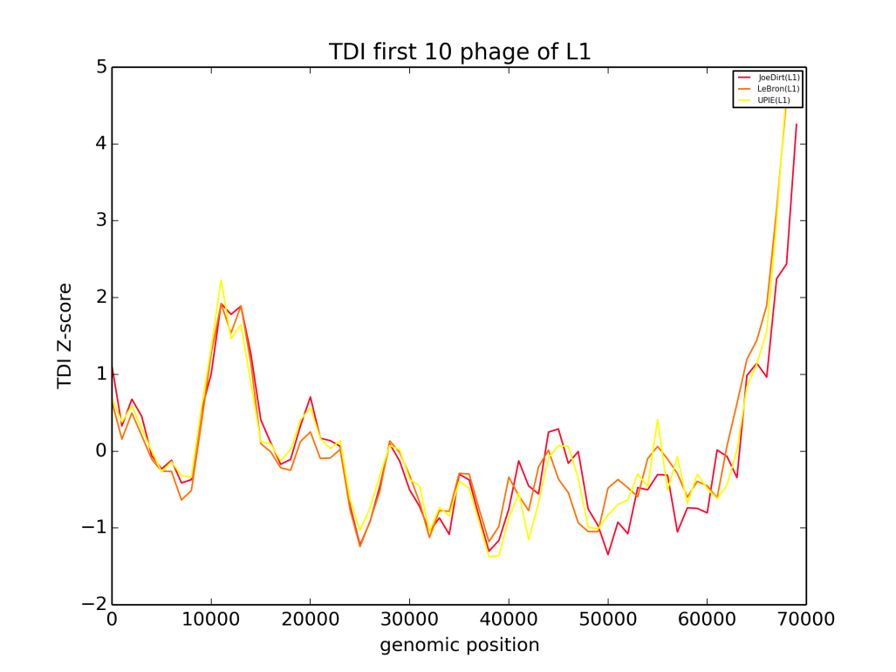
TDI spikes in cluster L indicate putative HGT

