Slide 1

MUSIC STORE DATA ANALYSIS

Slide 2
Agenda
About us
Objective of the Project
ER Diagram and schema explanation
SQL query results with screenshots or summaries
Conclusion (Key finding overall)
Your Experience/Challenges working on SQL – Data Analysis Project.

Slide 3
Name | Graduation | Work Experience | Linkedin URL | Github URL
Dasari Prasanna | B.Tech | Fresher | linkedin.com/in/prasanna-dasari-2bb046307 | https://github.com/prasannadasari356
Gaddam Pravallika | B.Tech | Fresher | https://www.linkedin.com/in/gaddam-pravallika-a0471322b/ | https://github.com/GaddamPravallika
Siddavatam Tejaswini | B.Tech | Fresher | https://www.linkedin.com/in/siddavatam-tejaswini-261493302 | https://github.com/SiddavatamTejaswini
Basireddy Sireesha | B.Tech | Fresher | https://www.linkedin.com/in/sireesha-basireddy-475674302 | https://github.com/sireesha basireddy

Slide 4
Objective of the Project
Customer Insights :Understand who the top customers are, how they shop, and where they come from.
Playlist Trends : Analyze playlist composition to understand customer preferences and popular tracks.
Inventory Insights : Study album and track availability, media types,and their sales impact.
Business Intelligence : Generate actionable insights to support marketing,inventory planning, and sales strategies.
SQL Application : Demonstrate practical use of SQL queries for data extraction,aggregation,and analysis.

Slide 5
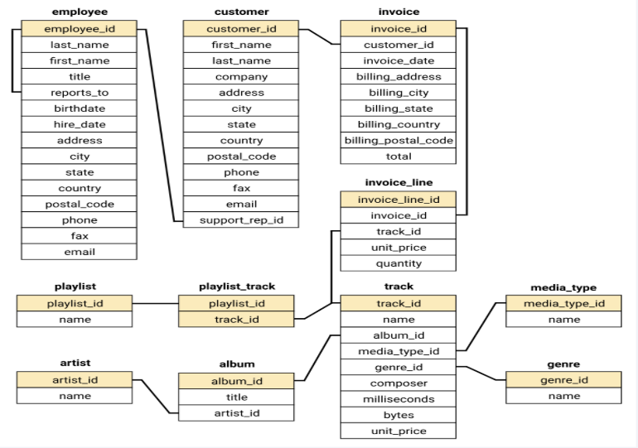
ER Diagram and schema explanation

Slide 6

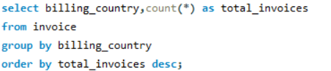
SQL query results with screenshots or summaries
1.Who is the senior most employee based on job title?
2. Which countries have the most Invoices?

Slide 7
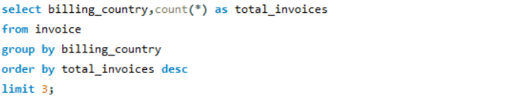
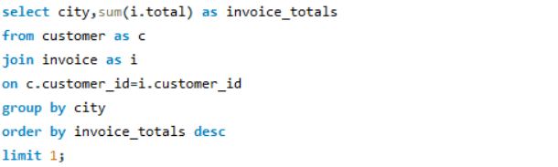
3. What are the top 3 values of total invoice?
4. Which city has the best customers? - We would like to throw a promotional Music Festival in the city we made the most money. Write a query that returns one city that has the highest sum of invoice totals. Return both the city name & sum of all invoice totals

Slide 8
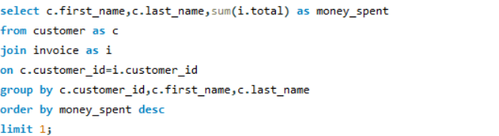
5. Who is the best customer? - The customer who has spent the most money will be declared the best customer. Write a query that returns the person who has spent the most money

Slide 9
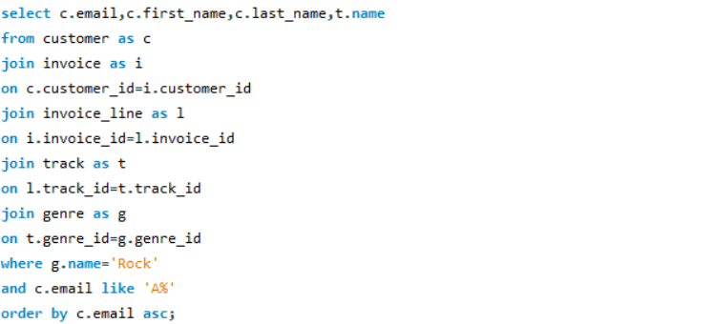
6. Write a query to return the email, first name, last name, & Genre of all Rock Music listeners. Return your list ordered alphabetically by email starting with A

Slide 10
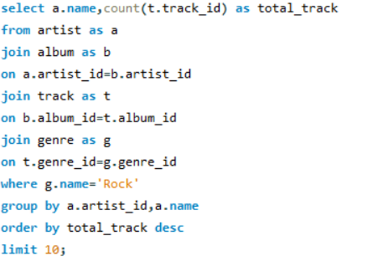
7. Let's invite the artists who have written the most rock music in our dataset. Write a query that returns the Artist name and total track count of the top 10 rock bands.

Slide 11
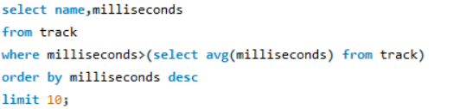
8. Return all the track names that have a song length longer than the average song length.- Return the Name and Milliseconds for each track. Order by the song length, with the longest songs listed first

Slide 12
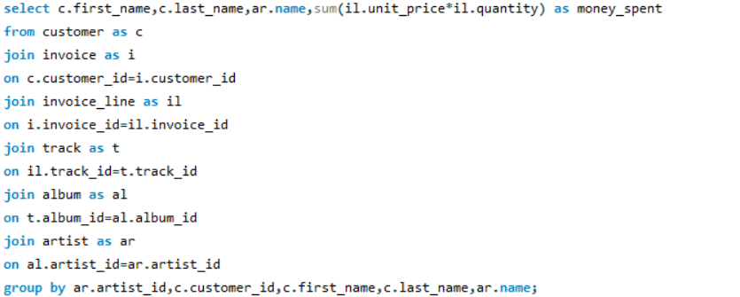
9. Find how much amount is spent by each customer on artists? Write a query to return customer name, artist name and total spent

Slide 13
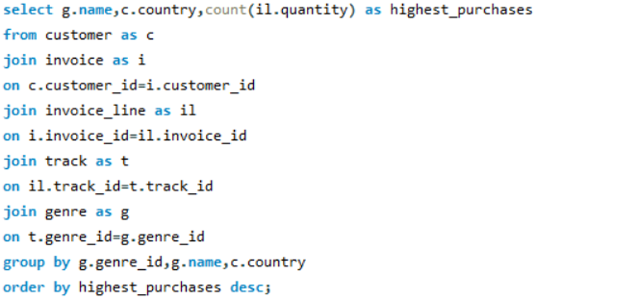
10. We want to find out the most popular music Genre for each country. We determine the most popular genre as the genre with the highest amount of purchases. Write a query that returns each country along with the top Genre. For countries where the maximum number of purchases is shared, return all Genres

Slide 14
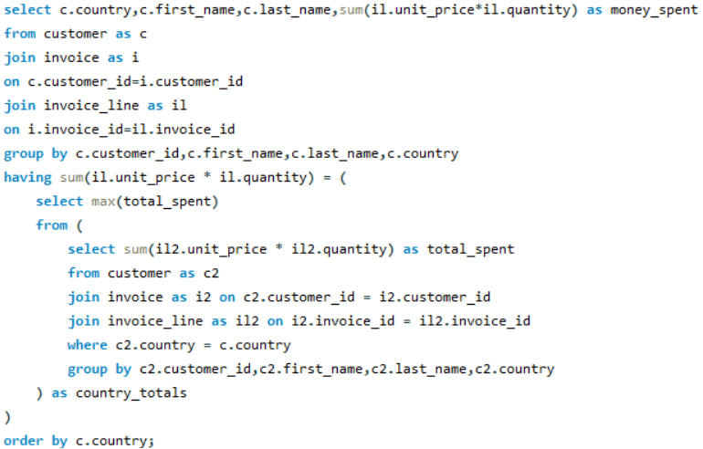
11. Write a query that determines the customer that has spent the most on music for each country. Write a query that returns the country along with the top customer and how much they spent. For countries where the top amount spent is shared, provide all customers who spent this amount

Slide 15
Conclusion
This project helped understand how data can tell a story about the music store’s performance. By using SQL, we explored customer spending habits, popular genres, top albums, and overall sales trends. The analysis also showed which employees contributed the most to sales and what kind of music people love listening to. These insights can help the store plan better marketing ideas, manage inventory smarter, and improve customer experience. Overall, the project proved that SQL is a powerful tool for making data-driven business decisions.

Slide 16
Our Experience/Challenges working on SQL – Data Analysis Project.
Working on the SQL Data Analysis project gave hands-on experience in writing complex queries and understanding real-world database relationships. It improved our ability to connect multiple tables, extract useful insights, and visualize data meaningfully.
However, we faced a few challenges—like handling large data joins, ensuring accurate results while grouping and aggregating data, and interpreting relationships between multiple tables. Overcoming these helped us strengthen our problem-solving skills and deepen our understanding of SQL and data analysis.

Slide 17

THANK YOU

