Slide 1
Computer Vision for Medical Imaging with MatLab Practical Implementations For Beginners
Beril Sirmacek
b.sirmacek@utwente.nl
April 5, 2018

Slide 2
Goal:
Doing hands-on practices for learning;
Reading and visualizing medical data
Some useful image processing methods
Some useful computer vision methods
Determining the further learning needs which could be addressed in the next session.

Slide 3
You need:
Matlab 2017b
Toolboxes:
Image processing toolbox
Computer Vision Toolbox
Data/Slides from:
??
Source code from:
https://github.com/bsirmacek

Slide 4
Content:
Exercise 1 reading, visualizing data,
histogram analysis,
morphological operations,
segmentation
gradients
active regions
Exercise 2 key points, descriptor vectors
object recognition
multiple object recognition
Discussion what to do next

Slide 5
Image
Processing
image
image

Slide 6
Image
Processing
image
image
Computer
Vision
image
information

Slide 7
Exercise 1 Reading data
Reading NIfTI file format (*.nii)
V = niftiread(filename); % (A 3D volume)
Reading DICOM file format (*.dcm)
X = dicomread(filename); %(Layers of grayscale images)
Now see example1.m (Go to MatLab. We will come back to the presentation later.)
Region growing example: https://youtu.be/IhpGmcI-Bwg

Slide 8
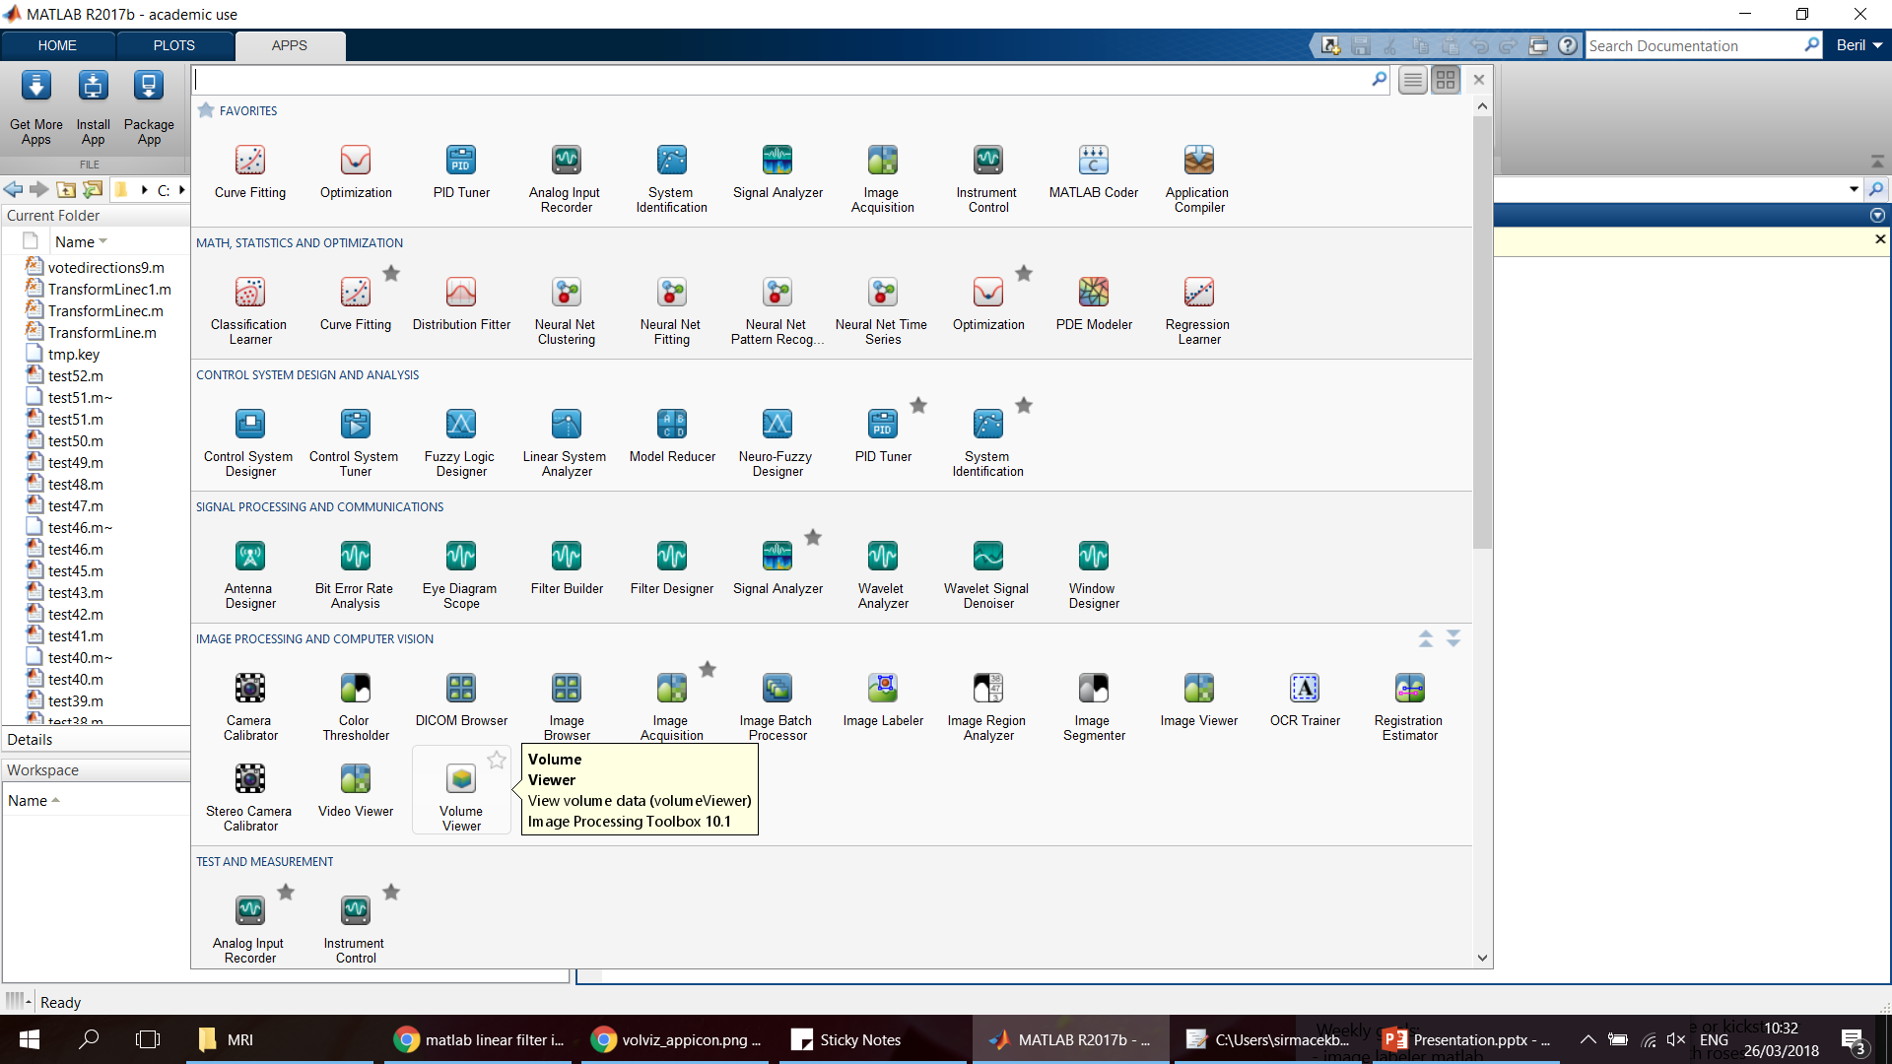

Exercise 1 Reading data
There is an app for that!

Slide 9
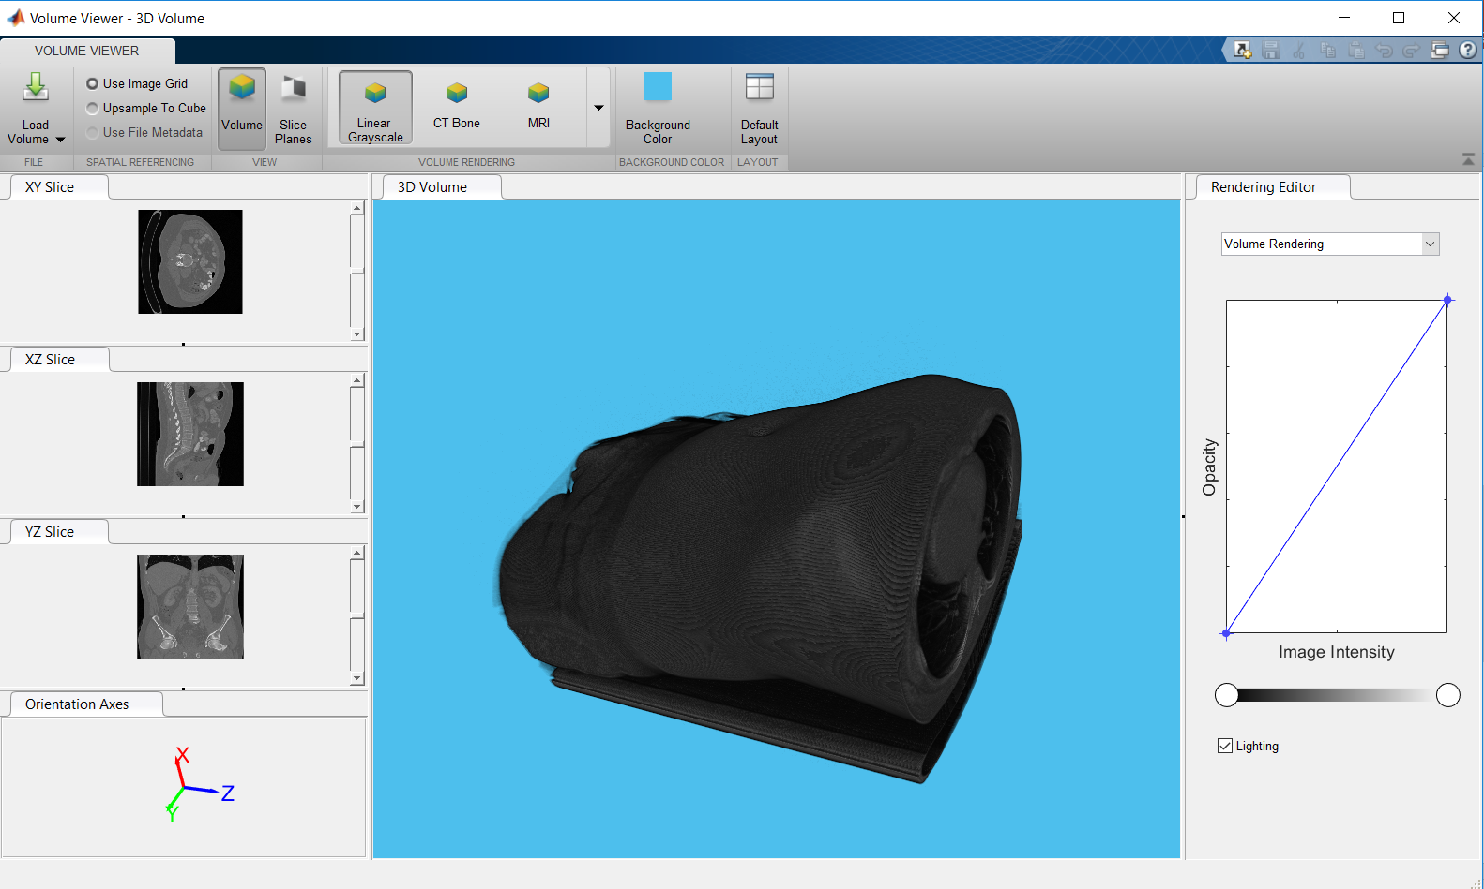
Exercise 1
It can read only *.dcm (DICOM) file format.
For other formats such as *.nii it is possible to read the data from command line, then call data from the workspace.

Slide 10
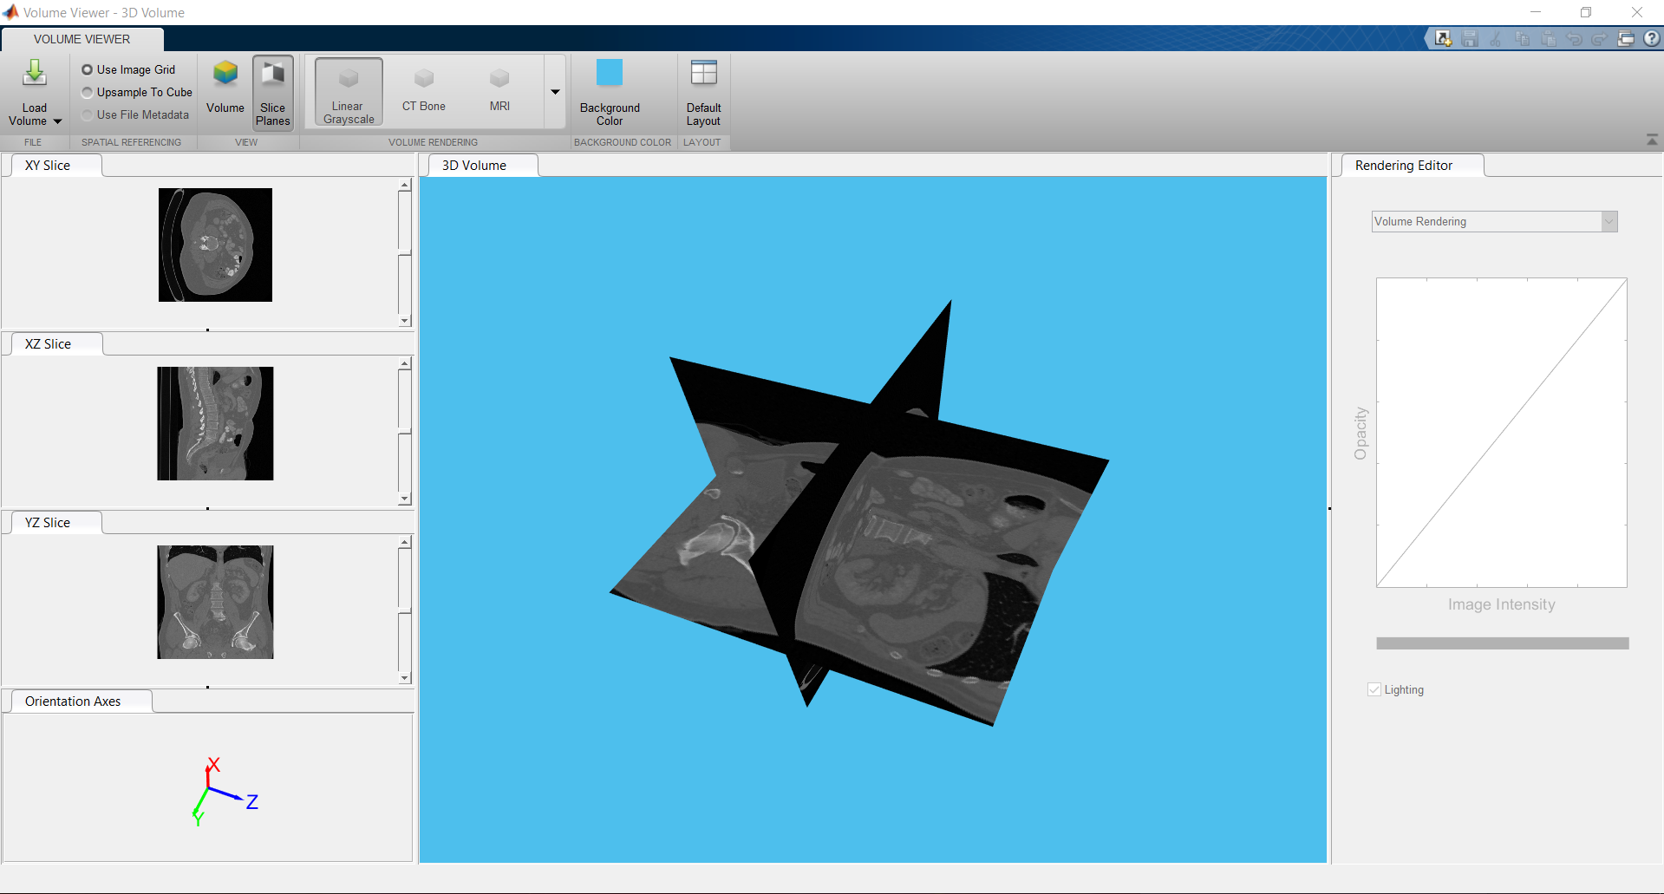
Exercise 1
See layers
Slide layers

Slide 11
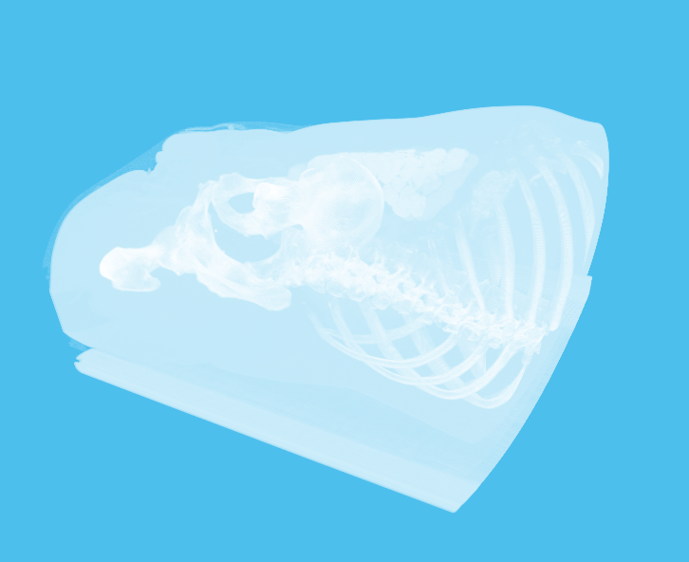
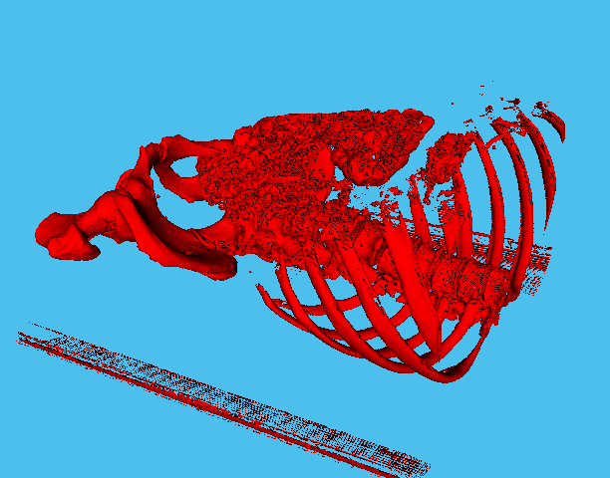
Exercise 1
Other viewer options (maximum intensity and isosurfaces)

Slide 12
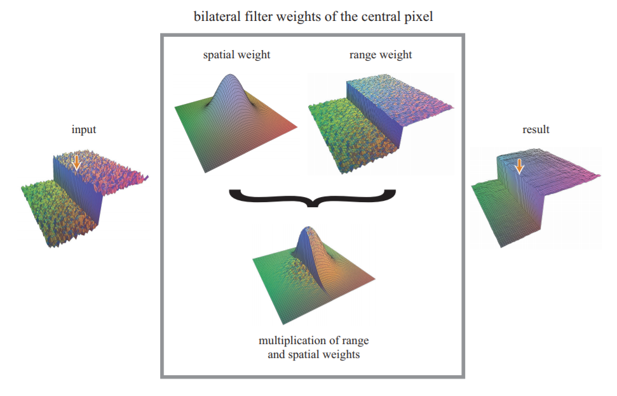

Exercise 1
Function to process the differences in intensity levels
Normalization value
[1] Tomasi, C., and R. Manduchi. "Bilateral Filtering for Gray and Color Images". Proceedings of the 1998 IEEE® International Conference on Computer Vision. Bombay, India. Jan 1998, pp. 836–846.

Slide 13
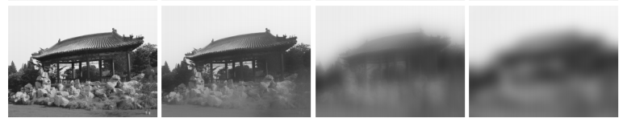
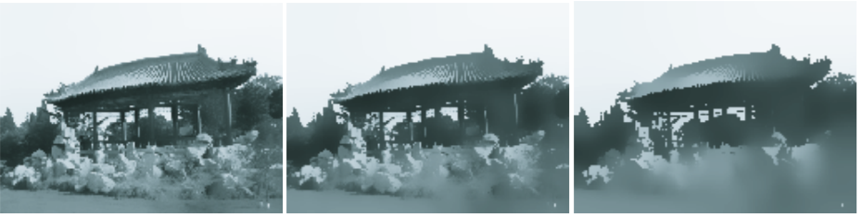
Exercise 1
Gaussian filter
Bilateral filter
[1] Tomasi, C., and R. Manduchi. "Bilateral Filtering for Gray and Color Images". Proceedings of the 1998 IEEE® International Conference on Computer Vision. Bombay, India. Jan 1998, pp. 836–846.

Slide 14
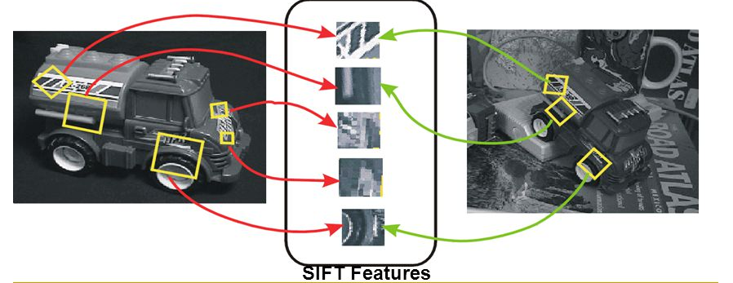
Exercise 2
Training image(s)
Key points &
Descriptor vectors
Test
image(s)

Slide 15
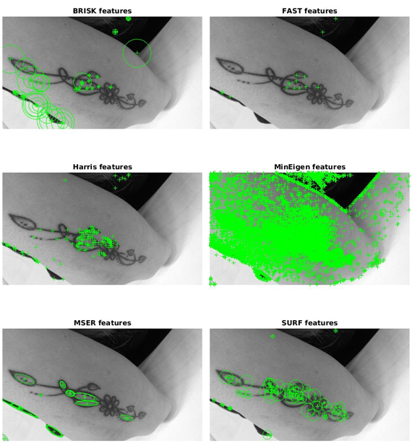
Exercise 2
Key points
Descriptor Vectors

Slide 16
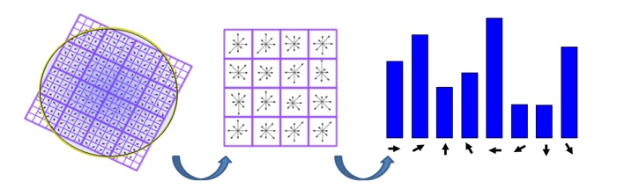
Exercise 2
Key points
Descriptor Vectors
Applications:
Automatic recognition
Matching
3D reconstruction
2D/3D change detection

Slide 17
Exercise 2
Training image(s)
Key points &
Descriptor vectors
Test
image(s)
Now, go to example2.m and we will come back later!

Slide 18
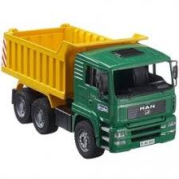

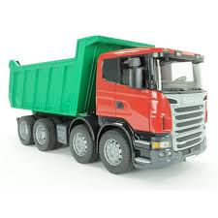
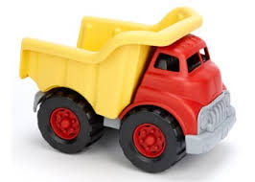
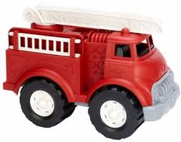
Exercise 2
What about detecting multiple trucks (i.e. tumors in our case)?

Slide 19
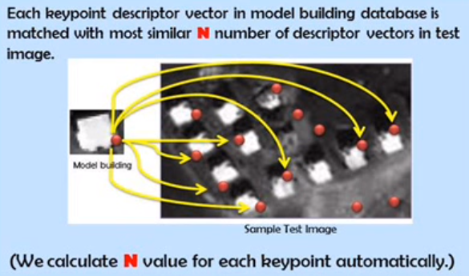
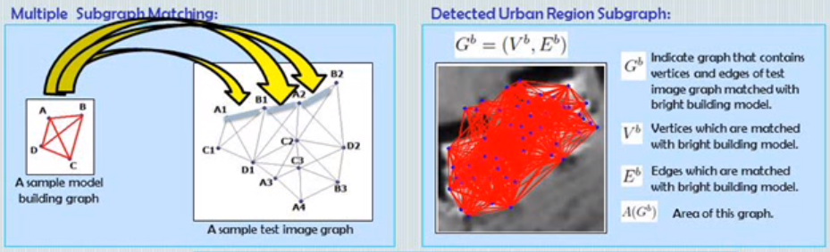
Exercise 2

Slide 20
Exercise 2
Dijkstra's algorithm solves the problem

Slide 21
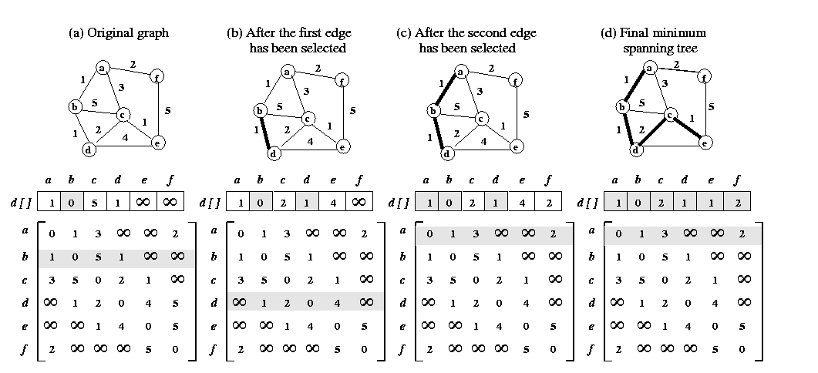
Exercise 2
Dijkstra's algorithm

Slide 22
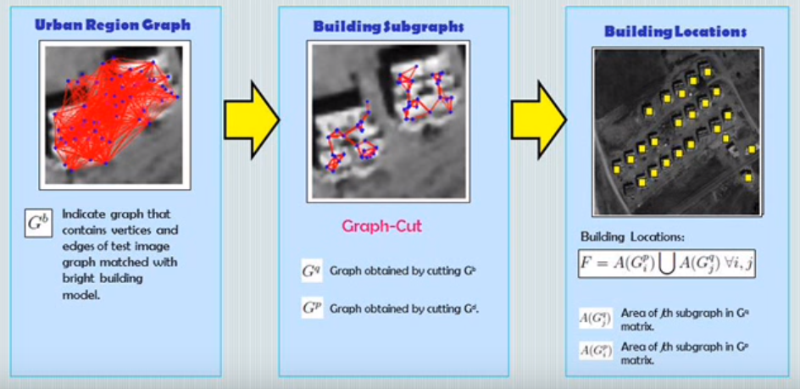
Exercise 2
B. Sirmacek, C. Unsalan, "Urban Area and Building Detection Using SIFT Keypoints and Graph Theory", IEEE Transactions on Geoscience and Remote Sensing, Vol.47 (4), pp. 1156-1167, April 2009

Slide 23
Next session (May 3rd)
Volume processing (3D region growing, voxels, 3D graphs)?
2D/3D features?
Pattern recognition?
Deep learning?
Other request?

