Slide 1

Project Ii Comparing median income and crime in chicago

Slide 2
Group Members
Bill white
Bosco sitati
Ji-heon kim

Slide 3
Concept
Create a web-based application that allows users to visualize Chicago area crime data and local median income information year-by-year and for user selected crimes over an eight-year period

Slide 4
Data Wrangling

Slide 5
Data Wrangling
Median Household Income
Median Household Income and Geo Tracts Obtained and Defined Using R
American Community Survey (ACS) Library – Provides U.S. Census data
Used acs.fetch to download demographic data via the Census API and converted to an acs object
Used this call to obtain median household income for each tract within the Chicago area
Median Income
Geo Tracts
Crime Data
Crime Data

Slide 6
Data Wrangling
Geo Tracts
Researched multiple packages for collecting geo tract data and mapping the information – R proved to be the best environment
The tigris package provides a uniform interface for R to download and work with line shapeﬁles from the United States Census Bureau
Used tigris to pull shapefiles for Chicago for all tracts as defined within the U.S. Census data
Median Income
Geo Tracts
Crime Data
Crime Data

Slide 7
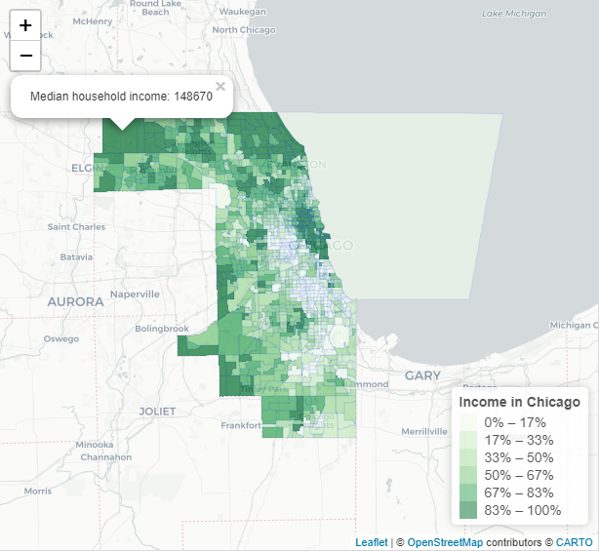
Data Wrangling
Merged Data
Merged Geo Tracts and Median Income on “GEOID”. Created one data frame w/geography for tracts and median income
Visualized the merged data in R with Leaflet and exported as GeoJSON
Median Income
Geo Tracts
Merged Data
Crime Data

Slide 8
Data Wrangling
Crime Data Downloaded Then Cleaned with Python in Jupyter Notebook Environment
Researched sites to find crime data for the Chicago MSA
Downloaded crime data from the Chicago Data Portal as CSV spanning 2001 to present – obtained more than 7 million lines
Utilizing Python, narrowed data set to include a random sampling of 700,000 criminal events over the 20-year period
Obtained a list of unique crimes
Removed all crimes missing latitude and longitude coordinates
Created connection to sqlite using the create_engine function and created sqlite table to enable use of data for the web application
Once data cleaned and exported to sqlite, top 8 crimes were selected to be used in creating web application
Median Income
Geo Tracts
Merged Data
Crime Data

Slide 9
web site development

Slide 10
Web Site Development
Created Default Map and Settings for Landing Page
Used L.map to create base map location in Chicago and to set zoom level
Added tile layer using mapbox and openstreetmap
Defined base year as 2018 which was then used to pull the median income data from the appropriate GeoJSON file
GeoJSON data was used to populate each tract with colors determined by the values set for each range of median incomes for all tracts
Using the assigned colors, created legend for median income data based on the base year of 2018
Added control boxes to allow user to select crimes for the base year to be visualized on the map
Added interactivity in the form of pop up labels that on clicking a census tract show the number of the census tract along with its median income for 2018
Base Layer
Radio Buttons
Check Boxes

Slide 11
Web Site Development
Created Radio Buttons for Year Selection
Added radio buttons to the bottom of web page to allow user to select various years to be visualized
Using selectAll, tracked changes to radio button selection
On change, updated median income map with census tract data for the selected year
Selected year was set as a variable that would be used to retrieve crime data for that year when user chooses various crimes to be visualized
Base Layer
Radio Buttons
Check Boxes

Slide 12
Web Site Development
Created Check Boxes for Crime Selection
Added check boxes to the right-hand side of the web page to allow user to select various crimes to be visualized
When a crime is selected, relevant latitude and longitude coordinates are pulled from sqlite database
Pins are then added to the map for the location of all occurrences of the newly selected crime in the selected year
Added interactivity with a pop up that shows the date, crime type, and location of each crime when a pin is clicked
Base Layer
Radio Buttons
Check Boxes

Slide 13
demonstration

Slide 14
Next steps

Slide 15
Next Steps
With More Time We Would Like to Do the Following
Replace the radio buttons that control the year shown with a slider that the user moves to select specific years
When zoomed out, have the crimes shown with a heatmap that transitions to pins when the user zooms in on a specific area
Find data sources that allow for the expansion of the years available for analysis

