Slide 1

Project Ii Comparing median income and crime in chicago

Slide 2
Group Members
Bill white
Bosco sitati
Ji-heon kim

Slide 3
Concept
Create a web-based application that allows users to visualize annual local median income information overlaid with Chicago area crime data for user selected crimes from 2011 to 2018

Slide 4
Data Wrangling

Slide 5
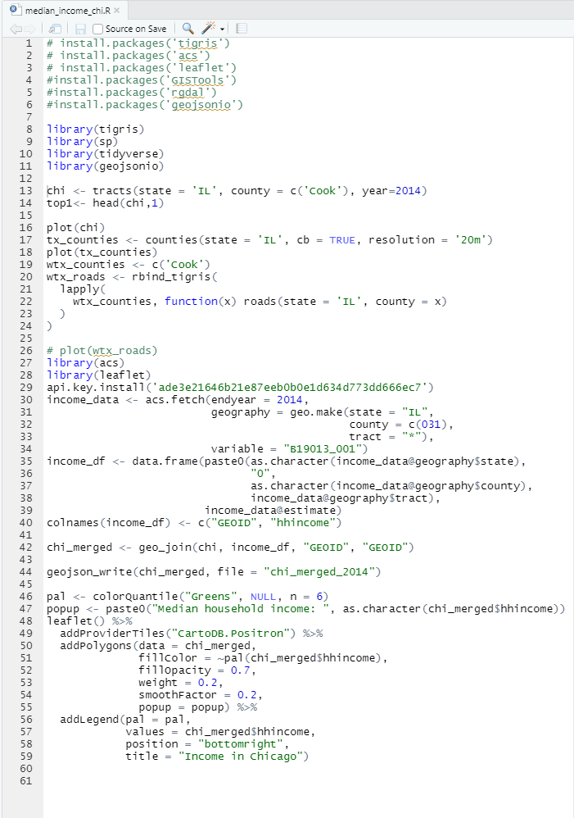
Data Wrangling
Median Household Income
Median Household Income and Geo Tracts Obtained and Defined Using R
American Community Survey (ACS) Library – Provides U.S. Census data
Used acs.fetch to download demographic data via the Census API and converted to an acs object
Used this call to obtain median household income for each tract within the Chicago area
Median Income
Geo Tracts
Merged Data
Crime Data

Slide 6
Data Wrangling
Geo Tracts
Researched multiple packages for collecting geo tract data and mapping the information – R proved to be the best environment
The tigris package provides a uniform interface for R to download and work with line shapeﬁles from the United States Census Bureau
Used tigris to pull shapefiles for Chicago for all tracts as defined within the U.S. Census data
Merged Geo Tracts and Median Income on “GEOID”. Created one data frame w/geography for tracts and median income
Median Income
Geo Tracts
Merged Data
Crime Data

Slide 7
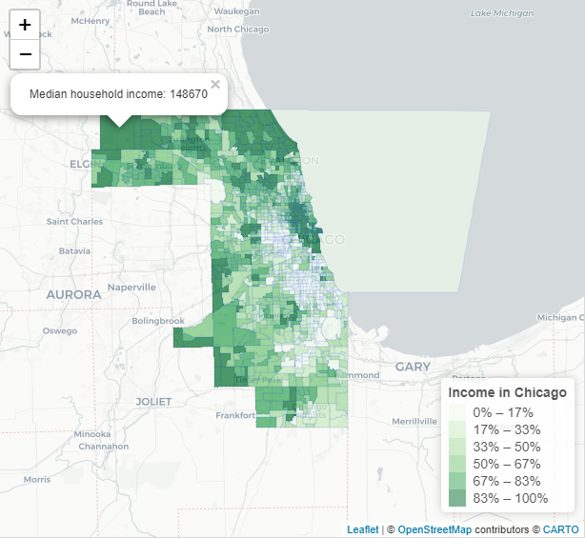
Data Wrangling
Merged Data
Visualized the merged data in R with Leaflet
Exported merged data to GeoJSON files to be used for populating the web site through Javascript
Median Income
Geo Tracts
Merged Data
Crime Data

Slide 8
Data Wrangling
Crime Data Downloaded Then Cleaned with Python in Jupyter Notebook Environment
Researched sites to find crime data for the Chicago area
Downloaded crime data from the Chicago Data Portal as CSV spanning 2001 to present – obtained more than 7 million lines
Utilizing Python, narrowed data set to include a random sampling of 500,000 criminal events over the 20-year period
In analyzing median income data, after noticing inconsistencies in data prior to 2011, restricted information to the period from 2011 to 2018
Obtained a list of unique crimes
Removed all crimes missing latitude and longitude coordinates
Created connection to sqlite using the create_engine function and created sqlite table to enable use of data for the web application
Once data cleaned and exported to sqlite, top 8 crimes were selected to be used in creating web application
Median Income
Geo Tracts
Merged Data
Crime Data

Slide 9
web site development

Slide 10
Web Site Development
Flask SQLAlchemy
Used SQLAlchemy to connect to the sqlite database
Using sql (select statement) queried the crimes data table to pull all the crime data
Used python to convert query results to objects of key-value pairs and jsonified the return values writing them into a json file
Created the json crime file in the local folder
Flask SQLAlchemy
Base Layer
Radio Buttons
Check Boxes

Slide 11
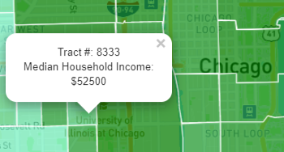
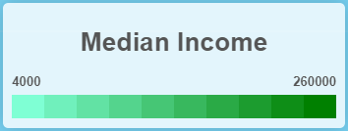
Web Site Development
Created Default Map and Settings for Landing Page
Used L.map to create base map location in Chicago and to set zoom level
Added tile layer using mapbox and openstreetmap
Defined base year as 2018 which was then used to pull the median income data from the appropriate GeoJSON file
GeoJSON data was used to create a choropleth layer on the base map which populated each tract with colors representing median income grouping
Using the assigned colors, created legend for median income data based on the base year of 2018
Added control boxes to allow user to select crimes for the base year to be visualized on the map
Added interactivity in the form of pop up labels that on clicking a census tract show the number of the census tract along with its median income for 2018
Flask SQLAlchemy
Base Layer
Radio Buttons
Check Boxes

Slide 12
Web Site Development
Created Radio Buttons for Year Selection
Added radio buttons to the bottom of web page to allow user to select various years to be visualized
Using d3.selectAll, tracked changes to radio button selection
On change, updated median income map with census tract data for the selected year
Selected year was set as a variable that would be used to retrieve crime data for that year when user chooses various crimes to be visualized
Flask SQLAlchemy
Base Layer
Radio Buttons
Check Boxes

Slide 13
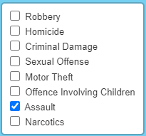
Web Site Development
Created Check Boxes for Crime Selection
Added check boxes to the right-hand side of the web page to allow user to select various crimes to be visualized
When a crime is selected, relevant latitude and longitude coordinates are pulled from sqlite database
Pins are then added to the map for the location of all occurrences of the newly selected crime in the selected year
Added interactivity with a pop up that shows the date, crime type, and location of each crime when a pin is clicked
Flask SQLAlchemy
Base Layer
Radio Buttons
Check Boxes

Slide 14
demonstration

Slide 15
Next steps

Slide 16
Next Steps
With More Time We Would Like to Do the Following
Replace the radio buttons that control the year shown with a slider that the user moves to select specific years
When zoomed out, have the crimes shown with a heatmap that transitions to pins when the user zooms in on a specific area
Find data sources to increase the years available for analysis
If reducing years, take sampling of crimes after year reduction
Allow for use of all available crimes (remove sampling)
Refactor code to make it cleaner and less repetitive
Change choropleth layer to reflect different socio-economic measures (i.e. percent below poverty level)
Improve comparability of crimes between years by holding previously selected crimes fixed when a new year is chosen

