Slide 1
DECENTRALIZED ONLINE MARKETPLACE- Apna Bazaar- Presented by : Bharatkumar Jain

Slide 2
WHAT IS A DECENTRALIZED ONLINE MARKETPLACE?
A decentralized online marketplace is an eCommerce platform operated on a blockchain.
These are the distinguishing characteristics:
No middleman controls the trade between buyers and sellers.
The terms of trade are determined by buyers and sellers, and no middlemen intervene.
The terms of trade are open, transparent, and immutable.
No tampering of transactions is possible.

Slide 3
Centralized online marketplaces have the following characteristics
A centralized company owns the platform, for e.g. Ebay,Amazon etc and takes a commission from sales.
The infrastructure is centralized, and can be hacked.
The company owning the marketplace can change terms and conditions (T&Cs) of trade at will.
Your personal sensitive data is held by the centralized owner and they can sell it to third parties.

Slide 4
Advantage of Decentralized Marketplaces
Decentralized Marketplaces is a decentralized distributed database, and all nodes are involved in maintaining the database.
Each has a full record of the database. There’s no central server for hackers to destroy.
No middleman controls the trade between buyers and sellers.
No tampering of transactions is possible.
Transactions are instantaneous, without depending on a third-party.

Slide 5
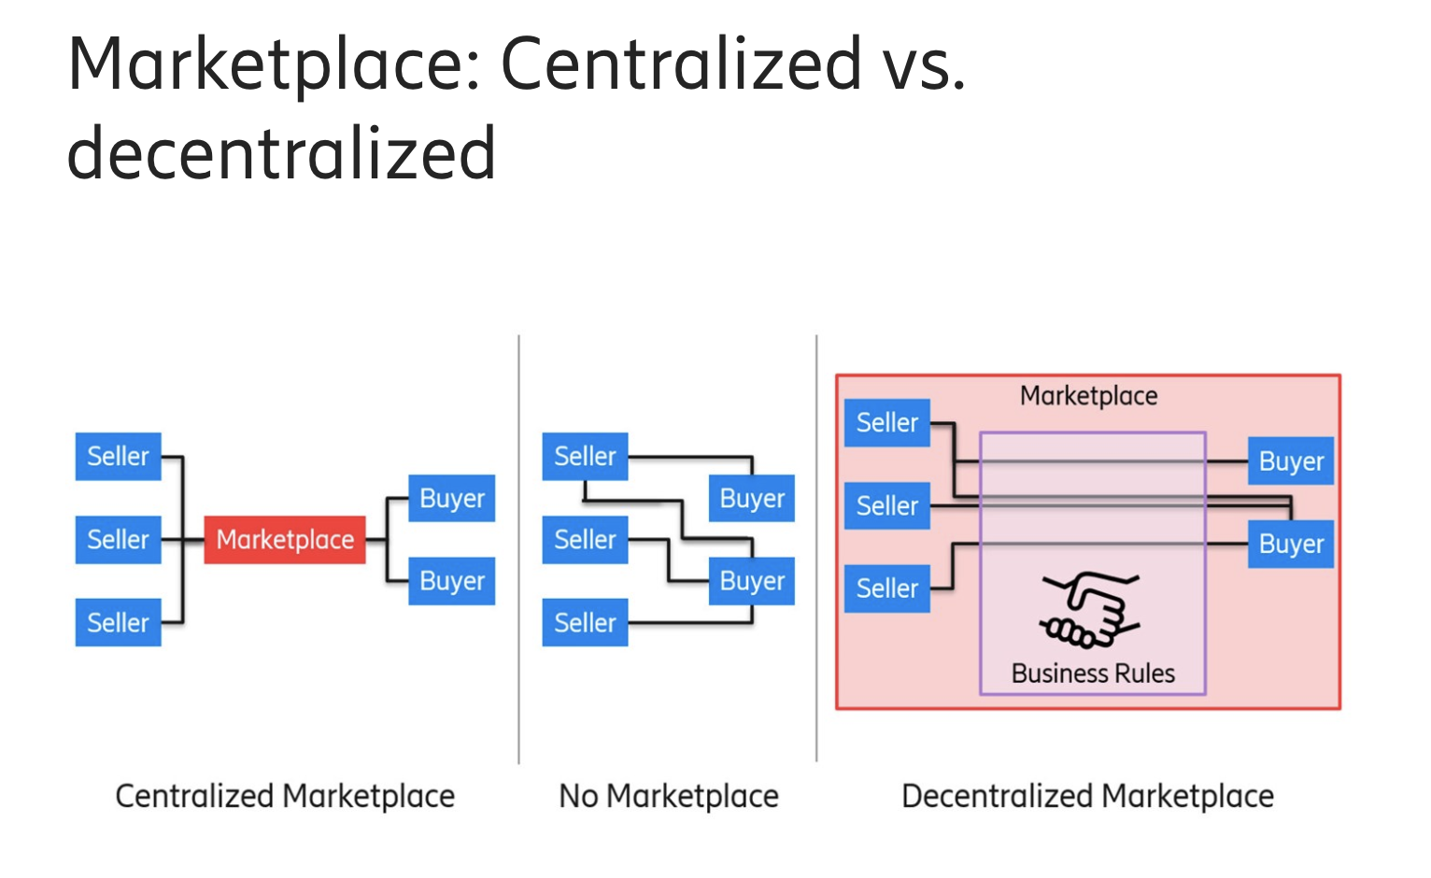

Slide 6
Thank you

