Slide 1
Proposal
Sravan Kumar Borra

Slide 2
Novel Contribution
Idea
The basic idea for this project is to predict the weather which will be used in smart city conditions.
Things to achieve:
Maximum and Minimum Temperatures
Forecasting the weather (Rainfall, Snowfall, Temperatures, Wind Speed Prediction)

Slide 3
Novel Contribution
Our predictions
Temperature- Maximum and minimum temperature of a day.
Humidity – For particular day prediction of humidity
Wind Speed – Wind speed at a specific time for a specific day.

Slide 4
Novel Contribution
Where can we use these predictions?
Temperature – In weather forecasting
Humidity – In weather forecasting during specific seasons.
Wind Speed – In electric industry and weather forecasting.

Slide 5
Work by Competitors
Title: Comparative Study of ANFIS and ARIMA Model for Weather Forecasting in Dhaka
Data set: Ten years of weather data (2000-2009) of Dhaka
Aim of the article: Comparing ANFIS and ARIMA
Prediction- Maximum Temperature and Minimum Temperature

Slide 6
Work by Competitors
Model: ARIMA and ANFIS
Parameters used for comparing ARIMA and ANFIS
Mean Absolute Error (MAE)
Root Mean Square Error (RMSE)
R-square error and the Sum of Square Error (SSE).

Slide 7
Work by Competitors (ARIMA and ANFIS)
ARIMA
Auto-Regressive Integrated Moving Average
Uses auto-regressive, integrated, moving-average
SPSS
ANFIS
Combination of fuzzy logic and Neural networks
ANFIS Editor GUI in the Fuzzy Logic Toolbox
ANFIS : Four inputs and one output

Slide 8
Work by Competitors(Discussion)
95% to training the model and 5% to testing the model
ANFIS : Four inputs and one output
ARIMA: 2,0,1 Model
MAE, SSE, RMSE results were obtained for both ANFIS and ARIMA

Slide 9
Work by Competitor
ARIMA
ANFIS
Time Series Deference
d=0 Observations Modelled directly
d=1 Difference b/w consecutive observations is modelled
Time dependence of stationary model
Autoregressive
Moving Average Terms
Time-varying covariates
Takes the previous errors as observation
Grades of Linguistic Label
Firing Strength of each rule
$i^{th}$ rule’s firing strength
𝑖^𝑡ℎ rule’s firing strength
Summation of all steps
Multiplying the results of step 3

Slide 10
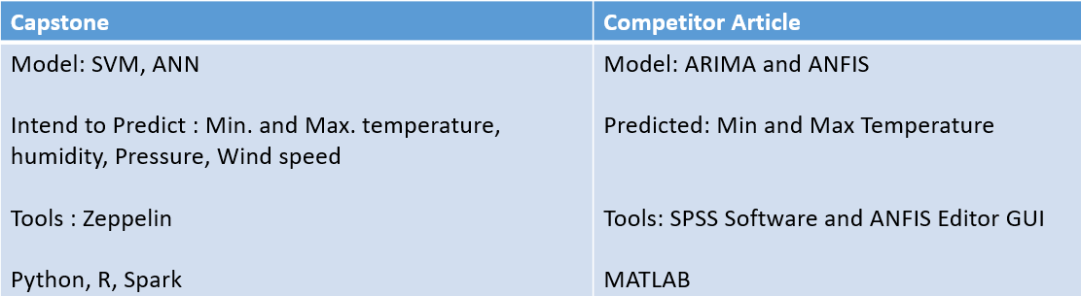
Work by competitor
Comparing the ideas of our project and competitor article

Slide 11
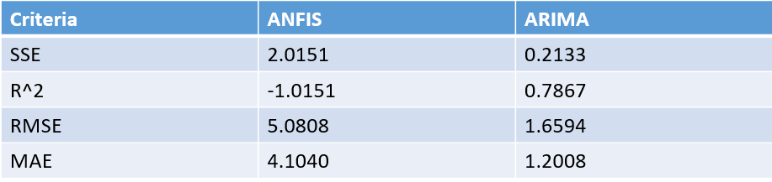
Results of Competitor Article
According to the results, ARIMA capture the behavior of weather better than the ANFIS.

Slide 12
Data
Weather data
City- Aarhus in Denmark
Duration of the dataset:
February 2014 - June 2014
August 2014 - September 2014
Contents of Data set: Dew Point, Humidity, Pressure, Temperature, Wind Direction, Wind Speed.

Slide 13
Data
What can we predict?
We have temperature data set. We can predict maximum and minimum temperatures.
We can also predict the temperature for a particular hour or day.
We can predict the wind speed for a particular time on a specific day using wind speed data set.
Humidity can also be predicted using the data set humidity.
Dew point at a particular time of the day can be predicted.

Slide 14
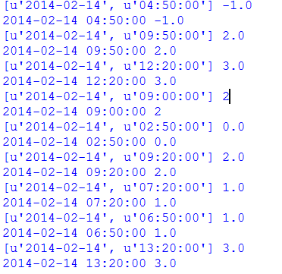
Data (Sample)
Data is a time series which has particular date of the year and a particular time of that specific date. After that the value is given according to the parameter.

Slide 15
Method
We need to predict the temperature (Max and Min), humidity, wind speed.
So we are using SVM and ANN.
SVM-Support Vector Machines
ANN-Artificial Neural Networks

Slide 16
Method-1(SVM)
Works on statistical learning
Also known as a kernel machine
Used for classification purpose and regression purpose
Segregates two important parts of a plot
Hyper plane
Line

Slide 17
Method(Steps in SVM)
Steps in SVM
DATA
Vectors Scaling
Selecting Kernel
CV(Cross Validation)
SVM Model
Applying on test Data
Prediction Result

Slide 18







Method(ANN)
N-inputs
Each input multiplies by weight
1 Y
Output (Y)
$$w_{0}$$
$$i_{1}$$
$$w_{1}$$
$$i_{2}$$
$$w_{2}$$
$$w_{n}$$
$$i_{n}$$

Slide 19
Method (ANN)
Complex decision boundaries can be represented by ANN
ANN has algorithms which can learn by itself
Neural networks has large number of parameters
Overfitting might be possible
Boolean functions also can be represented in ANN

Slide 20
Method (Process in ANN)
Flow chart of the Process
Start
Creating ANN Arch.
Data set Training
Error
NO
YES
Hidden nodes comparing
Stop
Adding nodes

Slide 21
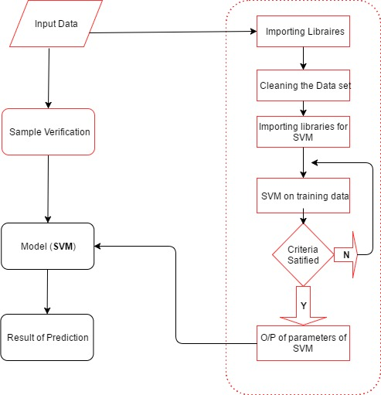
Method (Code Flow chart)

