Slide 1
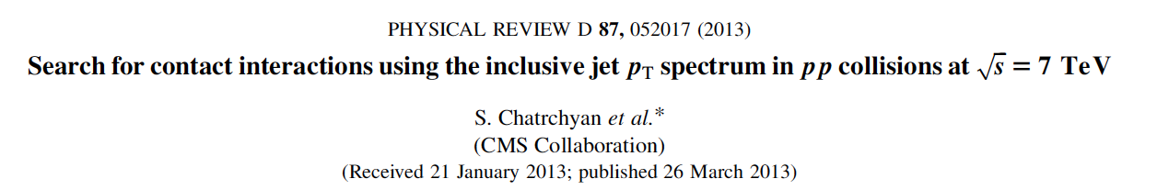
CMS Contact Interaction (CI) Search

Slide 2
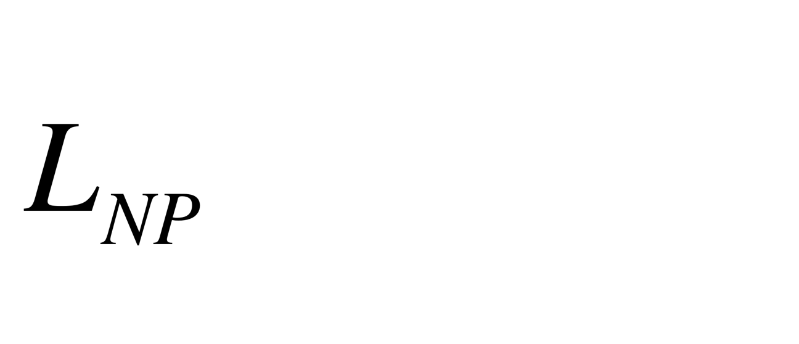
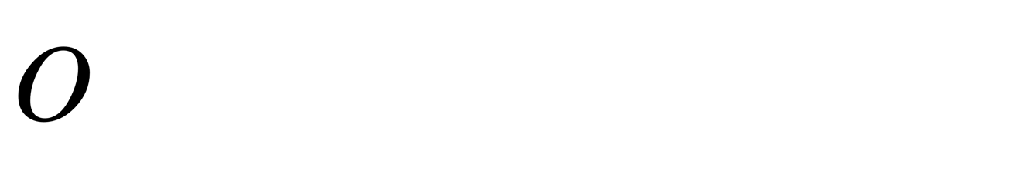
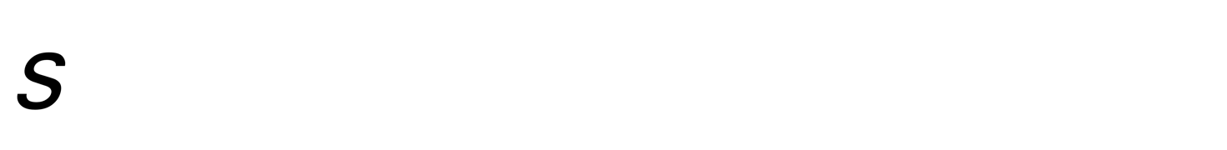
CI Analysis
Goal: search for new interactions amongst left-handed quark fields that can be modeled by the effective Lagrangian
where c = ±4π and O is the dimension 6 operator
which describes contact interactions between 4 fermion fields, characterized by the mass scale Λ. At leading order, the cross section is given by , where c, b, and a are jet p_{T}-dependent coefficients.

Slide 3

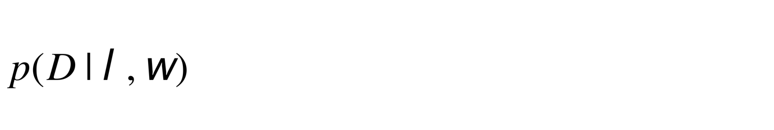
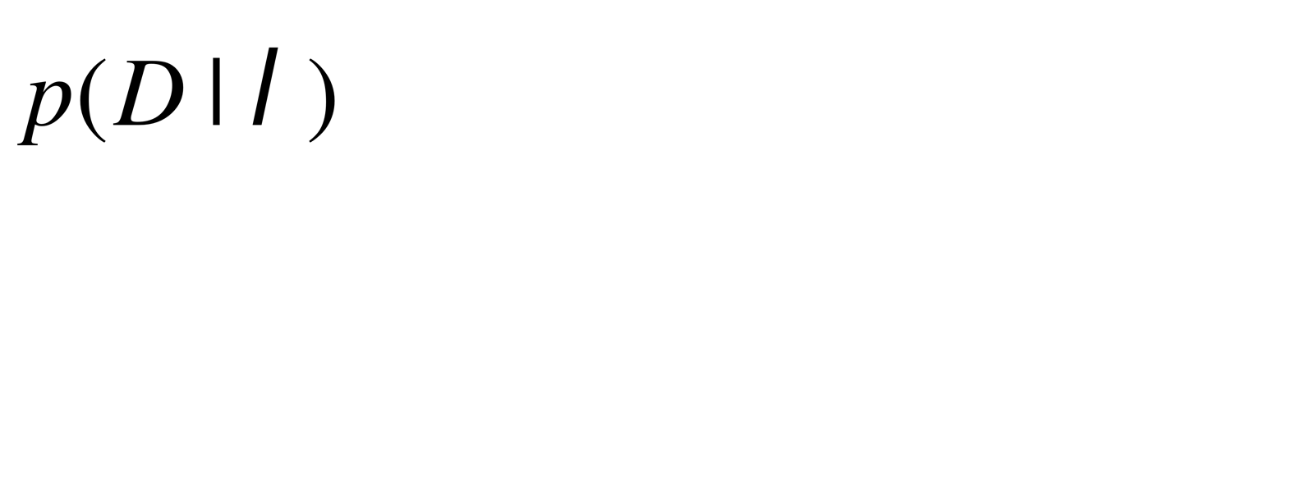
CI Analysis
Bin data into K = 20 jet p_{T} bins (507 ≤ p_{T} ≤ 2116 GeV)
Do a pure shape analysis using a multinomial likelihood
where ω represent the sets nuisance parameters {(c, b a)}
Compute marginal likelihood (by MC integration)

Slide 4
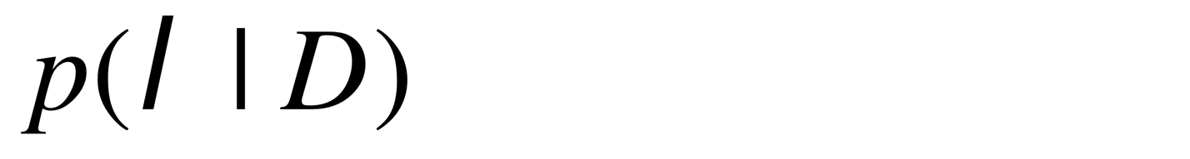
CI Analysis
Compute reference prior for λ (using refprior code in phystat.org)
Compute posterior density and limits on Λ. Would like to be able to reproduce this analysis using RooFit/Roostats

Slide 5
RooFit Questions
Given something like ws.factory('CEXPR::mypdf("func_c + func_b*lambda + func_a*lambda*lambda",lambda, func_c, func_b, func_a)’)
what is the tidiest way to make it into a PDF?
It seems that the generate method of a PDF built from RooDataHists and RooHistFuncs with observable x (e.g., the jet p_{T} in the CI analysis) generates x, even though what is returned is a RooDataSet of counts. Is this correct?
If so, would be possible to have the generate method directly generate the counts?

Slide 6
RooFit Questions
In the CI example, there are ~200,000 jet p_{T}s, but only 20 bins. It would be more more efficient to generate the 20 counts directly rather than generate 200,000 p_{T}s, which are then histogrammed.
In the next LHC run, the number of p_{T}s is likely to be in the millions!
Why is a bin integrator needed when one knows the expected count per bin from the RooDataHist/RooHistFuncs? Is there a tidier way to cause RooFit to use the bin integrator than the code: customConfig = RooNumIntConfig.defaultConfig() customConfig.method1D().setLabel("RooBinIntegator”) ws.pdf("mypdf").setIntegratorConfig(customConfig)

Slide 7
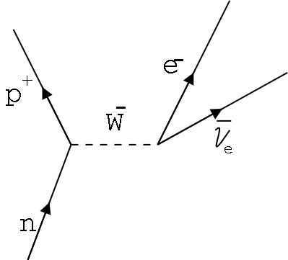
Backup
The classic example of a contact interaction model is Fermi’s theory of beta-decay. For example,
which we now
describe as:

