Slide 1
Search for Contact Interactions @ 8 TeV Plans
Jeff Haas, Harrison B. Prosper
Exotica-Multijets Meeting
07 March 2013

Slide 2
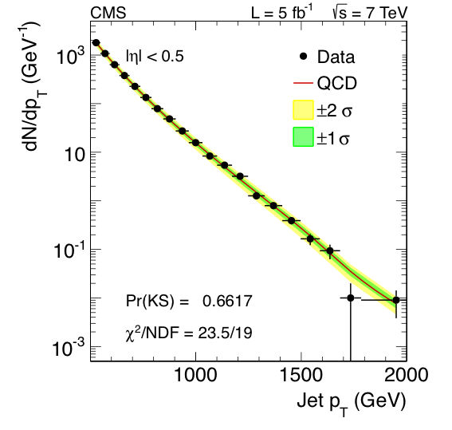
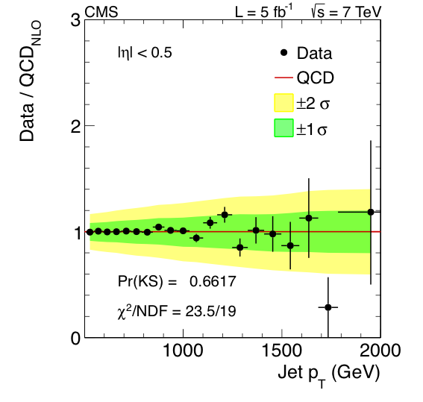
Reminder: 7 TeV Results
Λ > 9.9 TeV, 14.3 TeV @ 95 C.L.

Slide 3
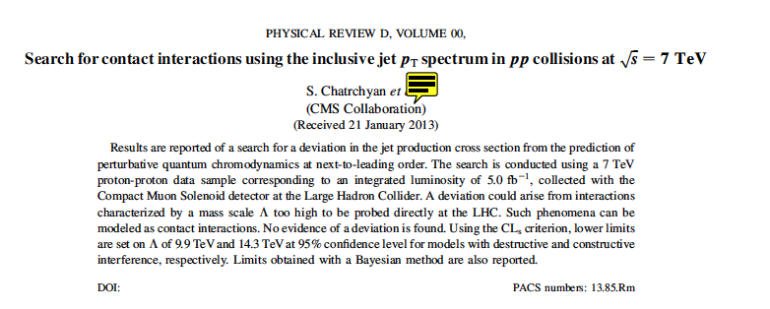
7 TeV Results
Proof-reading, expect to be published soon!

Slide 4
Outline
Overview
Plan
Status

Slide 5
Overview
Goal
Using the full 8 TeV data set, compare measured inclusive jet p_{T} spectrum of central jets to CI models aiming for a preliminary result by early summer.
What do we need? Experimental input:
Measured inclusive jet p_{T} spectrum
A high p_{T} region where trigger efficiency is constant
Jet energy resolution vs. jet p_{T}
Jet energy scale uncertainty
Jet energy resolution uncertainty

Slide 6
Overview
What do we need? Theoretical input:
Program to calculate QCD @ NLO
fastNLO (v2.1.0-1360 + fnl3323y0.tab)
Program to calculate CI @ NLO
CIJET (v1.0, Gao, arXiv:1301.7263v1)

Slide 7
Overview: Models
The effective Lagrangian may be written as
where λ = 1/Λ² and c_{i} are free parameters, and O_{i} are dimension six operators. This Lagrangian yields a cross section of the form
The primed terms depend logarithmically on λ.

Slide 8
Proposed Analysis
We shall follow the approach of the 7 TeV analysis, but with the following changes:
Compute all models at next-to-leading order.
Drop use of simulated events.
Drop use of ansatz for the ratio (QCD+CI)/QCD.
Raise p_{T} threshold (if this proves advantageous)
Compute limits using a Bayesian method only

Slide 9
Proposed Analysis
Analysis Steps
Generate ensembles of MSTW2008 PDF sets using the procedure described at http://mstwpdf.hepforge.org/random/. Apply same procedure to CTEQ6.6.
For each PDF set, and random choices of the renormalization and factorization scales, calculate inclusive jet p_{T} spectrum.
Convolve these spectra with jet response function using randomly sampled (JES, JER) pairs.

Slide 10
Proposed Analysis
Analysis Steps
Compute the marginal multinomial likelihood as before:
where θ denotes all the nuisance parameters. This time
implement likelihood in RooFit/RooStats
Compute reference prior π(λ)
Compute limit using

Slide 11
Status
We have exercised the fastNLO and CIJET programs
The RooFit/RooStats implementation of the likelihood will be tested soon
Work on the reference prior will start soon (Supriya Jain)
The random sampling of MTSW2008 PDF sets not yet exercised, but example code exists
Waiting for experimental input

