Slide 1
Search for Contact Interactions @ 8 TeV Status Report
Suman Beri¹, Supriya Jain²,
Greg Myers³, Harrison B. Prosper³
¹Panjab University, ²SUNY Buffalo, ³Florida State University
Exotica-Multijets Meeting
27 June 2013

Slide 2
Outline
Overview
Analysis Overview
Status
Plans

Slide 3
Overview
Goal
Using the full 8 TeV data set, compare measured inclusive jet p_{T} spectrum of central jets to QCD+CI models aiming for a preliminary result by this summer.
Experimental input
Measured inclusive jet p_{T} spectrum above 500 GeV where trigger efficiency is flat
Jet energy resolution (JER) σ vs. (true) jet p_{T}
Jet energy scale uncertainty (JES) (2% – 4%)
Jet energy resolution uncertainty (10%)

Slide 4
Overview
Theoretical input
Program to calculate QCD @ NLO
fastNLO (v2.1.0-1360 + fnl3323y0.tab)
Program to calculate CI @ NLO
CIJET (v1.0, Gao, arXiv:1301.7263v1)

Slide 5
Overview: Models
At next-to-leading order (NLO), the effective Lagrangian describing QCD-like interactions may be written as
where λ = 1/Λ² and κ_{i} are free parameters*, and each O_{i} is a sum over dimension six operators:
O_{1,2} ~ ū_{L}γ_{μ}u_{L} ū_{L}γ^{μ}u_{L}
O_{3,4} ~ ū_{L}γ_{μ}u_{L} ū_{R}γ^{μ}u_{R}
O_{5,6} ~ ū_{R}γ_{μ}u_{R} ū_{R}γ^{μ}u_{R}
* In order to avoid confusion with λ = 1/Λ², we use κ_{i} instead of λ_{i} as in Gao et al.’s paper

Slide 6
Overview: Models
At NLO, the cross section per jet p_{T} bin is of the form
where σ_{QCD} is the SM cross section at NLO.
Notes:
1. The primed terms vanish at leading order.
2. The cross section is linear in the terms involving λ.

Slide 7
Analysis Overview
We are following the approach of the 7 TeV analysis, but with the following changes:
Compute all model spectra at NLO and smeared with the jet response function given in SMP-12-012
Compute (QCD+CI)/QCD bin-by-bin using fastNLO and CIJET. (Ansatz no longer needed.)
Assume a constant 4% uncertainty in JES
Compute limits using a Bayesian method only
As in the 7 TeV analysis, we are doing a pure shape analysis

Slide 8
Analysis Overview
Analysis Steps
Generate 100 MSTW2008 PDF sets using the procedure described at http://mstwpdf.hepforge.org/random/. Do same for CT10. NNPDF21 already available as a sample.
For each PDF set and renormalization and factorization scales, calculate σ_{QCD} and all coefficients required to calculate inclusive jet p_{T} spectrum for given values of λ and κ_{i}.

Slide 9
Analysis Overview
Analysis Steps
Convolve σ_{QCD} and these coefficients with the jet response function for randomly sampled pairs (x, z) of the JES and JER,
where c is a coefficient. Given the smeared coefficients, we can calculate the model spectra for any choice of λ and κ_{i}.
Compute limits using 7 TeV analysis procedure

Slide 10
Status
We have calculated the QCD and CI spectra for the nominal choices of renormalization and factorization scales, different values of Λ and two sets of values for the coefficients κ_{i}. (Myers, Beri, HP)
The RooFit/RooStats implementation of the likelihood has been completed (Jain, HP)

Slide 11
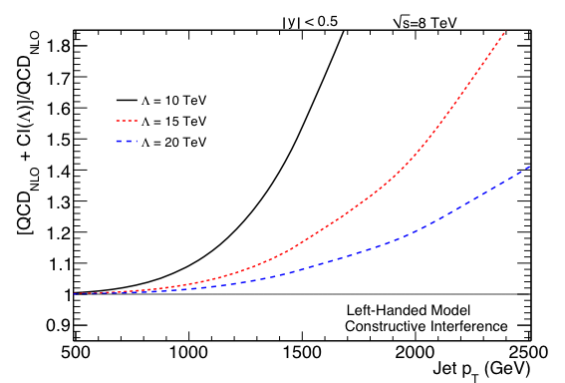
Left-Left Model

Slide 12
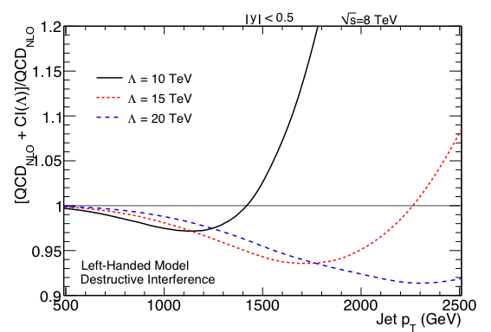
Left-Left Model

Slide 13
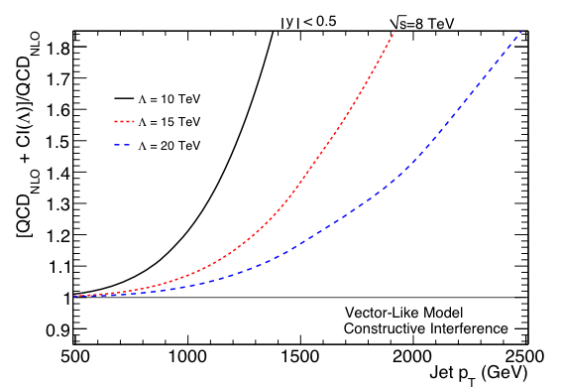
Vector-like Model

Slide 14
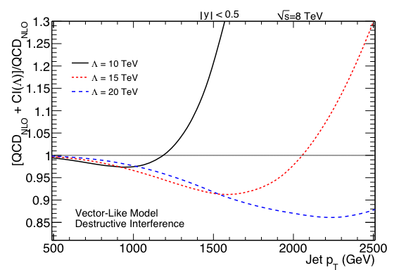
Vector-like Model

Slide 15
Plans
Smear all models with jet response function for randomly sampled JES and JER
Compute preliminary limit
Without and with JES and JER systematics
With JES, JER, PDF and renormalization and factorization scale variations
Timescale
1 to 2 months

