Slide 1
Search for Contact Interactions @ 8 TeV Status Report
Greg Myers¹, Harrison B. Prosper¹, Suman Beri²
¹Florida State University, ²Panjab University,
Exotica Multijets Working Group Meeting
20 March 2014

Slide 2
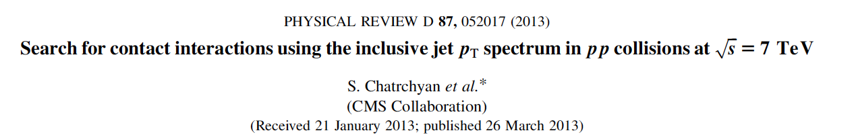
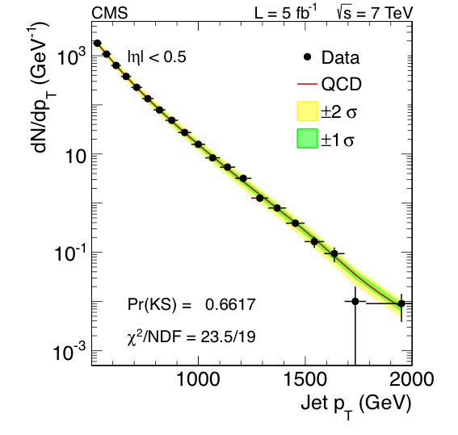
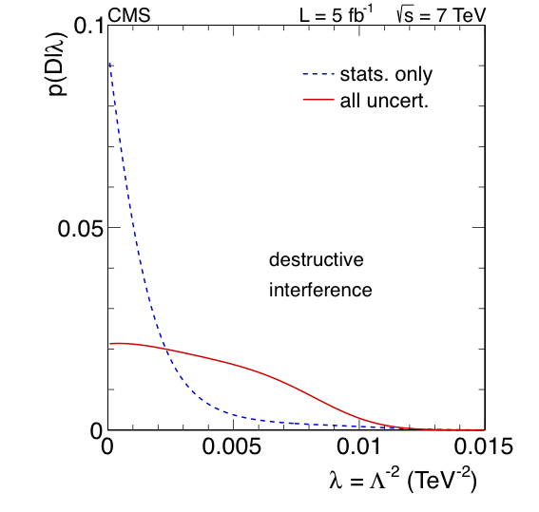
Contact Interaction (CI) Search @ 7 TeV

Slide 3
Outline
Overview
Analysis Overview
Status
Plans

Slide 4
Overview
Goal
Compare the inclusive jet p_{T} spectrum at 8 TeV of |y| < 0.5 jets to QCD+CI models computed at NLO accuracy, and draw conclusions about possible new QCD-like interactions, modeled as contact interactions.
Experimental Input
Measured inclusive jet p_{T} spectrum above 500 GeV where trigger efficiency is flat
Jet response function (JRF)
Jet energy scale (JES) uncertainty
Jet energy resolution (JER) uncertainty

Slide 5
Overview
Theoretical Input
Program to calculate QCD @ NLO
fastNLO (v2.1.0-1360 + fnl3323y0.tab)
Program to calculate CI @ NLO
CIJET (v1.0, Gao, arXiv:1301.7263v1)

Slide 6
Overview: Models
At next-to-leading order, the effective Lagrangian describing QCD-like interactions may be written as
where λ = 1/Λ² and κ_{i} are free parameters and each O_{i} is a sum over dim-6 operators:
O_{1,2} ~ ū_{L}γ_{μ}u_{L} ū_{L}γ^{μ}u_{L}
O_{3,4} ~ ū_{L}γ_{μ}u_{L} ū_{R}γ^{μ}u_{R}
O_{5,6} ~ ū_{R}γ_{μ}u_{R} ū_{R}γ^{μ}u_{R}

Slide 7
Overview: Models
Following CMS paper arXiv:1202.5535v1, we consider CI models defined by specific values of κ₁ …κ₆, namely,
Model η_{LL} η_{RL} η_{RR}
LL ±1 0 0
RR 0 0 ±1
VV ±1 ±1 ±1
AA ±1 ∓1 ±1
V-A 0 ±1 0
where η_{LL} = κ₁, η_{RL} = κ₃/2, η_{RR} = κ₅, and κ₂ = κ₄ = κ₆ = 0.

Slide 8
Overview: Models
At NLO, the cross section per jet p_{T} bin is of the form
where σ_{QCD} is the SM QCD cross section @ NLO.
At LO, the primed terms vanish.
(In the 7 TeV analysis, we considered the ad hoc model
σ = σ_{QCD}+ b/Λ² + a /Λ⁴, with σ_{QCD} at NLO.)

Slide 9
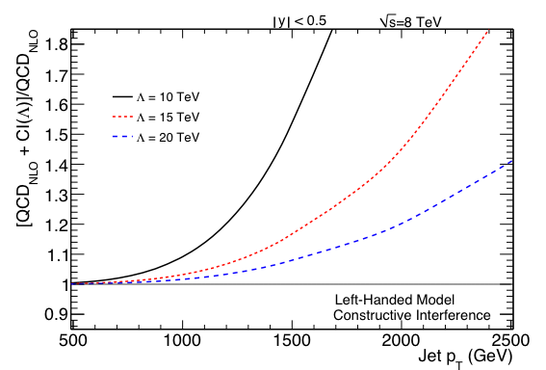
Left-Left (LL) Model

Slide 10
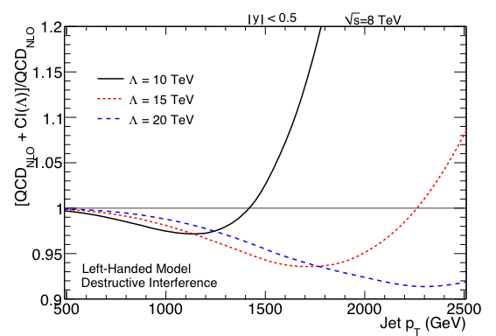
Left-Left (LL) Model

Slide 11
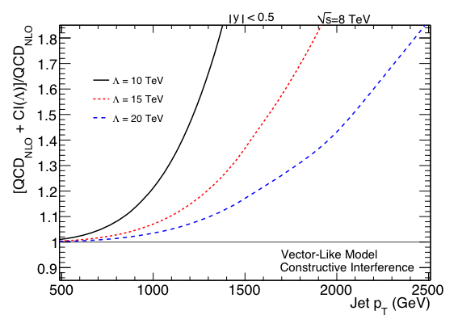
Vector (VV) Model

Slide 12
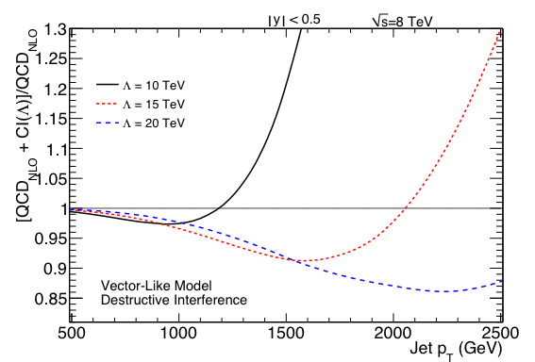
Vector (VV) Model

Slide 13
Analysis Overview
Analysis Steps
For a given CI model, randomly sampled PDF set, renormalization (μ_{R}) scale, and factorization (μ_{F}) scale, calculate σ_{QCD} and all CI coefficients bin-by-bin. Interpolate into smooth differential densities f (p_{T}) = dF/dp_{T}.
Convolve the differential densities f (p_{T}) with the jet response function for randomly sampled pairs (x, z) of scale factors that account for uncertainty in the jet energy scale (JES) and jet energy resolution (JER),

Slide 14
Analysis Overview
Jet Response Function (JRF)/JES
Use the jet response function (SMP-12-012, Sanmay Ganguly)
https://indico.cern.ch/event/271240/material/slides/0?contribId=7
and the (33!) jet energy scale (JES) uncertainty components documented at
https://twiki.cern.ch/twiki/bin/viewauth/CMS/JECUncertaintySources?topic=JECUncertaintySources

Slide 15
Status
We have:
For the LL model, with destructive interference and using NNPDF21, calculated an ensemble of 100 QCD and CI coefficient spectra, smeared each with the jet response function using randomly sampled JES and JER scale factors.
Built a RooFit/RooStats model of the CI likelihood (a multinomial distribution over 20 bins).
Built a RooFit/RooStats model of likelihood averaged over PDF, μ_{F}, μ_{R}, JES, and JER variations.
Calculated the posterior density without and with the inclusion of systematic uncertainties.

Slide 16
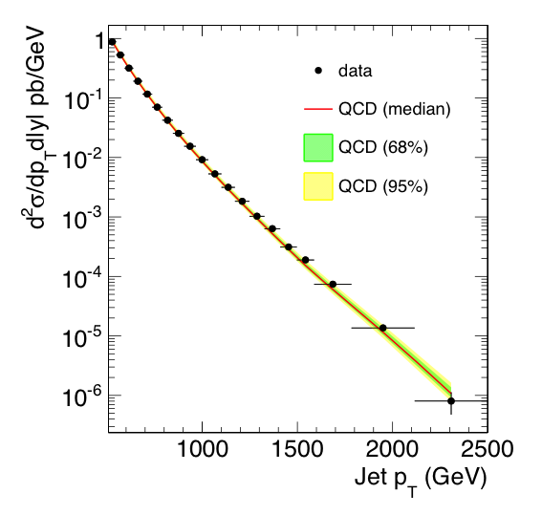
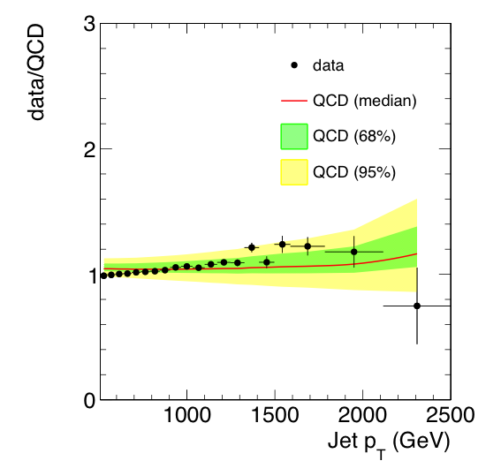
Data vs QCD

Slide 17
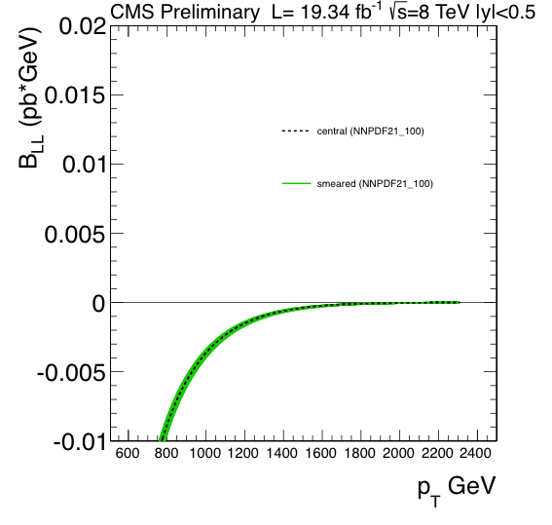
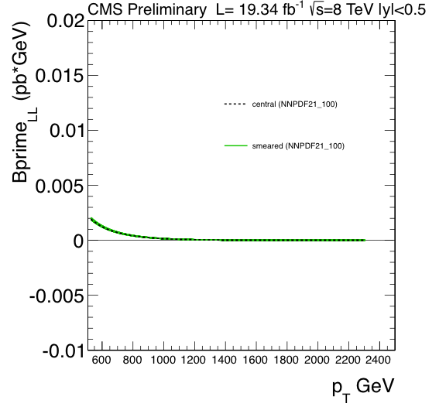
LL Model Coefficients – 1

Slide 18
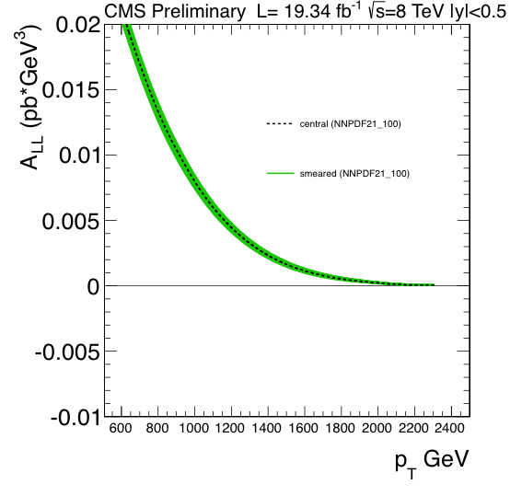
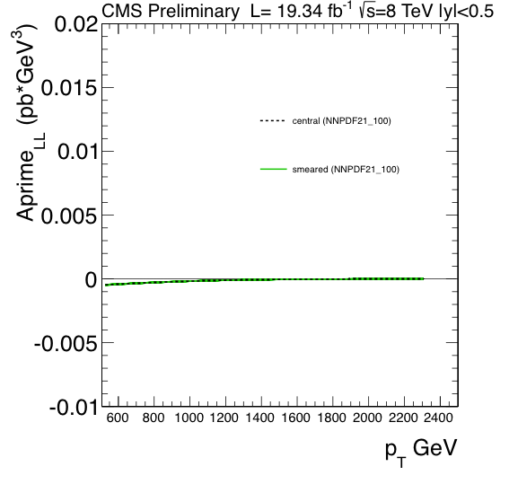
LL Model Coefficients – 2

Slide 19
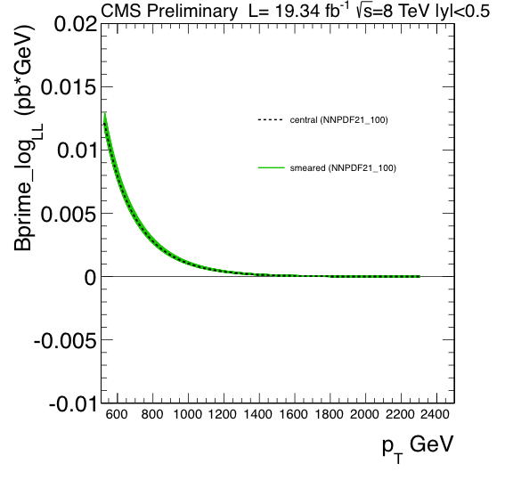
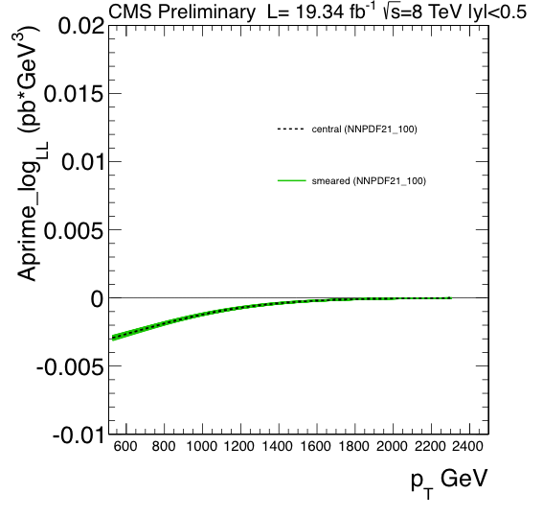
LL Model Coefficients – 3

Slide 20
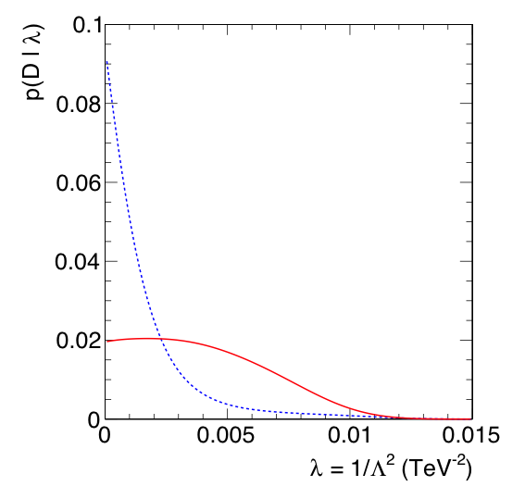
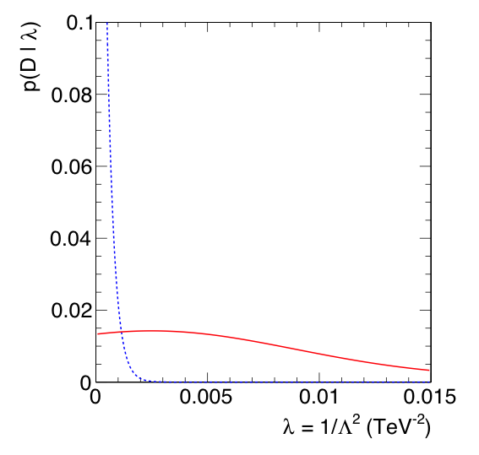
First Attempt at 8 TeV Likelihood
Warning: Here, we are comparing red apples with green ones!
LL
QCD(NLO)+CI(LO)
LL
QCD(NLO)+CI(NLO)
L = 5fb⁻¹ @ 7 TeV
L = 19.34fb⁻¹ @ 8 TeV

Slide 21
Plans
Add MSTW2008
Include non-perturbative corrections
Repeat using all 10 CI models
Compute limits (using a Bayesian method)
Document analysis
Ask for an ARC etc.
Wish 1: Results presented at some conference this summer.
Wish 2: Publish results within 6 months.

