Slide 1
Search for Contact Interactions in Jet p_{T} Status Report
Suma Beri¹, Suneel Dutt², and Harrison B. Prosper³
¹Panjab University, ²Shoolini University, ³Florida State University
Exotica Multijets Working Group Meeting
6 November 2014

Slide 2
Outline
Overview
Analysis Overview
Status
Plans

Slide 3
Overview
Goal
Use the measured inclusive jet p_{T} spectrum at 8 TeV to draw conclusions about possible new QCD-like interactions that can be modeled as contact interactions (CI).
Experimental Input
Inclusive jet p_{T} spectrum in |y| < 0.5, 507 ≤ p_{T} ≤ 2500 GeV (SMP-12-012, Sanmay Ganguly et al.)
Jet response function (JRF)
Jet energy scale (JES) uncertainty
Jet energy resolution (JER) uncertainty

Slide 4
Overview
Theoretical Input
PDFs (LHAPDF-6.1.4)
CT10nlo, MSTW2008nlo68cl, NNPDF23_nlo
Program to calculate QCD @ NLO
fastnlo_toolkit-2.3.1pre-1871 + fnl3332y0.tab
Program to calculate CI @ NLO
CIJET-1.1
Non-perturbative corrections (Sanmay Ganguly)

Slide 5
Overview: Models
At next-to-leading order, the effective Lagrangian describing QCD-like interactions may be written as
where λ = 1/Λ² and κ_{i} are free parameters and each O_{i} is a sum over dim-6 operators:
O_{1,2} ~ ū_{L}γ_{μ}u_{L} ū_{L}γ^{μ}u_{L}
O_{3,4} ~ ū_{L}γ_{μ}u_{L} ū_{R}γ^{μ}u_{R}
O_{5,6} ~ ū_{R}γ_{μ}u_{R} ū_{R}γ^{μ}u_{R}

Slide 6
Overview: Models
We consider CI models defined by specific values of κ₁ …κ₆, namely,
Model η_{LL} η_{RL} η_{RR}
LL ±1 0 0
RR 0 0 ±1
VV ±1 ±1 ±1
AA ±1 ∓1 ±1
V-A 0 ±1 0
where η_{LL} = κ₁, η_{RL} = κ₃/2, η_{RR} = κ₅, and κ₂ = κ₄ = κ₆ = 0.

Slide 7
Overview: Models
The QCD+CI cross section, @NLO, can be written as
where g = –ln(μ₀√k) and
f = ln(√(k / λ))
The CI sum comprises 57
coefficients

Slide 8
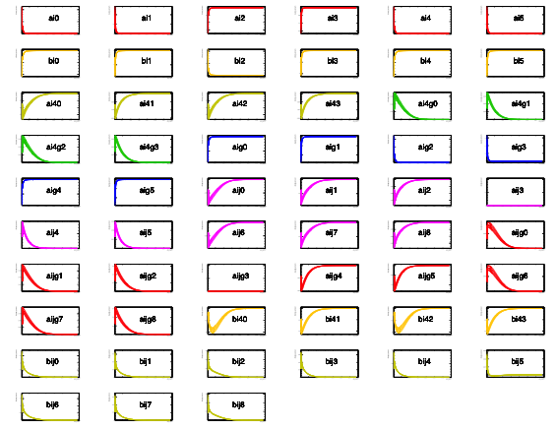
CI Cross Section Coefficients

Slide 9
Outline
Overview
Analysis Overview
Status
Plans

Slide 10
Analysis Overview
Analysis Steps
For CT10, MSTW2008, generate 100 randomly sampled PDF sets. (Use recently released tool, hessian2replicas, in LHAPDF6). NNPDF random sample already provided.
For each of the randomly sampled PDF sets and 7 combinations of the renormalization and factorization scales, compute the QCD inclusive jet p_{T} spectrum.
Do the same for the 57 differential coefficients needed to compute the CI spectra for arbitrary values of κ and Λ.

Slide 11
Analysis Overview
Analysis Steps
Convolve each spectrum, f (p_{T}) = d²F/dp_{T}dy (either QCD or the 57 CI coefficients),
with the jet response function R, for randomly sampled pairs (x, y) of zero mean, unit variance, Gaussian variates that account for uncertainty in the jet energy scale (JES) and jet energy resolution (JER), respectively, taking care to maintain the correlation across all bins and all spectra.

Slide 12
Analysis Overview
Jet Response Function (JRF)/JES
Use the jet response function (SMP-12-012, Sanmay Ganguly et al.)
https://indico.cern.ch/event/271240/material/slides/0?contribId=7
and the (33!) jet energy scale (JES) uncertainty components documented here
https://twiki.cern.ch/twiki/bin/viewauth/CMS/JECUncertaintySources?topic=JECUncertaintySources

Slide 13
Outline
Overview
Analysis Overview
Status
Plans

Slide 14
Status
All 3 x 100 x 7 QCD spectra have been calculated and smeared.
All 3 x 100 x 7 x 57 CI differential coefficients have been calculated.
All 100 x 7 x 57 CT10nlo CI differential coefficients have been smeared. The MSTW, NNPDF calculations will be done soon.
Limit setting code from the 7 TeV analysis has been revamped and tested in another analysis (SUSY razor boost). But the multinomial likelihood used for the 7 TeV analysis needs to be adapted to the more flexible calculation of the CI spectra before limits can be calculated.

Slide 15
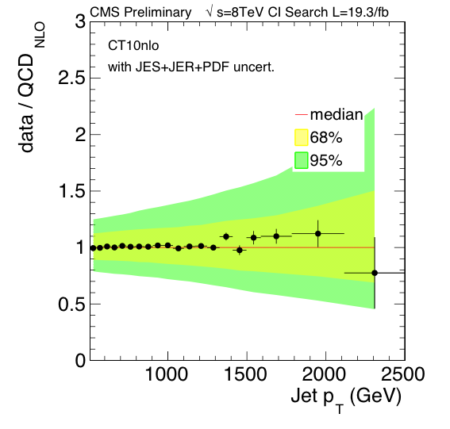
Status: Data/QCD with CT10nlo

Slide 16
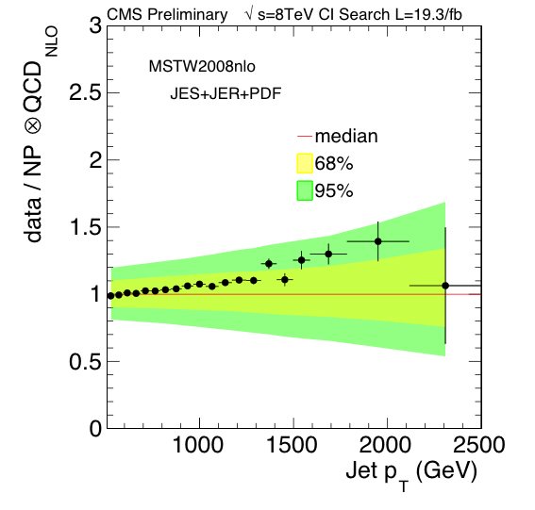
Status: Data/QCD with MSTW2008

Slide 17
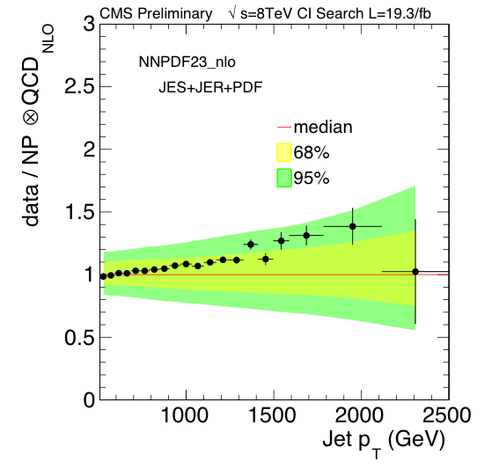
Status: Data/QCD with NNPDF23

Slide 18
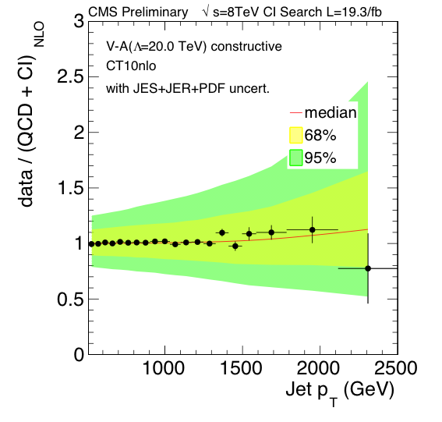
Status: Data/QCD for V-A model

Slide 19
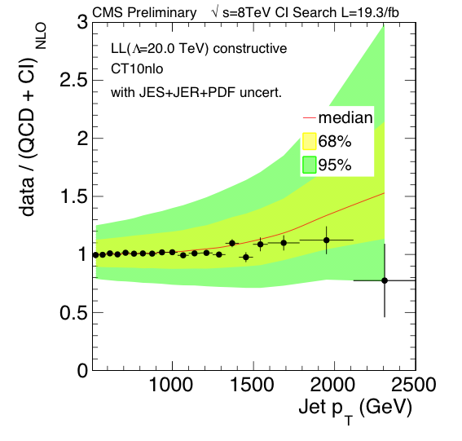
Status: Data/QCD for LL model

Slide 20
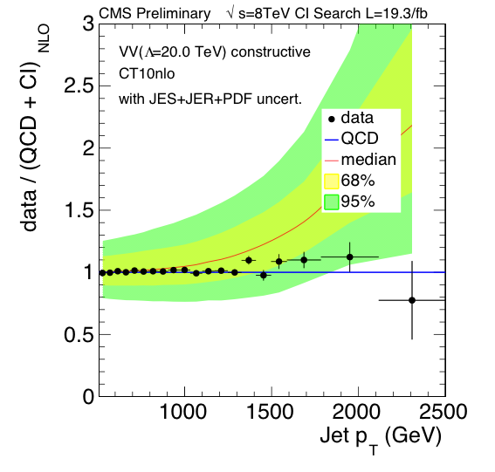
Status: Data/QCD for VV model

Slide 21
Plans
Complete CI calculations for MSTW and NNPDF
Complete adaptation of 7 TeV likelihood to new CI model
Compute limits (using a Bayesian method)
Document analysis (analysis note already started)
Ask for an ARC etc. Timescale for obtaining results ~ one month if all goes well.

Slide 22
backup

Slide 23
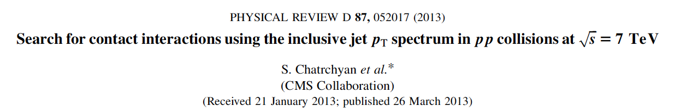
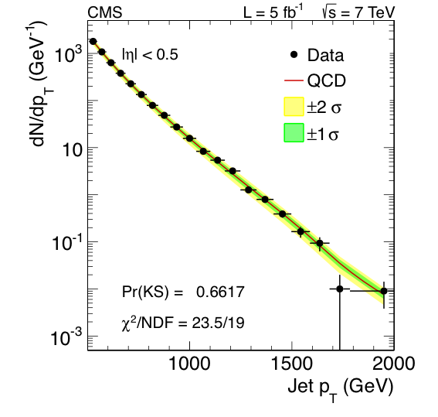
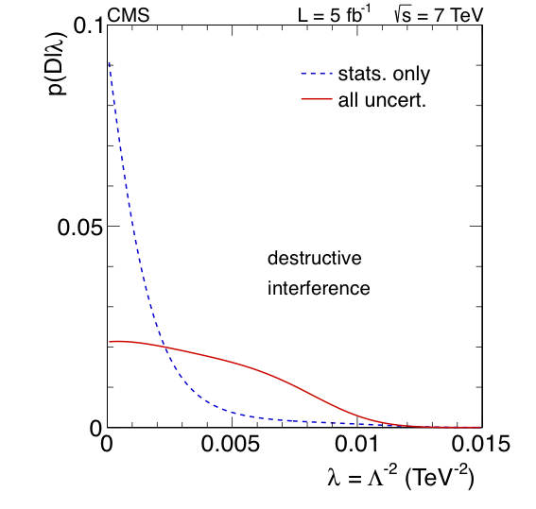
Contact Interaction (CI) Search @ 7 TeV

Slide 24
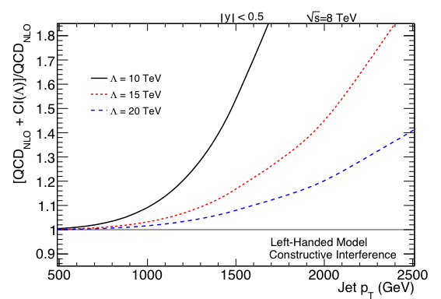
Left-Left (LL) Model

Slide 25
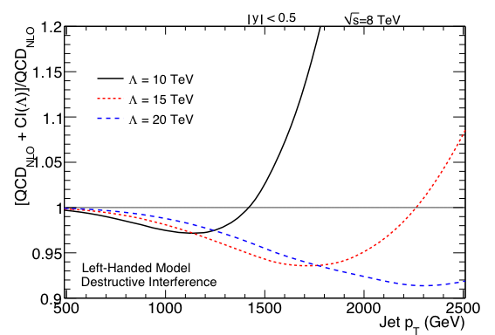
Left-Left (LL) Model

Slide 26
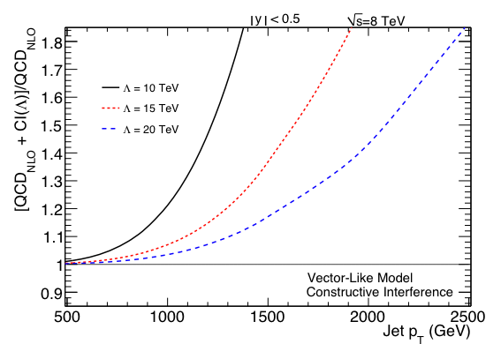
Vector (VV) Model

Slide 27
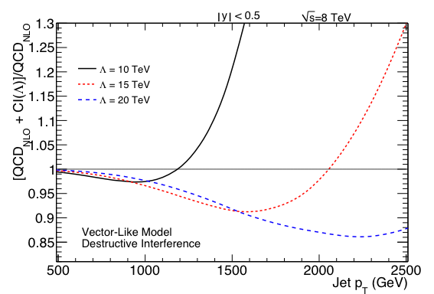
Vector (VV) Model

