Slide 1
Search for Contact Interactions in Jet p_{T} Update
Suman Beri¹, Suneel Dutt², and Harrison B. Prosper³
¹Panjab University, ²Shoolini University, ³Florida State University
Exotica Multijets Working Group Meeting
27 November 2014

Slide 2
Outline
Updates (data, JEC)
Limit Setting Procedure
Preliminary Expected Limits
Plans

Slide 3
Updates
Use full 19.71 fb⁻¹ inclusive jet pT spectrum.
Use Winter14_V5 JEC uncertainties (Winter14_V5_DATA_UncertaintySources_AK7PF.txt)
Use latest JER (for |y| < 0.5)
Many thanks to Sanmay Ganguly.

Slide 4
Updates
Multinomial likelihood adapted to NLO calculation of the CI spectra.
Workspace created for 8 TeV.
Workspace also created for 7 TeV data in same format in order to check likelihood calculation and limit setting procedure.

Slide 5
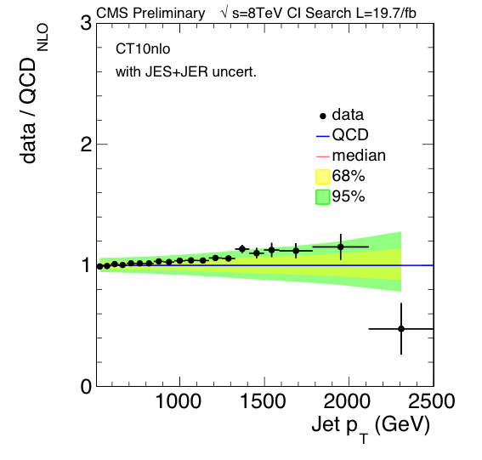
19.7fb⁻¹ Data / QCD – CT10nlo
JES + JER
uncertainties

Slide 6
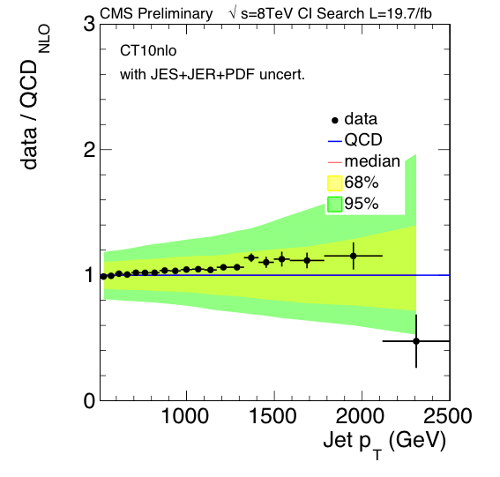
19.7fb⁻¹ Data / QCD – CT10nlo
JES + JER +
PDF
uncertainties

Slide 7
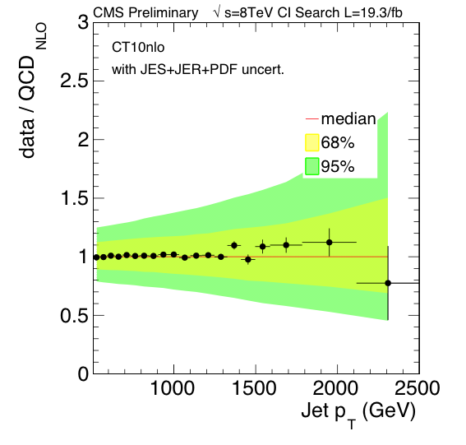
19.3fb⁻¹ Data / QCD – CT10nlo

Slide 8
Outline
Updates (data, JEC)
Limit Setting Procedure
Preliminary Expected Limits
Plans

Slide 9
Limit Setting Procedure
Use likelihood (D = N₁,…, N₂₀)
Set κ values, e.g., κ₁ = ±1, κ₂… κ₆= 0 for left-left (LL)
Solve for upper limit on λ and hence a lower limit on Λ = 1/ λ^{½}

Slide 10
Outline
Updates (data, JEC)
Limit Setting Procedure
Preliminary Expected Limits
Plans

Slide 11
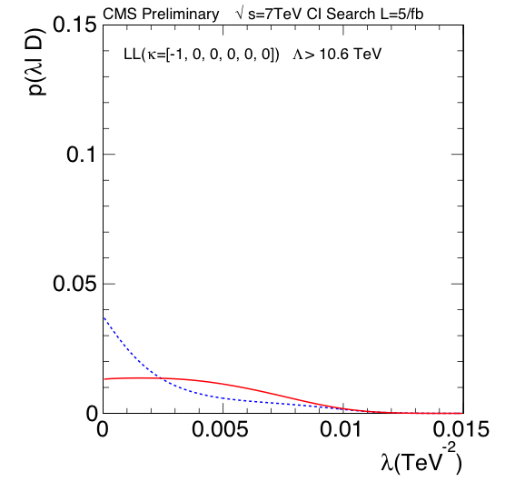
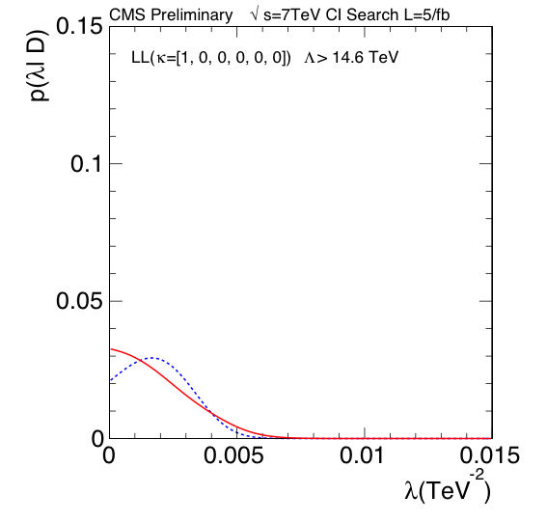
Expected Limits – 7 TeV – LL
CTEQ6.6

Slide 12
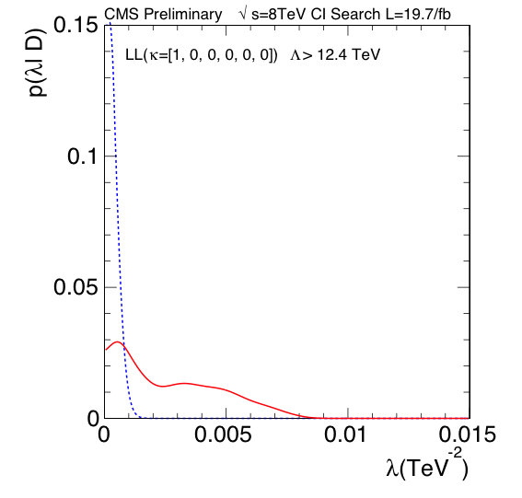
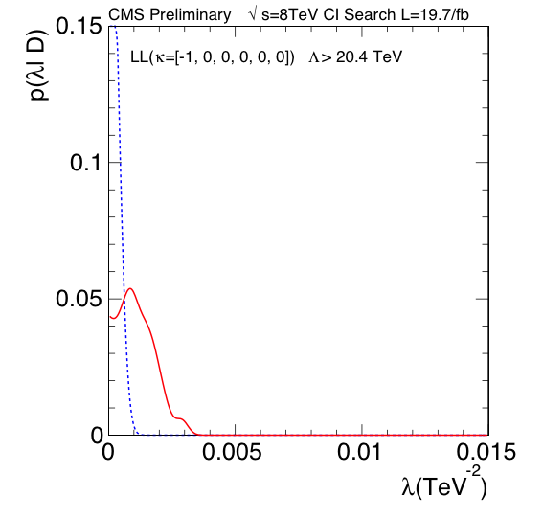
Expected Limits – 8 TeV – LL
CT10

Slide 13
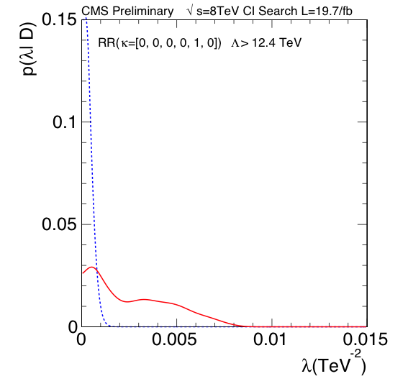
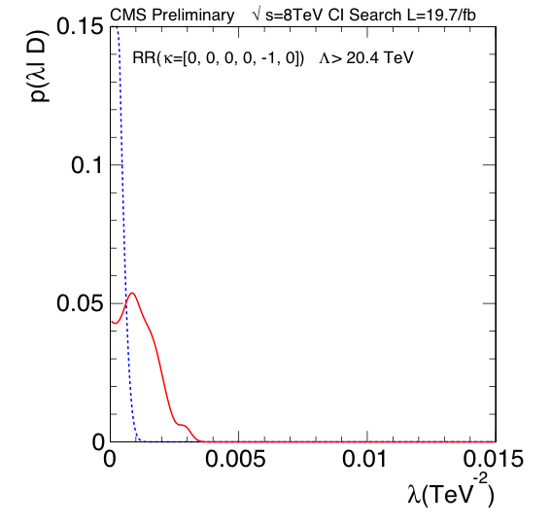
Expected Limits – 8 TeV – RR
CT10

Slide 14
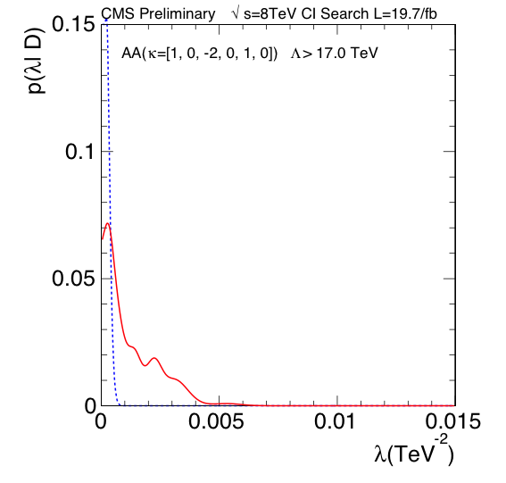
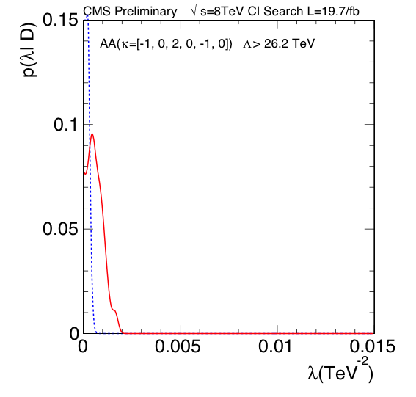
Expected Limits – 8 TeV – AA
CT10

Slide 15

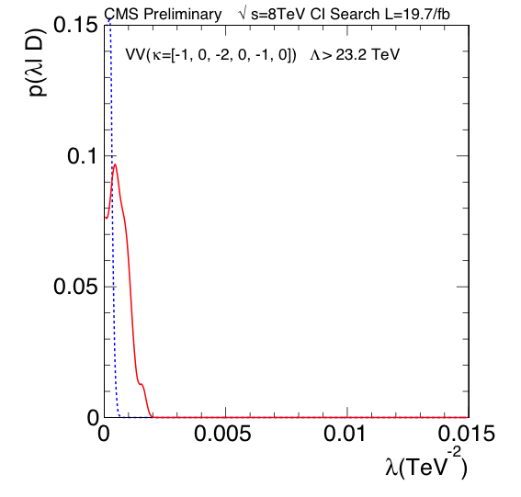
Expected Limits – 8 TeV – VV
CT10

Slide 16
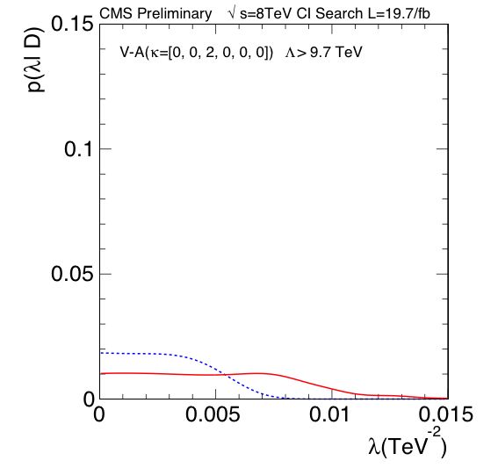
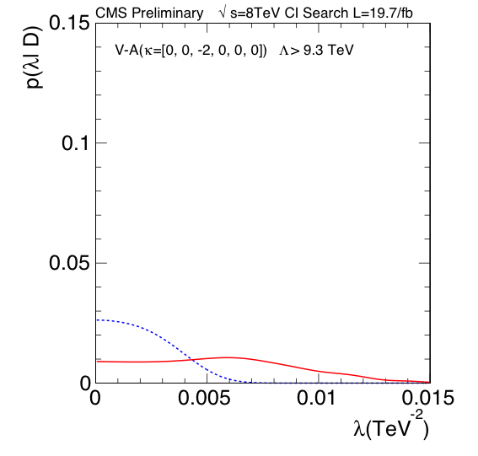
Expected Limits – 8 TeV – V-A
CT10

Slide 17
Plans
Investigate cause of “wiggles” in <likelihood>. May be due to rounding errors in likelihood calculation.
Include electroweak corrections (already provided by Sanmay)
Compute observed limits for CT10, MSTW and NNPDF separately, and together
Complete analysis note

Slide 18
backup

Slide 19
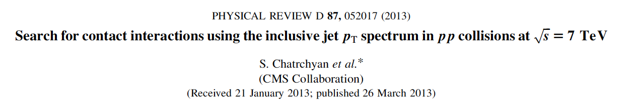
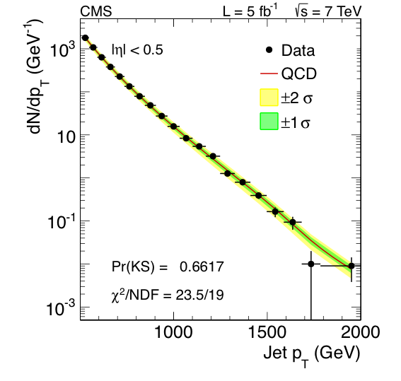
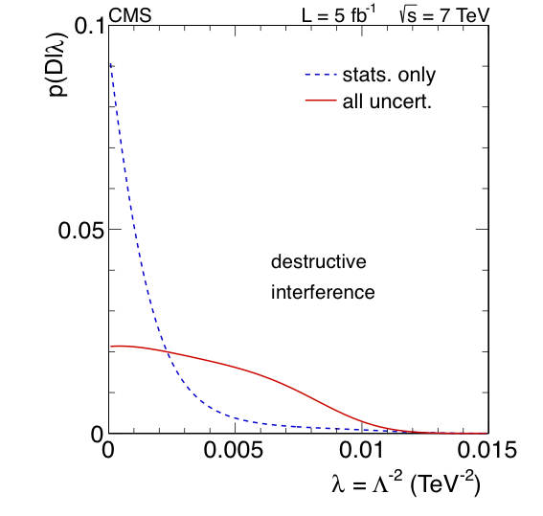
Contact Interaction (CI) Search @ 7 TeV

