Slide 1
Search for Contact Interactions in Jet p_{T} Progress Report
Suman Beri¹, Suneel Dutt², and Harrison B. Prosper³
¹Panjab University, ²Shoolini University, ³Florida State University
Exotica Multijets Working Group Meeting
5 February 2015

Slide 2
To Do List (as of 27 Nov. 2014)
Investigate cause of “wiggles” in likelihood in progress
Include non-perturbative and electroweak corrections done
Compute observed limits for CT10, MSTW and NNPDF separately, and together to do
Complete analysis note in progress

Slide 3
New Issues
Bug in PDFSet::randomValueFromHessian(….) method (in LHAPDF 6.1.4 and 6.1.5, corrected in 6.1.6, received fix from Graeme Watt) => Need to re-compute QCD and the 57 CI coefficient spectra.
Bug in L1 jet energy corrections => Need to re-smear all spectra and include Winter 14 V8 JEC uncertainties.

Slide 4
Status
PDFs: Re-computed QCD and CI spectra for each of 100 randomly sampled CT10nlo members. To do: MSTW
Corrections: Non-perturbative and electroweak corrections implemented for QCD and CI model spectra.
Data: Switched to latest (post L1 bug) 19.71 fb⁻¹ inclusive jet p_{T} spectrum (thanks to Sanmay Ganguly). But, still using Winter 14 V5 JEC. Need to switch to V8 to be fully synchronized with inclusive jet group.
Likelihood: Wiggles in likelihood under investigation.

Slide 5
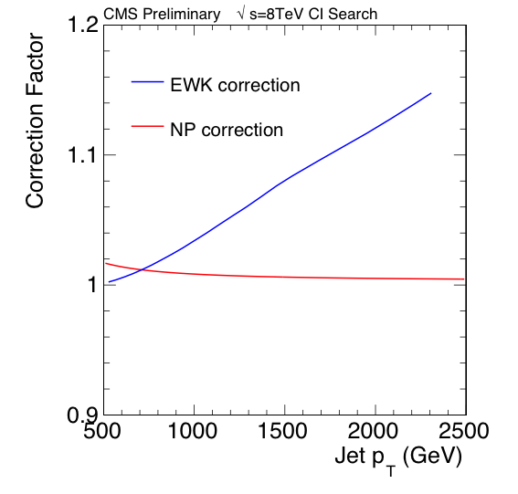
Corrections: NP & EWK
From inclusive jet group (Sanmay)

Slide 6
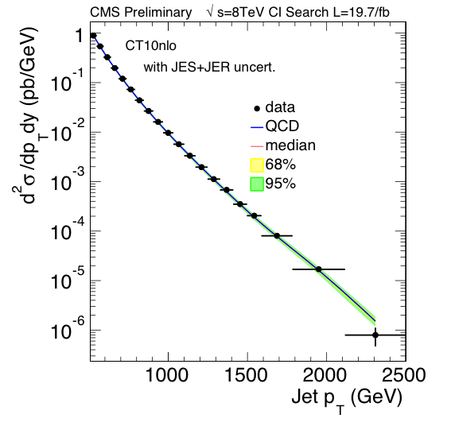
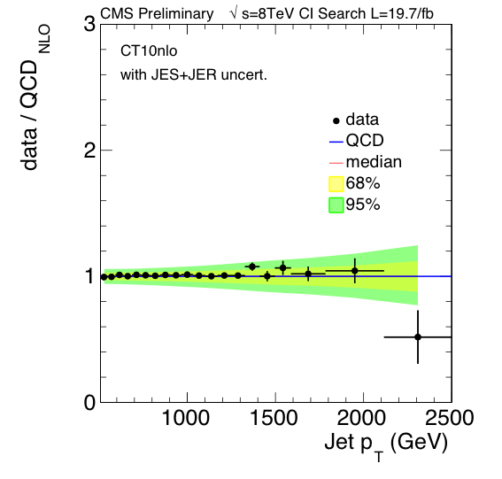
Data: Data vs. QCD (19.7fb⁻¹)
JES + JER (Winter 14 V5) uncertainties
CT10nlo

Slide 7
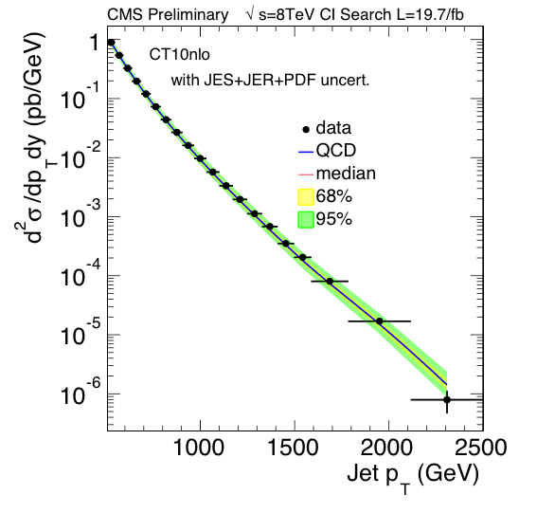
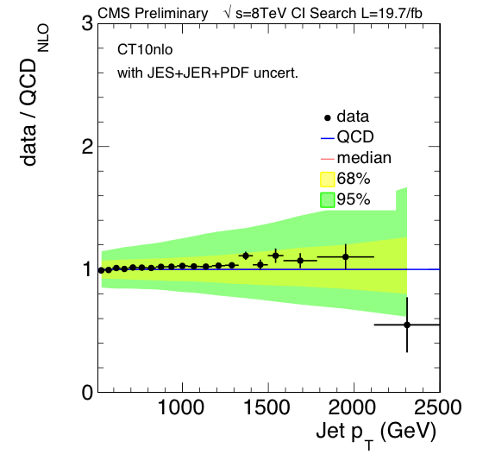
Data: Data vs. QCD (19.7fb⁻¹)
JES + JER (Winter 14 V5) + PDF uncertainties
CT10nlo

Slide 8
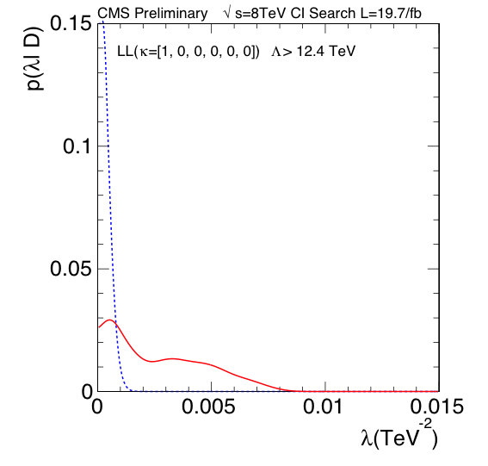
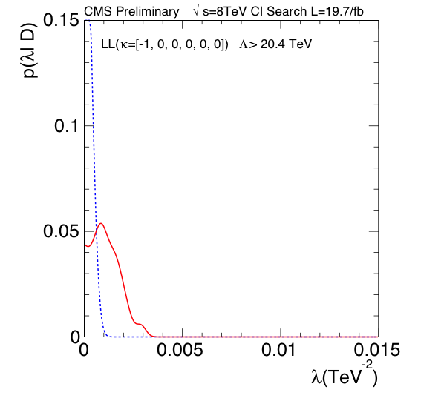
Likelihood: 8 TeV – LL
CT10nlo

Slide 9
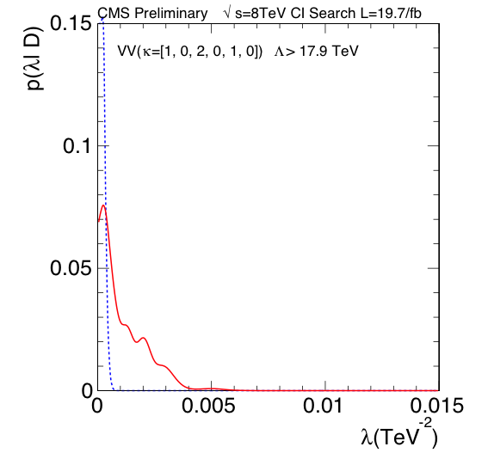
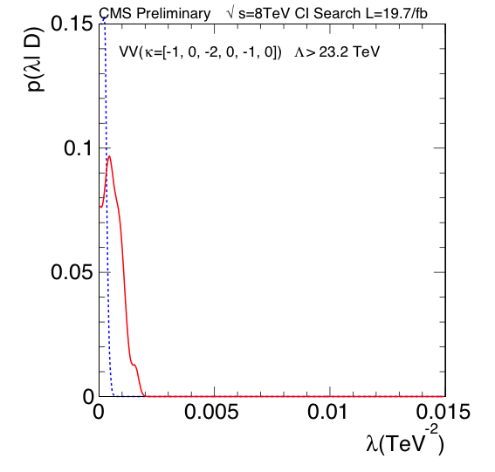
Likelihood: 8 TeV – VV
CT10nlo

Slide 10
Cross Section Calculation
The QCD+CI cross section, @NLO, can be written as
where g = –ln(μ₀√k) and
f = ln(√(k / λ))
λ = 1/Λ²
and κ define the CI models.
A total of 57 coefficients.

Slide 11
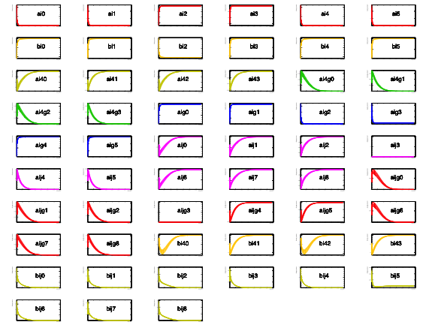
Cross Section Coefficient Spectra
Coefficient spectra look smooth.

Slide 12
Likelihood Calculation
Our likelihood is
Note: the counts range from D₁ = 722,864 in the first bin to
D₂₀ = 6 in the last bin!
So it is perhaps not surprising that computing the multinomial function is problematic

Slide 13
Plans
Re-smear all spectra (CT10, MSTW, NNPDF) using the V8 JEC uncertainties.
Find better numerical approximation of the likelihood.
Compute expected and observed limits for CT10, MSTW and NNPDF separately, and together, for several CI models (defined by different κ values).
Make a concerted effort to complete analysis note.

Slide 14
backup

Slide 15
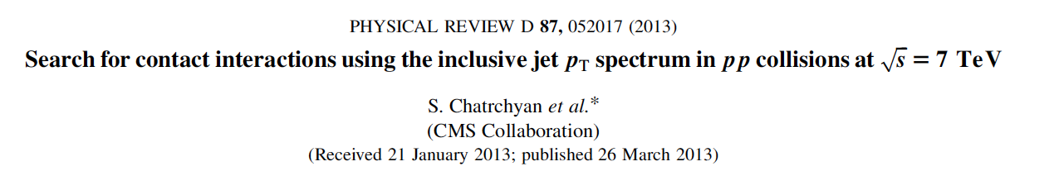
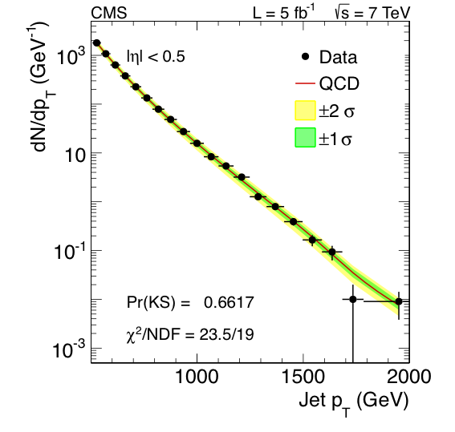
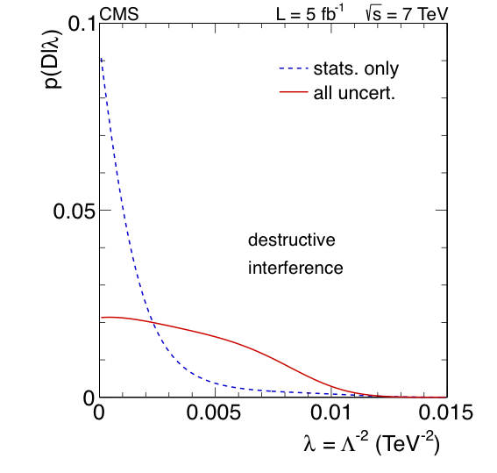
Contact Interaction Search @ 7 TeV

