Slide 1
Contact Interactions Search Using Inclusive Jet Spectrum PDF Uncertainties
Harrison B. Prosper
Florida State University
PDF@CMS Meeting
20 November 2014

Slide 2
Outline
Introduction
Analysis Overview
PDF Uncertainties in CI Search
Summary

Slide 3
Introduction
Goal
Use the p_{T} spectrum of inclusive jet events
to search for new QCD-like interactions whose details cannot be resolved at current energies
Search Region
|y| < 0.5
507 ≤ p_{T} ≤ 2500 GeV
In the process of finalizing the 8 TeV search

Slide 4
Introduction
Model
Use the effective Lagrangian
where λ = 1/Λ², κ_{i} are free parameters, and each O_{i} is a sum of dim-6 operators:
O_{1,2} ~ ū_{L}γ_{μ}u_{L} ū_{L}γ^{μ}u_{L}
O_{3,4} ~ ū_{L}γ_{μ}u_{L} ū_{R}γ^{μ}u_{R}
O_{5,6} ~ ū_{R}γ_{μ}u_{R} ū_{R}γ^{μ}u_{R}

Slide 5
Introduction
The QCD+CI cross section, @NLO, can be written as
where g = –ln(μ₀√k) and
f = ln(√(k / λ))
The CI term contains 57
coefficients

Slide 6
Introduction
Theoretical Input
QCD @ NLO
fastnlo_toolkit-2.3.1pre-1871 + fnl3332y0.tab
CI @ NLO
CIJET-1.1
Non-perturbative corrections (Sanmay Ganguly)
PDFs (LHAPDF-6.1.4)
CT10nlo, MSTW2008nlo68cl, NNPDF23_nlo

Slide 7
Summary of PDF Sets Used
PDF sets used in CI search @ 8 TeV
 | CT10nlo | MSTW2008 | NNPDF2.3
No. of PDFs | 6 | 7 | 7
No. of Parameters | 26 | 28 | 259
HERA DIS | ✓ | ✓ | ✓
Fixed-target DIS | ✓ | ✓ | ✓
Fixed-target DY | ✓ | ✓ | ✓
Tevatron W, Z+jets | ✓ | ✓ | ✓
LHC W, Z+jets |  |  | ✓
S. Forte and G.Watt, Ann.Rev.Nucl.Part.Sci. 63 (2013) 291-328

Slide 8
Outline
Introduction
Analysis Overview
PDF Uncertainties in CI Search
Summary

Slide 9
Analysis Overview
Analysis Steps
For CT10, MSTW2008, generate 100 randomly sampled PDF sets (using hessian2replicas in LHAPDF6), plus the 100 random sets from NNPDF.
For each of the randomly sampled PDF sets and 7 combinations of the renormalization and factorization scales, compute the QCD inclusive jet p_{T} spectrum and the CI contribution for given values of κ and Λ.
Convolve each spectrum with the jet response function taking into account JES and JER uncertainties.
Average likelihood over pooled ensemble of spectra.
Compute limit on Λ for specific values of κ.

Slide 10
Analysis Overview
Bayesian Justification for Pooling PDF ensembles
Each PDF fitting group M provides (in effect) a prior p(ω_{M} | M)
Using PDF model M, we approximate the marginal likelihood
by averaging the likelihood with respect to the randomly generated PDFs.

Slide 11
Analysis Overview
Bayesian Justification for Pooling PDF ensembles
Given a discrete prior π(M), we can average over models
to obtain an overall likelihood p(D | Λ) for computing limits.
Moreover, for a specific physics model, say QCD (Λ = ∞), we can calculate the probability of the PDF model M
and thereby rank PDF models according to which best fits the data.

Slide 12
Outline
Introduction
Analysis Overview
PDF Uncertainties in CI Search
Summary

Slide 13
PDF Uncertainties
Contact interaction effects are most prominent at y = 0 and at high jet p_{T} .
But this is also where the uncertainties in the jet energy scale (JES) and the PDFs are largest.
Moreover, at present, the PDF uncertainties are comparable to the JES uncertainties and will become dominant in the early part of Run II.

Slide 14
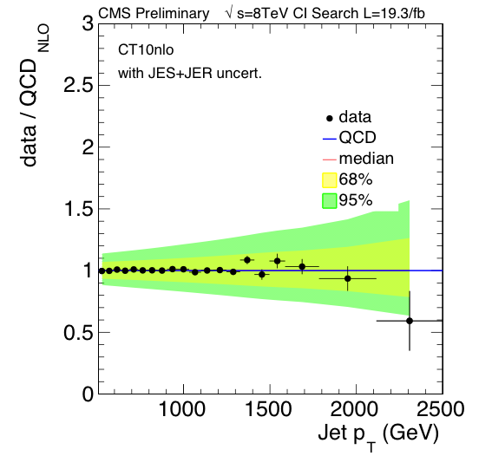
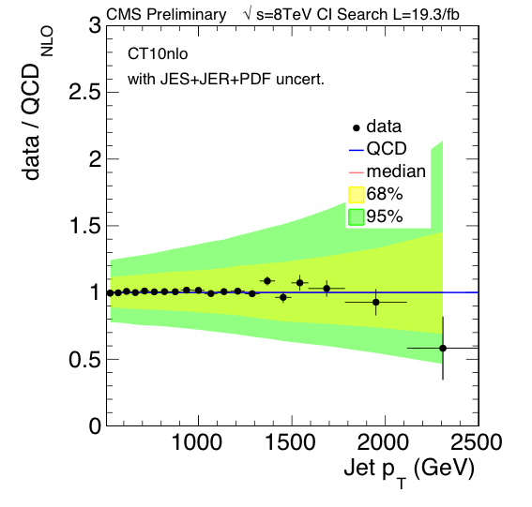
CT10nlo PDF Uncertainties

Slide 15
CT10nlo PDF Uncertainties

Slide 16
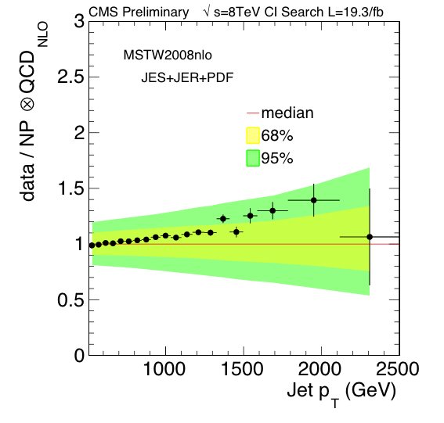
MSTW2008nlo PDF Uncertainties

Slide 17
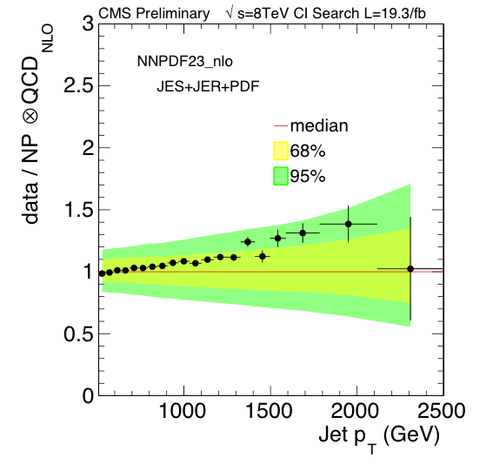
NNPDF23 PDF Uncertainties

Slide 18
Issues with PDF Fits
Currently, all PDF fitting groups extract PDF parameters by minimizing a quadratic form (typically, referred to as χ²)
where θ are the parameters of the PDFs, and Σ is the covariance matrix of the data D, which are either real or replicas, X, generated from real data by sampling from
The criterion ΔY = Y(θ) – minY(θ) = T with T = 1 yields unreasonably small 68% confidence sets. Therefore, CTEQ and MSTW use a value of T ~ 50 – 100.

Slide 19
Issues with PDF Fits
There is no consensus about the value of T nor about which of the following
discrepant data
incomplete theory
PDF parameterization
is the principal reason why T must be ~ 50 – 100.
It is not clear (at least to me) why NNPDF and MSTW arrive at similar uncertainties. Nor is it clear that NNPDF has solved the problem of PDF uncertainties in a statistically sound way.

Slide 20
Issues with PDF Fits
The basic question that no one has answered is this:
How do we know that the PDF uncertainties are “correct”?
And this cannot be answered sensibly without first answering:
What does “correct” mean?

Slide 21
Summary
Owing to the advances in LHAPDF6, the CI search is now able to use multiple PDF models in a well-founded manner. The old PDF4LHC recommendation should be retired.
Unfortunately, PDF uncertainties are now, or soon will, the dominant uncertainty in analyses that use jets of high p_{T}.
However, in spite of impressive advances in PDF theory and methodology, more work is urgently needed to put PDF uncertainties on a statistically solid foundation.

