Slide 1
Search for Contact Interactions Using Inclusive Jet p_{T} Spectrum Plans for 13 TeV
Suman Beri¹, Suneel Dutt², Bipen Kotwal², and Harrison B. Prosper³
¹Panjab University, ²Shoolini University, ³Florida State University
Exotica Jets+X Working Group Meeting
7 March 2016

Slide 2
Outline
Overview
Proposed Analysis
Status
Near Future

Slide 3
Overview
Goal
Search for new QCD-like interactions that can be modeled as contact interactions (CI). Look for deviations in the inclusive jet p_{T} spectrum at high p_{T}.
Aim for preliminary results by end of June 2016 using existing inclusive jet cross section measurement.
Publishable result by the end of calendar year 2016.
Thereafter, update result periodically.
Manpower
Bipen Kotwal (Ph.D. student), co-supervisors S. Beri (Panjab U.) , S. Dutt (Shoolini U.)
H.B. Prosper (FSU)

Slide 4
Overview
Experimental Input
Inclusive jet p_{T} spectrum in |y| < 0.5, 638 ≤ p_{T} ≤ 3000 GeV. Use a single high p_{T} jet trigger and work on trigger plateau
Jet response function (JRF)
Jet energy scale (JES) uncertainty
Jet energy resolution (JER) uncertainty

Slide 5
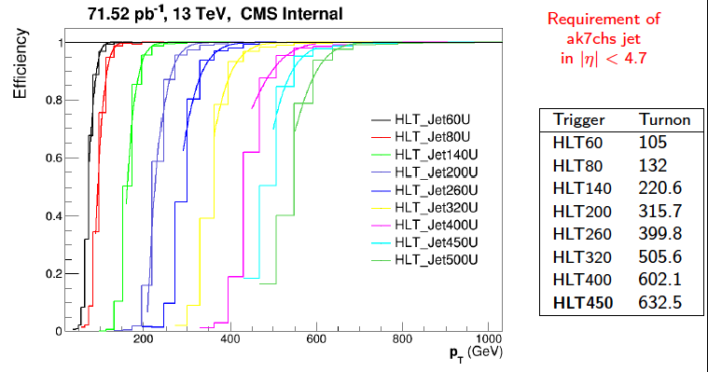
Overview: Triggers
SMP-15-007

Slide 6
Overview
Theoretical Input
PDFs (LHAPDF-6.1.6)
CT14nlo, MMHT2014nlo68cl, NNPDF30_nlo
Program to calculate QCD@NLO
fastnlo_toolkit-2.3.1pre-2163 InclusiveNJets_fnl5332g_v23_fix.tab
Program to calculate CI@NLO
CIJET-1.1
Non-perturbative corrections
Electroweak corrections

Slide 7
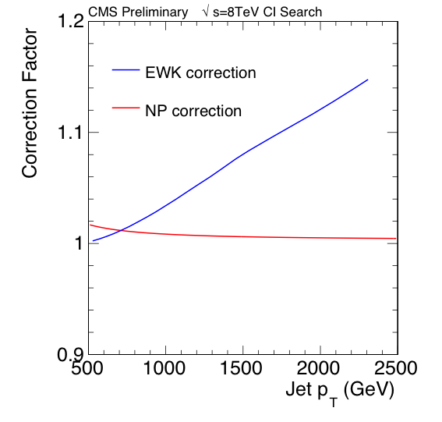
Overview: NP & EWK Corrections
From inclusive jet group

Slide 8
Overview: Models
At NLO accuracy, new QCD-like interactions can be described using an effective Lagrangian of the form
where Λ is a mass scale, κ_{i} are additional free parameters, and each O_{i} is a sum over dim-6 operators:
O_{1,2} ~ ū_{L}γ_{μ}u_{L} ū_{L}γ^{μ}u_{L}
O_{3,4} ~ ū_{L}γ_{μ}u_{L} ū_{R}γ^{μ}u_{R}
O_{5,6} ~ ū_{R}γ_{μ}u_{R} ū_{R}γ^{μ}u_{R}

Slide 9
Overview: Models
In principle, the parameters κ₁ …κ₆ are free to assume any values. However, we plan to consider only the following discrete set of values:
Model η_{LL} η_{RL} η_{RR}
LL ±1 0 0
RR 0 0 ±1
VV ±1 ±1 ±1
AA ±1 ∓1 ±1
V-A 0 ±1 0
where κ₁ = η_{LL}, κ₃ = 2η_{RL}, κ₅ = η_{RR}, and κ₂ = κ₄ = κ₆ = 0.

Slide 10
Outline
Overview
Proposed Analysis
Status
Near Future

Slide 11
Proposed Analysis
For the results of the proposed analysis to be reliable, it is critical that the uncertainties be correctly accounted for, including the correlations across bins, and across models.
We therefore propose to integrate over the jet energy scale (JES), jet energy resolution (JER), and parton density function (PDF) parameters by sampling over these quantities.
Furthermore, we plan to sum over three different PDF sets in order to account for the uncertainty arising from the different estimates of the PDFs by different PDF groups.

Slide 12
Proposed Analysis
Analysis Steps
For each PDF, we shall generate 500 randomly sampled PDF sets using the tool hessian2replicas in LHAPDF6.1.6, except for NNPDF30_nlo for which the sample already exists.
For each of the randomly sampled PDF sets and 7 combinations of the renormalization and factorization scales, we shall compute the QCD inclusive jet p_{T} spectrum. This will yield 3500 spectra.
Do the same for the 57 differential coefficients needed to compute the CI spectra for arbitrary values of κ and Λ.

Slide 13
Analysis Overview
Analysis Steps
Convolve each differential spectrum, f (p_{T}) = d²F/dp_{T}d|y| (either QCD or the 57 CI coefficients),
with the jet response function R, while accounting for the uncertainty in the jet energy scale and jet energy resolution, taking care to maintain the correlations across all bins and all spectra.

Slide 14
Analysis Overview
Analysis Steps
Compute the likelihood where D denotes the counts per bin, ν denotes the JES, JER, and PDF nuisance parameters and, in the absence of evidence of a significant deviation from QCD, set limits on Λ for different choices of κ. The function π(ν) encodes the JES, JER, and PDF nuisance parameters.

Slide 15
Outline
Overview
Proposed Analysis
Status
Near Future

Slide 16
Status
Machinery for computing and smearing spectra thoroughly exercised at 8 TeV. The 13 TeV version requires minor updates.
Corrections: Non-perturbative corrections obtained from inclusive jet cross section group (Paolo Gunnelli). 13 TeV electroweak corrections not yet available.
Data: Have in hand details of first measurement of inclusive jet spectrum from inclusive jet cross section group. Bipen will work with the SMP group on subsequent cross section measurements.

Slide 17
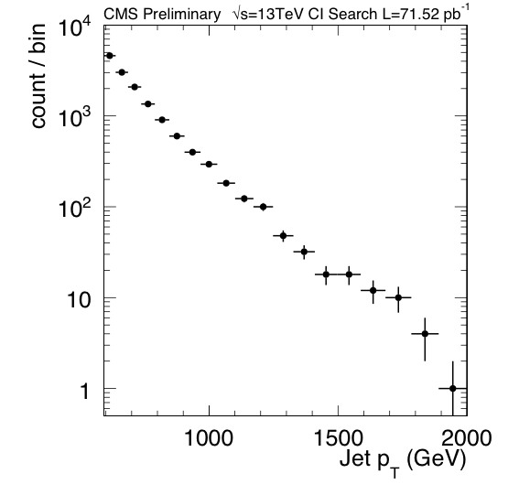
Data: 71.52 pb⁻¹

Slide 18
Status: Lessons Learned from 8 TeV
Large range in counts (~700,000 at 500 GeV to 6 at 2000 GeV for 8 TeV data) induces huge dynamic range in likelihood function.
This makes integrating over JES, JER, and PDF parameters difficult (see next two slides).
Therefore, need to sample over larger and larger numbers of spectra to check for convergence of Monte Carlo integration.
Should explore whether the use of smaller bins (at lower p_{T}), in order to limit count per bin, yield likelihoods with a more manageable dynamic range.
PDF uncertainties now dominate over JES and JER.

Slide 19
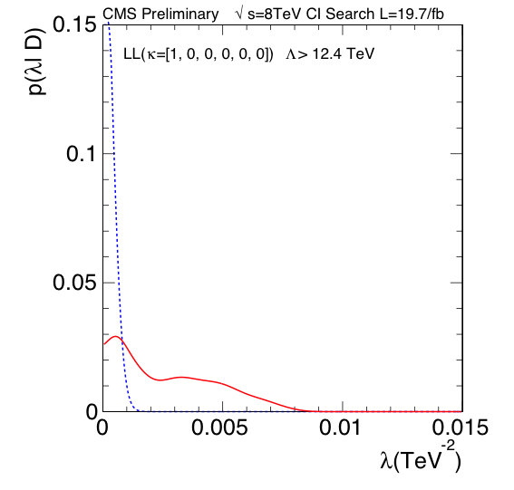
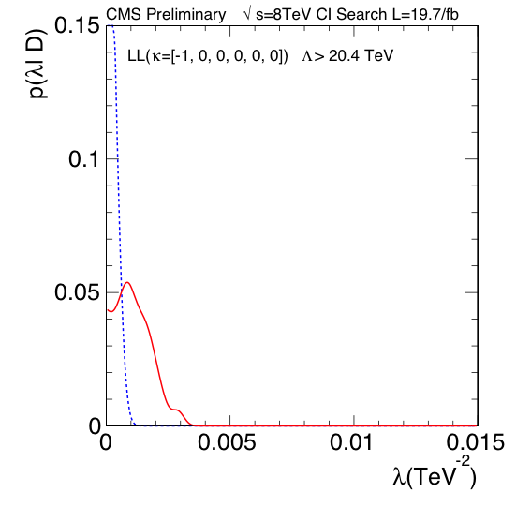
Likelihoods: LL @ 8 TeV
Blue: without JES, JER, PDF uncertainties
Red: with JES, JER, PDF uncertainties
λ = 1 / Λ²
Constructive
interference
Destructive
interference
The wiggles indicate that the Monte Carlo
integration is not accurate enough.
CT10nlo

Slide 20
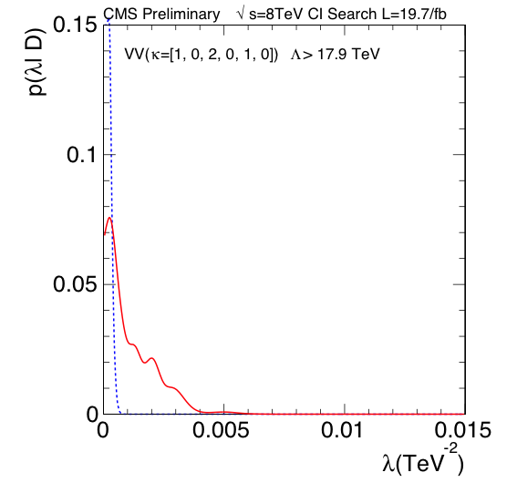
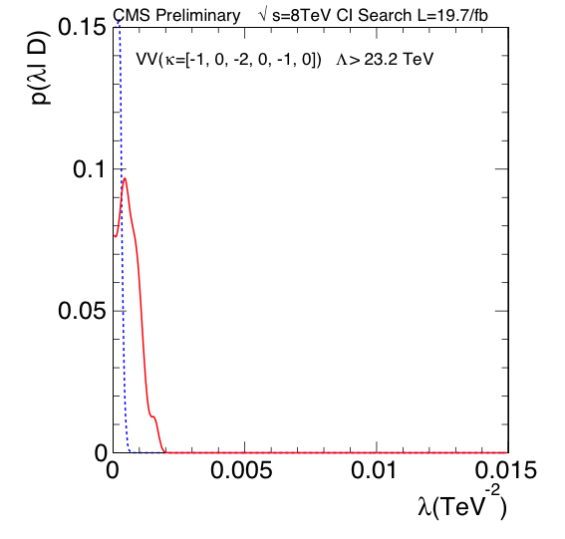
Likelihoods: VV @ 8 TeV
Blue: without JES, JER, PDF uncertainties
Red: with JES, JER, PDF uncertainties
λ = 1 / Λ²
Constructive
interference
Destructive
interference
The wiggles indicate that the Monte Carlo
integration is not accurate enough.
CT10nlo

Slide 21
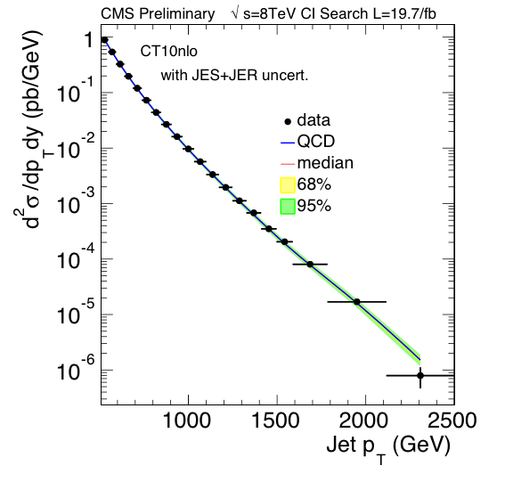
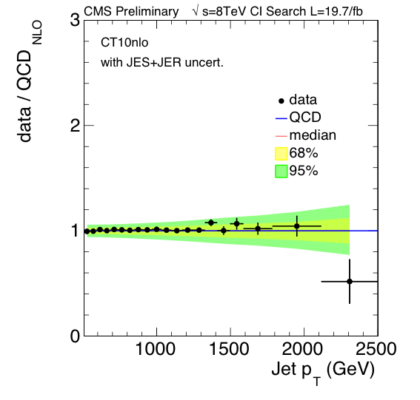
Data vs. QCD (19.7fb⁻¹ @ 8 TeV)
JES + JER (Winter 14 V5) uncertainties
CT10nlo

Slide 22
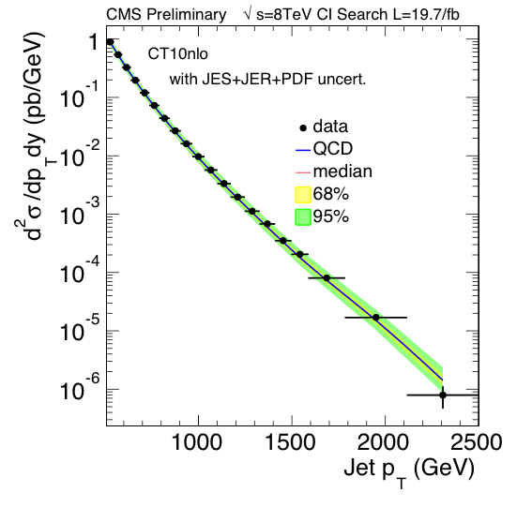
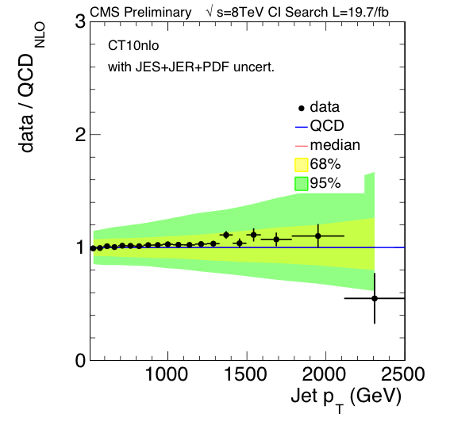
Data vs. QCD (19.7fb⁻¹ @ 8 TeV)
JES + JER (Winter 14 V5) + PDF uncertainties
CT10nlo

Slide 23
Near Future
Compute QCD spectra @ 13 TeV.
Compute 57 CI coefficient spectra @ 13 TeV.
Smear spectra.
Obtain preliminary limits on all models using existing inclusive jet cross section measurements. For now, use electroweak corrections from 8 TeV.
Bipen will make regular presentations at this meeting.

Slide 24
backup

Slide 25
Overview: Models
The QCD+CI cross section, at NLO, can be written as
where g = –ln(μ₀√k) and λ = 1/Λ²
f = ln(√(k / λ))
The CI term comprises 57
coefficients

Slide 26
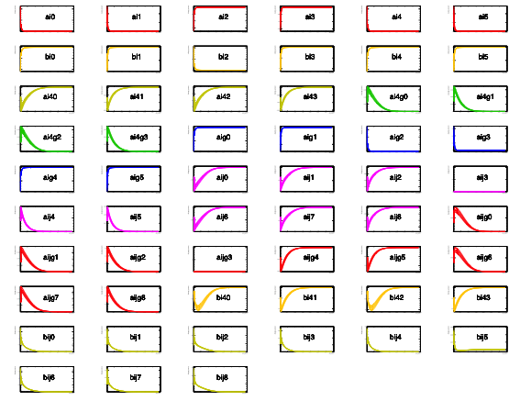
CI Cross Section Coefficients (8 TeV)

Slide 27
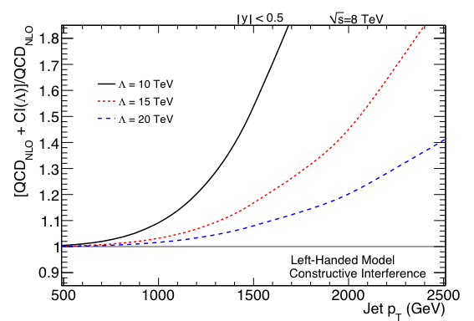
Left-Left (LL) Model

Slide 28
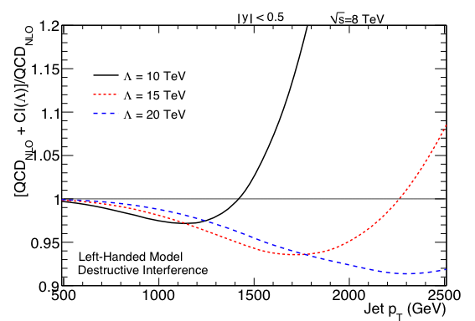
Left-Left (LL) Model

Slide 29
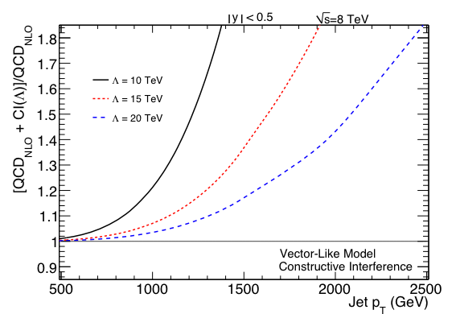
Vector (VV) Model

Slide 30
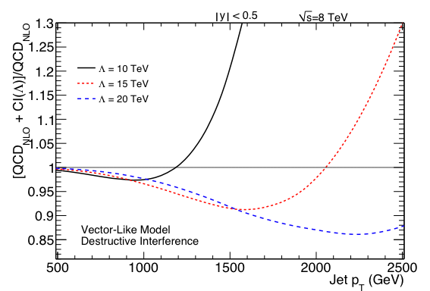
Vector (VV) Model

Slide 31
Likelihood Calculation
Our likelihood is
Note: for the 8 TeV data, the counts range from D₁ = 722,864 in the first bin (507 GeV) to
D₂₀ = 6 in the last bin
So it is perhaps not surprising that computing the multinomial function is problematic

Slide 32
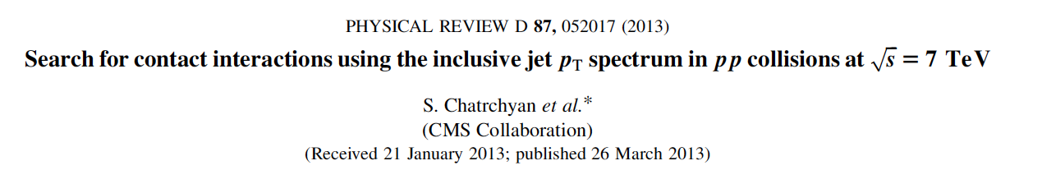
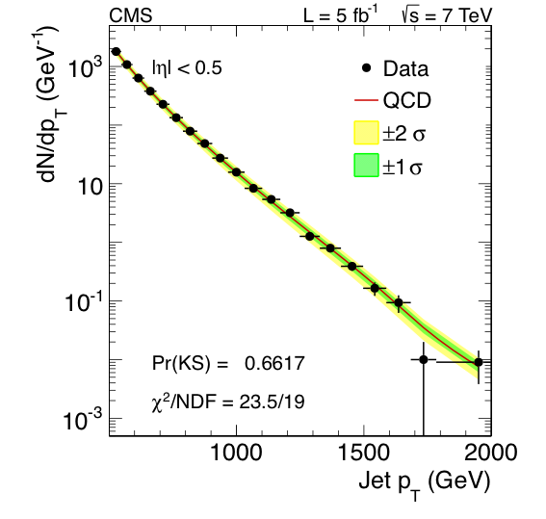
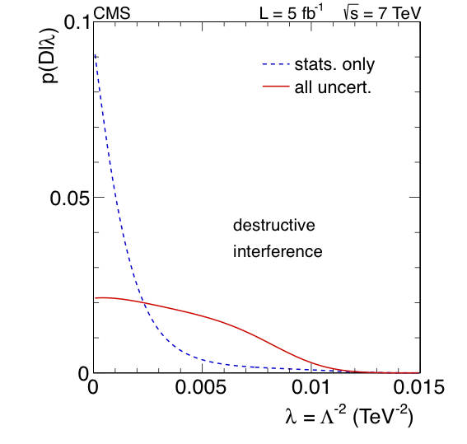
Contact Interaction Search @ 7 TeV

