Slide 1
Search for Contact Interactions Using Inclusive Jet p_{T} Spectrum
Suman Beri¹, Suneel Dutt², Bipen Kotwal²,
Pampa Ghose³, Harrison B. Prosper³
¹Panjab University, ²Shoolini University, ³Florida State University
Exotica Jets+X Working Group Meeting
27 June 2016

Slide 2
Outline
Overview
Analysis
Preliminary Results
Plans

Slide 3
Overview
Goal
Search for new QCD-like interactions that can be modeled as contact interactions (CI) at LHC energies. Look for deviations in the inclusive jet p_{T} spectrum at high p_{T}.
Preliminary results by end of August 2016 using SMP-15-007 inclusive jet cross section measurement.
Publishable result by the end of calendar year 2016.
Manpower
Bipen Kotwal (Ph.D. student), co-advisors S. Beri (Panjab U.) , S. Dutt (Shoolini U.)
P. Ghose (Ph.D. student), H.B. Prosper (FSU)

Slide 4
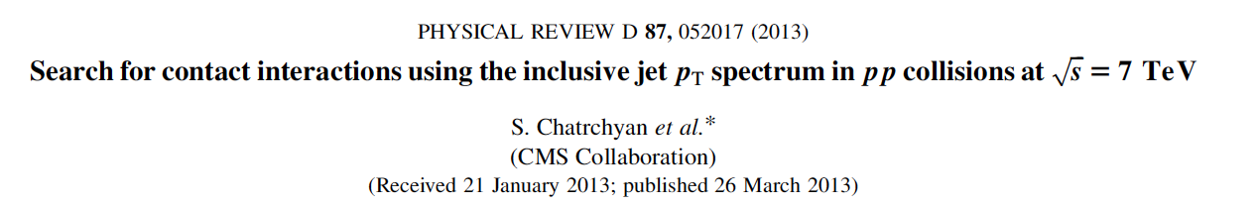
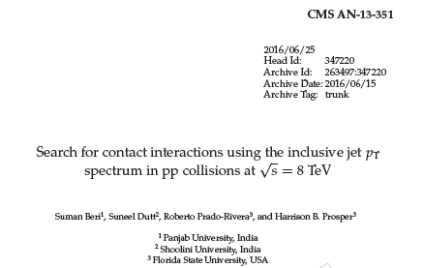
Overview
Previous results at 7 and 8 TeV:

Slide 5
Overview
Experimental Input
Inclusive jet p_{T} spectrum in |y| < 0.5, 638 ≤ p_{T} ≤ 2000 GeV, L = 71.5/pb
Use AK7 jets
Jet response function (JRF)
Jet energy correction (JEC) uncertainty
Jet energy resolution (JER) uncertainty

Slide 6
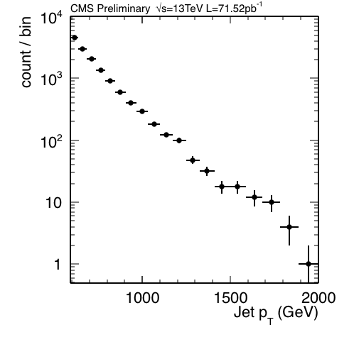
Data: L = 71.5 pb⁻¹

Slide 7
Overview
Theoretical Input
PDFs (LHAPDF-6.1.5)
CT14nlo, MMHT2014nlo68cl, NNPDF30_nlo
QCD predictions at NLO
fastnlo_toolkit-2.3.1pre-2163 InclusiveNJets_fnl5332g_v23_fix.tab
CI predictions at NLO
CIJET-1.1
Non-perturbative corrections
Electroweak corrections

Slide 8
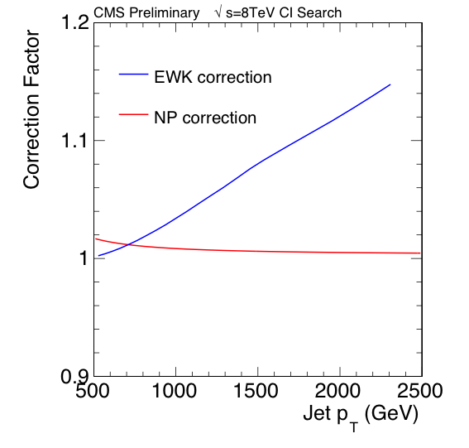
Overview: NP & EWK Corrections
This will be
updated.

Slide 9
Overview: Models
New QCD-like interactions described using the effective Lagrangian
where Λ is a mass scale, κ_{i} are additional free parameters, and each O_{i} is a sum over dim-6 operators:
O_{1,2} ~ ū_{L}γ_{μ}u_{L} ū_{L}γ^{μ}u_{L}
O_{3,4} ~ ū_{L}γ_{μ}u_{L} ū_{R}γ^{μ}u_{R}
O_{5,6} ~ ū_{R}γ_{μ}u_{R} ū_{R}γ^{μ}u_{R}

Slide 10
Overview: Models
This yields a QCD+CI cross section per p_{T} bin of the form
where g = –ln(μ₀√k) and λ = 1/Λ²
f = ln(√(k / λ))
The CI term comprises 57
coefficients

Slide 11
Overview: Models
The parameters κ₁ …κ₆ are free, but we consider only the following discrete set of values:
Model η_{LL} η_{RL} η_{RR}
LL ±1 0 0 Left-Left
RR 0 0 ±1 Right-Right
VV ±1 ±1 ±1 Vector-Vector
AA ±1 ∓1 ±1 Axial Vector
V-A 0 ±1 0 Vector – Axial Vector
where κ₁ = η_{LL}, κ₃ = 2η_{RL}, κ₅ = η_{RR}, and κ₂ = κ₄ = κ₆ = 0.

Slide 12
Outline
Overview
Analysis
Preliminary Results
Plans

Slide 13
Analysis: Roadmap
Analysis Steps
For each PDF set (except for NNPDF for which sample exists), 200 sets of PDFs are randomly sampled using the hessian2replicas tool in LHAPDF6.1.5.
For each of these PDF sets, and 7 combinations of the renormalization and factorization scales, compute the QCD inclusive jet p_{T} spectrum using fastNLO. This yields an ensemble of 3x200x7 = 4200 spectra.
Do the same for the 57 differential coefficients needed to compute the CI spectra for arbitrary values of κ and Λ.

Slide 14
Analysis: Roadmap
Analysis Steps
Each spectrum, f (p_{T}) = d²F/dp_{T}dy, (either QCD or the 57 CI differential coefficients) is smeared
with the jet response function R. We also randomly sample the jet energy correction (JEC) and jet energy resolution (JER), taking care to maintain the correlations across all bins and all spectra.

Slide 15
Analysis: Roadmap
Analysis Steps
Next, compute the likelihood where D denotes the counts per bin and ν denotes the JEC, JER, and PDF nuisance parameters. Since there is no evidence of a significant deviation from QCD, we set limits on Λ for different choices of κ. The three PDF sets are given equal weight. The likelihood and data are stored in a RooStats Workspace.

Slide 16
Analysis: Status
QCD and CI spectra for all PDFs have been calculated.
All spectra have been smeared. However, we are still using the 8 TeV jet response function and jet energy correction uncertainties. We plan to migrate to the Summer15_50ns uncertainties over the next week or so.
Corrections: Non-perturbative corrections have been implemented as well as the far more significant electroweak corrections (thanks to Paolo Gunnellini).
The workspace has been built and preliminary expected limits have been calculated for all models.

Slide 17
Outline
Overview
Analysis
Preliminary Results
Plans

Slide 18
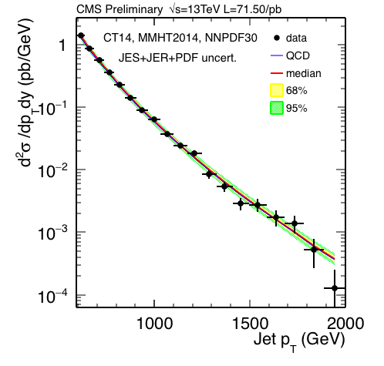
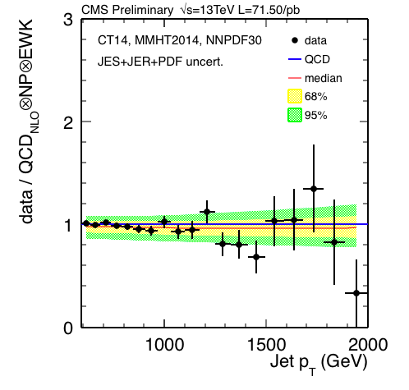
Data / QCD Comparison
No evidence of a significant deviation from Standard Model.

Slide 19
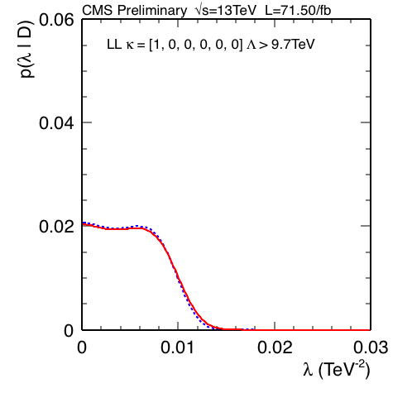
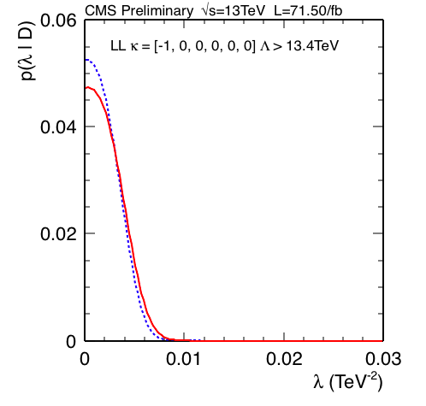
Expected Limits – LL

Slide 20
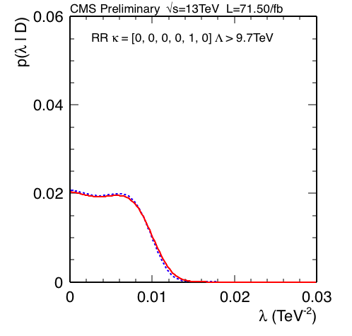
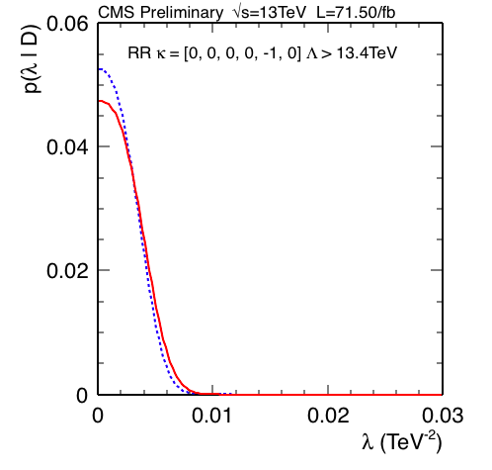
Expected Limits – RR

Slide 21
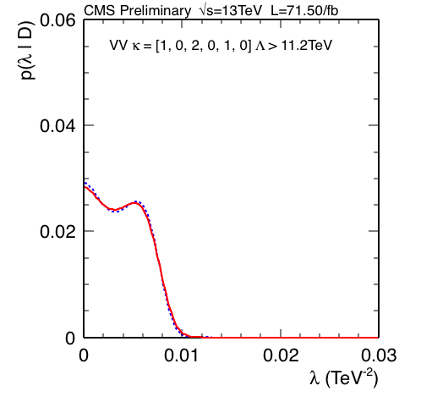
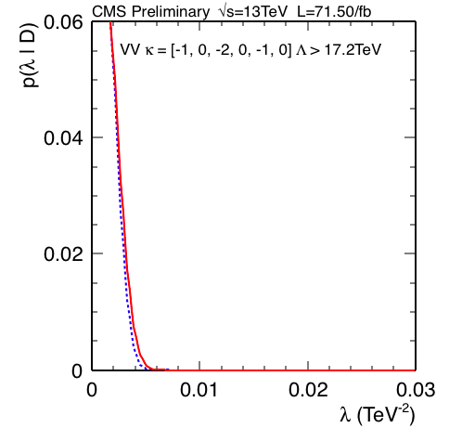
Expected Limits – VV

Slide 22


Expected Limits – AA

Slide 23
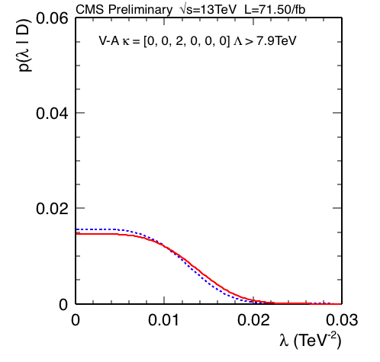
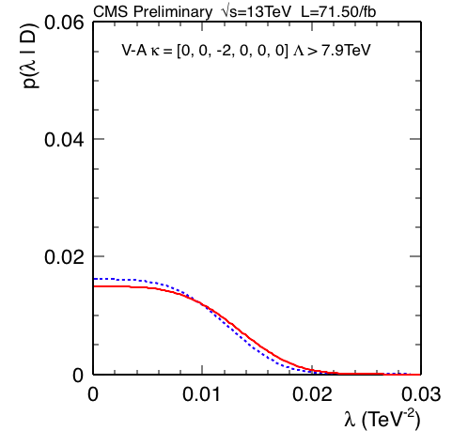
Expected Limits – V - A

Slide 24
Outline
Overview
Analysis
Preliminary Results
Plans

Slide 25
Near Term Plans
Re-smear all spectra using the same jet response function as used in SMP-15-007 and use the Summer15_50ns jet energy correction uncertainties.
Re-compute expected limits.
Check stability of expected limits by repeating calculations with increasing thresholds on minimum jet p_{T}. Also, repeat calculations with different (bootstrap) samples of spectra and study distribution of limits to check that they behave sensibly.

Slide 26
Near Term Plans
Compute observed limits for all models.
Complete 13TeV Analysis Note.
Subject analysis to ARC review and write paper.

Slide 27
backup

Slide 28
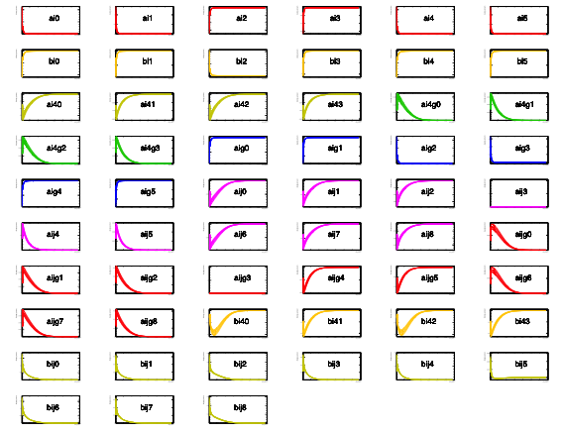
CI Cross Section Coefficients (8 TeV)

Slide 29
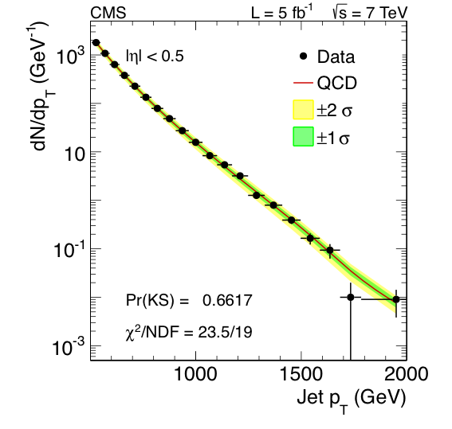
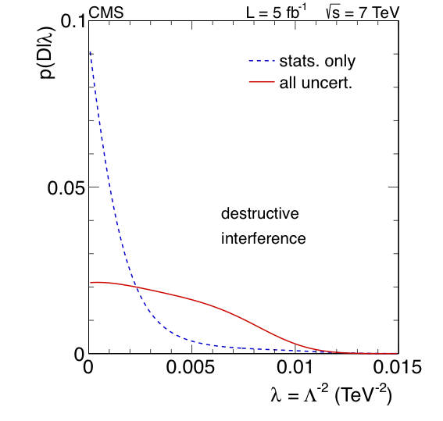
Contact Interaction Search @ 7 TeV

Slide 30
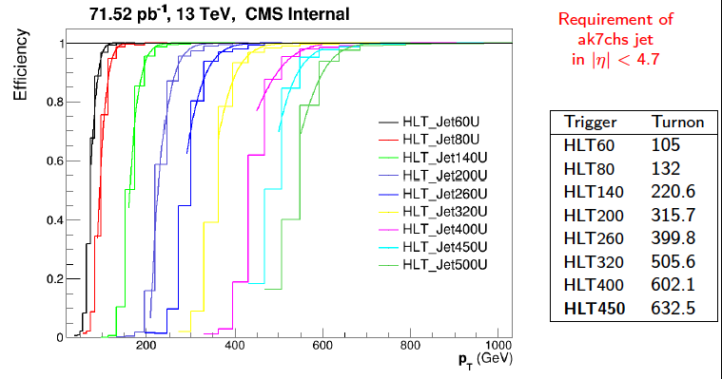
Overview: Triggers
SMP-15-007

