Slide 1
Search for Contact Interactions Using Inclusive Jet p_{T} Spectrum @13 TeV
Suman Beri¹, Suneel Dutt², Pampa Ghose³, Bipen Kotwal², and Harrison B. Prosper³
¹Panjab University, ²Shoolini University, ³Florida State University
Exotica Jets+X Working Group Meeting
3 October 2016

Slide 2
Outline
Overview
Analysis
Results
Plans for 2016 Data

Slide 3
Overview
Goal
Search for new QCD-like interactions by looking for deviations from QCD in the inclusive jet p_{T} spectrum.
Inclusive: all jets that fall within a given phase space.
Basic Assumption
At LHC energies, the “true” Lagrangian L can be written as
in which the L⁽²⁾ term contains dim-6 operators that describe 4-quark interactions, which can be approximated as contact interactions (CI).

Slide 4
Overview
Experimental Input
Inclusive jet p_{T} spectrum in |y| < 0.5, 638 ≤ p_{T} ≤ 2000 GeV¹, anti-k_{T} R = 0.7 jets.
Jet response function (JRF)
Jet energy scale (JES) uncertainty: Summer15_50nsV5 for AK8PF jets
Jet energy resolution (JER) uncertainty: 10%
¹Eur. Phys. J. C76 (2016) no.8, 451, SMP-15-007

Slide 5
Overview
Theoretical Input
PDFs (LHAPDF-6.1.6)
CT14nlo, MMHT2014nlo68cl, NNPDF30_nlo_as_0118_1000
Program to calculate QCD@NLO
fastnlo_toolkit-2.3.1pre-1871 InclusiveNJets_fnl5332g_v23_fix.tab
Program to calculate CI@NLO
CIJET-1.1 (J. Gao, Comput.Phys.Commun. 184 (2013) 2362)
Non-perturbative corrections (NP)
Electroweak corrections (EWK)

Slide 6
Overview
Many thanks to the Inclusive Jet Group!
Sourav Dev
Giannis Flouris
Hannes Jung
Panos Kokkas
Ksenia Shchelina
and especially to Paolo Gunnellini who provided the details of the measured spectrum and the NP and EWK correction functions.

Slide 7
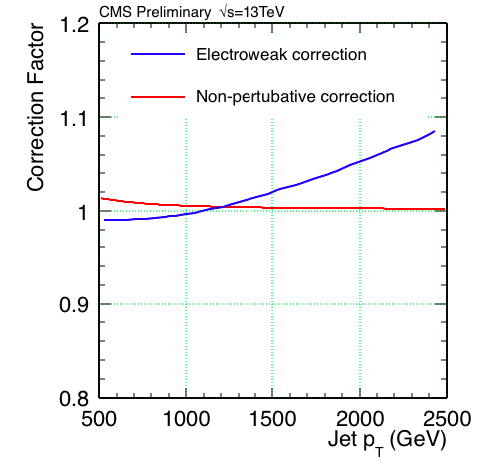
Overview: NP & EWK Corrections

Slide 8
Overview: Models
At NLO accuracy, new 4-quark interactions can be described using an effective Lagrangian of the form
where Λ is a mass scale, κ_{i} are additional free parameters, and each O_{i} is a sum over dim-6 operators:
O_{1,2} ~ ū_{L}γ_{μ}u_{L} ū_{L}γ^{μ}u_{L}
O_{3,4} ~ ū_{L}γ_{μ}u_{L} ū_{R}γ^{μ}u_{R}
O_{5,6} ~ ū_{R}γ_{μ}u_{R} ū_{R}γ^{μ}u_{R}

Slide 9
Overview: Models
We consider the following discrete set of values for the κ parameters:
Model η_{LL} η_{RL} η_{RR}
LL ±1 0 0
RR 0 0 ±1
VV ±1 ±1 ±1
AA ±1 ∓1 ±1
V-A 0 ±1 0
where κ₁ = η_{LL}, κ₃ = 2η_{RL}, κ₅ = η_{RR}, and κ₂ = κ₄ = κ₆ = 0.

Slide 10
Overview: Models
The NLO QCD+CI cross section per jet p_{T} bin can be written as
where g = –ln(μ₀√k) and λ = 1/Λ²
f = ln(√(k / λ))
The CI term comprises 57
coefficients

Slide 11
Outline
Overview
Analysis
Results
Plans

Slide 12
Analysis
Big Picture
Integrate multinomial likelihood p(D|λ, ν) over nuisance parameters ν associated with PDFs, renormalization and factorization scales, jet energy scale, and jet energy resolution. (λ = 1/Λ² and D denotes the observed counts.)
Compute expected limits by setting “observed” counts = expected counts
Compute observed limits using observed counts.
See backup for details.

Slide 13
Outline
Overview
Analysis
Results
Plans

Slide 14
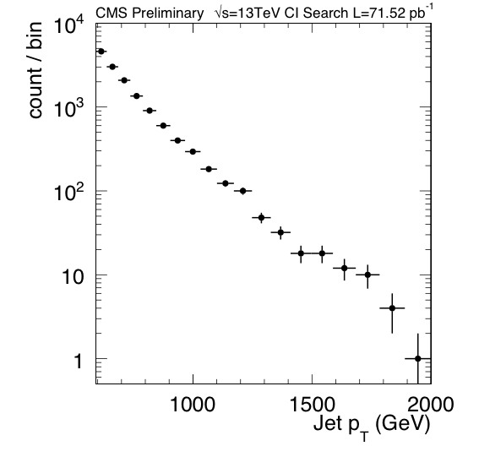
Data: 71.52 pb⁻¹ @ 13TeV

Slide 15
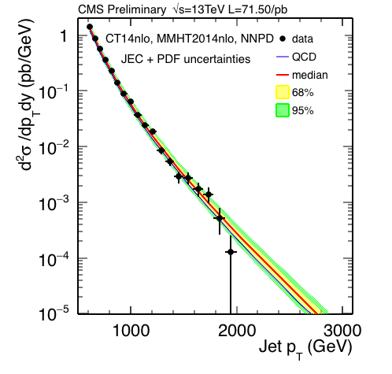
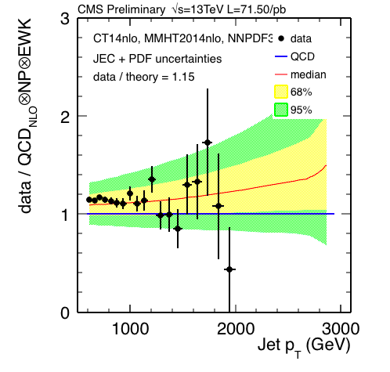
Data vs. QCD
PDF + JES + JER (Summer15 V5) uncertainties

Slide 16
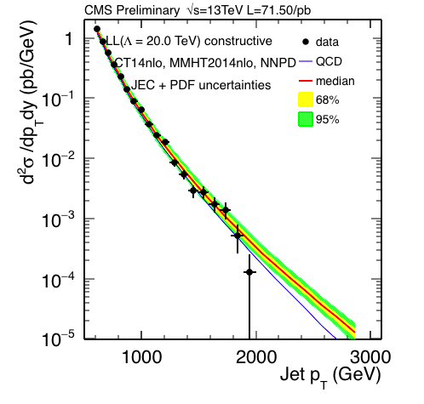
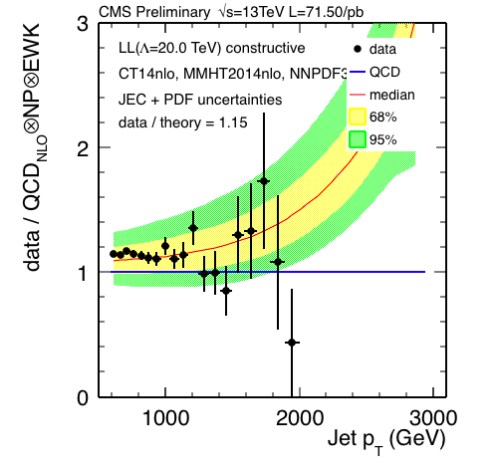
Data vs. LL Model (Λ=20TeV)
PDF + JES + JER (Summer15 V5) uncertainties
Constructive

Slide 17
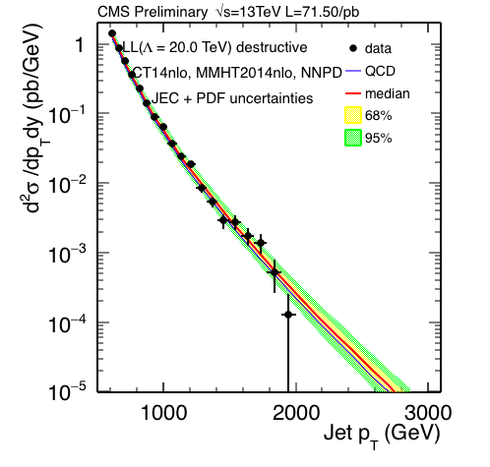
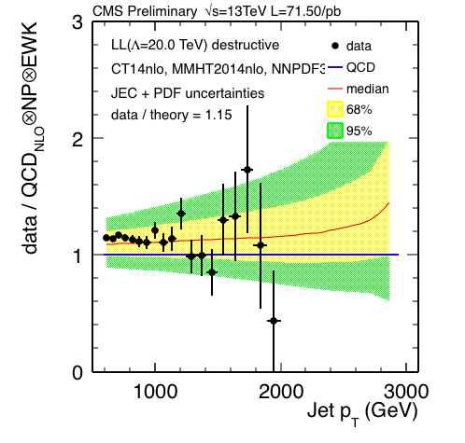
Data vs. LL Model (Λ=20TeV)
PDF + JES + JER (Summer15 V5) uncertainties
Destructive

Slide 18
Limits

Slide 19
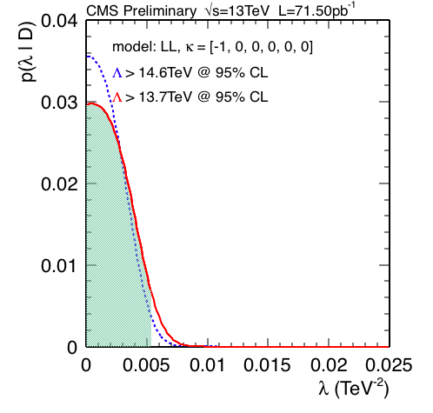
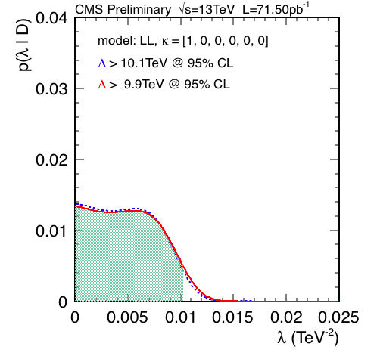
LL Limits @ 95% CL: Expected

Slide 20
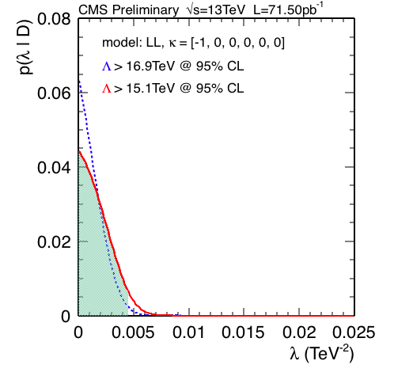
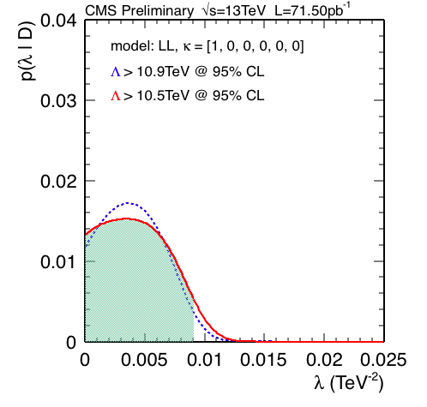
LL Limits @ 95% CL: Observed

Slide 21
Limits @ 95% CL
L = 0.072 fb⁻¹
AN-16-338
L = 2.6 fb⁻¹
AN-15-245*
Model | Observed (TeV) | Expected (TeV) | Expected (TeV)
Λ⁺(LL/RR) | 10.5 | 9.9 | 12.1
Λ⁻(LL/RR) | 15.1 | 13.7 | 17.3
Λ⁺(VV) | 12.0 | 11.5 | 13.9
Λ⁻(VV) | 19.5 | 17.5 | 22.2
Λ⁺(AA) | 12.1 | 11.5 | 13.9
Λ⁻(AA) | 19.3 | 17.5 | 22.1
Λ⁺(V-A) | 8.7 | 8.0 | 9.5
Λ⁻(V-A) | 8.7 | 8.0 | 9.5
*Search for quark contact interactions and extra spatial dimensions in the
dijet angular distributions at 13 TeV, AN-15-245, L. Apanasevich et al.

Slide 22
Plans for 2016 Data
We would like to work on a publishable result using the 2016 data set.
However, this only makes sense if the analysis is not severely limited by systematic uncertainties.
We’ve made a rough estimate for the LL model (assuming JEC uncertainties become << PDF uncertainties) using CT14.

Slide 23
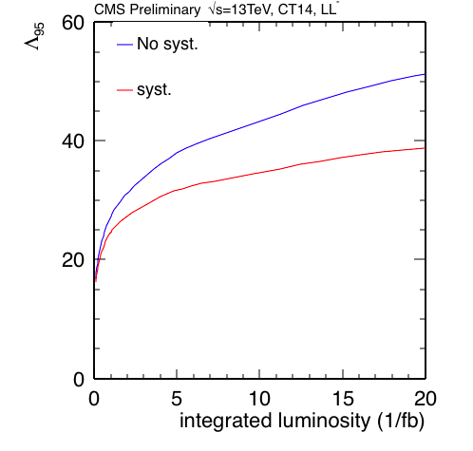
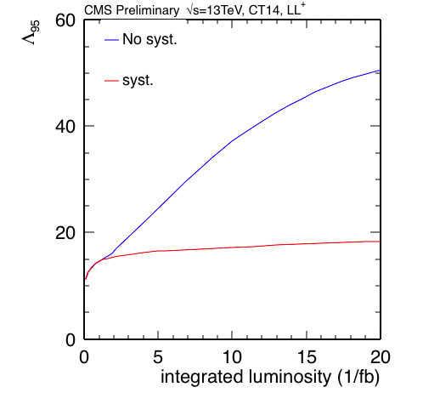
Plans for 2016 Data: Λ⁹⁵ vs Lumi
These plots suggest that we can use up to ~2.0/fb for destructive
interference models and up to ~20/fb for constructive
interference models with 2014 PDFs.

Slide 24
Plans for 2016 Data
Work with inclusive jet group on ongoing measurement of inclusive jet p_{T} spectrum using 2016 data.
Repeat analysis using 2016 measurement. Extend cross section predictions beyond 2TeV.
Write AN/paper.
Timescale ~ 6 – 8 months.
Immediate plans: complete current AN, then write a PAS.

Slide 25
backup

Slide 26
Analysis
Steps
For each PDF generate 200 randomly sampled PDF sets using hessian2replicas in LHAPDF6.1.6, except for NNPDF30_nlo for which the sample already exists.
For each sampled PDF set and 7 combinations of the renormalization and factorization scales, compute the QCD inclusive jet p_{T} spectrum (yielding 4200 spectra).
Repeat 2., but instead use CIJET to compute the 57 differential coefficients needed to compute the CI spectra for arbitrary values of κ and Λ (57 × 4200 spectra).

Slide 27
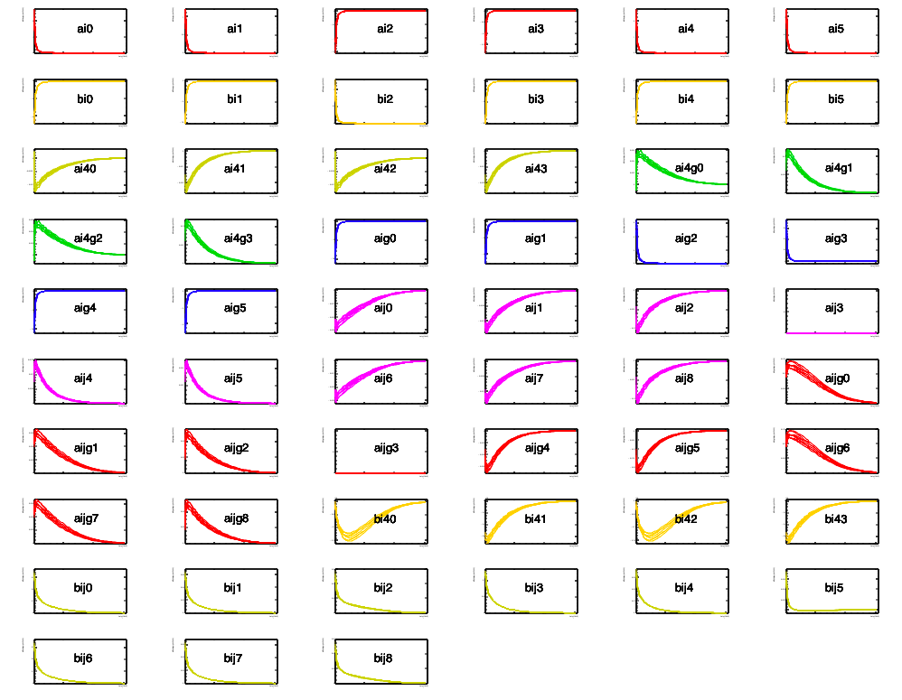
CI Differential Coefficients (CT14, 0)

Slide 28
Analysis
Steps
Convolve each differential spectrum, f (p_{T}) = d²F/dp_{T}d|y| (either QCD or the 57 CI coefficients),
with the jet response function R, while accounting for the uncertainty in the jet energy scale (JES) and jet energy resolution (JER), taking care to maintain the correlations across all bins and all spectra.

Slide 29
Analysis
Steps
Compute the marginal likelihood where D denotes the counts per bin, and ν denotes the JES, JER, and PDF nuisance parameters.
Compute upper limit on λ by solving

Slide 30
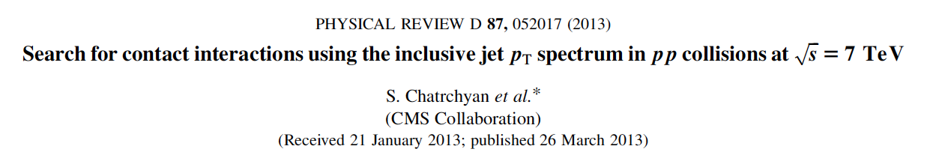
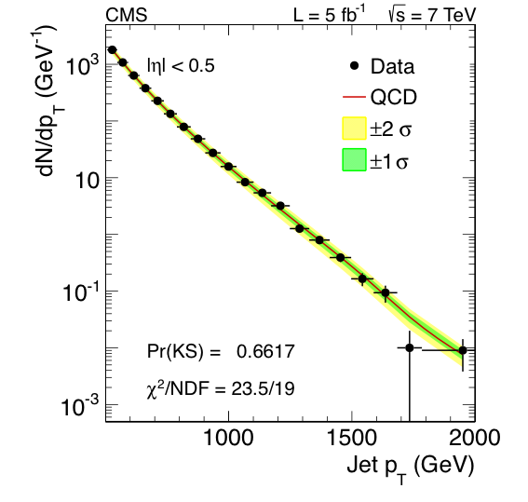
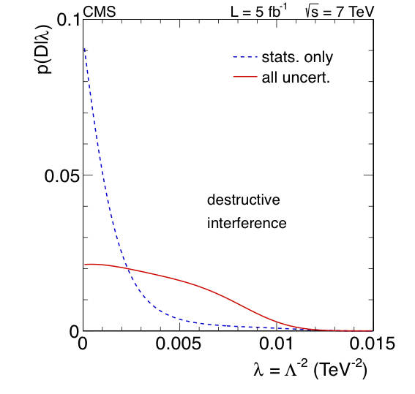
Contact Interaction Search @ 7 TeV

Slide 31
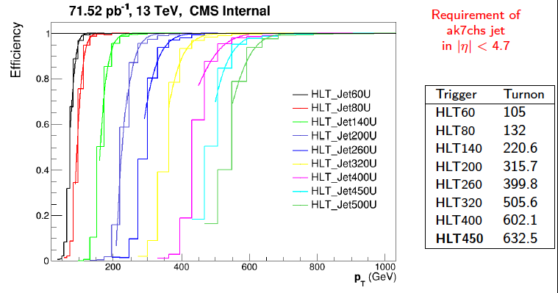
Overview: Triggers
SMP-15-007
Constructive

Slide 32
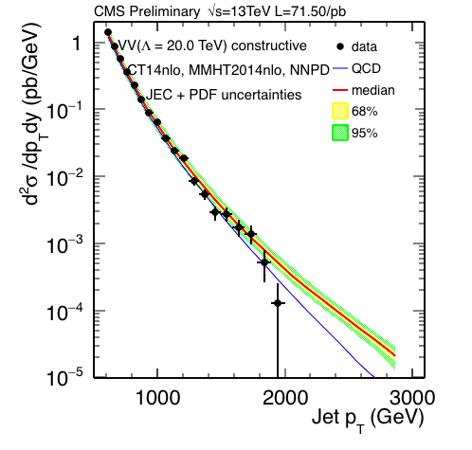
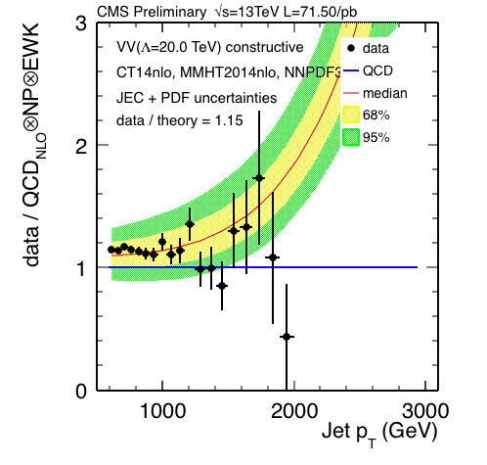
Data vs. VV Model (Λ=20TeV)
PDF + JES + JER (Summer15 V5) uncertainties
Constructive

