Slide 1
13TeV Inclusive Jets Contact Interaction Analysis
Suman Beri¹, Suneel Dutt², Bipen Kotwal², and Harrison B. Prosper³
¹Panjab University, ²Shoolini University, ³Florida State University
SMP-J: Jet Analysis Meeting
15 December 2016

Slide 2
Outline
Introduction
Review: Analysis 2015 dataset (72.5pb^{–1} @ 13TeV)
Plans: Analysis 2016 dataset

Slide 3
Introduction
Goals
Search for new QCD-like interactions by looking in the inclusive jet spectrum for deviations from QCD predictions at high jet p_{T}.
Extend the 13TeV contact interaction analysis, based on SMP-15-007 (Eur. Phys. J. C76 (2016) no.8, 451), to the 2016 dataset.
Publication before the end of 2017.

Slide 4

Introduction
Basic Assumption
At the LHC, the Lagrangian L can be approximated as
in which the L⁽²⁾ term, which contains 4-quark dim-6 operators, can be approximated as contact interactions (CI).

Slide 5
Outline
Introduction
Review: Analysis 2015 dataset (72.5pb^{–1} @ 13TeV)
Plans: Analysis 2016 dataset

Slide 6
Analysis 2015 Dataset
Many thanks to the Inclusive Jet Group!
Sourav Dev
Giannis Flouris
Hannes Jung
Panos Kokkas
Ksenia Shchelina
and special thanks to Paolo Gunnellini who provided all the necessary details, including the observed jet p_{T} bin counts (L = 71.5pb^{–1}).

Slide 7
Analysis 2015 Dataset
Experimental Input
Inclusive jet p_{T} spectrum in |y| < 0.5, 638 ≤ p_{T} ≤ 2000 GeV, anti-k_{T} R = 0.7 jets.
Jet response function (JRF)
Jet energy scale (JES) uncertainty: Summer15_50nsV5 for AK8PF jets
Jet energy resolution (JER) uncertainty: 10%

Slide 8
Analysis 2015 Dataset
Theoretical Input
PDFs (LHAPDF-6.1.6)
CT14nlo, MMHT2014nlo68cl, NNPDF30_nlo_as_0118_1000
Program to calculate QCD@NLO
fastnlo_toolkit-2.3.1pre-1871 InclusiveNJets_fnl5332g_v23_fix.tab
Program to calculate CI@NLO
CIJET-1.1 (J. Gao, Comput.Phys.Commun. 184 (2013) 2362)
Non-perturbative corrections (NP)
Electroweak corrections (EWK)

Slide 9

Analysis 2015 Dataset: Models
At NLO accuracy, 4-quark interactions can be described using an effective Lagrangian of the form
where Λ is a mass scale, κ_{i} are additional free parameters, and each O_{i} is a sum over dim-6 operators:
O_{1,2} ~ ū_{L}γ_{μ}u_{L} ū_{L}γ^{μ}u_{L}
O_{3,4} ~ ū_{L}γ_{μ}u_{L} ū_{R}γ^{μ}u_{R}
O_{5,6} ~ ū_{R}γ_{μ}u_{R} ū_{R}γ^{μ}u_{R}

Slide 10
Analysis 2015 Dataset: Models
We consider the following discrete set of values for the κ parameters:
Model η_{LL} η_{RL} η_{RR}
LL ±1 0 0
RR 0 0 ±1
VV ±1 ±1 ±1
AA ±1 ∓1 ±1
V-A 0 ±1 0
where κ₁ = η_{LL}, κ₃ = 2η_{RL}, κ₅ = η_{RR}, and κ₂ = κ₄ = κ₆ = 0.

Slide 11

Analysis 2015 Dataset: Models
The NLO QCD+CI cross section per jet p_{T} bin can be written as
where g = –ln(μ₀√k) and λ = 1/Λ²
f = ln(√(k / λ))
The CI term comprises 57
coefficients

Slide 12
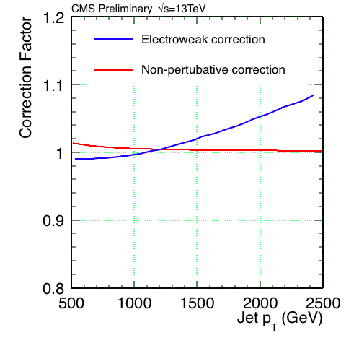
2015 Dataset: NP & EWK Corrections

Slide 13
Analysis 2015 Dataset: Overview
Integrate (multinomial) likelihood p(D|λ, ν) over nuisance parameters ν associated with PDFs, renormalization and factorization scales, jet energy scale, and jet energy resolution. (λ = 1/Λ² and D denotes the observed counts.)
Compute expected limits by setting “observed” counts = expected counts
Compute observed limits using observed counts.
See backup for details.

Slide 14
Analysis 2015 Dataset: Results & Limits

Slide 15
2015 Dataset: 71.52 pb⁻¹ @ 13TeV

Slide 16
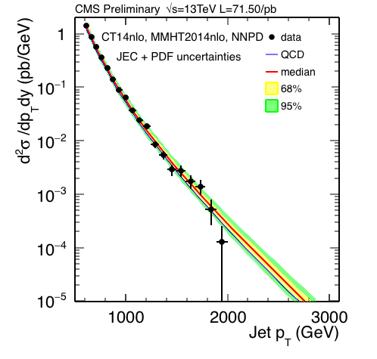
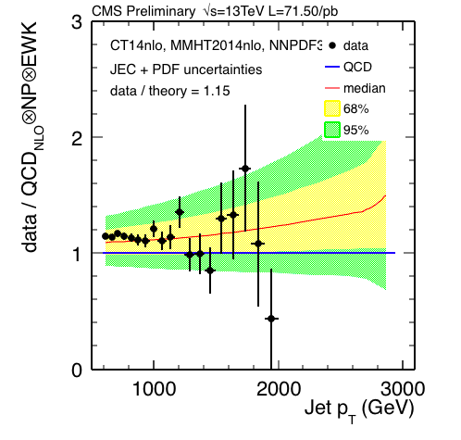
Data vs. QCD
PDF + JES + JER (Summer15 V5) uncertainties

Slide 17
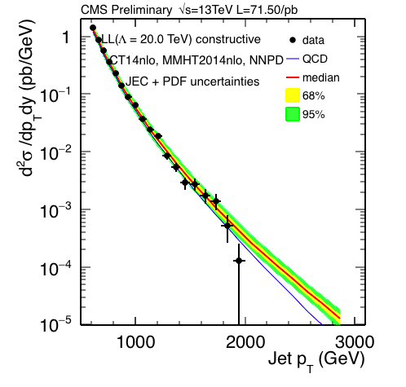
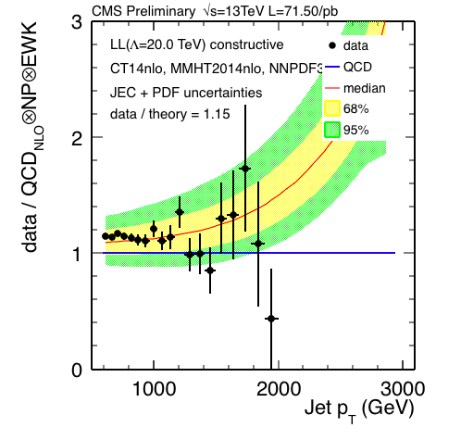
Data vs. LL Model (Λ = 20TeV)
PDF + JES + JER (Summer15 V5) uncertainties
Constructive

Slide 18
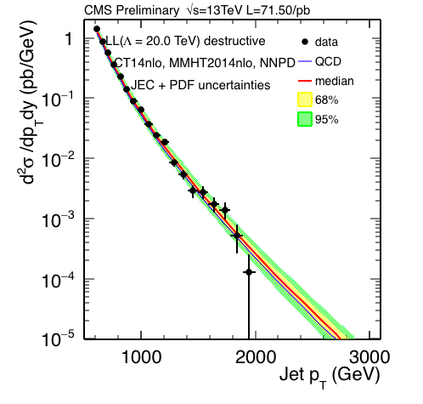
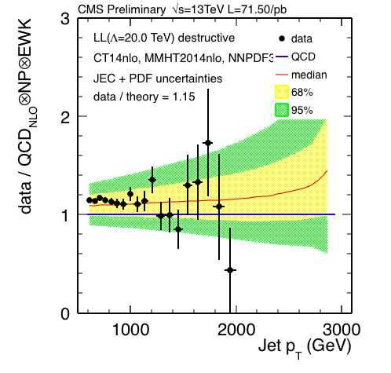
Data vs. LL Model (Λ = 20TeV)
PDF + JES + JER (Summer15 V5) uncertainties
Destructive

Slide 19
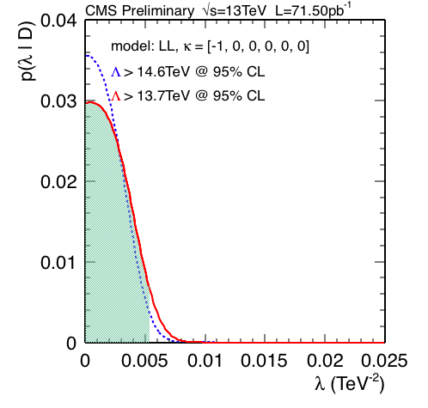
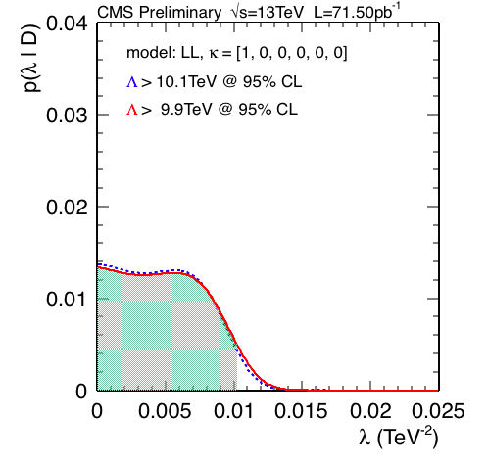
LL Limits @ 95% CL: Expected

Slide 20
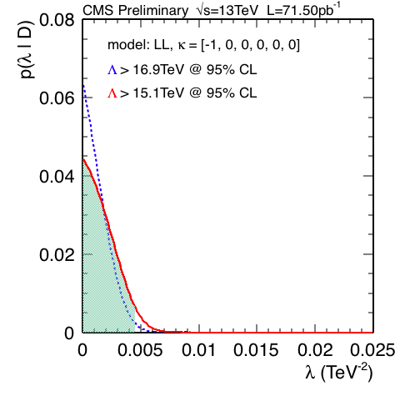
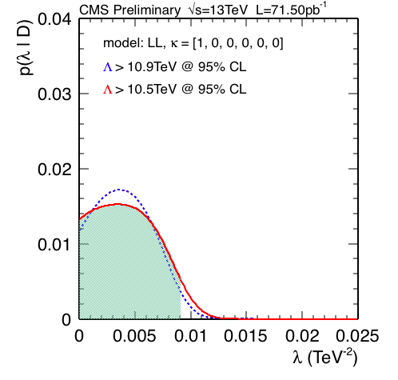
LL Limits @ 95% CL: Observed

Slide 21
Limits @ 95% CL
L = 0.072 fb⁻¹
AN-16-338
L = 2.6 fb⁻¹
AN-15-245*
Model | Observed (TeV) | Expected (TeV) | Expected (TeV)
Λ⁺(LL/RR) | 10.5 | 9.9 | 12.1
Λ⁻(LL/RR) | 15.1 | 13.7 | 17.3
Λ⁺(VV) | 12.0 | 11.5 | 13.9
Λ⁻(VV) | 19.5 | 17.5 | 22.2
Λ⁺(AA) | 12.1 | 11.5 | 13.9
Λ⁻(AA) | 19.3 | 17.5 | 22.1
Λ⁺(V-A) | 8.7 | 8.0 | 9.5
Λ⁻(V-A) | 8.7 | 8.0 | 9.5
*Search for quark contact interactions and extra spatial dimensions in the
dijet angular distributions at 13 TeV, AN-15-245, L. Apanasevich et al.

Slide 22
Plans: Analysis 2016 Dataset
We plan to work on a publishable result using the 2016 data set.
However, this only makes sense if the analysis is not severely limited by systematic uncertainties.
We’ve made a rough estimate for the LL model (assuming JEC uncertainties become << PDF uncertainties) using CT14.

Slide 23
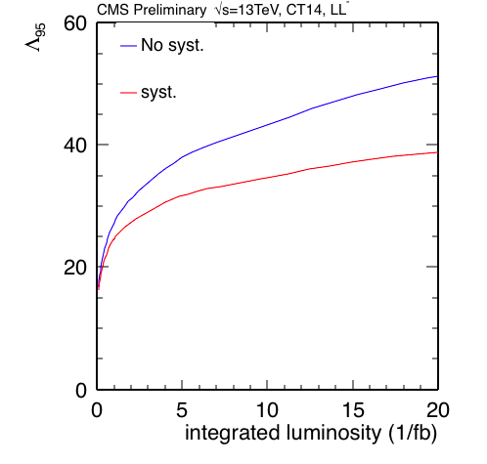
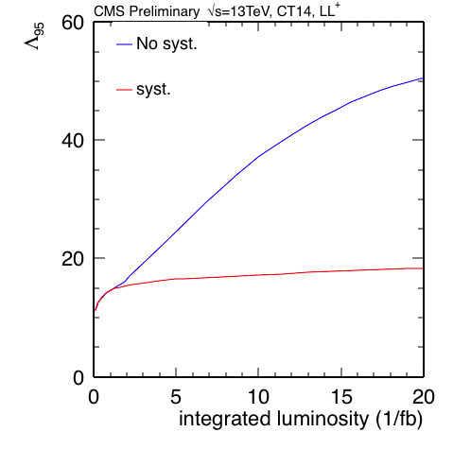
Plans: 2016 Dataset – Λ⁹⁵ vs. Lumi
These plots suggest that we can use up to ~ 20/fb for
constructive interference models and up to ~ 2/fb for
destructive interference models with 2014 PDFs.

Slide 24
Plans: Analysis 2016 Dataset
Work with jet group on ongoing jet measurements, including the inclusive jet p_{T} spectrum using 2016 data.
Repeat analysis using 2016 inclusive jet cross section measurement. Extend p_{T} spectrum 2TeV.
Write AN/paper.
Timescale ~ 6 – 8 months (2017)
Immediate plans: work with jet group.

Slide 25
backup

Slide 26
Analysis
Steps
For each PDF generate 200 randomly sampled PDF sets using hessian2replicas in LHAPDF6.1.6, except for NNPDF30_nlo for which the sample already exists.
For each sampled PDF set and 7 combinations of the renormalization and factorization scales, compute the QCD inclusive jet p_{T} spectrum (yielding 4200 spectra).
Repeat 2., but instead use CIJET to compute the 57 differential coefficients needed to compute the CI spectra for arbitrary values of κ and Λ (57 × 4200 spectra).

Slide 27
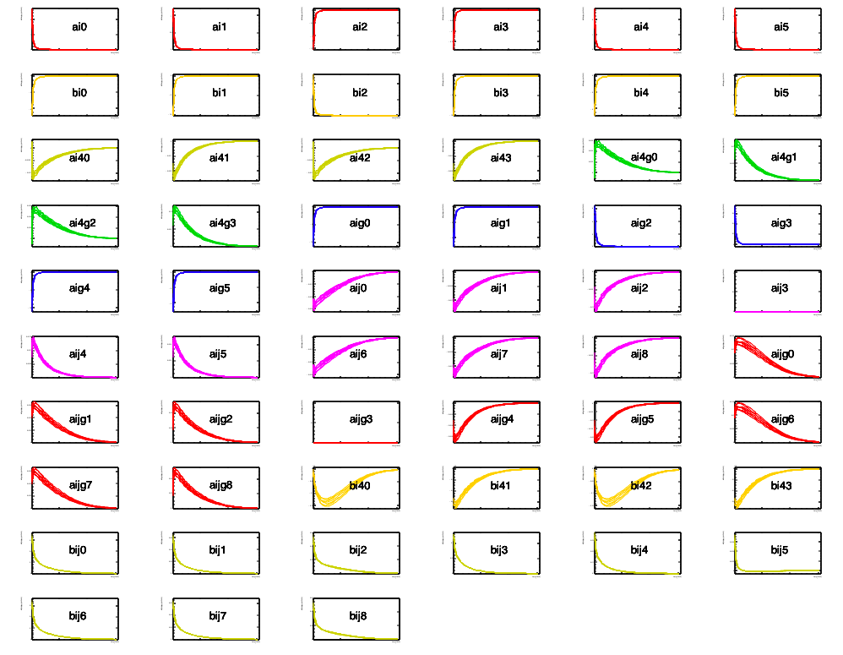
CI Differential Coefficients (CT14, 0)

Slide 28
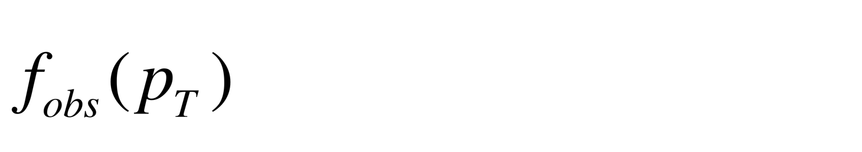
Analysis
Steps
Convolve each differential spectrum, f (p_{T}) = d²F/dp_{T}d|y| (either QCD or the 57 CI coefficients),
with the jet response function R, while accounting for the uncertainty in the jet energy scale (JES) and jet energy resolution (JER), taking care to maintain the correlations across all bins and all spectra.

Slide 29
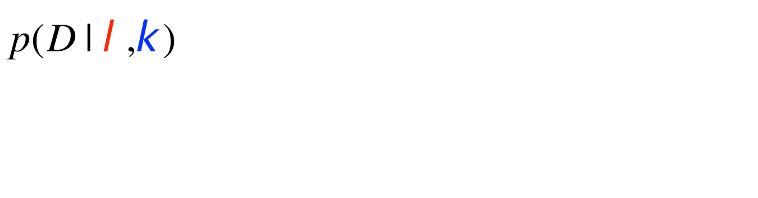
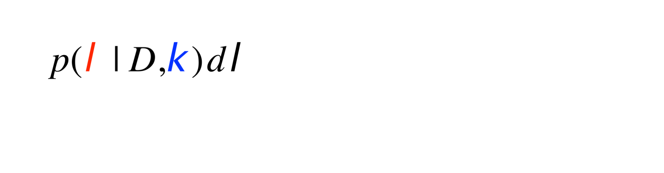
Analysis
Steps
Compute the marginal likelihood where D denotes the counts per bin, and ν denotes the JES, JER, and PDF nuisance parameters.
Compute upper limit on λ by solving

Slide 30
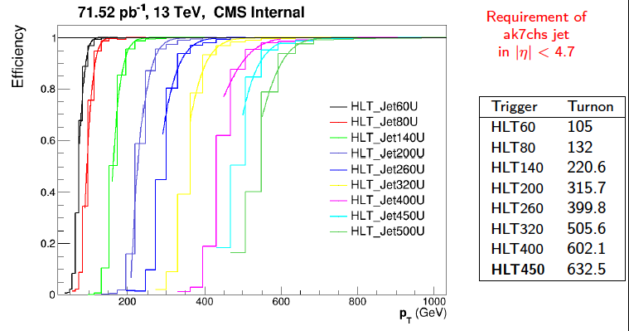
Triggers
SMP-15-007

Slide 31
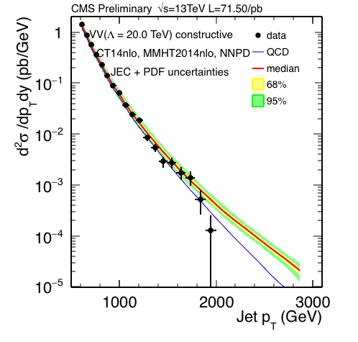
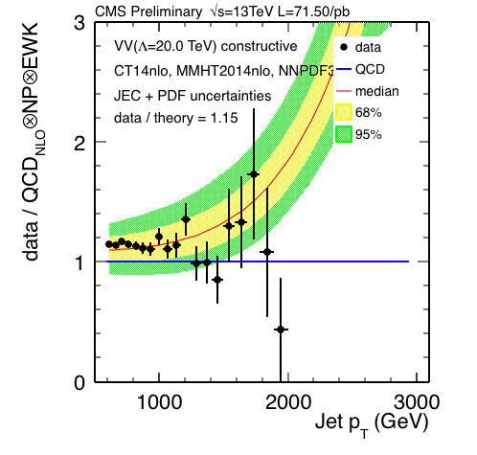
Data vs. VV Model (Λ=20TeV)
PDF + JES + JER (Summer15 V5) uncertainties
Constructive

Slide 32
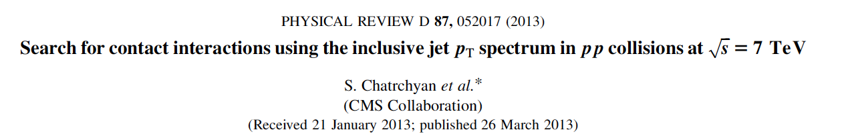
Contact Interaction Search @ 7 TeV

