Slide 1
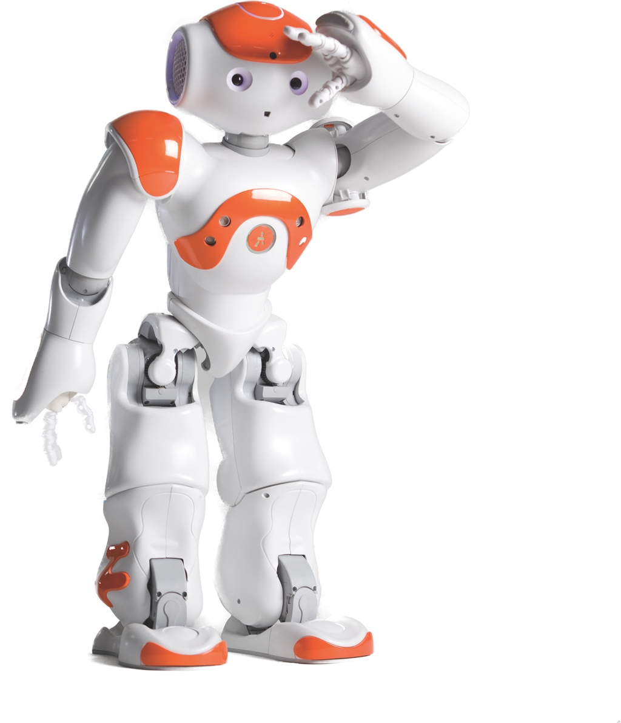
RoboCup
Estimator
COOPERATIVE ESTIMATION AND PREDICTION
OF PLAYER AND BALL MOVEMENT

Slide 2
We‘ll talk about
PROBLEM SETUP
MATHEMATICAL MODEL
KALMAN FILTER
GO, MATLAB, GO!
OUTLOOK

Slide 3
The Problem
1 PROBLEM SETUP
No global eye
Noisy measurements
Dropped and repeated measurements
Known inputs only for one team

Slide 4
Our Approach
1 PROBLEM SETUP
Robot
Robot
Robot
Robot
COLLECTIVE SPATIAL DATA
ESTIMATOR
ESTIMATOR
ESTIMATOR
ESTIMATOR
Collective Model

Slide 5
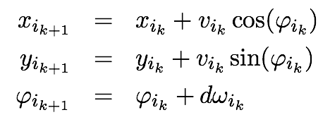
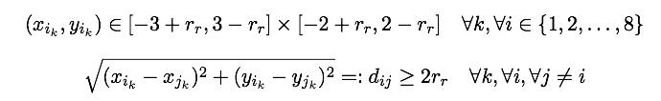
Player Model
2 MATH. MODEL
Motion equations
Boundary conditions

Slide 6
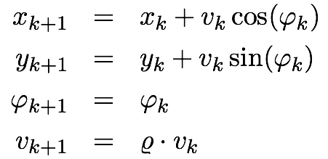
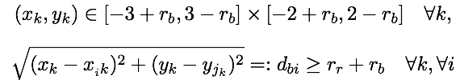
Ball Model
2 MATH. MODEL
Motion equations
Boundary conditions

Slide 7
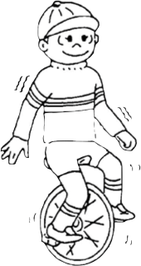
Random Collision
2 MATH. MODEL
Robot vs. robot: Swapping direction
Robot vs. sideline: Law of reflection
Ball vs. sideline: Law of reflection
Ball vs. robot: kick ⊥ robot
small change in directon
constant velocity

Slide 8
Random Collision
2 MATH. MODEL

Slide 9
Random Potential
2 MATH. MODEL
Collision avoidance
robot/sidelines: positive charged
ball: negative charged

Slide 10
Random Potential
2 MATH. MODEL

Slide 11
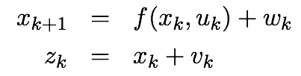
Noise
2 MATH. MODEL

Slide 12
Global Eye
2 MATH. MODEL

Slide 13
Basics
3 KALMAN FILTER
Estimation of states:
DKF - Estimation of state x:
A,B,H, R, Q (without sensor fusion)

Slide 14

Basics
3 KALMAN FILTER
Ongoing discrete KF cycle:
Figure: G. Welch and G. Bishop, “An Introduction to the Kalman Filter,” UNC-Chapel Hill, 2006.

Slide 15
Extended KF
3 KALMAN FILTER
Robots and ball are modeled as nonlinear systems
Ext. KF = KF that linearizes about the current mean and covariance
A,B,H, Q constant
Sensor fusion -> Measurment noise R

Slide 16
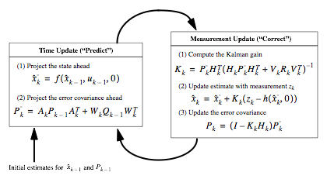
Extended KF
3 KALMAN FILTER
Figure: G. Welch and G. Bishop, “An Introduction to the Kalman Filter,” UNC-Chapel Hill, 2006.

Slide 17
Applying KF
4 GO, MATLAB, GO!
- filmli
- norm(R)-plots

Slide 18
Measurement Drop
4 GO, MATLAB, GO!
Through realistic Field of view™
Applied for
Team members
Opponents
Ball

Slide 19
Limited Knowledge
4 GO, MATLAB, GO!
movie snippet with growing error
(eg. l0sing touch with the ball)
Notes:
kopiere folien

Slide 20
Sensor Fusion
4 GO, MATLAB, GO!
movie snippet with growing error
(eg. l0sing touch with the ball)

Slide 21
Sensor Fusion
4 GO, MATLAB, GO!
Robot
Robot
Robot
Robot
COLLECTIVE SPATIAL DATA
ESTIMATOR
ESTIMATOR
ESTIMATOR
ESTIMATOR
Collective Model

Slide 22
Challenges...
5 OUTLOOK
Providing measurements may be difficult
Inaccuracies of the model
(e.g. assumption of white noise)
Better prediction of opponent‘s movement

Slide 23
...for the future
5 OUTLOOK
Implementation on Nao Platform
Usage of others filters (E.g. particle filter instead of an extended Kalman filter)
Find movement strategies to improve measurements

