Slide 1
SAPS Case Dockets: Why Victims Still Get Turned Away
What Requirement Engineering Can Do About It
Requirement Engineering Research Project – Topic 3
Group 36 | July 2026
Notes:
Good morning/afternoon. Today, Group 36 will present our Requirement Engineering Research Project focusing on SAPS case dockets. We will explore why victims are still being turned away at police stations and how a targeted requirement engineering approach can build a system to fix these accountability gaps.

Slide 2
Introduction & Context
The 'Hinge' of the Justice System: Opening a docket is the critical first step.
Failure 1: Unlawful Refusal - Officers improperly deciding not to open a case.
Failure 2: Post-Opening Neglect - Cases stall, paperwork goes missing, victims are left chasing answers.
Project Goal: Translate documented evidence (2024–2026) into actionable system requirements.
Notes:
Every criminal case in South Africa begins the same way: a victim walks into a station. This administrative step is actually the hinge the entire justice system turns on. Our project addresses two persistent failures: unlawful refusals to open dockets, and the subsequent stalling of cases that do get opened. We aim to translate these real-world problems into concrete system requirements.

Slide 3
Literature Review & Key Findings
Policy vs. Practice: National Instruction 3 of 2011 mandates registration, but everyday practice deviates.
The '121 Dockets' Case: Active political killing dockets moved to SAPS head office in 2025 remained inactive (Madlanga Commission).
The Wider Backlog: ~1.9 million cases open; >5.4 million dockets closed for 'lack of evidence' since 2018/19.
Oversight Gaps: IPID and the National Complaints Centre are reactive and overburdened.
Notes:
Our literature review, including evidence up to the 2025/2026 Madlanga Commission, shows this isn't just isolated admin errors. The '121 dockets' controversy proves that even high-profile cases can vanish due to poor tracking. With millions of dockets closed or stalled, relying on victims to proactively complain to an already backlogged IPID is a broken model.

Slide 4
Core Challenges Identified
1. Unlawful Refusal: No independent digital record exists when a victim is turned away.
2. Missing/Stalled Dockets: Manual processes allow cases to be overlooked.
3. Victim-Driven Escalation: Unfair burden placed on traumatized complainants to chase the system.
4. Oversight Backlogs: Reactive mechanisms (like IPID) are overwhelmed, reducing accountability.
Notes:
We distilled the literature into four major challenges. The most critical is the 'invisible refusal'—when a victim is turned away, there is no digital footprint that they even tried to report a crime. This forces the victim to carry the burden of escalation, which is both unfair and ineffective.

Slide 5
Problem Statement
The Gap: Disconnect between National Instruction 3 of 2011 and station-level practice.
Accountability Deficit: Existing systems depend on the complainant to identify and escalate failures.
The Need: A digital compliance and escalation system that can:
• Record all complaint attempts (even refused ones).
• Monitor docket progress and identify inactivity.
• Create an immutable audit trail.
• Automatically escalate unresolved problems.
Notes:
Our problem statement is clear: there is an accountability deficit. We need a system that shifts the burden of monitoring from the victim to the system itself. It must record every attempt, track inactivity, and automatically escalate issues before they become cold cases.

Slide 6
Key Stakeholders
Complainants/Victims: Need confirmation of recording and simple status tracking.
CSC Officers & Detectives: Need efficient tools that don’t add unnecessary admin work.
Station & Cluster Commanders: Need visibility into delays and non-compliance.
SAPS Management: Require reliable, system-wide compliance data.
Oversight Bodies (IPID): Need reliable audit trails for misconduct investigations.
Notes:
A successful system must serve multiple stakeholders. While victims need transparency, we must also ensure the system supports police officers and commanders with actionable visibility, rather than just punishing them. Oversight bodies like IPID are key beneficiaries of the automated audit trails.

Slide 7
Functional Requirements
FR1: Complaint Recording - Timestamped record created immediately upon any report attempt.
FR2: Refusal Recording - Mandatory justification required if a docket is not registered.
FR3: Officer Identification - All actions linked to an authenticated officer.
FR4: Automatic Escalation - Flags complaints not converted to dockets within a defined period.
FR5: Commander Notification - Alerts station/cluster commanders of unresolved flags.
FR6: Case Tracking - Reference numbers for victims to check status.
FR7: Audit Trail & Reporting - Complete history of actions and compliance indicator reports.
Notes:
Our functional requirements focus on automation and accountability. Crucially, if an officer refuses to open a docket, the system forces them to record a reason. If a deadline is missed, the system automatically escalates the issue to the station commander, removing the burden from the victim.

Slide 8
Non-Functional Requirements
Security & Privacy: Strict authentication, authorization, and POPIA compliance.
Integrity & Auditability: Records protected against unauthorized alteration; all actions logged.
Offline Capability: Supports offline operation with sync upon reconnection (critical for load-shedding).
Scalability & Performance: Must handle millions of dockets across all SAPS stations.
Usability: Simple interface to avoid disrupting normal station operations.
Notes:
Non-functional requirements are just as critical. Given South Africa's infrastructure challenges, offline capability is a must. Furthermore, strict POPIA compliance and immutable audit trails are non-negotiable to ensure the data can be trusted in legal or oversight proceedings.

Slide 9
System Data Model (Entity Relationships)
Complaint Received → 2. Timestamped Record Created → 3. Docket Registered (or 4. Refusal Recorded with Justification).
Automatic Monitoring for inactivity/missed deadlines.
First Escalation: Alert to Station Commander.
Further Escalation: To Cluster Commander or Oversight Authority (IPID).
Complainant Tracking: Victim checks status via reference number.
Audit & Reporting: Management reviews complete case history.
Notes:
This slide shows the high-level entity-relationship model of our proposed system. Notice how Case_Rejection and Case_Escalation are first-class entities, not just afterthoughts. Every action is linked to an officer, a station, and an activity log, ensuring a complete, tamper-evident audit trail.

Slide 10
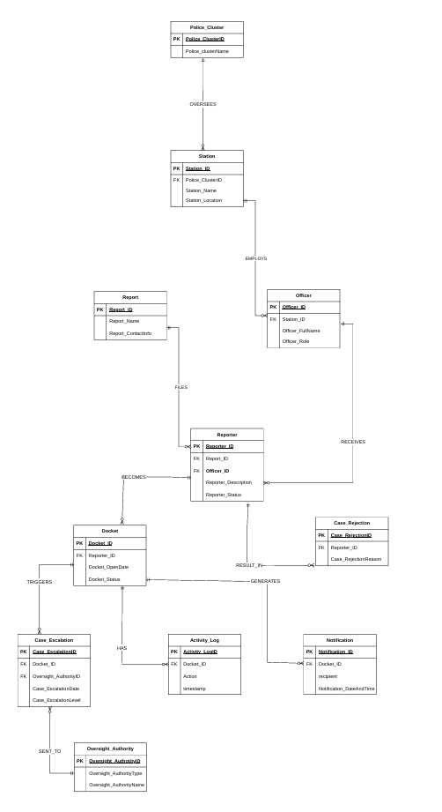
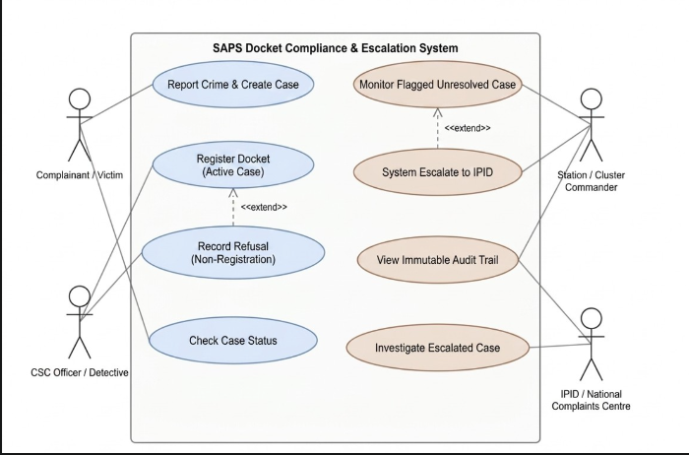
System Data Model

Slide 11
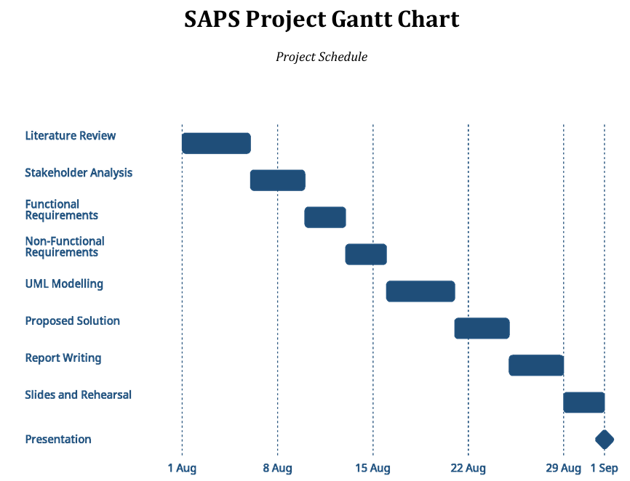
Project Plan & Timeline
Notes:
Our project plan spans a tight 5-week window from August 1st to September 1st. We have structured this into 9 distinct phases, with hard milestones for the literature review, requirements finalization, and UML modelling to ensure we meet our final submission date.

Slide 12
Feasibility Analysis
Technical Feasibility: HIGH. Acts as a monitoring layer, not a full system replacement. Timestamps and rule-based triggers are straightforward.
Economic/Resource Feasibility: HIGH. Relies on publicly available policy documents and commission testimony. No paid tools required.
Operational Feasibility: MODERATE. Success depends on human factors: officers using the system and commanders acting on alerts.
Schedule Feasibility: MODERATE. Tight 4.5-week window; delays in early phases risk the final deadline.
Notes:
Our feasibility analysis shows high technical and economic viability because we are proposing a lightweight compliance layer, not a massive system overhaul. However, operational and schedule feasibility are moderate. The technology is only as good as the officers using it, and our timeline has very little slack.

Slide 13
Risk Register & Mitigation Strategies
RISK | LIKELIHOOD | IMPACT | MITIGATION STRATEGY
Scope Creep | Medium | High | Strictly enforce scope boundary at Phases 5–6
Compressed Schedule | High | High | Treat Phase 1–2 end dates as hard deadlines; cut source depth if needed.
Outdated Literature | Medium | Medium | Lock source list end of Phase 1; only add material changes.
Sensitive Subject Matter | Low | High | Every claim must trace to a cited source; no speculation.

Slide 14
Conclusion
The Evidence is Clear: Unlawful refusals and accountability failures are well-documented, not obscure.
The RE Value: Requirement engineering turns this existing evidence into something testable and buildable.
The Solution: A layered compliance-and-escalation system strengthens existing SAPS processes without requiring a total replacement.
The Caveat: Technology makes failure visible earlier, but human action (officers using it, managers acting on alerts) is still required.
Notes:
In conclusion, requirement engineering doesn't invent a new problem here; it takes well-documented, live evidence and turns it into a testable, buildable solution. Our proposed layered system can make failures visible much earlier. However, technology alone cannot solve this. It requires officers to use it, commanders to act on it, and oversight bodies to enforce it.

Slide 15
Q&A & References
Questions?
Key References:
• SAPS National Instruction 3 of 2011
• Madlanga Commission of Inquiry Testimony (2025–2026)
• IPID Reports & Parliamentary Statements (2024–2026)
• Full reference list available in the submitted report.
Notes:
Thank you for your time and attention. We welcome any questions you may have regarding our requirements, proposed solution, or project methodology.

