Slide 1

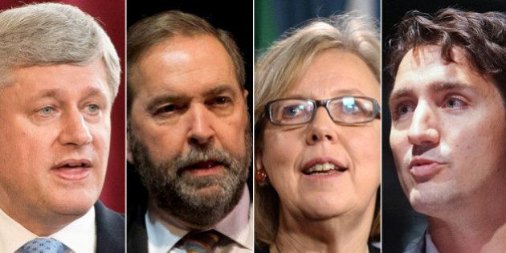
Canadian Federal Elections 2015
The data behind the vote
This Photo by Unknown Author is licensed under CC BY

Slide 2
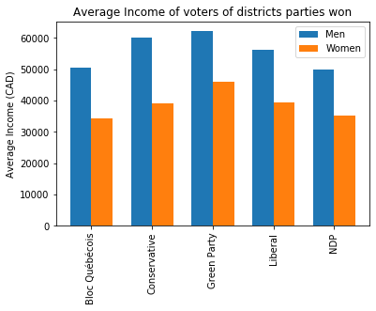
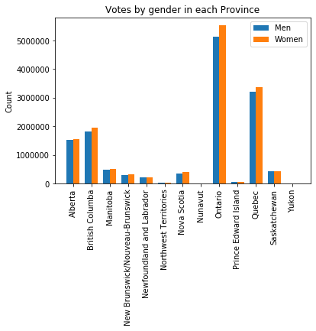
General Outlook

Slide 3
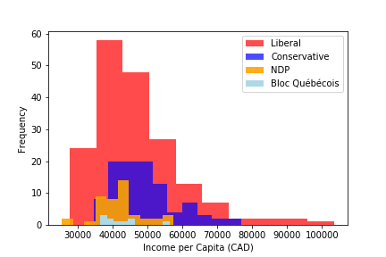

Slide 4
