Slide 1

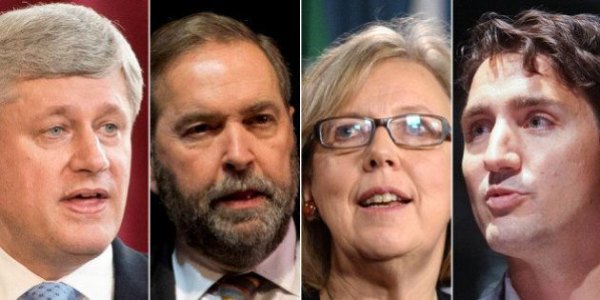
Canadian Federal Elections 2015
The data behind the vote
This Photo by Unknown Author is licensed under CC BY

Slide 2
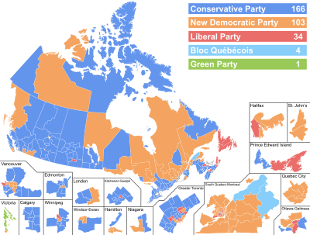

Slide 3
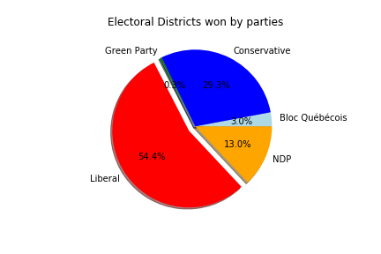

Slide 4


Hypothesis of factors influencing an Election
Age
Education
Gender
Turnout
Income

Slide 5
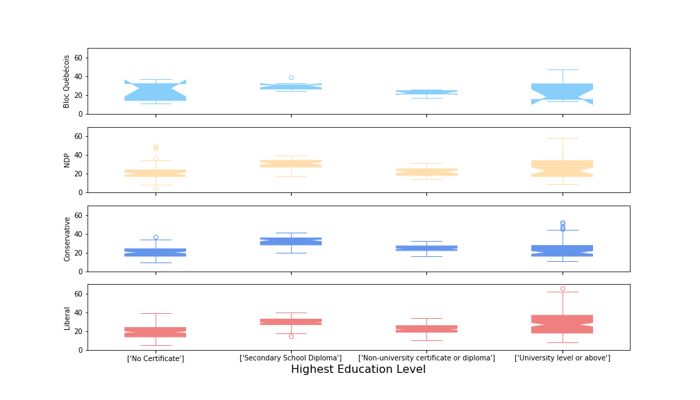
%Population by Highest Education Level
P=0.29
P=1.4x10⁻⁵
P=1.1x10⁻³⁰
P=1.9x10⁻³⁶

Slide 6
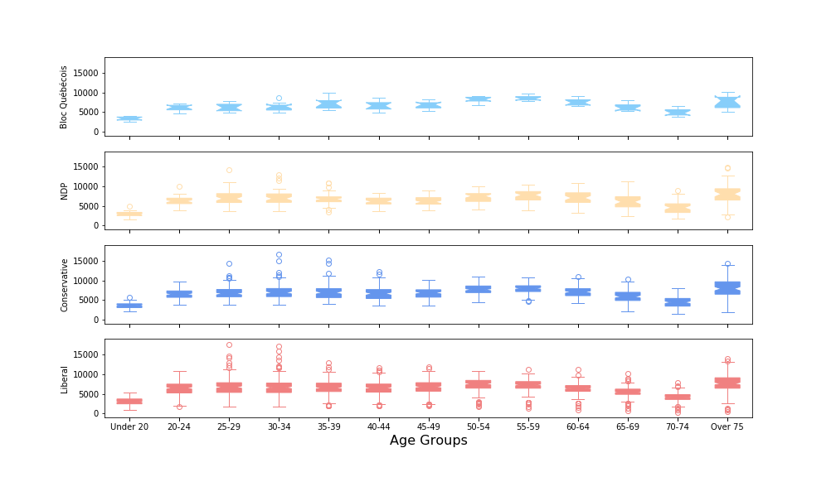
Riding Age Demographics, Grouped by Party
P=2.2x10⁻²⁰
P=5.2x10⁻⁵⁴
P=7.3x10⁻¹²⁰
P=2.9x10⁻¹⁹⁶

Slide 7
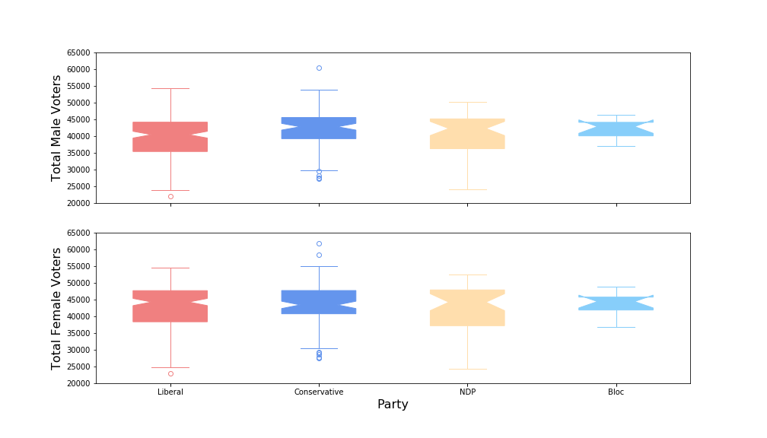
Male & Female Vote Totals Analyzed by Party
P=0.0079
P=0.44

Slide 8
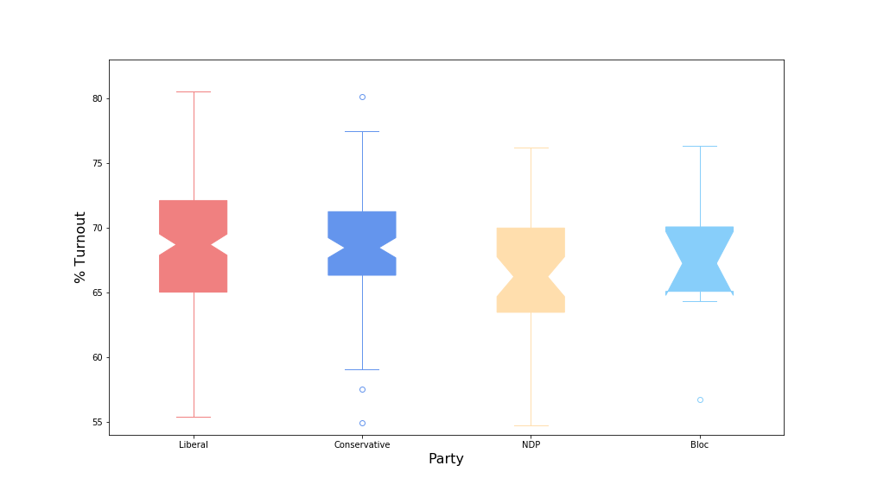
Turnout Analyzed by Party
P=0.24

Slide 9
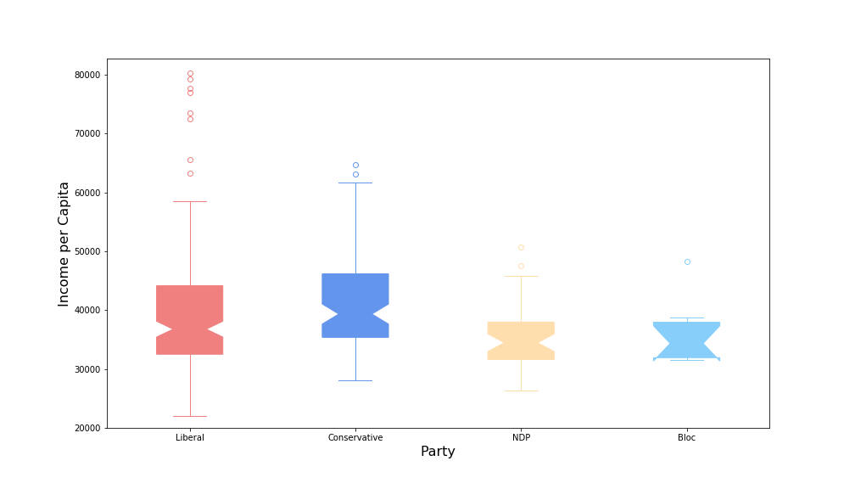
Income per Capita Analyzed by Party
P=0.0013

Slide 10
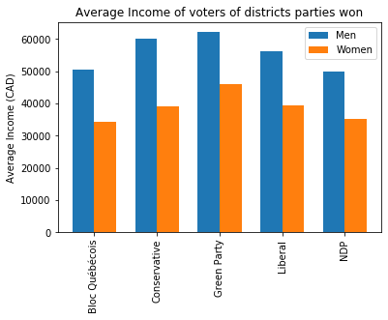
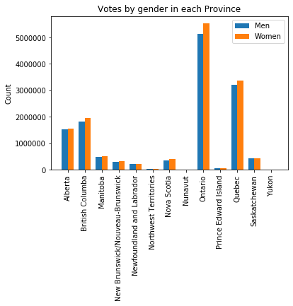
General Outlook

Slide 11
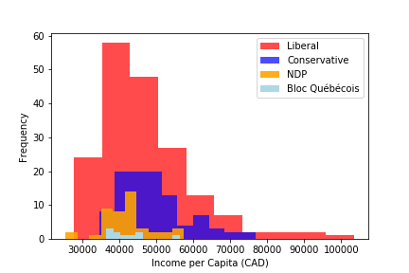

Slide 12
