Slide 1
Infrastructure as code
Store it in source control, like application code
Integrate with CI/CD pipeline
Consistent and repeatable

Slide 2
Programming style
Imperative – Define the steps to be carried out
Example: PowerShell + Azure CLI tool
Programmer manages dependencies
Declarative – Describe the result you want
Azure ARM template (json)
AWS Cloud Formation (json/yaml)
Terraform script

Slide 3
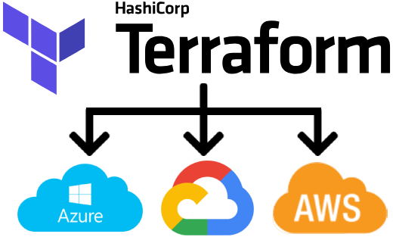
Cloud Providers

Slide 4
Main Commands
plan | Show the steps that will be carried out
apply | Make changes to cloud resources
destroy | Tear down cloud resources

Slide 5
Types of Variables
Input | Value passed into the script
Local | Read/write from within the script
Output | Value is returned from the script

