Slide 1
Presentation on Knowledge Sharing
Submitted By Supervised By
Md. Murad Hossain Maimuna Begum Kali
Id: 20151201034 Dept. of CSE
Dept. of CSE
Bangabandhu Sheikh Mujibur Rahman Science and Technology University,Gopalganj-8100

Slide 2
Overview
Introduction
Motivation
Objectives
Methodology
Implementation
Conclusion
Limitation
Future Work
References

Slide 3
Introduction
Knowledge Sharing is a web based application using oop php language
Only departmental courses works there
If anyone faces the departmental course related problems, share your questions easily
Anyone reply to the answer of sharing the question but must registered user of these applications.

Slide 4
Motivation
Knowing about Programabad, Quora, Stack Overflow
This application works Question-Answer, works huge amount Information and also many categories
So I motivated by the application but only my departmental course related topics
Anyone can question-answer English and also Bengali language which is best help our newcomers of our department

Slide 5
Objectives
To share your knowledge easily with your friends, seniors, juniors in your department.
To help the getting real answer according to the questions.
To get a huge information specific a topics of our departmental courses.

Slide 6
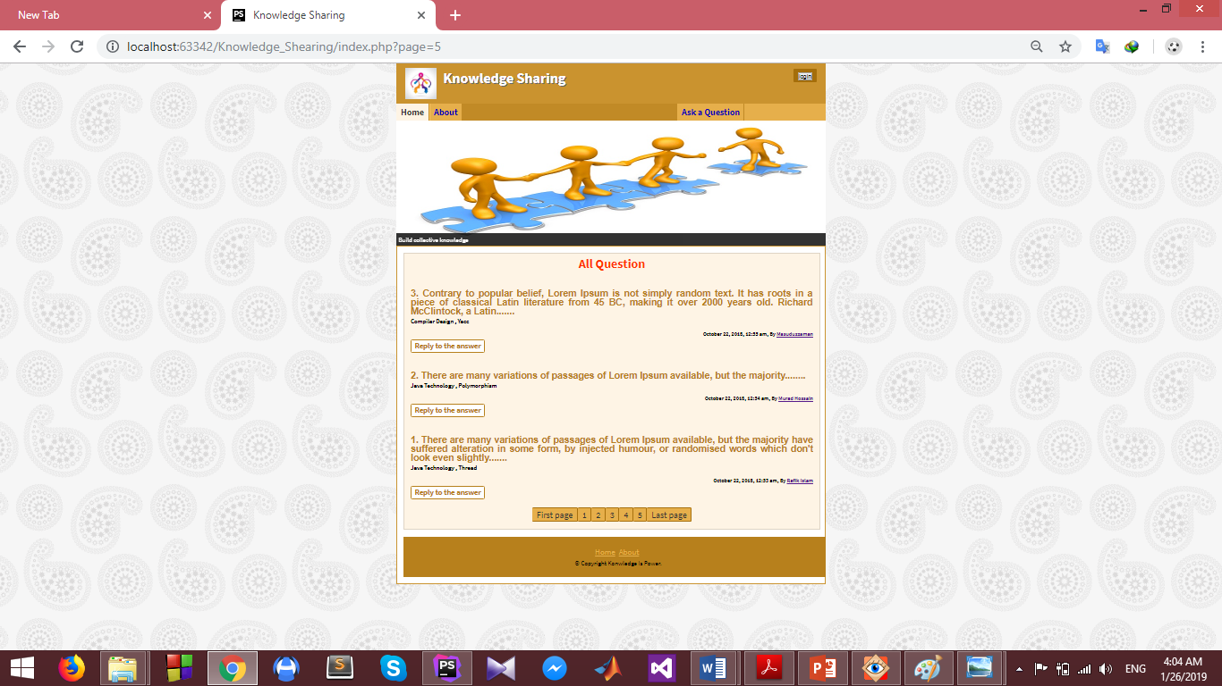
Methodology

Slide 7
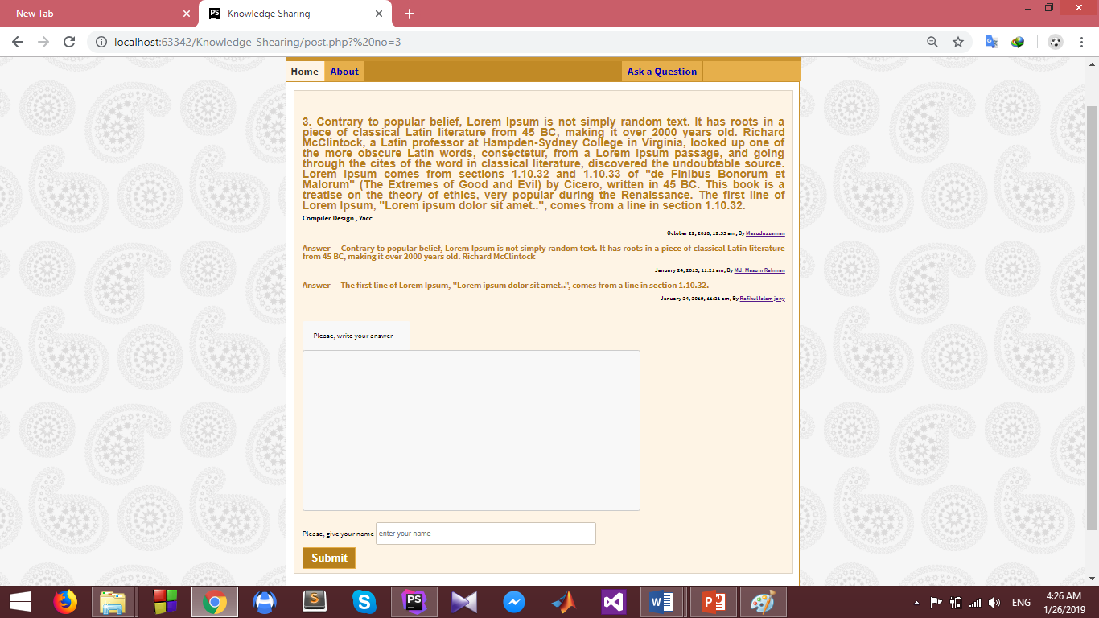
Details Page

Slide 8
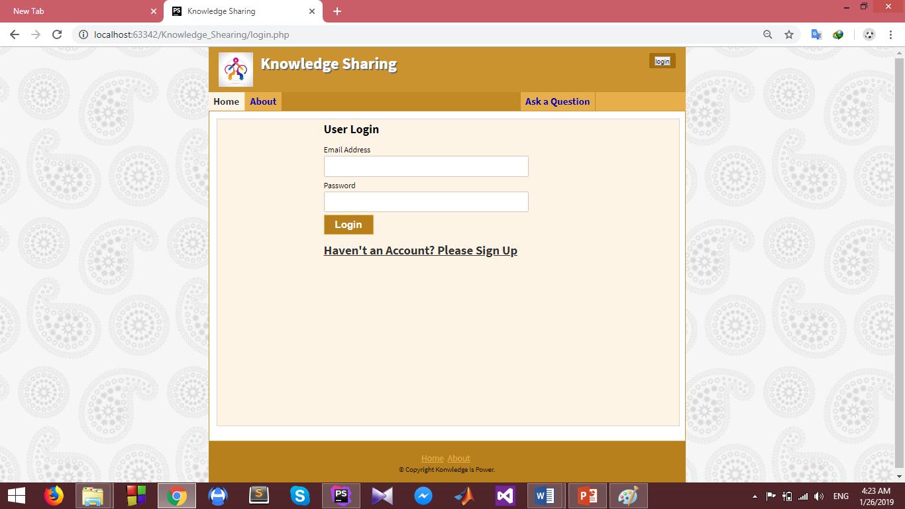
Login Page

Slide 9
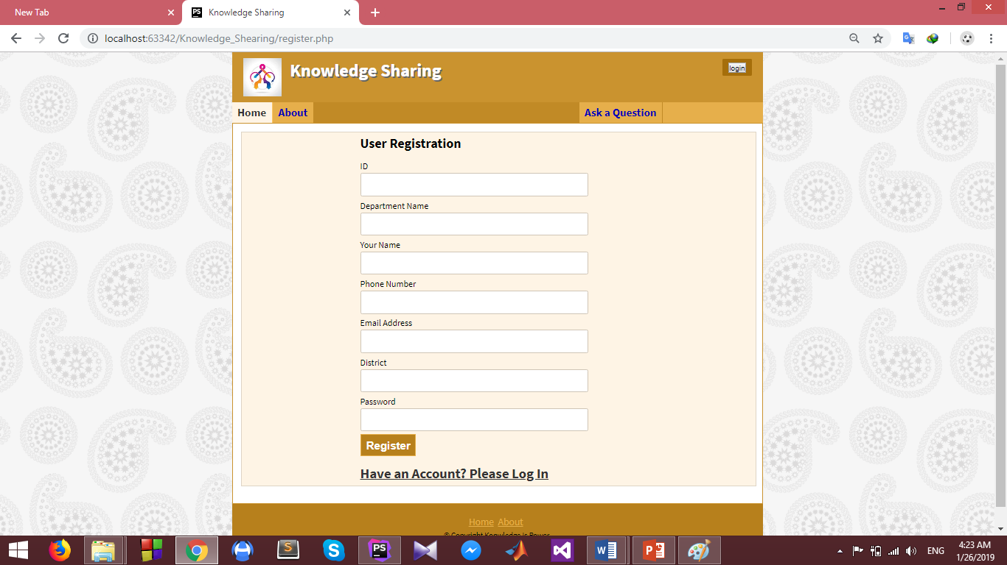
Register Page

Slide 10
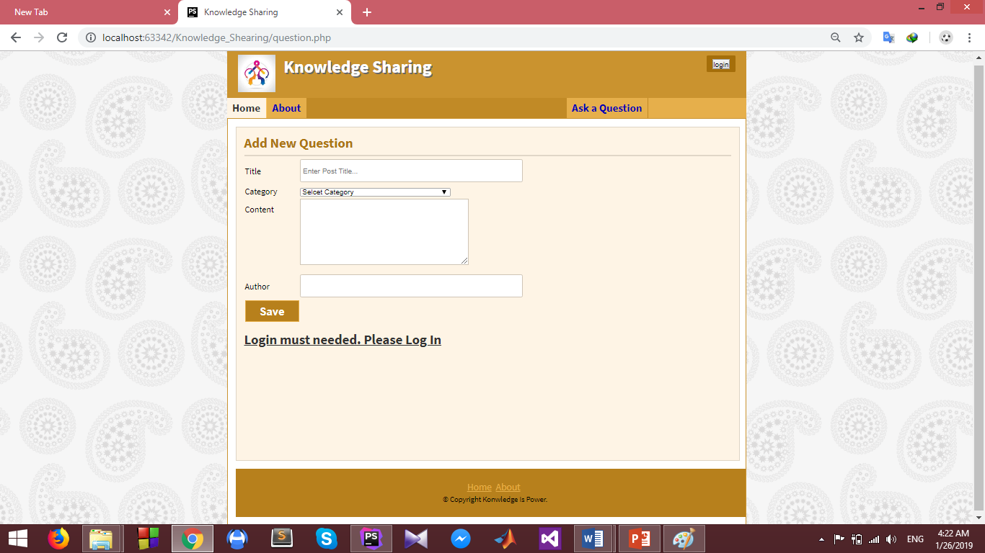
Question Page

Slide 11
Implementation
Knowledge Sharing is based on the fundamental concept that one of the most valuable assets of the getting easily solution according to the problem.
Represents these web using the Object Oriented Programming PHP Language and MySql Database.
Using a different software such as PhpStorm, Google Chrome etc.

Slide 12
Conclusion
Knowledge Sharing Application specially a great helps our new comers students in cause huge information will get by this.
Here, there are many topics can describe in Bengali Language, so it’s a helpful ours.

Slide 13
Limitation
Admin does not maintain the user’s registration.
Admin who edit, delete the user’s question and answer’s but does not work in this project.

Slide 14
Future Scope
Not only our departmental courses but also include all departmental courses in our campus.
Different different a great topics included there.
Not only a web platform, also included an Android and IOS platform.

Slide 15
References
Training with live project
Link- http://www.trainingwithliveproject.com/p/php-tutorials.html
W3 Schools
Link- https://www.w3schools.com/php/default.asp

