Slide 1
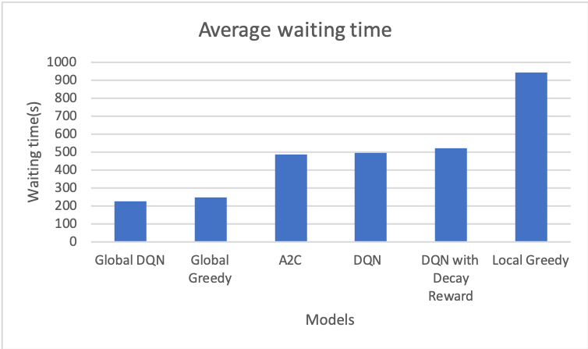
Autonomous Mobility on Demand Using Deep Learning
Dong Chen, Hangting Cao, Hui Sun, Junzhe Xu, and Kedong He
{donchen,hangting,huisunum,junzhexu,kedongh}@umich.edu
Introduction
Neural Network
Results
Autonomous mobility-on-demand (AMoD) system is predicted to be the solution for the future to reduce the pressure from urban mobility. In this project, we adopts Deep Q-Learning network (DQN) of the previous work and Actor-Critic Network (A2C), and creates new states and actions, which are closer to the actual situation. The combination of the modified networks and the novel variables make the AMoD system more reliable.
Deep Q-Learning
Actor-Critic
Model
Data Preprocess
The server will provide information on both the vehicles and requests, and the algorithm should process the information to obtain the states (S), action space ( A = {pickups, rebalance to adjacent regions, stay}). The state that goes into the neural network is counting-based, including:
All requests in the adjacent regions
The requests in the last hour, recorded into 4 sections, 15 mins for each section
The number of available vehicles in each region
Reward Design
Each vehicle will be awarded R points for each pick-up
Each vehicle will give a small cost when they are driving to a customer or rebalance
Each vehicle will be given a penalty P if there exist some requests that are not handled and yet the vehicle chooses an action other than a pick-up: P = B / (1 + d), where B is the penalty base constant, and d is the distance to the request
No-pickup Penalty is not used for DQN-rebalance
DQN & DQN-rebalance
Pickup actions will be determined by the system in DQN-rebalance, in a greedy manner
Pickup actions are learnt in DQN (decentralized)
Results
Conclusion
Deep learning method is a successful way to reduce the average waiting time of AMoD system relatively
The performance of global strategies is better than that of decentralized strategies
The DQN-rebalance model outperforms all other models
The action space including pickups and rebalance is hard to be learnt in the network, while the action space with only rebalance is relatively easier.
Future work: Global Rebalance vs. Local Rebalance
References
[1] Mnih, V., Kavukcuoglu, K., Silver, D., Rusu, A. A., Veness, J., Bellemare, M. G., ... & Petersen, S. (2015). Human-level control through deep reinforcement learning. Nature, 518(7540), 529.
[2] Konda, V. R., & Tsitsiklis, J. N. (2000). Actor-critic algorithms. In Advances in neural information processing systems (pp. 1008-1014.
[3] Jonker, R., & Volgenant, T. (1986). Improving the Hungarian assignment algorithm. Operations Research Letters, 5(4), 171-175.
Group ID: 35

